Slide 1

DNA Deep Network Analysis
Data drives the message
Team B9:
Mehmed Mladenov
Marc Tse

Slide 2
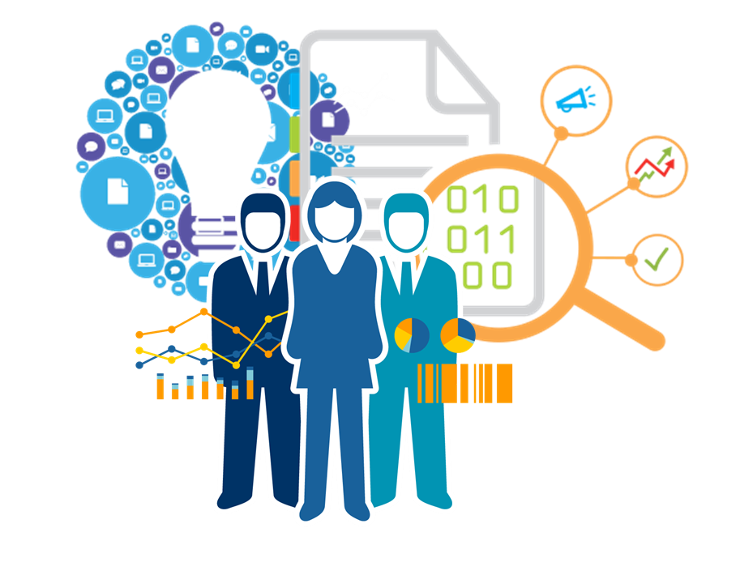
Status Quo
High skill-based jobs
Data Misuse/Privacy Breach
Data Security

Slide 3
Observations
Companies employ large teams of expertise spanning multiple fields in order to conduct data analysis.
Concerns from general public on individual data collected.
Concerns about individual employees leaking data.

Slide 4
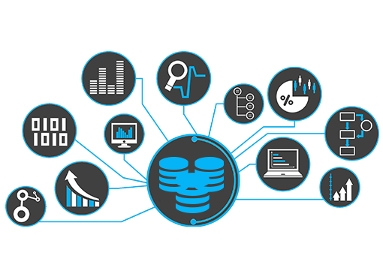
Story
Lack of expertise in this field → cannot easily find large pools of experts, therefore need to incur large expenditures on hiring skilled personnel.
Because of specific skill set required for data analytics, most growing companies are not able to incorporate these methods to determine insights and strategy for growing their operations.
General public is distrusting of organizations using data analytics when potential for growth is immense.

Slide 5

Insight - Requirements
Estimates for global spending on big data in 2018 exceed $114 billion USD.¹
80% of enterprises and 63% of small & medium businesses (SMBs) already have deployed or are planning to deploy big data projects in 2019.²
IBM predicts that demand for data scientist will increase 28% by 2020.³

Slide 6
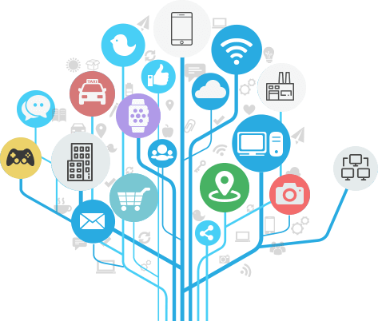
Insight - Requirements
When asked about next big marketing trend, survey respondents identified consumer personalization (29%), AI (26%) and voice search (21.23%).⁴
Fast growing IOT Networks will provide more data and touchpoints for businesses to collect information.⁵

Slide 7
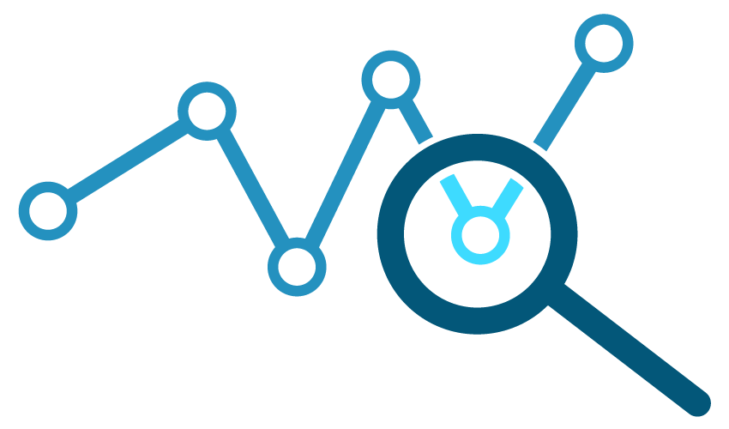
Opportunity - Analysis
With help of machine learning, companies no longer have to invest money into technologists for decision making → productivity can increase substantially
Marketing strategy trending towards consumer personalization

Slide 8
AnalogY
IBM commercial transition 2014 -> 2016. From a “World of Big Data” to “Police use of Data Analytics”, and “Make smarter decision”.
IBM Watson lets you learn more with less data.

Slide 9
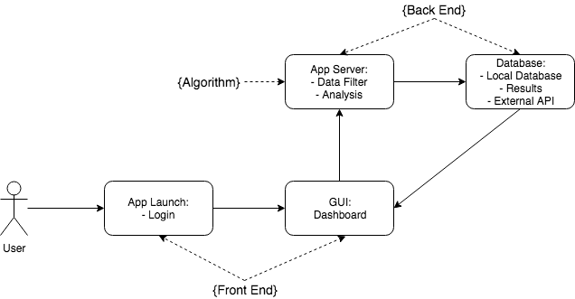
Solution - Design

Slide 10
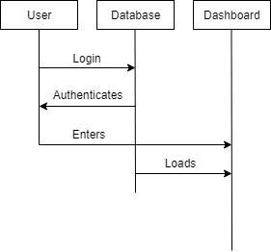
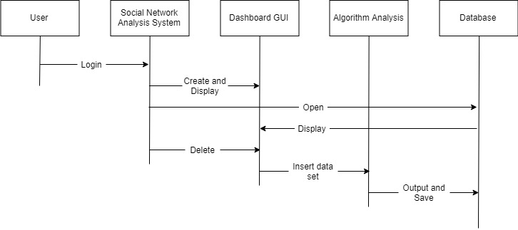
Solution - Design

Slide 11
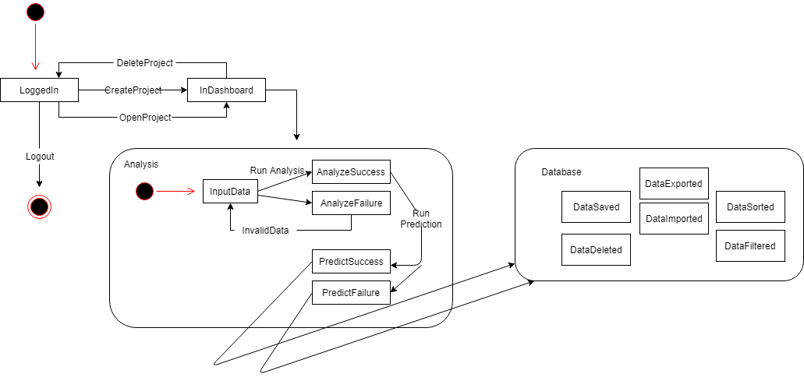
Solution – Design

Slide 12
DEMO

Slide 13

Advantage
No advanced knowledge required
Ease of use for non-technical personnel
Scalability

Slide 14

Ethos - Future work
Application is not fully complete
More acceptable data formats, platforms
Neural network training

Slide 15
Post Implementation Review
Things We Did Wrong:
Time Management
Communication
Debugging

Slide 16
Post Implementation Review
Things We Did Well:
Reduced number of defects per document
Solid definition of project
Good division of workload

Slide 17
POST IMPLEMENTATION REVIEW
Things We Would Change:
Schedule more meetings and self evaluations
Make a decision earlier when deciding which backend to use
Better research

Slide 18
SPMP DEFECTS
Artifact or Deliverable | Who (individual and team) | Estimated | Actual | Difference
SPMP | Marc | 5 | 2 | 3
 | Mehmed | 9 | 2 | 7
 | Team summary (Avg.) | 7 | 2 | 5

Slide 19
RAS DEFECTS
Artifact or Deliverable | Who (individual and team) | Estimated | Actual | Difference
RAS | Marc | 36 | 30 | 6
 | Mehmed | 25 | 30 | -5
 | Team summary (Avg.) | 31 | 30 | 1

Slide 20
SDD DEFECTS
Artifact or Deliverable | Who (individual and team) | Estimated | Actual | Difference
SDD | Marc | 20 | 12 | 8
 | Mehmed | 12 | 12 | 0
 | Team summary (Avg.) | 16 | 12 | 4

Slide 21

Questions & Answers

Slide 22

Works Cited
¹:https://www.abiresearch.com/press/big-data-spending-to-reach-114-billion-in-2018-loo/
²:https://www.forbes.com/sites/louiscolumbus/2015/03/15/data-analytics-dominates-enterprises-spending-plans-for-2015/#716c2e3b1801
³:https://www.forbes.com/sites/louiscolumbus/2017/05/13/ibm-predicts-demand-for-data-scientists-will-soar-28-by-2020/
⁴:http://www.cmo.com/features/articles/2017/8/24/15-mindblowing-stats-about-artificial-intelligence-dmexco.html#gs.C8AMRi8
^{5.}:https://marketinginsidergroup.com/strategy/big-data-trends-you-should-know-about-in-2018-infographic/
^{6.}:http://adage.com/article/advertising/godaddy-bows-global-campaign/303482

