Slide 1
VPN Project
IK2206
Pietro Cannalire
Oscar Melin
2016

Slide 2
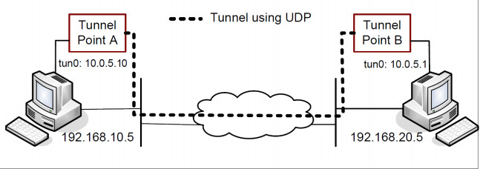
3.1 Host-to-Host Tunnel
Run provided simpletun.c on virtual interface tun0.
Configure host-only adapters so host machine can act as a router.
Assign IP addresses according to provided model.
Enable IP forwarding to allow routing between adapters.

Slide 3
3.1 Converting simpletun to UDP
Almost removed concept of Server and Client from simpletun.
Removed listen and connect from server and connect from client to turn it to UDP server
UDP socket is the main one; data is generated here and sent to the tun0 interface
On the otherside we read from tun0 and send data to the UDP socket.
Implementation works but we realized that it is better to put the tun0 interface directly where data is genrated.

Slide 4
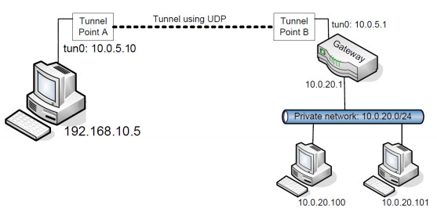
3.2 Host-to-Gateway Tunnel
Forward ports on gateway NAT adapters, we used port 55555.
Assign IP addresses according to provided model.
Configure routing in private network and on both gateways. Complete routing settings will be shown in 3.3.

Slide 5
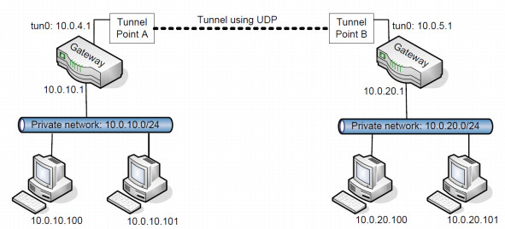
3.3 Gateway-to-Gateway Tunnel
Mirror the network and gateway settings from task 3.2 to the new network.
Test that we can connect both within the two networks and between the two networks.

Slide 6
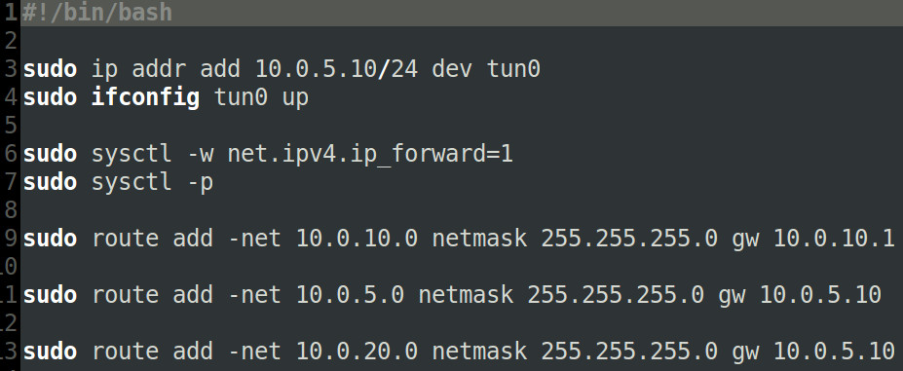
3.3 Gateway configuration

Slide 7
3.4 Securing the tunnel: Confidentiality
256 bit AES encryption + Cipher Block Chaining mode.
EVP_EncryptInit_ex(ctx, EVP_aes_256_cbc(), NULL, key, iv)
Key generated by OpenSSL after tutorial 4.4
Initialization vector generated using OpenSSL function RAND_bytes

Slide 8
3.4 Securing the tunnel: Integrity
Message authentication code, MAC added to each packet before sending and after encrypting using
HMAC(EVP_sha256(), key, 32, encrypted_text, encrypted_text_len, NULL, NULL);
Recomputed and verified when receiving a packet.

Slide 9
3.5 Authentication and Key Exchange
Create keys and certificates for both our gateways and a mock trusted CA authority.
Create a TCP control channel to setup SSL running in parallel with our UDP tunnel.
Use public key certificates to authenticate the server for the client and the client for the server when establishing connection.
Generate a session key and IV and share it over the now established secure SSL TCP connection.
Encrypt the packets using the new session key as in task 3.4

Slide 10
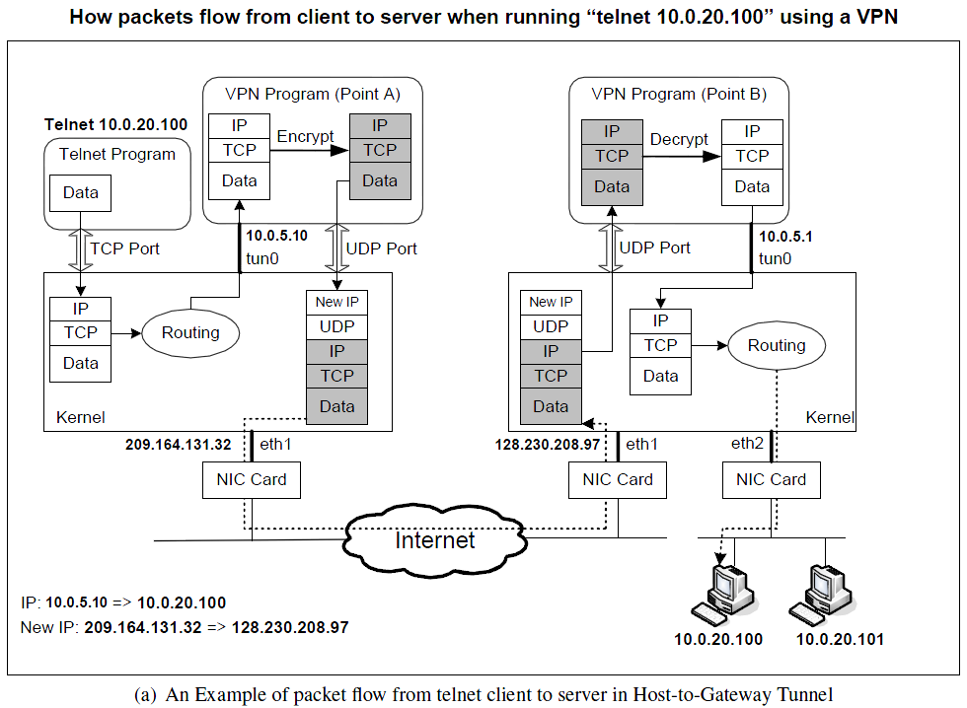
Notes:
1. The data of the packet starts from the telnet program.
2. The kernel will construct an IP packet, with the destination IP address being 10.0.20.100.
3. The kernel needs to decide which network interface the packet should be routed through: eth1 or
tun0. You need to set up your routing table correctly for the kernel to pick tun0. Once the decision
is made, the kernel will set the source IP address of the packet using the IP address of the network
interface, which is 10.0.5.10.
4. The packet will reach our VPN program (Point A) through the virtual interface tun0, then it will be
encrypted, and then be sent back to the kernel through a UDP port.
This is because our VPN program use the UDP as our tunnel.
5. The kernel will treat the encrypted IP packet as UDP data, construct a new IP packet, and put the
entire encrypted IP packet as its UDP payload. The new IP’s destination address will be the other end
of the tunnel (decided by the VPN program we write); in the figure, the new IP’s destination address
is 128.230.208.97.
6. You need to set up your routing table correctly, so the new packet will be routed through the interaface
eth1; therefore, the source IP address of this new packet should be 209.164.131.32.
7. The packet will now flow through the Internet, with the original telnet packet being entirely encrypted,
and carried in the payload of the packet. This is why it is called a tunnel.
8. The packet will reach our gateway 128.230.208.97 through its interface eth1.
9. The kernel will give the UDP payload (i.e. the encrypted IP packet) to the VPN program (Point B),
which is waiting for UDP data. This is through the UDP port.
10. The VPN program will decrypt the payload, and then feed the decrypted payload, which is the original
telnet packet, back to the kernel through the virtual network interface tun0.
11. Since it comes through a network interface, the kernel will treat it as an IP packet (it is indeed an IP
packet), look at its destination IP address, and decide where to route it. Remember, the destination IP
address of this packet is 10.0.20.100. If your routing table is set up correctly, the packet should
be routed through eth2, because this is the interface that connects to the 10.0.20.0/24 network.
12. The telnet packet will now be delivered to its final destination 10.0.20.100.

