Slide 1
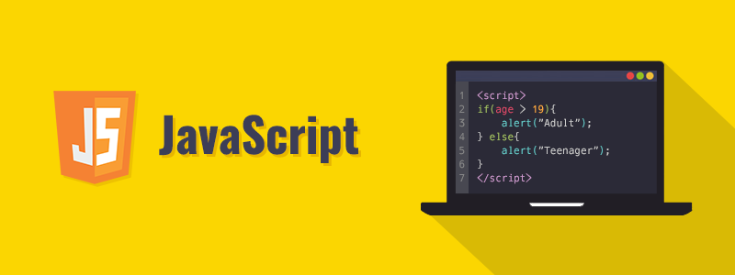
JavaScript for Beginners

Slide 2
Today’s Schedule
Warm Up Task with Switch and If else
Loops
Arrays
Functions
Objects

Slide 3
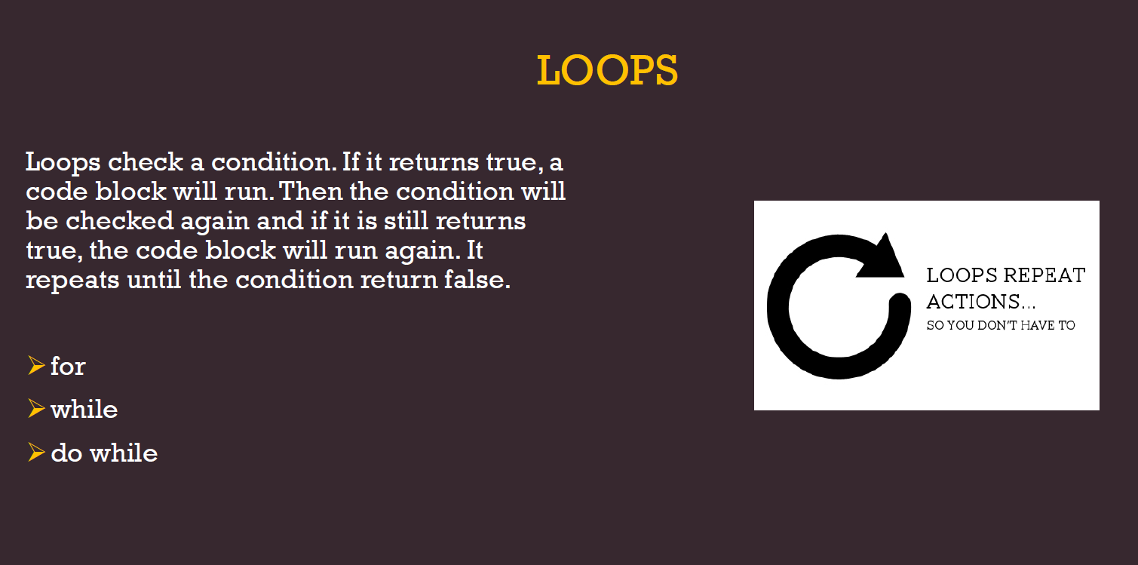

Slide 4
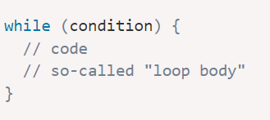
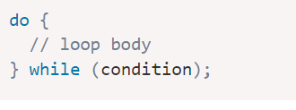
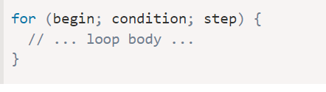
Loops: while and for
We often need to repeat actions.
The while loop syntax:
The “do…while” loop: The condition check can be moved below the loop body using
The for loop is more complex, but it’s also the most commonly used loop. It looks like this:

Slide 5
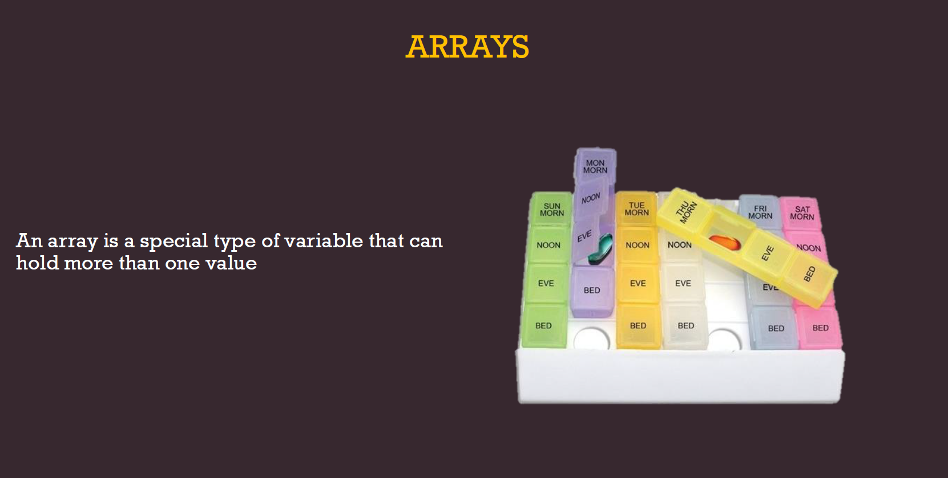

Slide 6
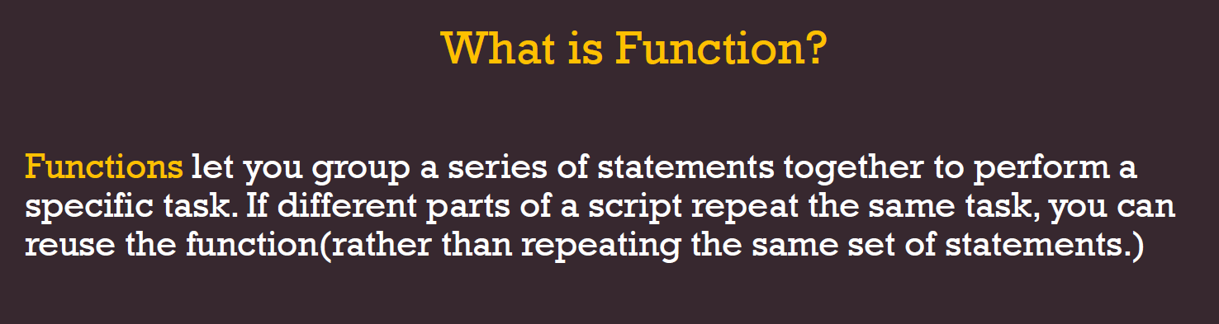
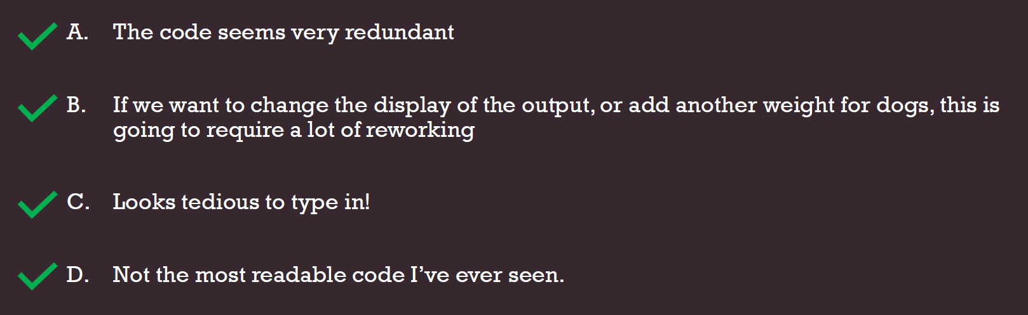

Slide 7
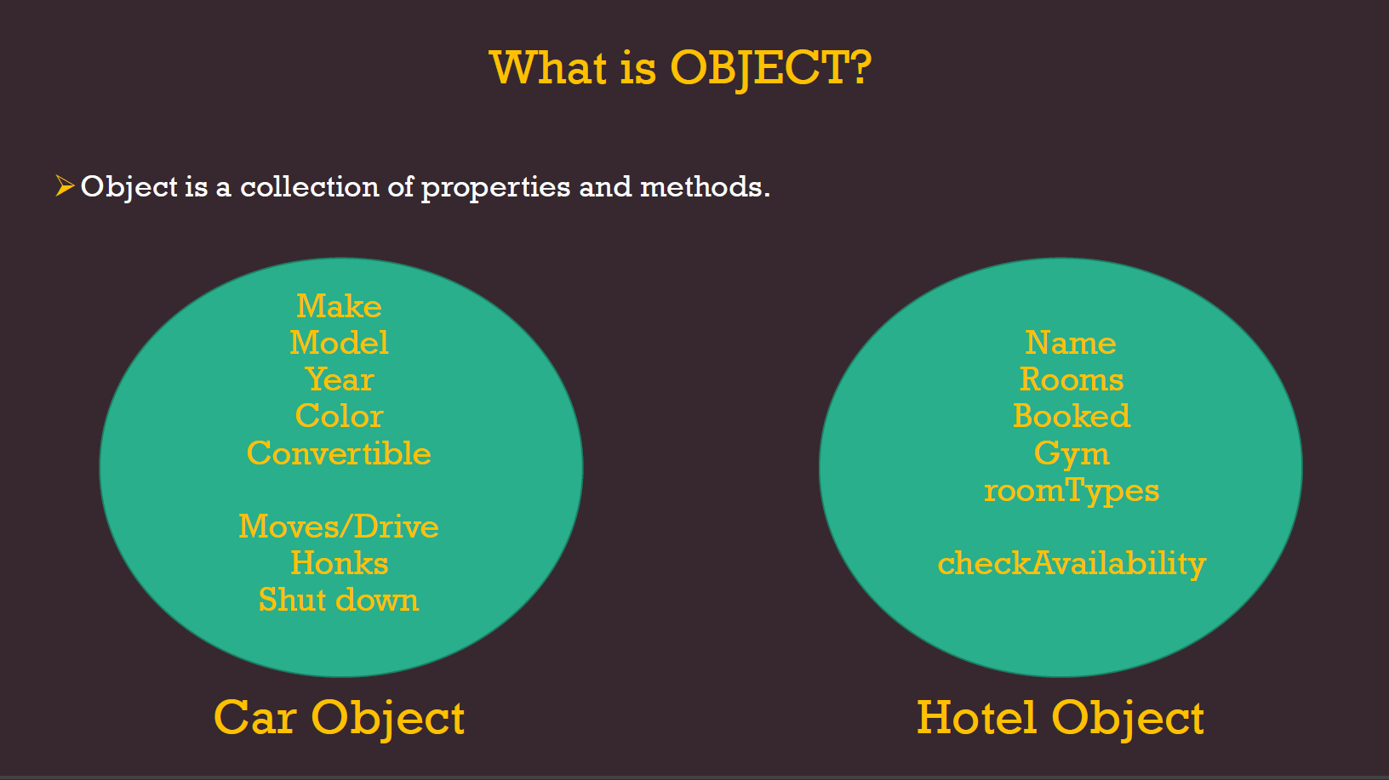

Slide 8
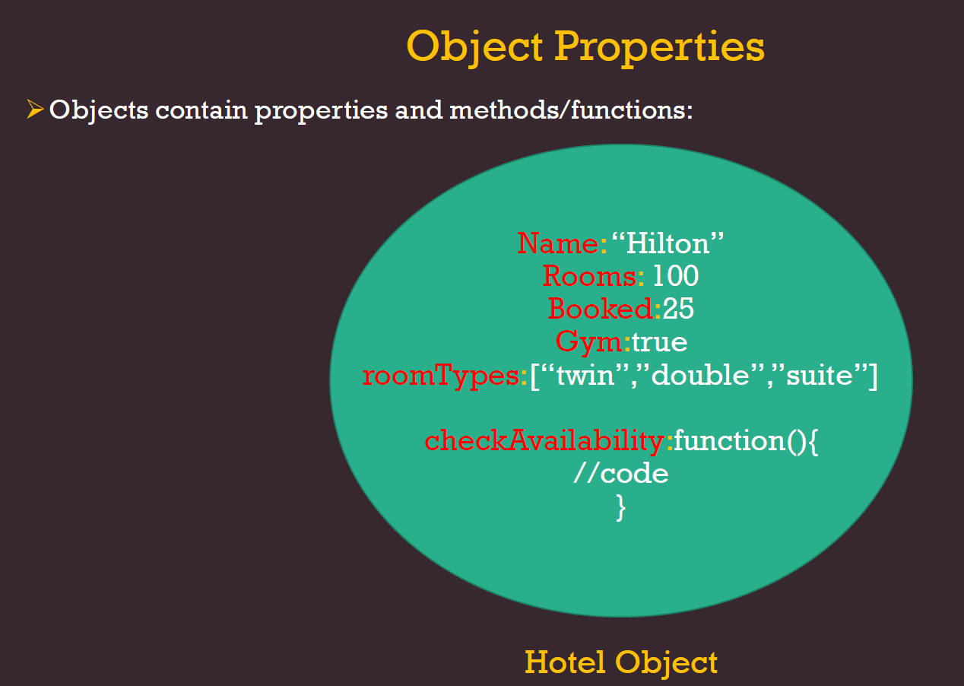

Slide 9
