Slide 1
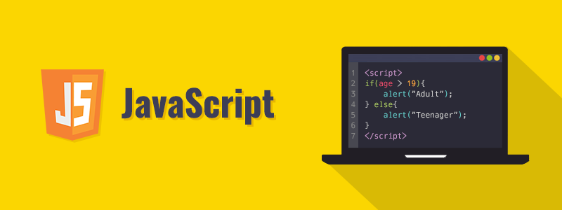
JavaScript for Beginners

Slide 2
Today’s Schedule
Solutions for Tasks (Warm Up)
Conditionals: if/else if
Ternary Operator
Switch Statement
Loops

Slide 3
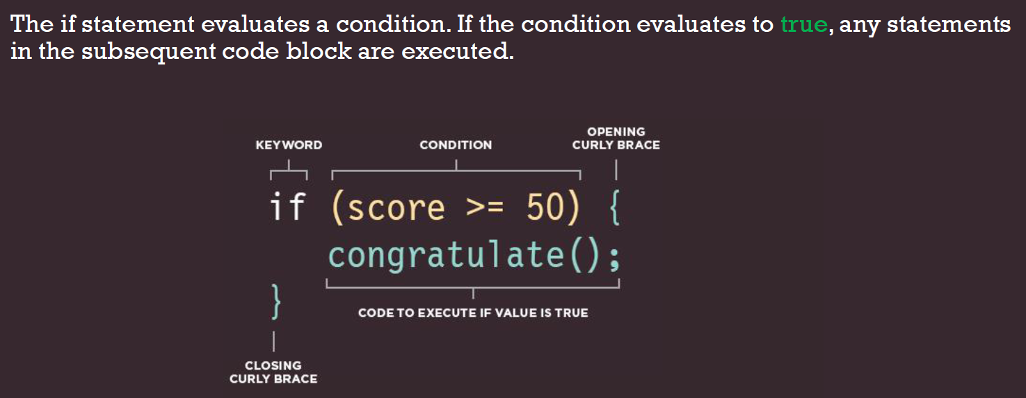
Conditional branching: if, if else
Sometimes, we need to perform different actions based on different conditions. To do that, we can use the if statement

Slide 4
“question mark” operator
The so-called “conditional” or “question mark” operator lets us do that in a shorter and simpler way.
The operator is represented by a question mark ?. Sometimes it’s called “ternary”, because the operator has three operands. It is actually the one and only operator in JavaScript which has that many.
The syntax is:
let result = condition ? value1 : value2;
If condition is true, result is value1, if wrong result is value2

Slide 5
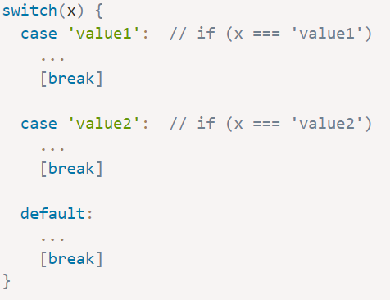
The "switch" statement
A switch statement can replace multiple if checks.
It gives a more descriptive way to compare a value with multiple variants.
The syntax : has one or more case blocks and an optional default.
It looks like this:

Slide 6
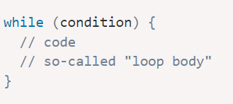
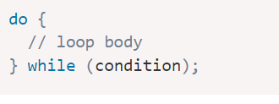
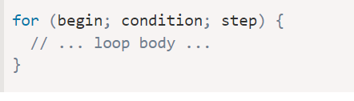
Loops: while and for
We often need to repeat actions.
The while loop syntax:
The “do…while” loop: The condition check can be moved below the loop body using
The for loop is more complex, but it’s also the most commonly used loop. It looks like this:

