Slide 1
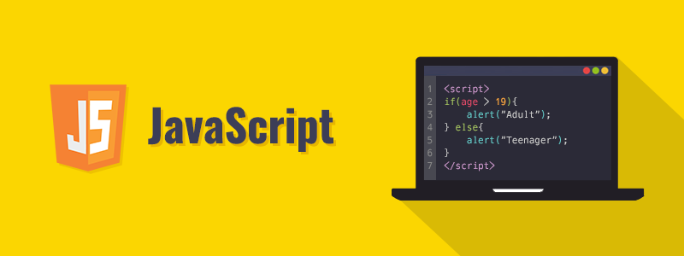
JavaScript for Beginners

Slide 2
Today’s Schedule
JavaScript Intro and Fundamentals of Programming
Variables
Operators

Slide 3
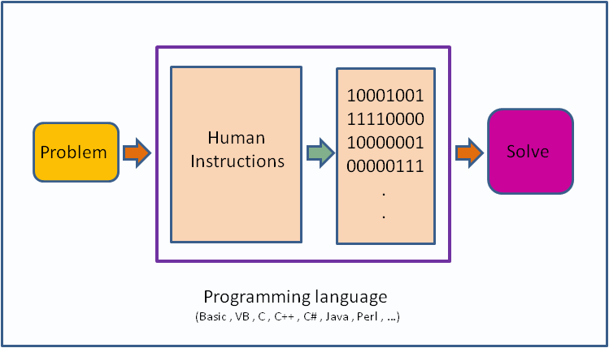
What is a program?
A computer is a tool for solving problems with data.
A program is a sequence of instructions that tell a computer how to do a task.
When a computer follows the instructions in a program, we say it executes the program.
Computer is dumb. A computer will only do what you tell it to do.

Slide 4
Fun Activity
Come up with a sequence of instructions to tell someone how to make a peanut butter sandwich. Don't leave any steps out, or put them in the wrong order.
https://www.youtube.com/watch?v=Ct-lOOUqmyY&ab_channel=NowI%27veSeenEverything
Computers are machines, and at the most basic level, they are a collection of switches—where 1 represents "on" and 0 represents "off". Everything that a computer does is implemented in this most basic of all numbering systems—binary.
https://www.binarytranslator.com/

Slide 5
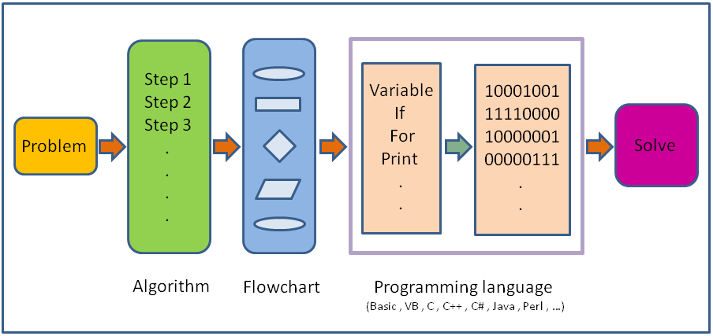
What is a programming language?
If you really wanted to tell a computer what to do directly, you'd have to talk to it in binary, giving it coded sequences of 1s and 0s that tell it which instructions to execute. However, this is nearly impossible. In practice, we use a programming language.

Slide 6
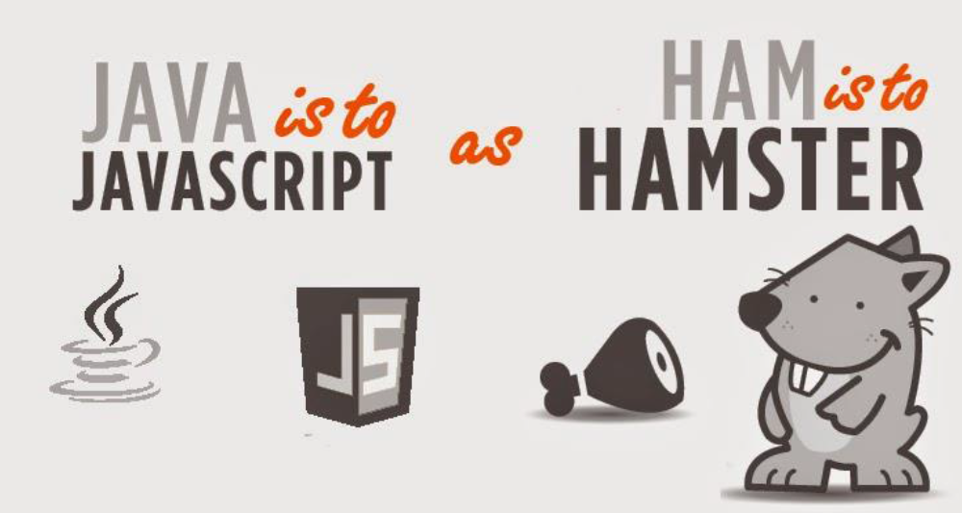
What is JavaScript?
JavaScript was initially created to “make web pages alive”.
The programs in this language are called scripts. They can be written right in a web page’s HTML and run automatically as the page loads.
Scripts are provided and executed as plain text. They don’t need special preparation or compilation to run.
In this aspect, JavaScript is very different from another language called Java.
Notes:
Show etsy.com as an example with inspect function
Why is it called JavaScript?
When JavaScript was created, it initially had another name: “LiveScript”. But Java was very popular at that time, so it was decided that positioning a new language as a “younger brother” of Java would help.
But as it evolved, JavaScript became a fully independent language with its own specification called ECMAScript, and now it has no relation to Java at all.

Slide 7
JavaScript Run Environments
Today, JavaScript can execute not only in the browser, but also on the server, or actually on any device that has a special program called the JavaScript engine.
The browser has an embedded engine sometimes called a “JavaScript virtual machine”.
Different engines have different “codenames”. For example:
V8 – in Chrome, Opera and Edge.
SpiderMonkey – in Firefox , etc.
We have installed Node.js so that we can run our JS codes directly in the code editor – Visual Studio Code VSC

Slide 8
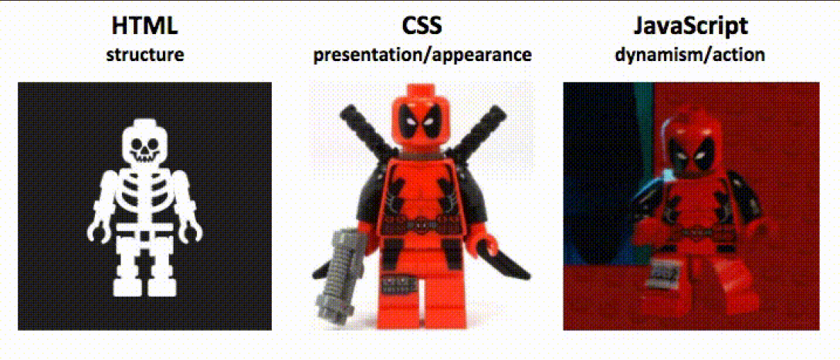
The Role of JavaScript
JavaScript is one of the three core technologies web development.
For instance, in-browser JavaScript is able to:
React to user actions, run on mouse clicks, pointer movements, key presses.
Send requests over the network to remote servers, download and upload files (so-called AJAX technologies).
Get and set cookies, ask questions to the visitor, show messages.

Slide 9
Where do we put JS code?
The <script> tag contains JavaScript code which is automatically executed when the browser processes the tag.
If we have a lot of JavaScript code, we can put it into a separate file.
Script files are attached to HTML with the src attribute:
<script src="/path/to/script.js"></script>

Slide 10
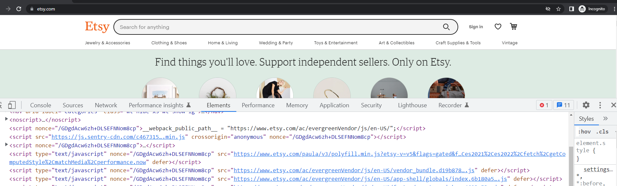
How do we see JS code on a Browser Page?
Let’s learn how to open Developer console of Google Chrome
Press F12 or, if you’re on Mac, then Cmd+Opt+J.

Slide 11
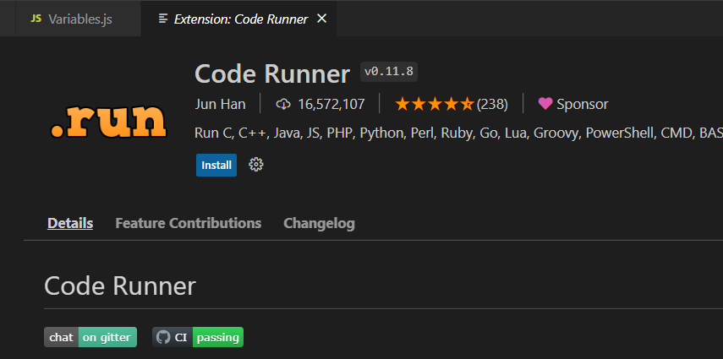
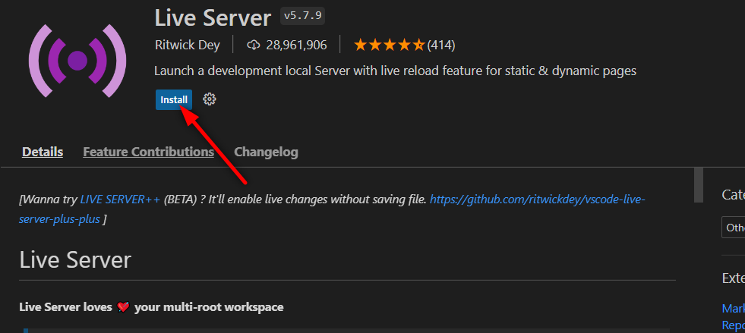
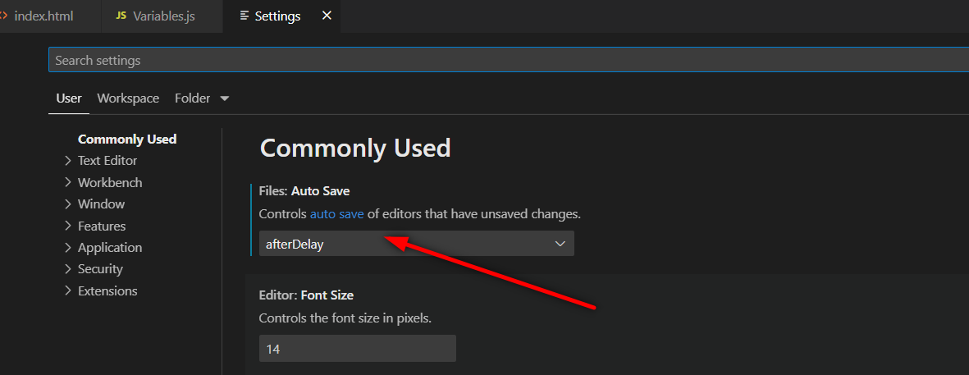
VSC Extensions Required
Code Runner
Live Server
Enable AutoSave after delay

Slide 12
Hello World!
Let’s write our first JavaScript code:
Assuming we have installed VSC, Node.js, and extensions (liveServer, CodeRunner)
Create a folder named JavaScriptProgramming on Desktop
Open folder in VSC
Create folder named Day01
Create index.html file
Create Variables.js file

Slide 13
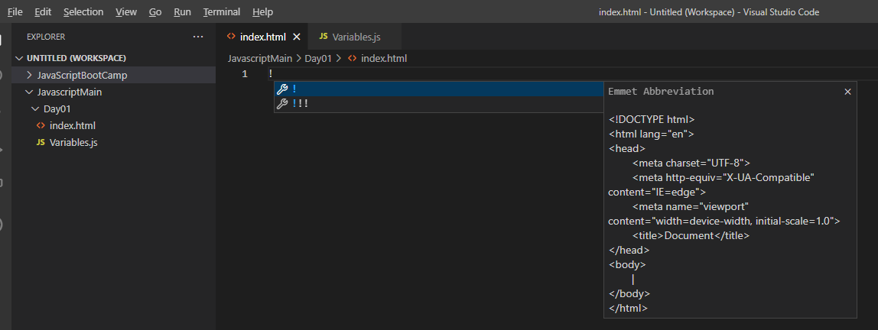
Hello World!
Write ‘ ! ‘ on the index.html and press tab

Slide 14
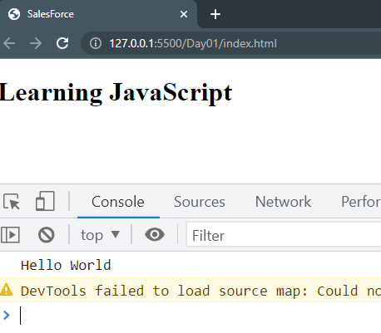
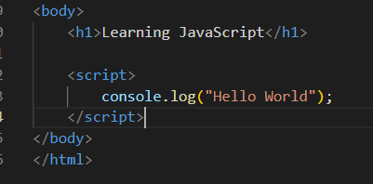
Hello World!
Write the following text in the index.html
Open live server
In the browser open console and observe Hello World

Slide 15
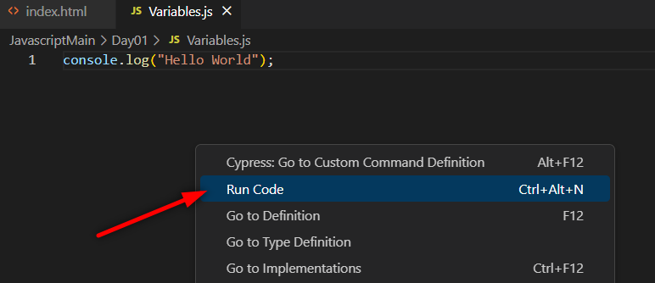
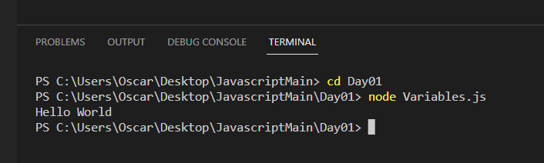
Hello World!
Run your codes with Node.js engine in your computer with Code Runner extension
Or running your code from Terminal

Slide 16
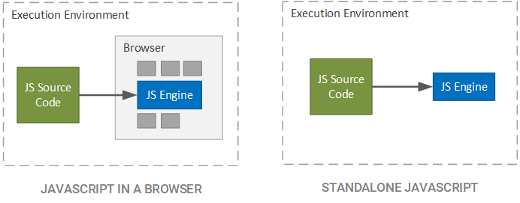
Javascript Virtual Machine Browser vs Node.js
HTML file needed: Runs on browser JS Virtual Machine
No HTML file: Runs on Node.js Machine

Slide 17
Code structure
Statements : are syntax constructs and commands that perform actions.
console.log(‘Hello World’);
A semicolon may be omitted in most cases when a line break exists.
In most cases, a newline implies a semicolon. But “in most cases” does not mean “always”!
But there are situations where JavaScript “fails” to assume a semicolon where it is really needed.

Slide 18
Today’s Schedule
JavaScript Intro and Fundamentals of Programming
Variables
Operators

Slide 19
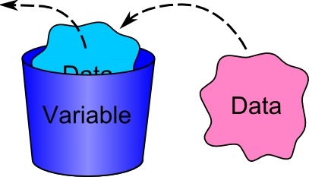
Variables
A variable is a “named storage” for data. We can use variables to store data.
To create a variable in JavaScript, use the let keyword.
The statement below creates (in other words: declares) a variable with the name “message”:
let message;
Now, we can put some data into it by using the assignment operator =
message = 'Hello'; // store the string 'Hello' in the variable named message

Slide 20
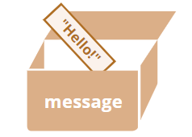
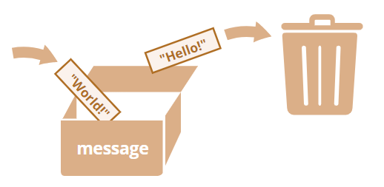
Variables
We can easily grasp the concept of a “variable” if we imagine it as a “box” for data, with a uniquely-named sticker on it.
For instance, the variable message can be imagined as a box labeled "message" with the value "Hello!" in it:
We can put any value in the box. We can also change it as many times as we want. When the value is changed, the old data is removed from the variable:

Slide 21
Variable naming
There are two limitations on variable names in JavaScript:
The name must contain only letters, digits, or the symbols $ and _.
The first character must not be a digit.
Examples of valid names:
let userName;
let test123;
When the name contains multiple words, camelCase is commonly used. That is: words go one after another, each word except first starting with a capital letter:
myVeryLongName.

Slide 22
Variable naming
Case matters
Variables named apple and APPLE are two different variables.
Reserved names
There is a list of reserved words, which cannot be used as variable names because they are used by the language itself.
For example: let, class, return, and function are reserved.
Name things right
A variable name should have a clean, obvious meaning, describing the data that it stores.

Slide 23
Task- Working with variables
Declare two variables: admin and firstName.
Assign the value "John" to firstName.
Copy the value from firstName to admin.
Show the value of admin using console.log (must output “John”).

Slide 24
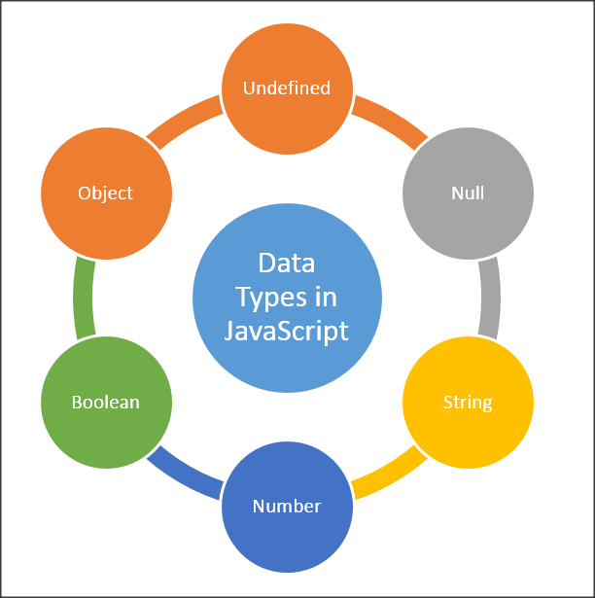
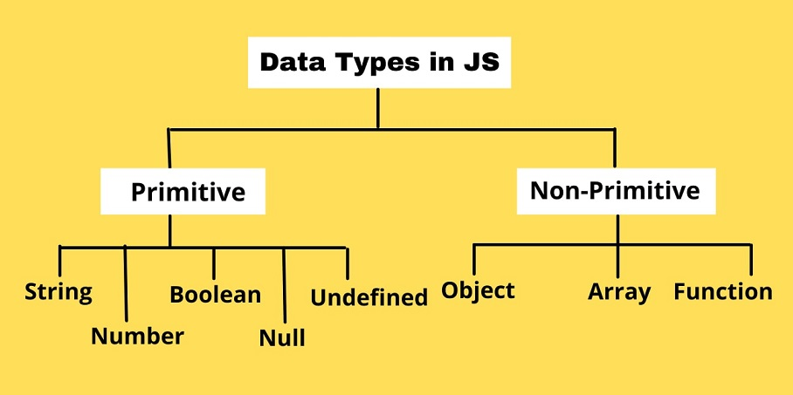
Data Types

Slide 25
Strings
In JavaScript, there are 3 types of quotes.
Double quotes: "Hello".
Single quotes: 'Hello'.
Backticks: `Hello`.
Double and single quotes are “simple” quotes. There’s practically no difference between them in JavaScript.
Backticks are “extended functionality” quotes. They allow us to embed variables and expressions into a string by wrapping them in ${…}, for example:

Slide 26
Basic operators, maths
The following math operations are supported:
Addition +,
Subtraction -,
Multiplication *,
Division /,
Remainder %,
Exponentiation **.

