Slide 1
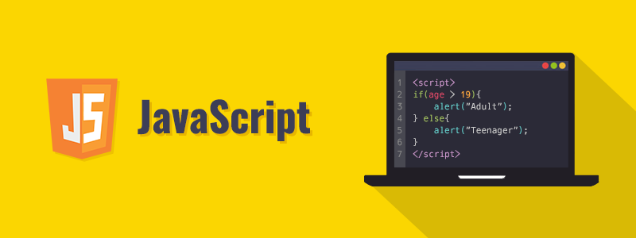
JavaScript for Beginners

Slide 2
Today’s Schedule
Operators
Control flow statements
Conditionals: if/else if

Slide 3
Arithmetic operators
The following math operations are supported:
Addition +,
Subtraction -,
Multiplication *,
Division /,
Remainder %,
Increament ++
Decreament --

Slide 4
Increment/decrement
Increasing or decreasing a number by one is among the most common numerical operations. So, there are special operators for it:
Increment ++ increases a variable by 1
Decrement -- decreases a variable by 1
The operators ++ and -- can be placed either before or after a variable.
When the operator goes after the variable, it is in “postfix form”: counter++.
The “prefix form” is when the operator goes before the variable: ++counter.
The prefix form returns the new value while the postfix form returns the old value (prior to increment/decrement).

Slide 5
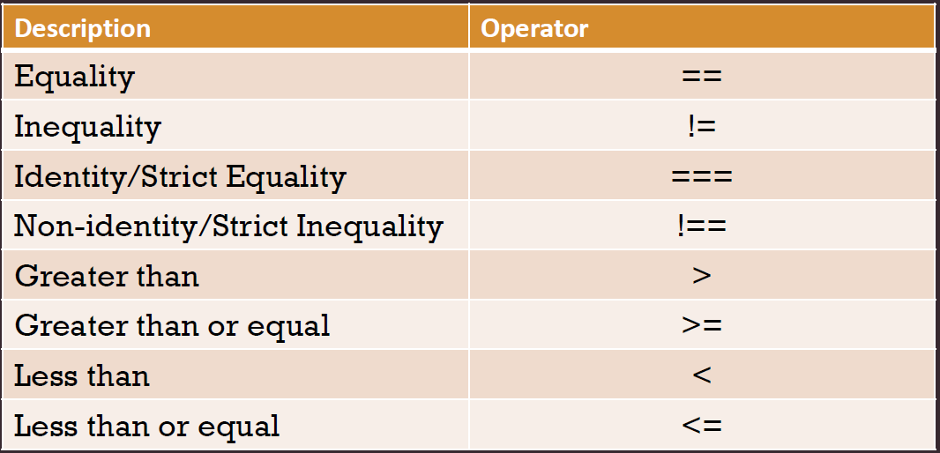
Comparison Operators
Boolean is the result
All comparison operators return a boolean value:
true – means “yes”, “correct” or “the truth”.
false – means “no”, “wrong” or “not the truth”.

Slide 6
Logical operators
|| (OR)
The “OR” operator is represented with two vertical line symbols:
&& (AND)
The AND operator is represented with two ampersands &&
Precedence of AND && is higher than OR ||
So the code a && b || c && d is essentially the same as if the && expressions were in parentheses: (a && b) || (c && d).
! (NOT)
The boolean NOT operator is represented with an exclamation sign !.

Slide 7
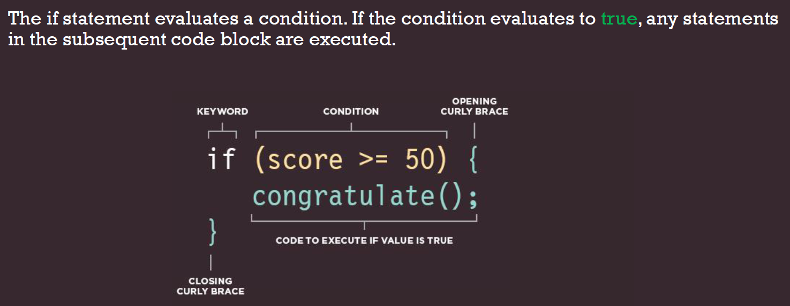
Conditional branching: if, if else
Sometimes, we need to perform different actions based on different conditions. To do that, we can use the if statement

