Slide 1
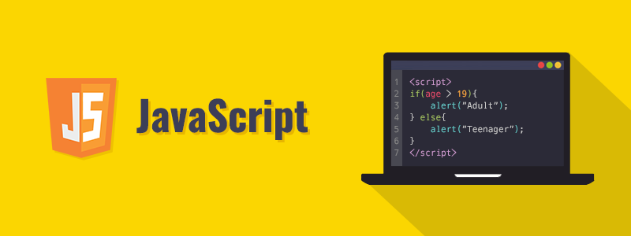
JavaScript Tasks

Slide 2

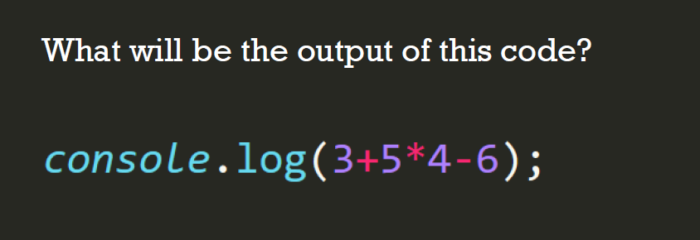

Slide 3


What are the outputs of these codes?

Slide 4


What are the outputs of these codes?

Slide 5

Use If Statements for this Task
let age = 25;
Then write the necessary if statement:

