Slide 1
React
Web team

Slide 2
What is React?
Fackbook - Instagram
A Javascript Mvc Framework.
2013.5

Slide 3
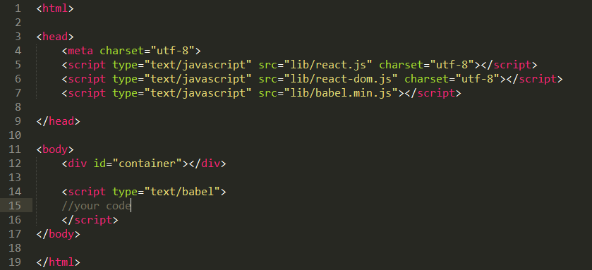
Start
What we need?
react.js
https://unpkg.com/react@15/dist/react.js
react-dom.js
https://unpkg.com/react-dom@15/dist/react-dom.js
brower.min.js(Babel)
https://unpkg.com/babel-standalone@6/babel.min.js

Slide 4
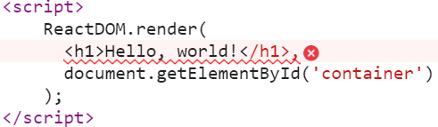
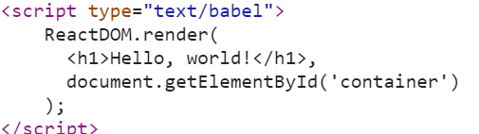
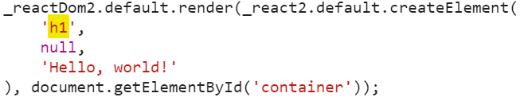
Start
What is JSX?
A blend of JS and HTML.
Why Babel(browser)?
In react, we will have some JSX files.Need to compile them to JS.
OR

Slide 5
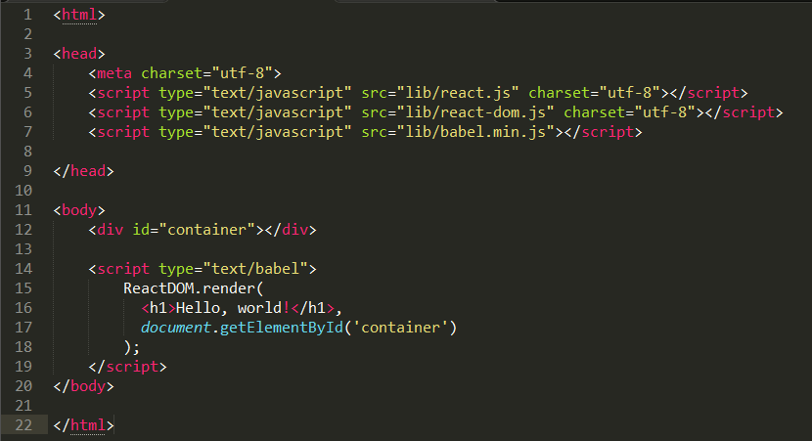
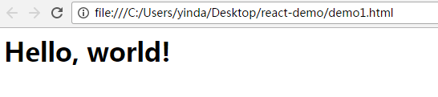
Hello world
Let us react now!
Here is a “hello world”

Slide 6
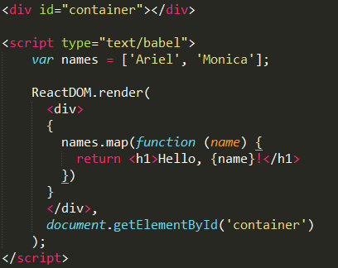
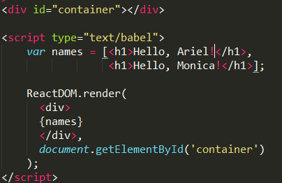
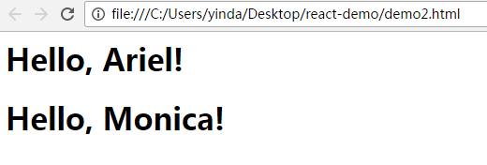
Use JS in Template!
In JSX, we can run a funtion in Template.

Slide 7
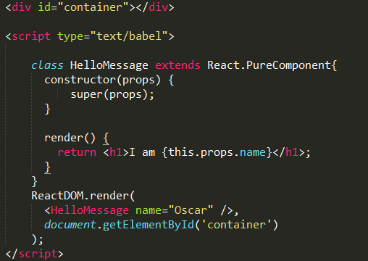
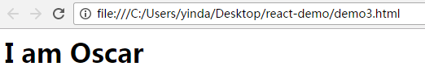
Component(PropTypes)
HelloMessage is a Pure Component.
React also has Component.
this.props.XXX

Slide 8
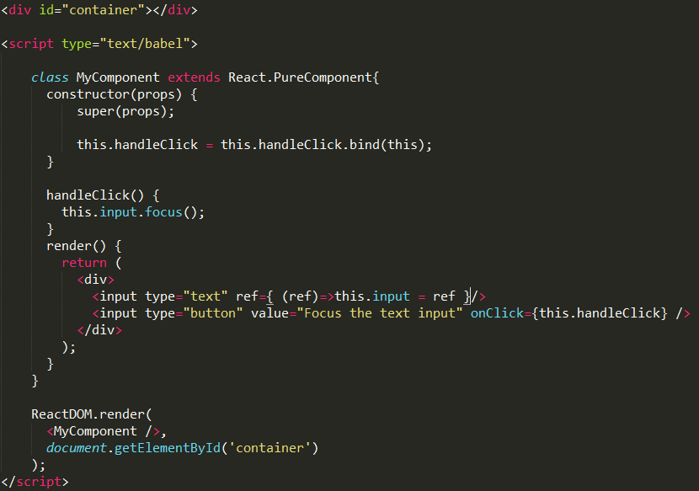

Get DOM(Ref)
{(ref)=>this.input = ref}
function(ref){
this.input = ref;
}

Slide 9
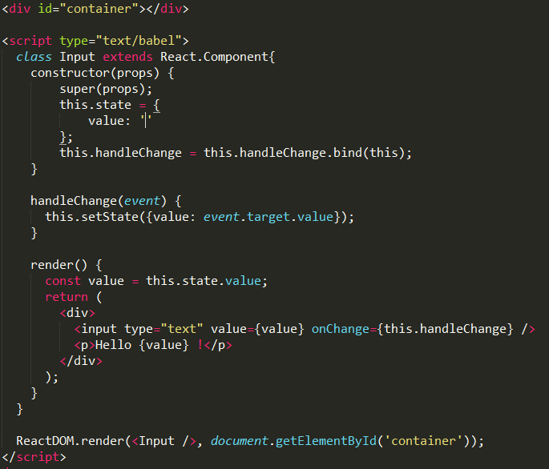
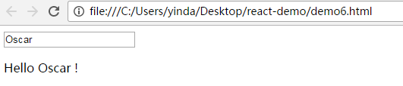
State
What is state?
Change state to refresh view.
One state → One view.

Slide 10
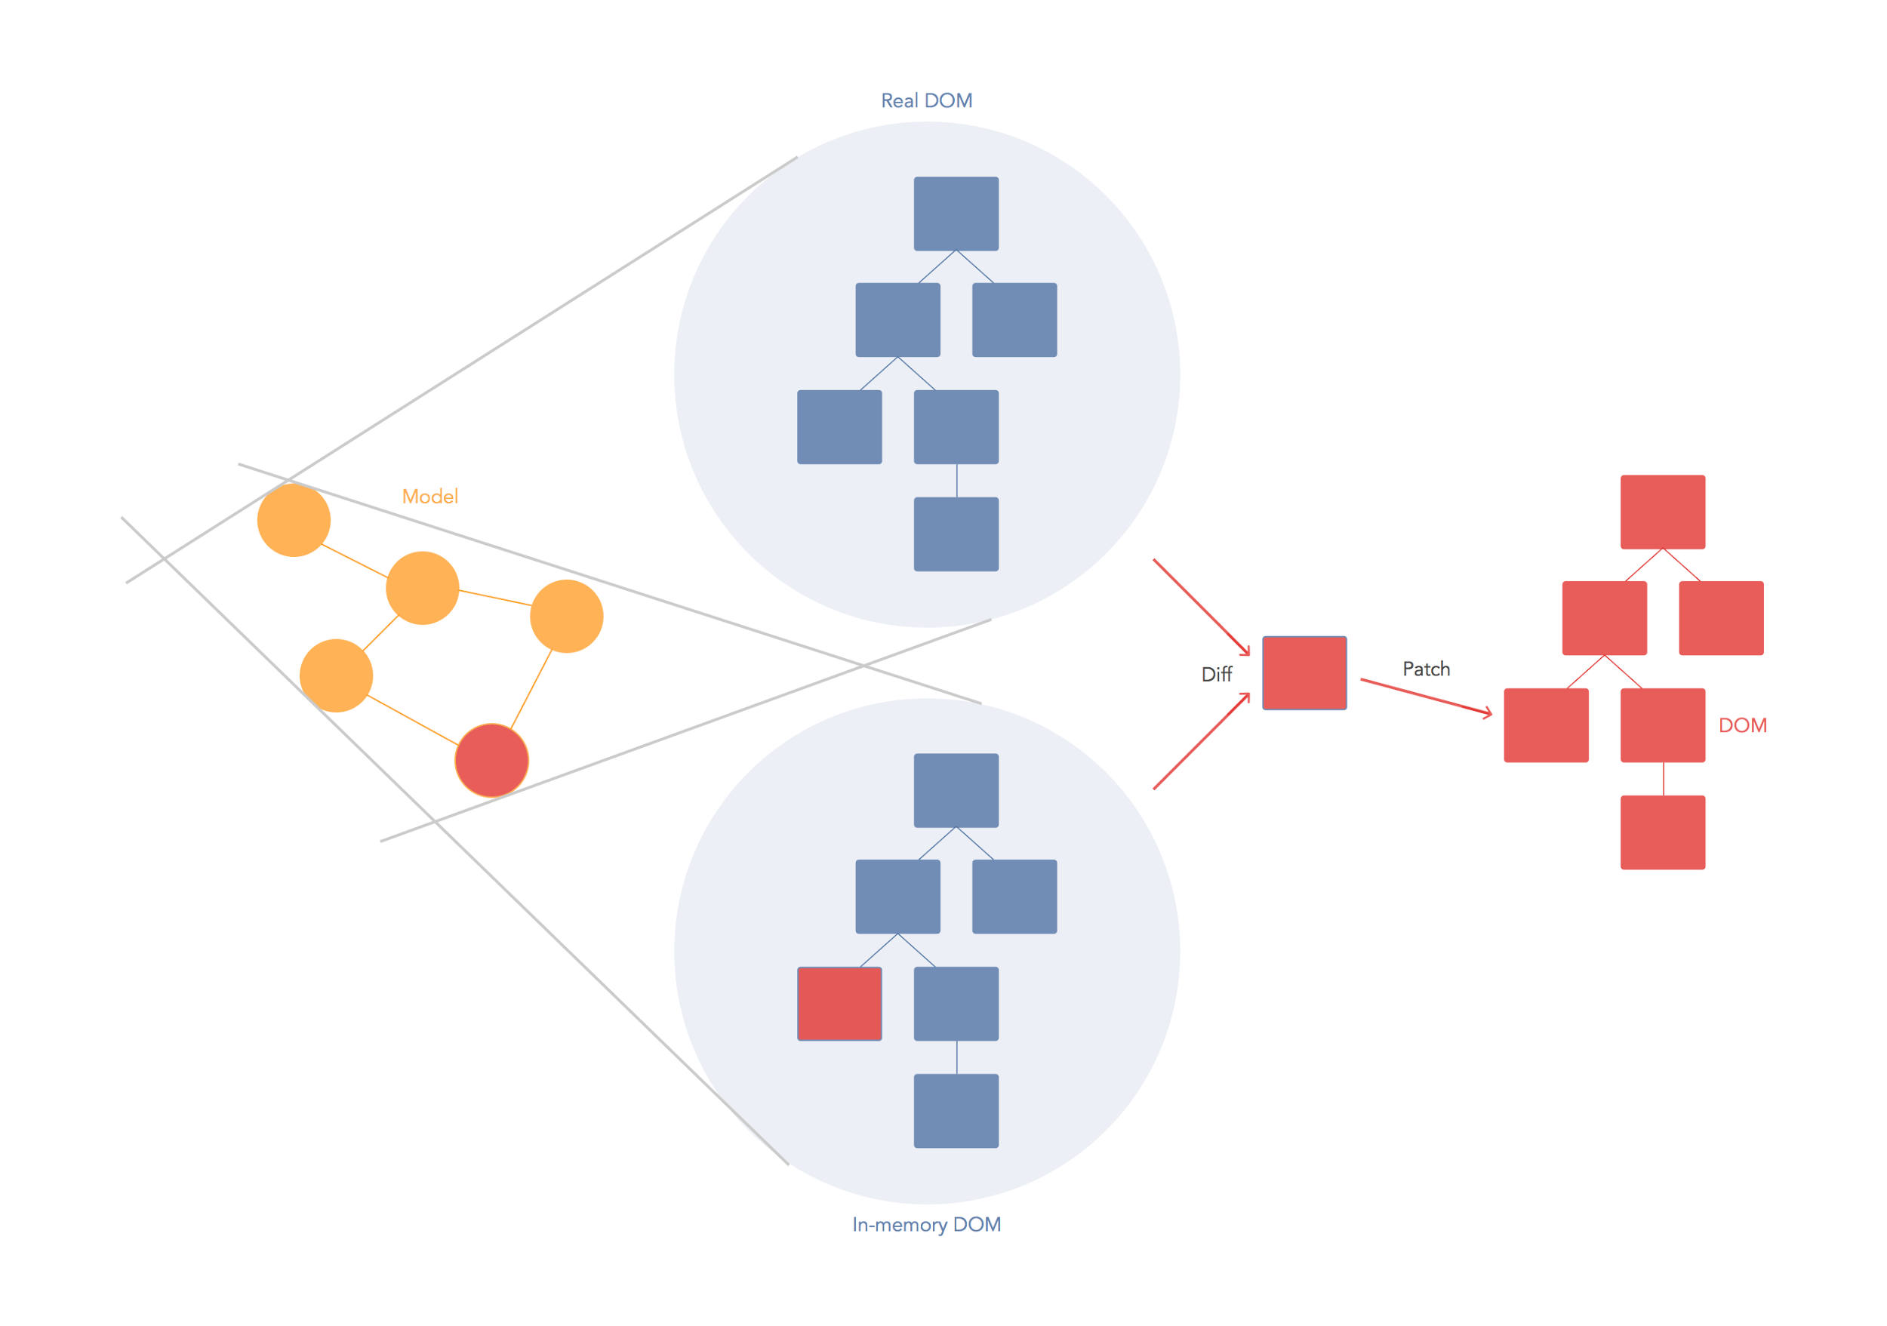
Virtual DOM
When we change state.
React will refresh the Virtual DOM.
And compare.
Only refresh Dirty DOM.

Slide 11
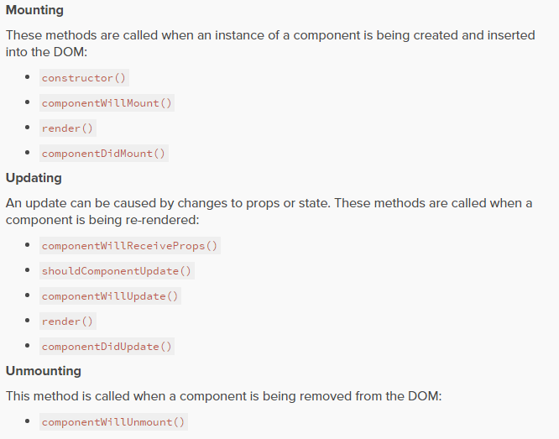
Lifecycle

Slide 12
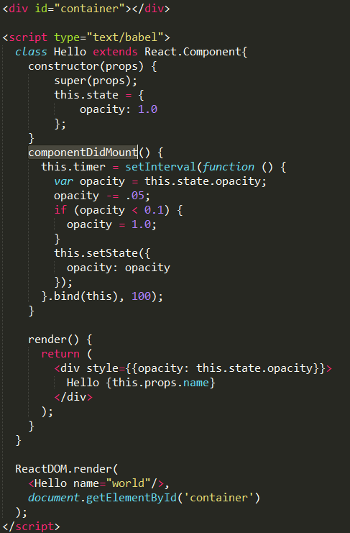
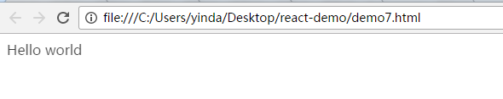
Lifecycle
Here is a demo for componentDidMount()

Slide 13
Thank you!
Congratulation! U can work with react now.
U can get these demo from https://github.com/OscarYin/React-demo.git

