Slide 2
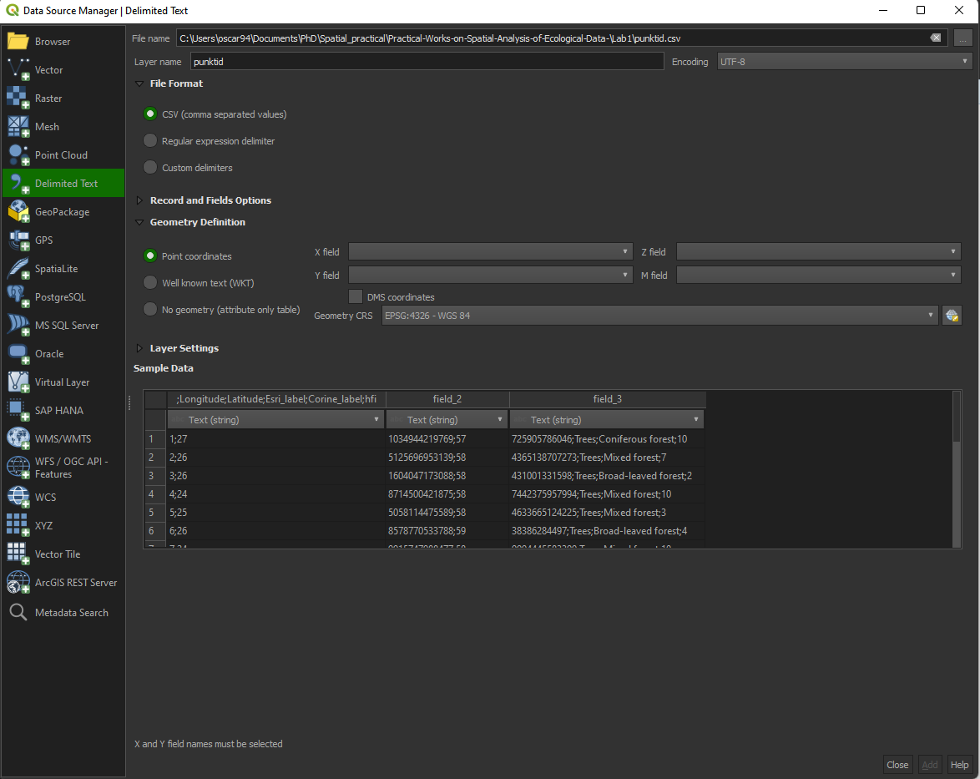
1) Locate your file
2) Check the Sample data. Are columns adequately separated?

Slide 3
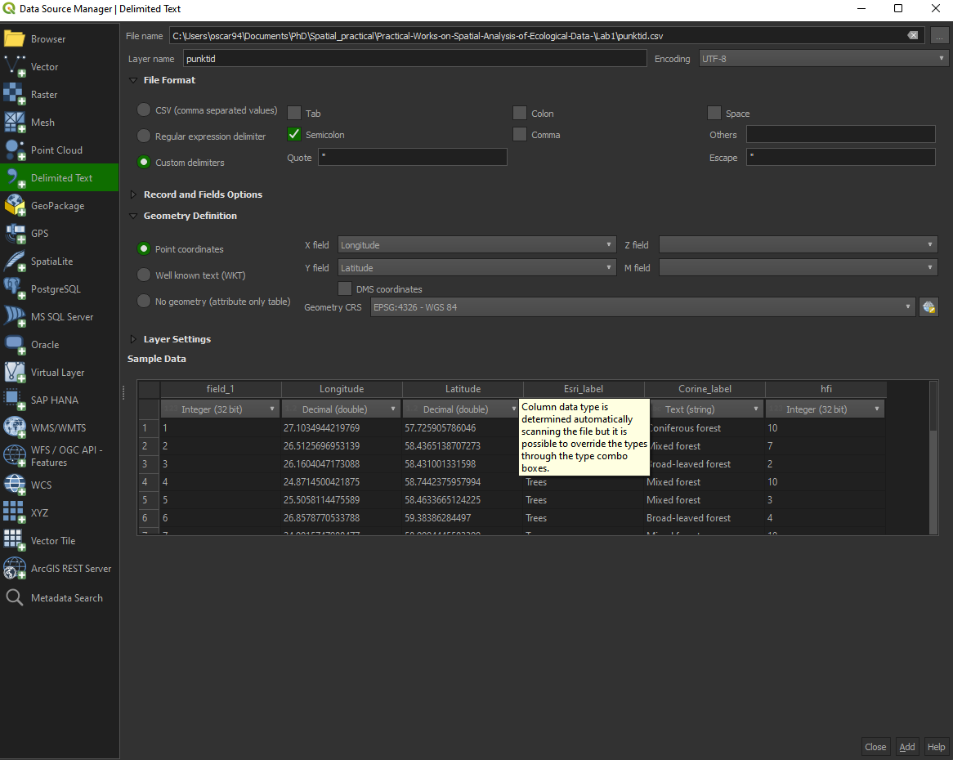
3) Choose the right delimiter
4) Indicate the columns with the spatial information (Lon, Lat)
5) Add

Slide 4
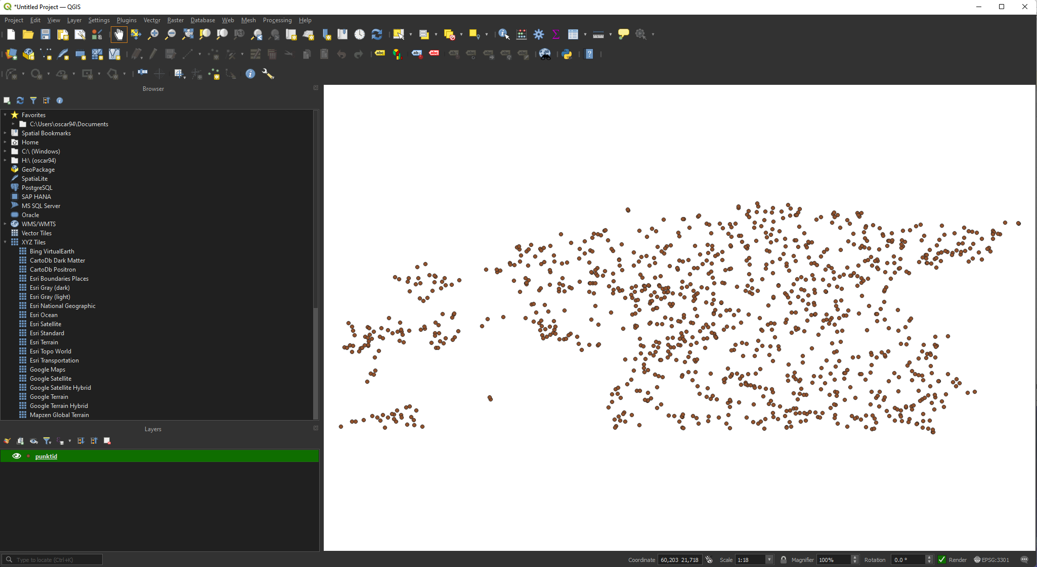

Slide 5
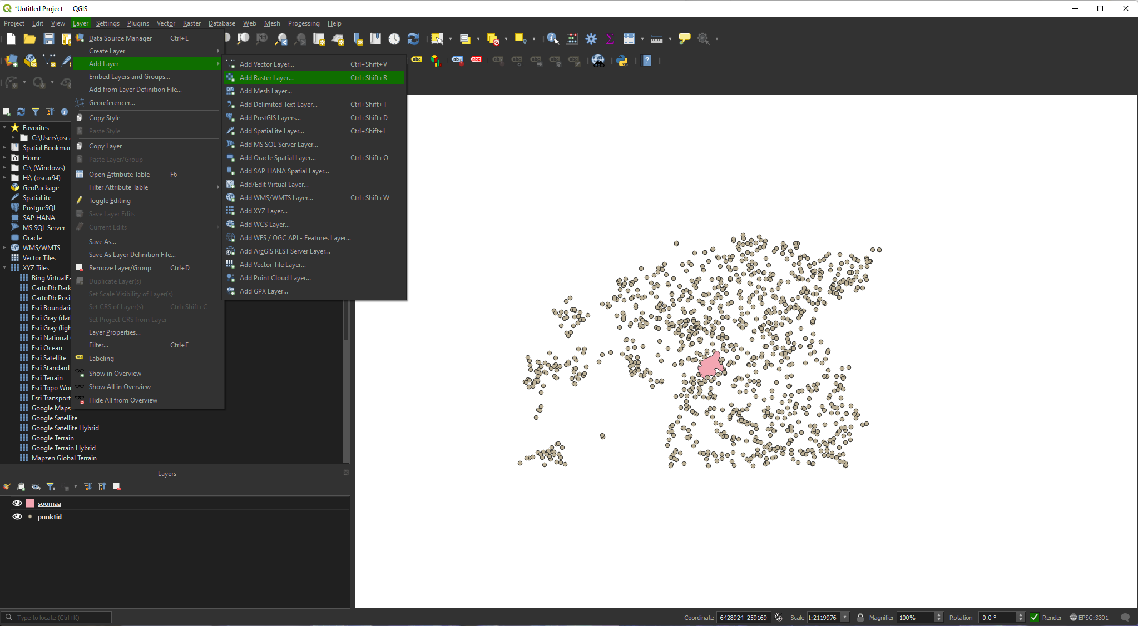

Slide 6
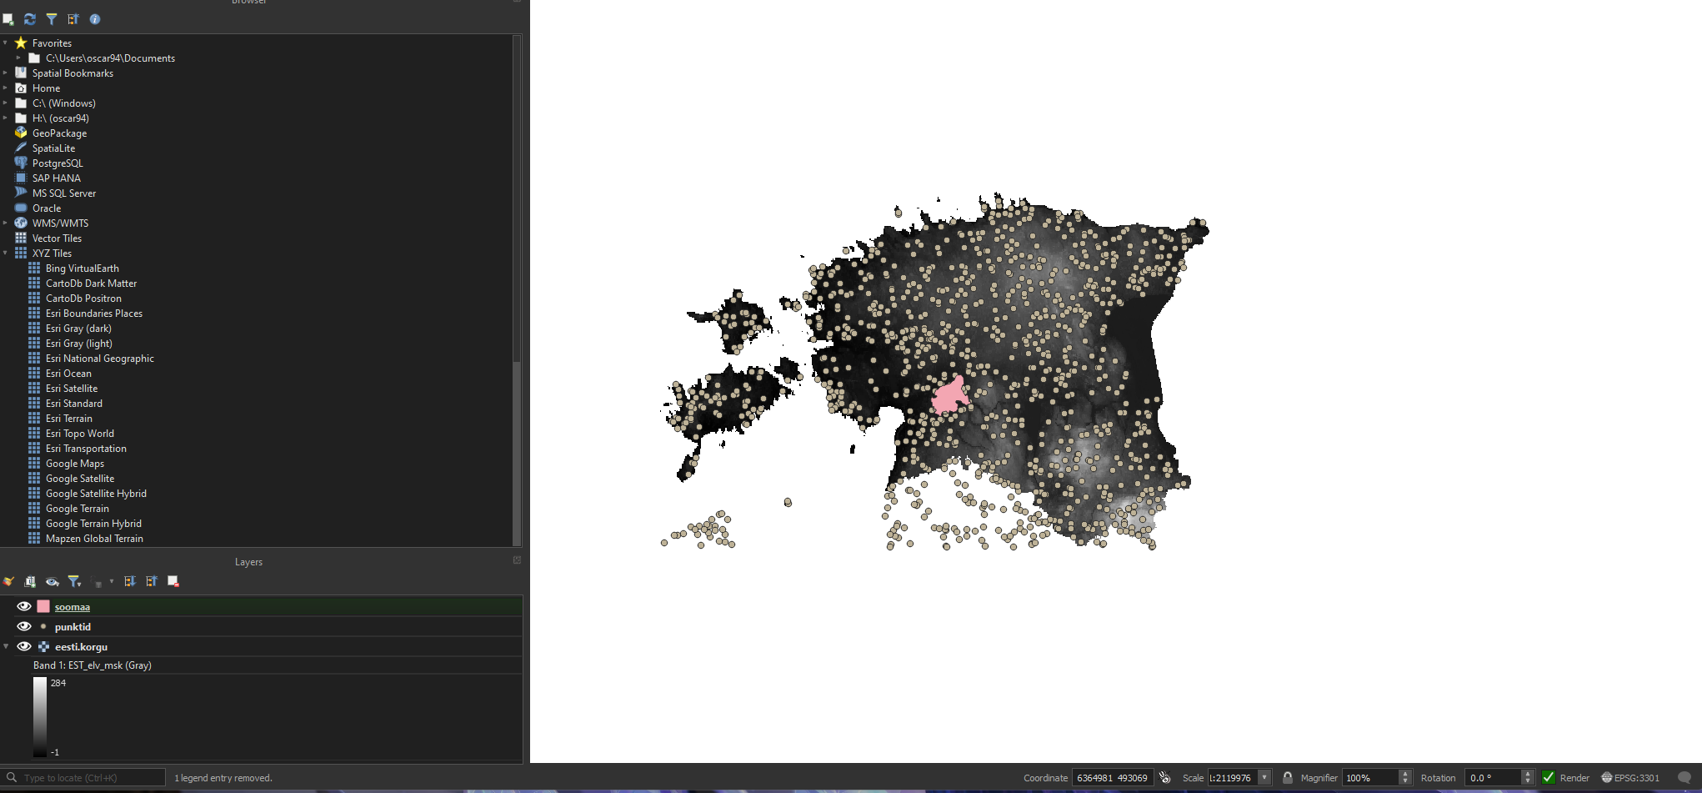

Slide 7
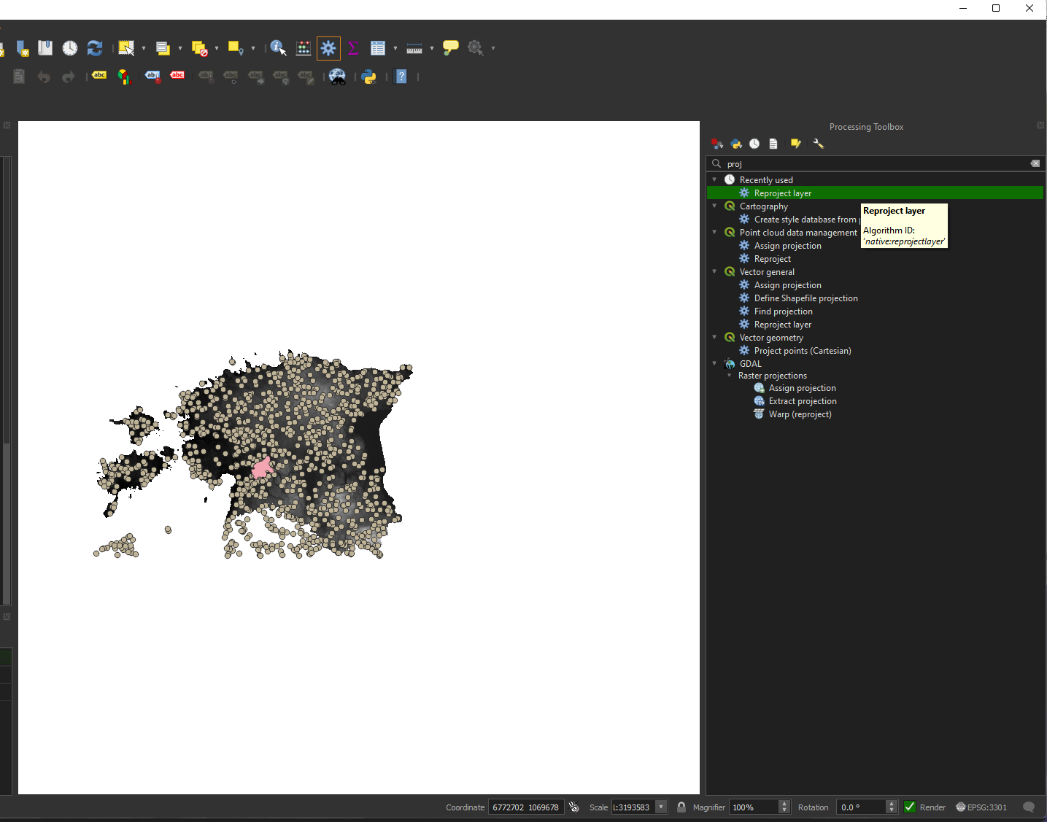
1) Find the toolbox
2) Search for the function: reproject later

Slide 8
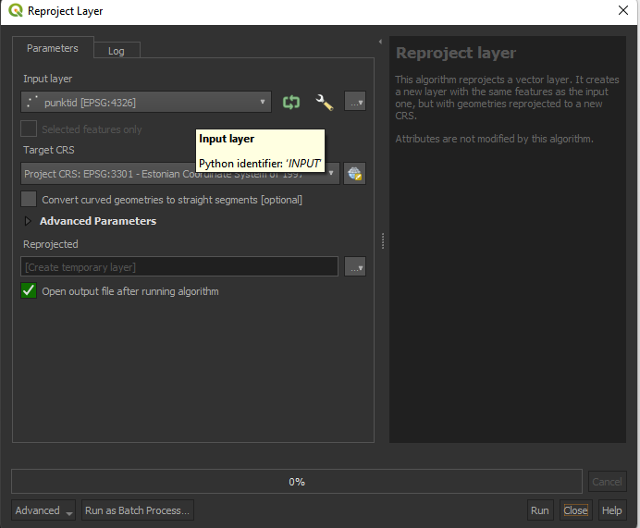
3) Choose the layer
4) Choose target CRS
5) Run

Slide 9
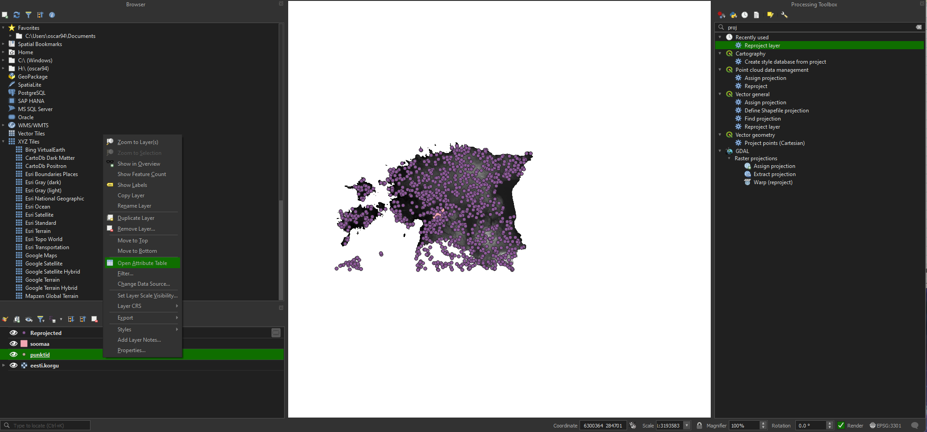
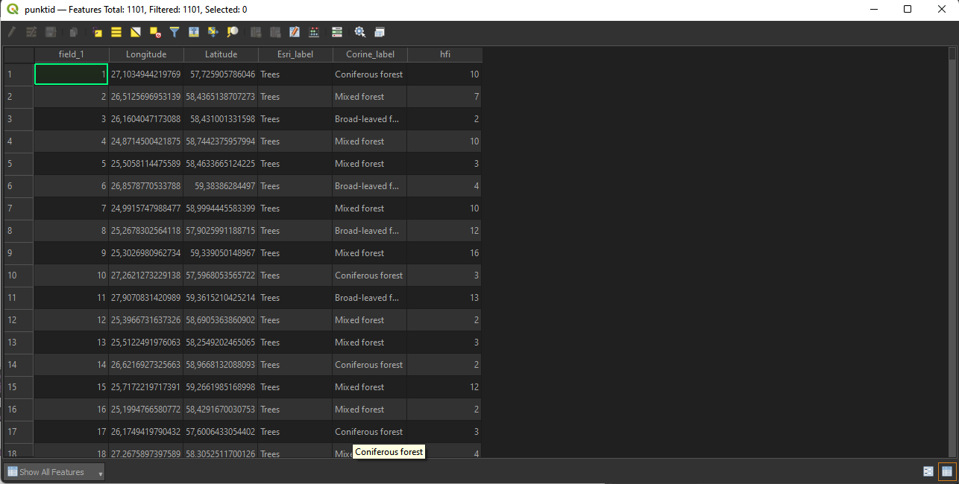

Slide 10
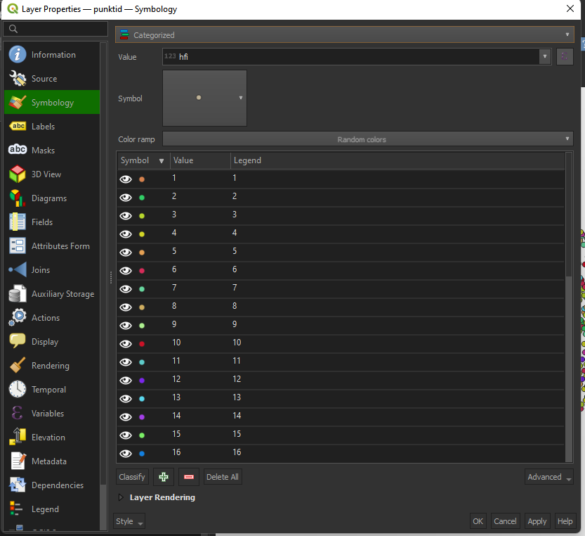

Slide 11
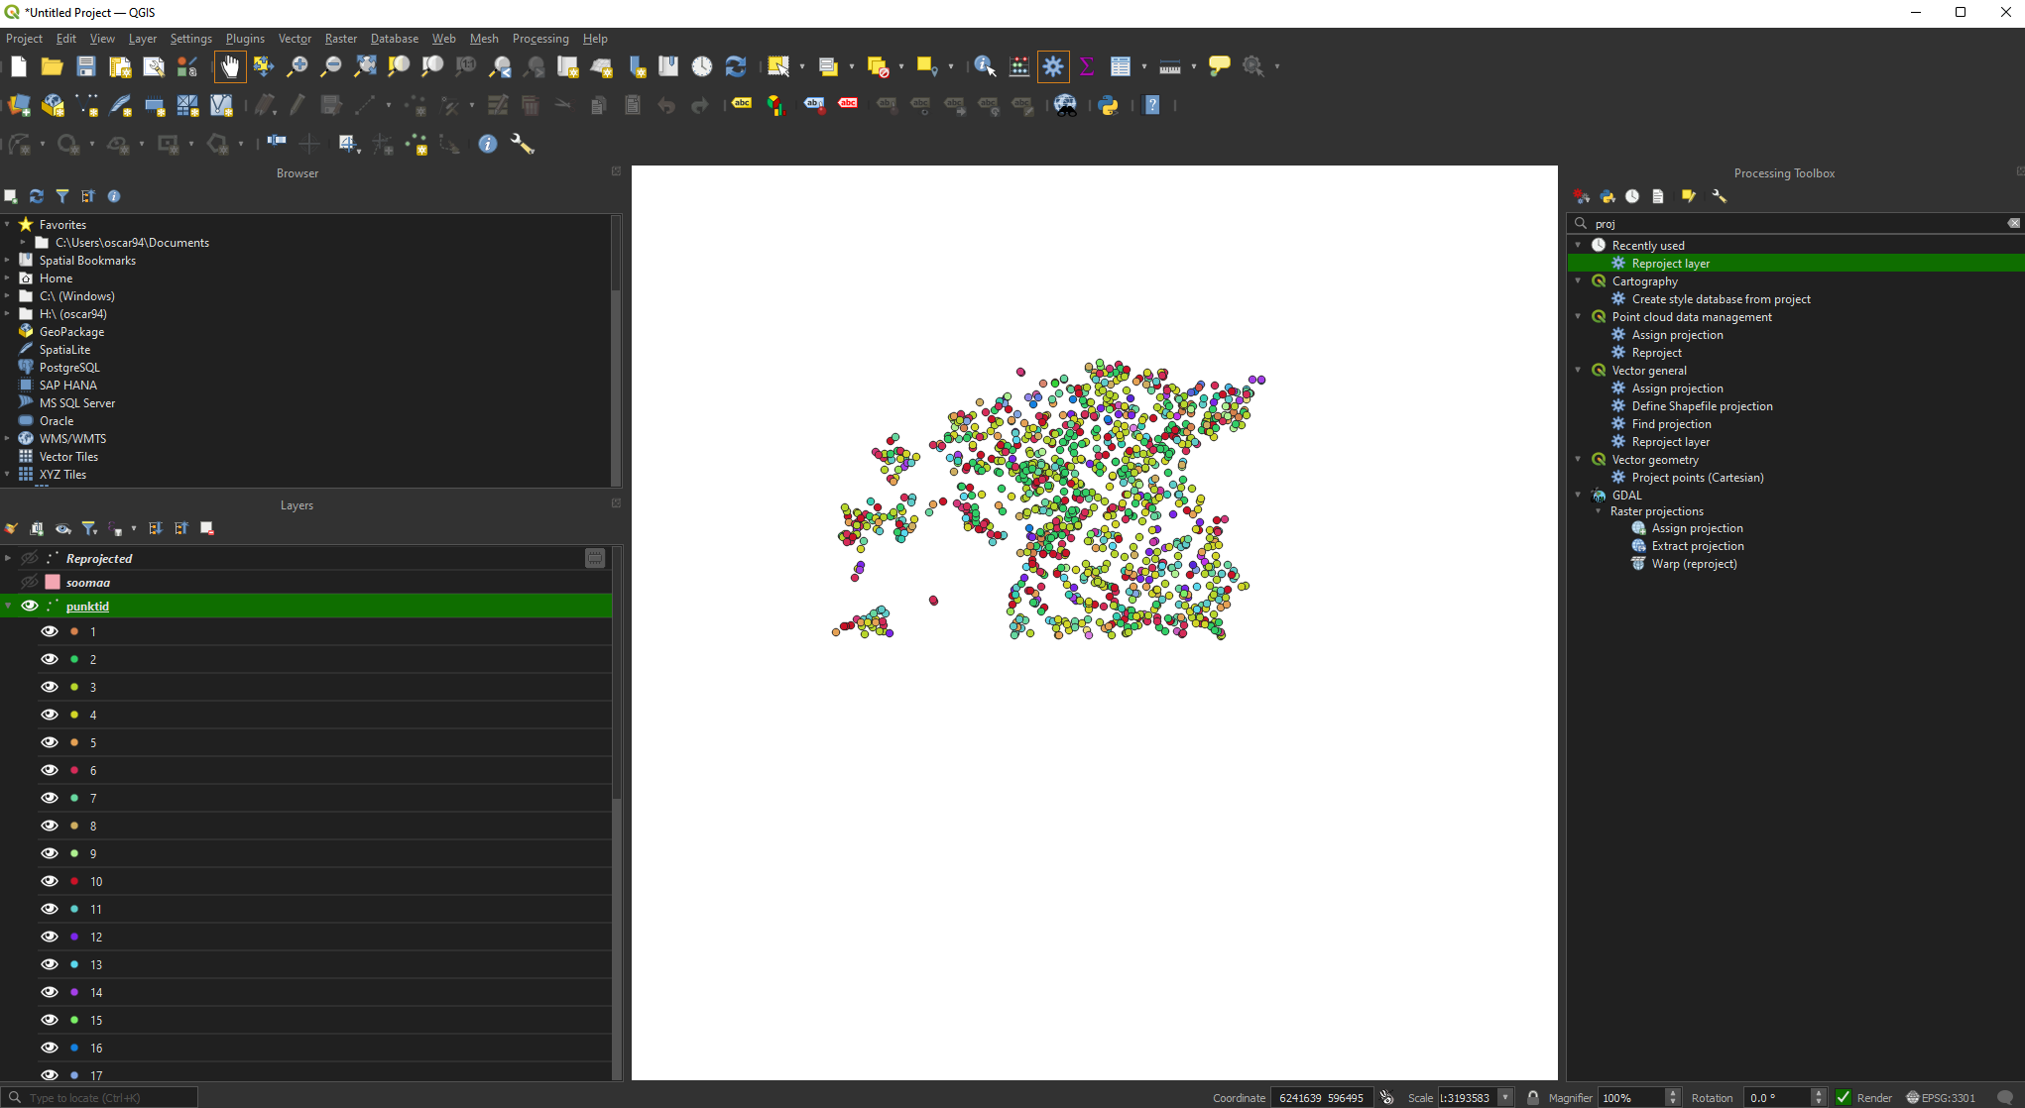

Slide 12
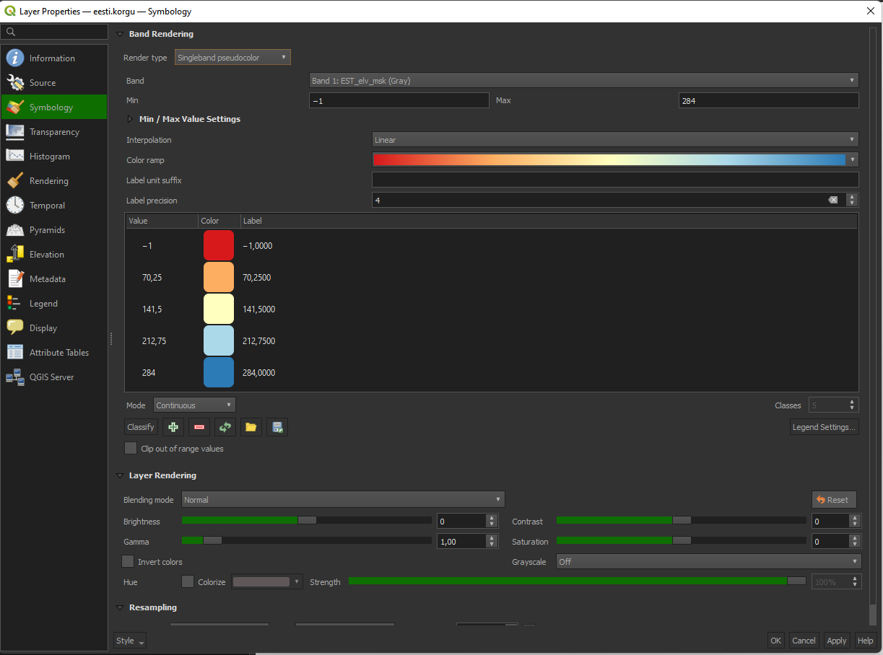
1) Select singleband pseudocolor
2) Choose a proper color ramp

Slide 13
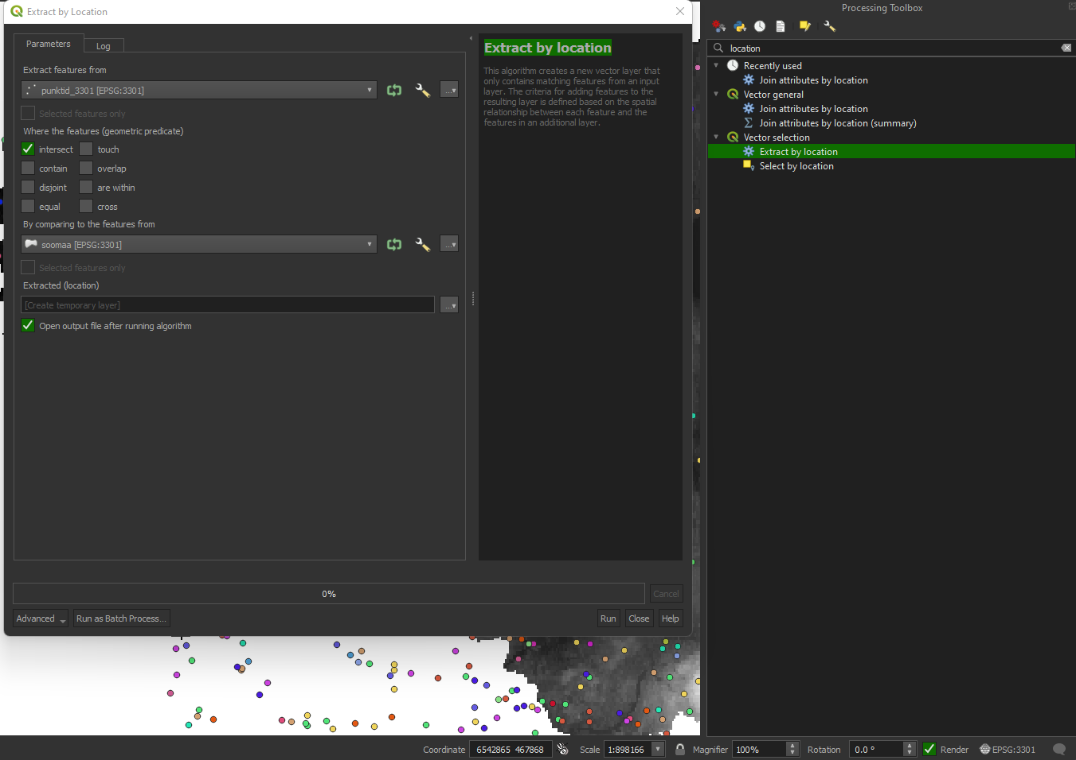
1) Choose point
2) Choose function
3) Choose soomaa layer
4) Run

Slide 14
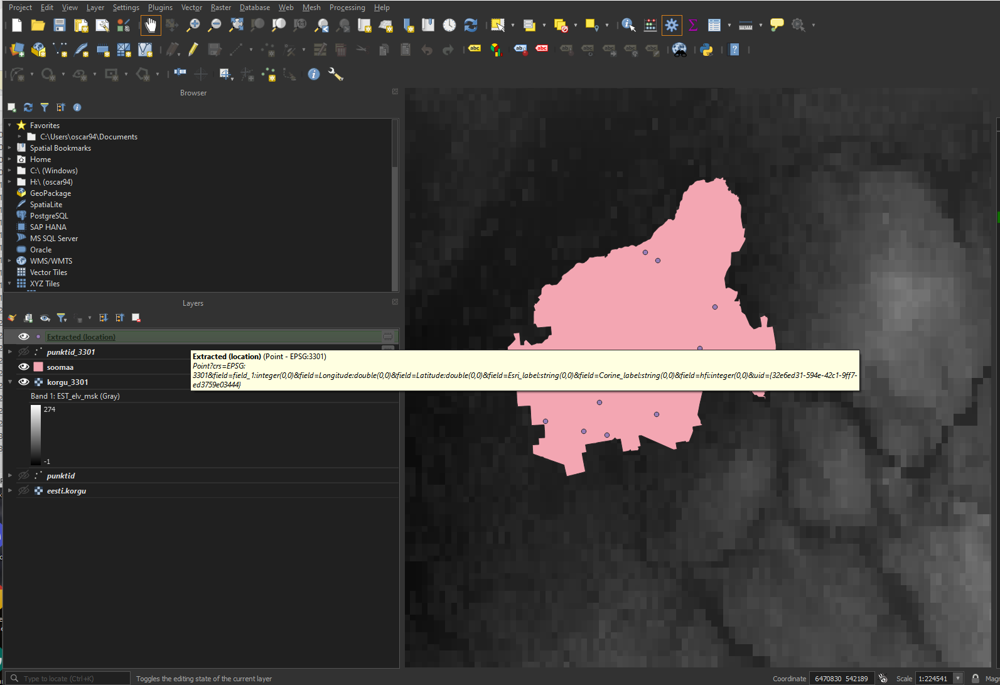

Slide 15
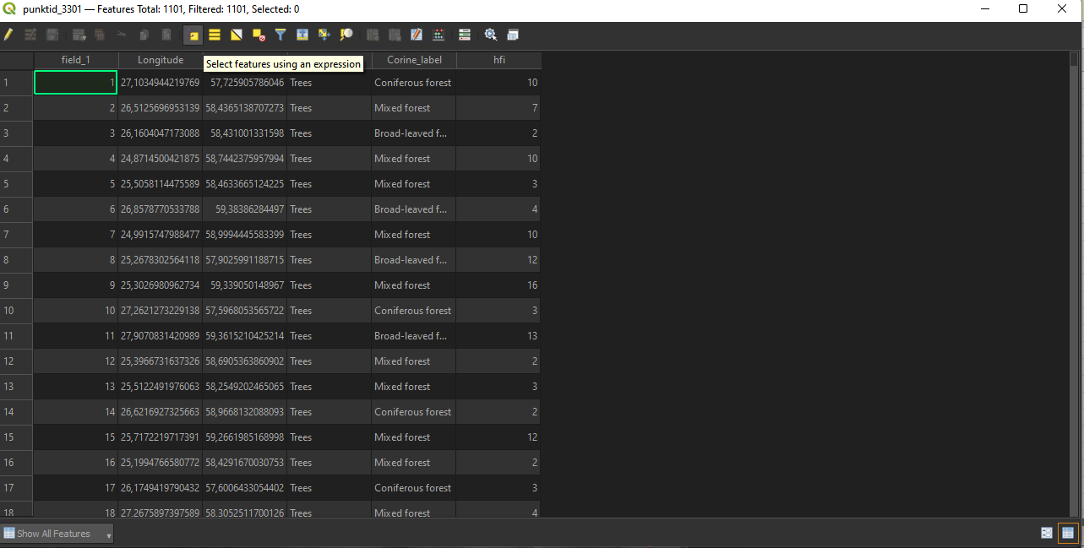

Slide 16
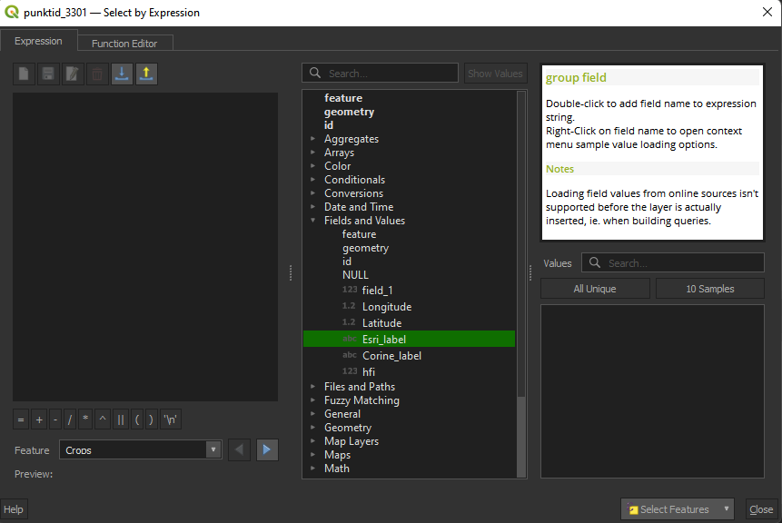
1) Click Fields and Values
2) Double click the Column name
3) Click All Unique

Slide 17
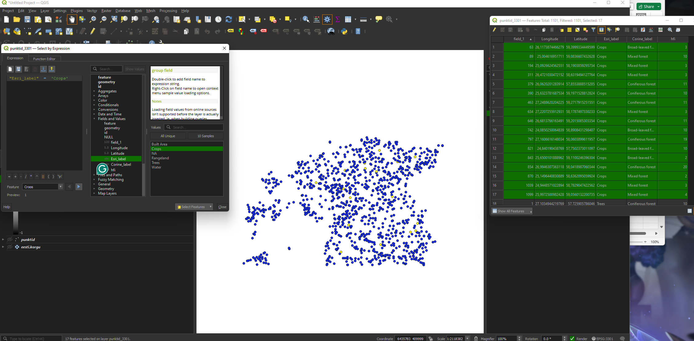

Slide 18
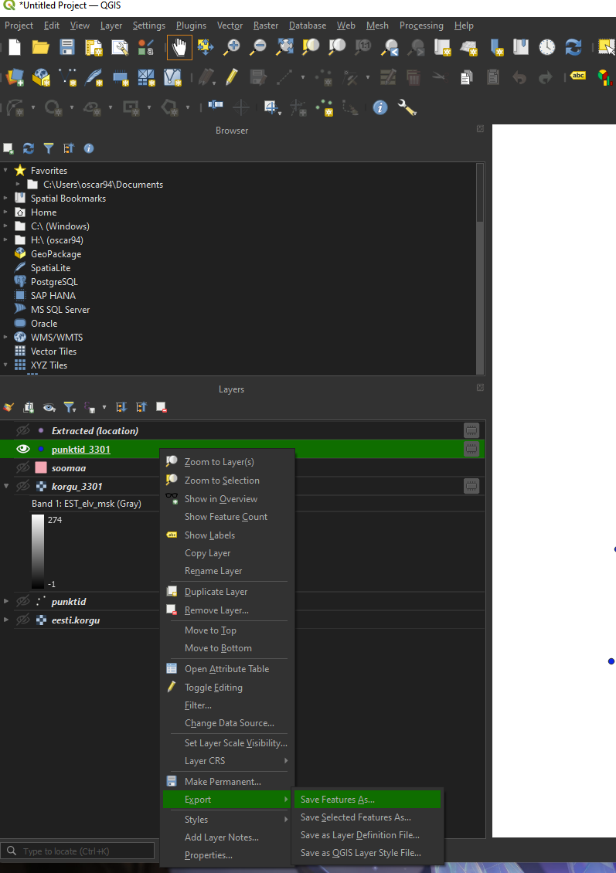
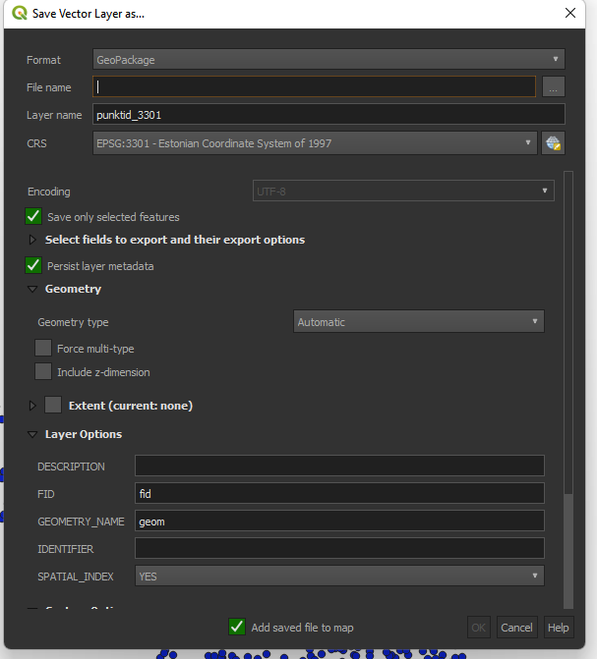

Slide 19
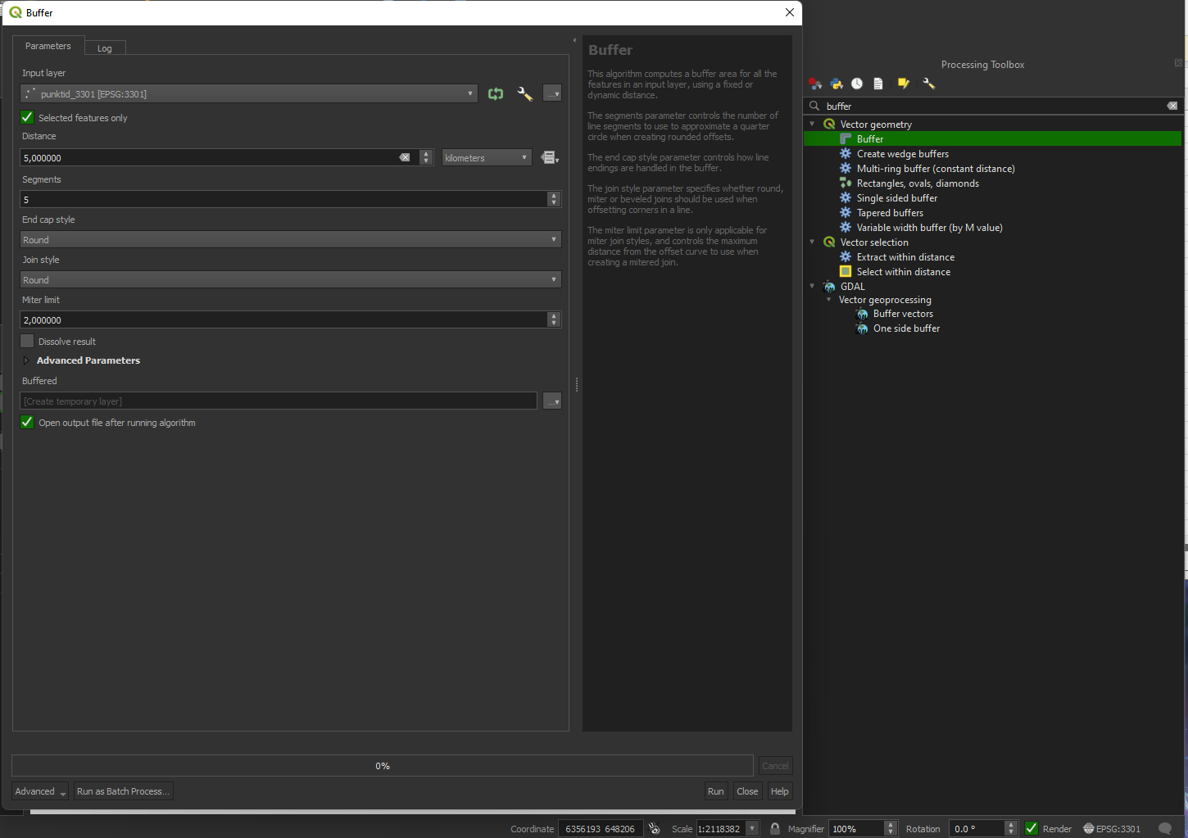
1) Choose the layer, and click Selected values
2) Write the desired Buffer distance and units

Slide 20
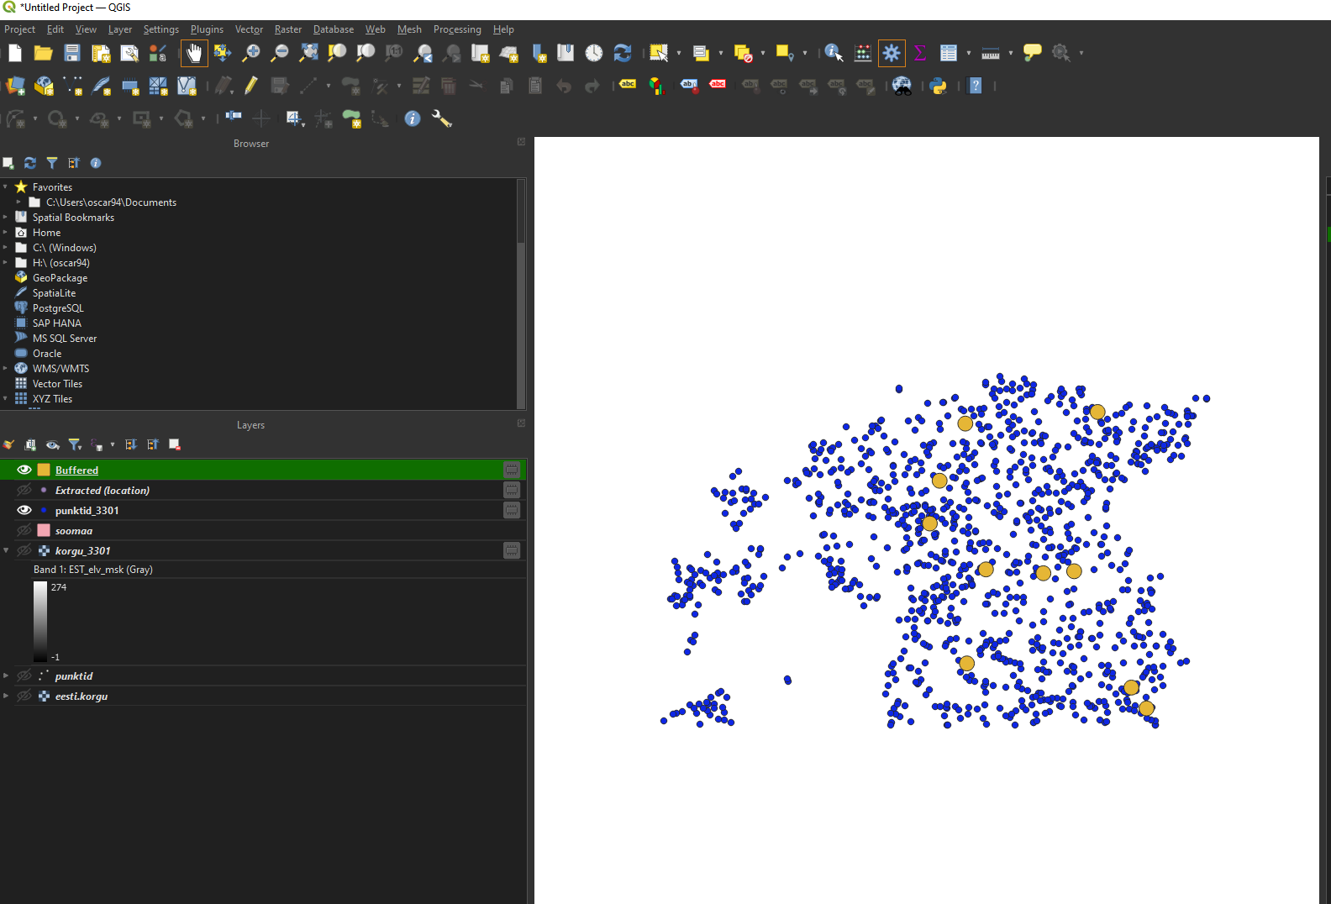

Slide 21
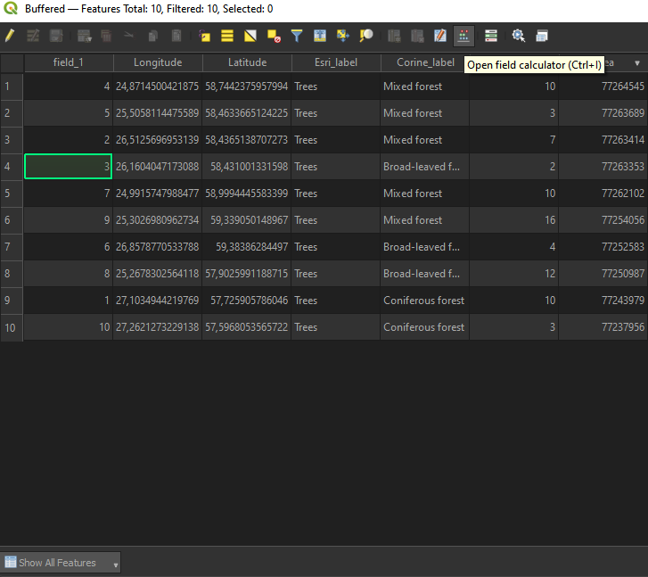

Slide 22
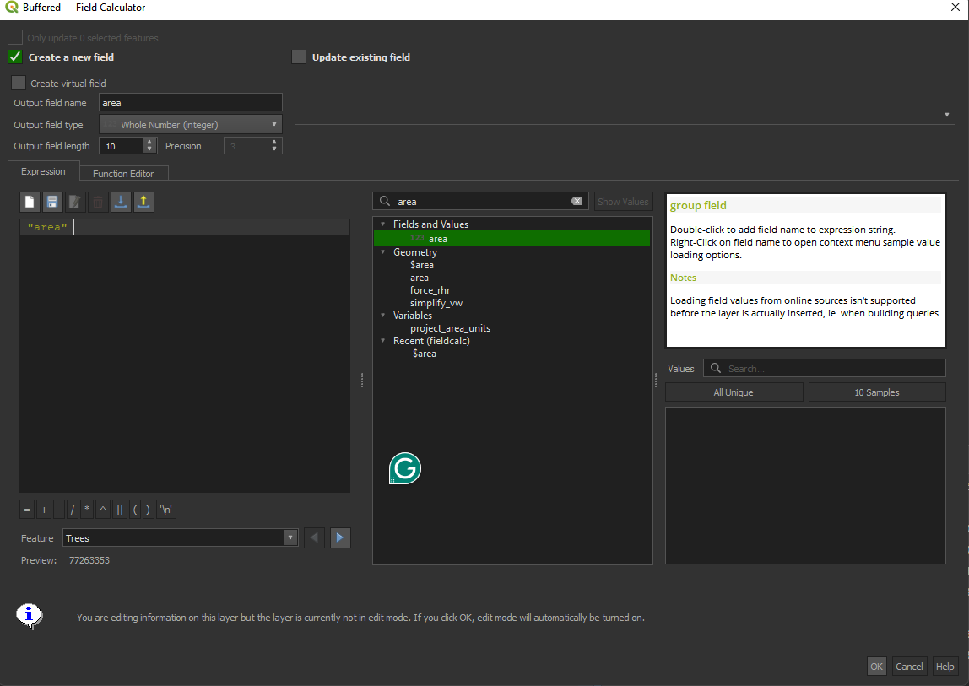
1) Create a new field
2) Give a name
3) Look for the function
Double click or write it

Slide 23
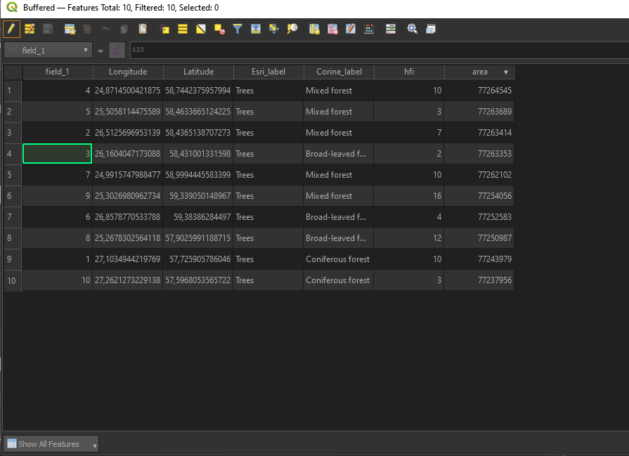

Slide 24
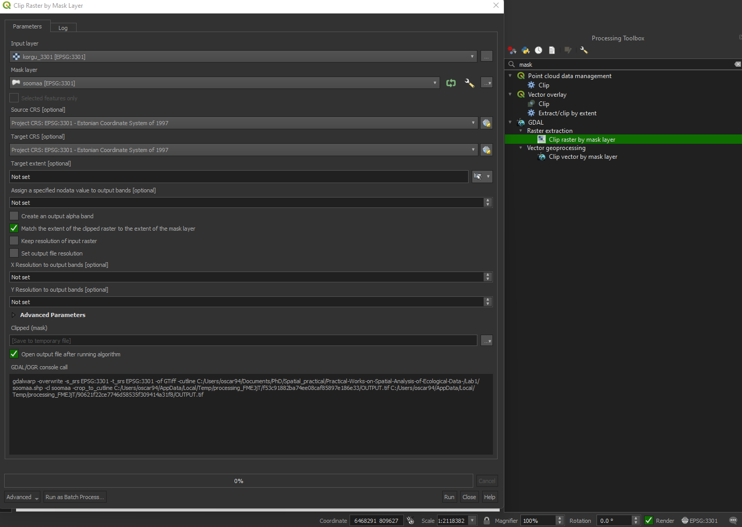

Slide 25
