Slide 1
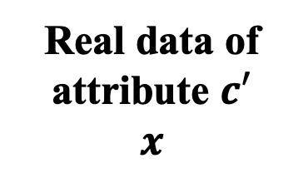

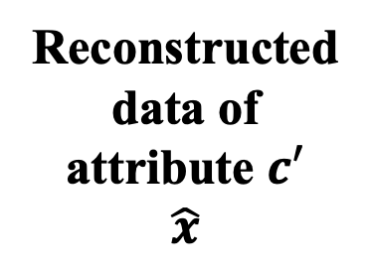


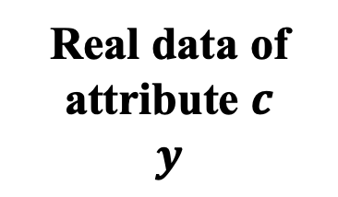
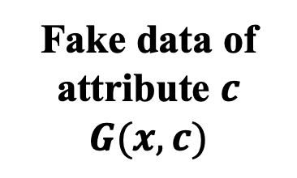
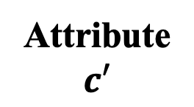
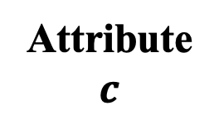
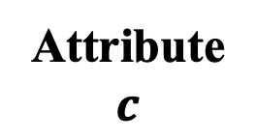
Real data of
attribute $c$
$$y$$
Attribute
$$c$$
Attribute
$$c$$
Generator
$$G$$
Real data of
attribute $c′$
$$x$$
Discriminator
Fake data of
attribute $c$
$$G(x, c)$$
$$D$$
Reconstructeddata of attribute $c′$
$$\hat{x}$$
$$G$$
Attribute
$$c′$$
T/F

