Slide 1
What the Food!
Team
Jeff Bezos

Slide 2
Team members
Ose
Smruti
Kirti
Sanket
Shrigovind
Prajwal

Slide 3
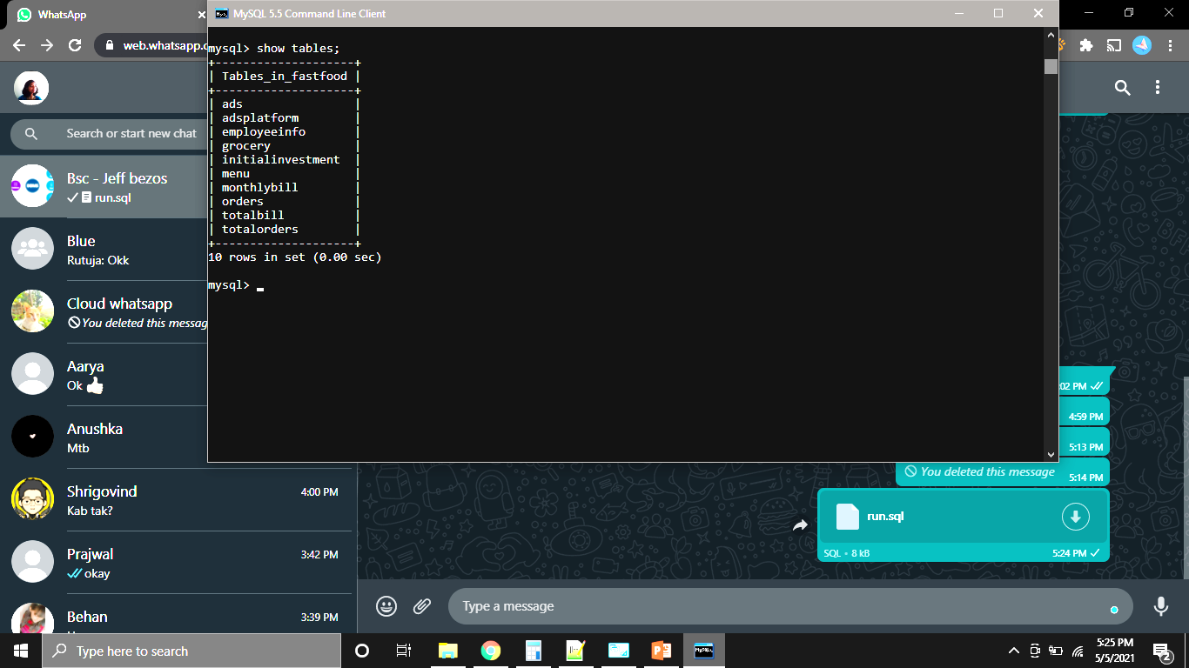
Master table
1 | Ads
2 | employeeinfo
3 | Grocery
4 | Menu
5 | Monthlybill
6 | Orders
7 | Initialinvestment
Transaction table
1 | adsplatform

Slide 4
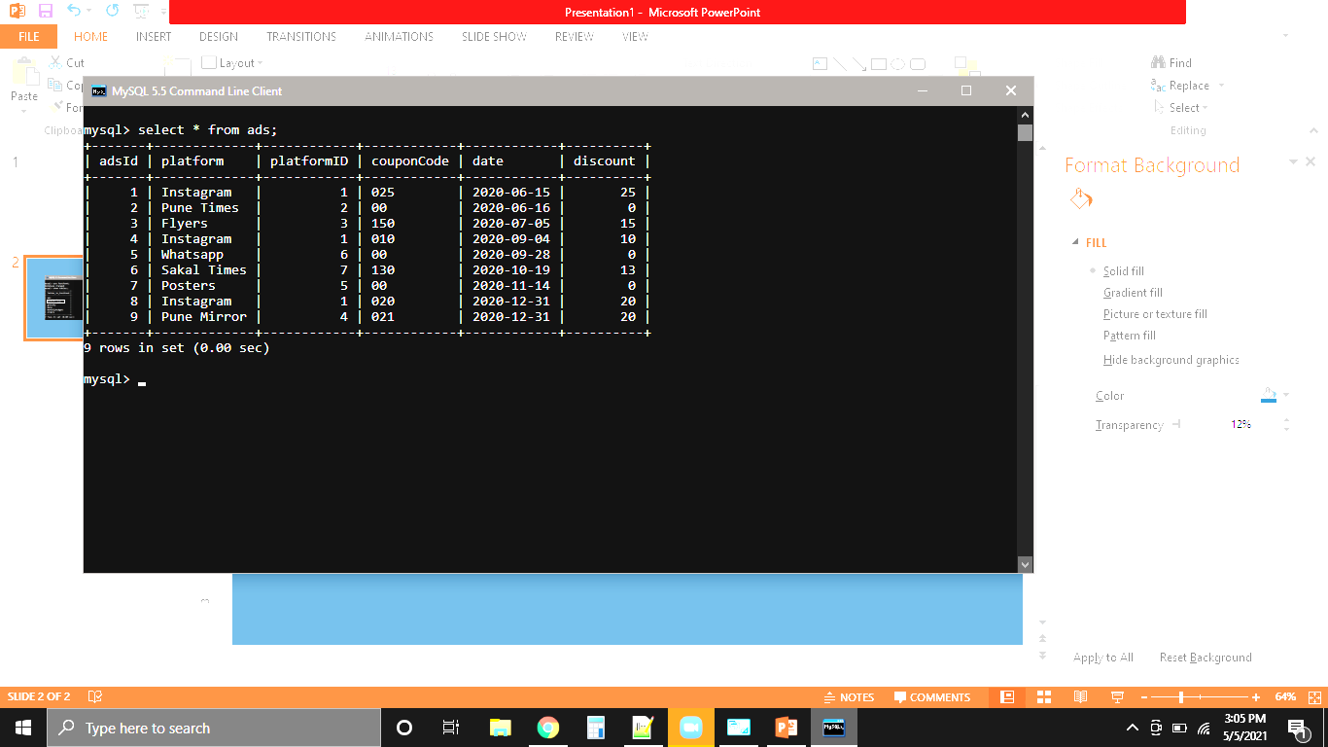
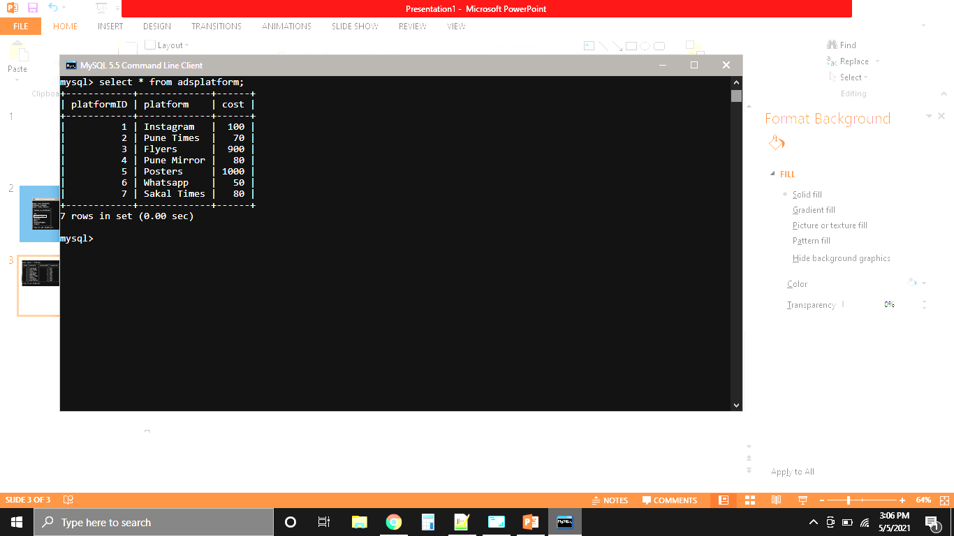
Here is the table covering the advertising section
of the restaurant. It shows the various platforms on
which we have placed our ads offering various
offers to our customers
select sum(adsplatform.cost) as adsCost
from adsplatform, ads
where ads.platformID = adsplatform.platformID;

Slide 5
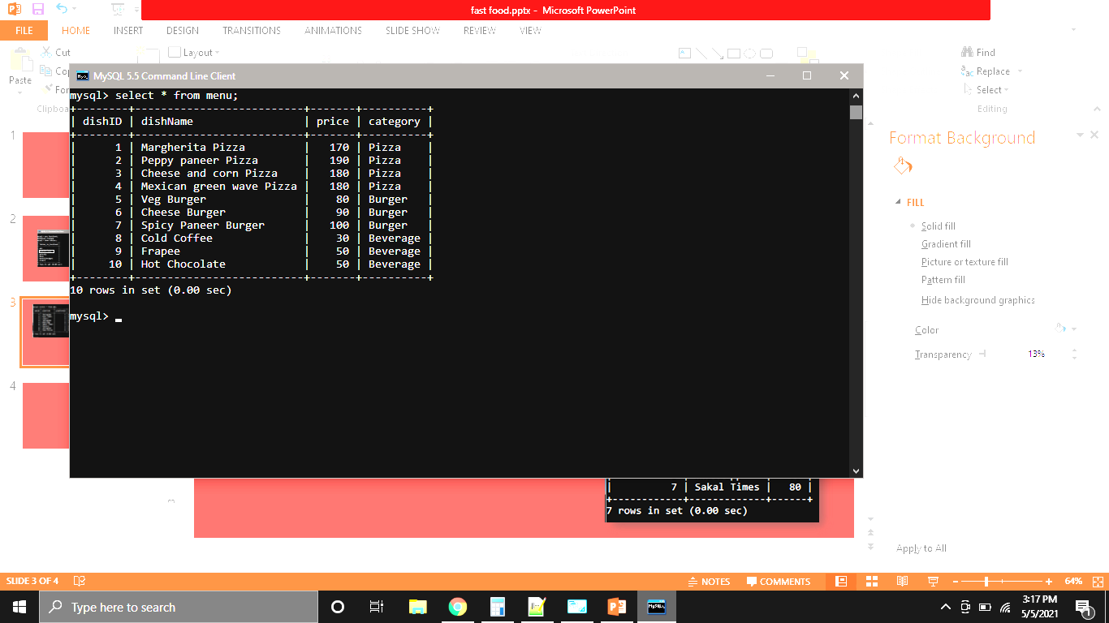
As we are running a restaurant. It is important to have menu.
Here dishID is primary key and it will be used later.
Also, category is repeated. But, we do not need it anytime later. It is just for the customer comfort.
As, we respect our customers. ☺

Slide 6
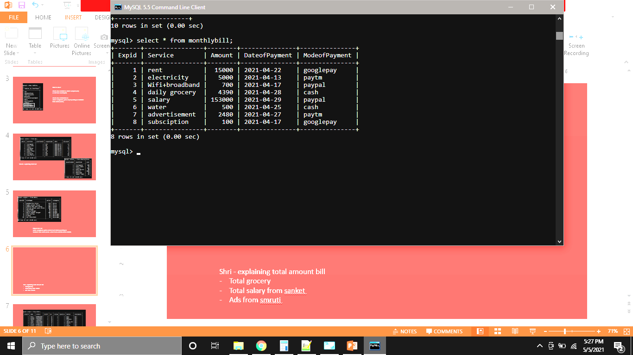
Expid is the primary id.
Service column has the needed monthly services.
Amount is the amount we needed to pay this month for each service.
Dateofpayment contains dates when we paid for each specific service.
Modeofpayment is for the different ways we paid for the services.

Slide 7
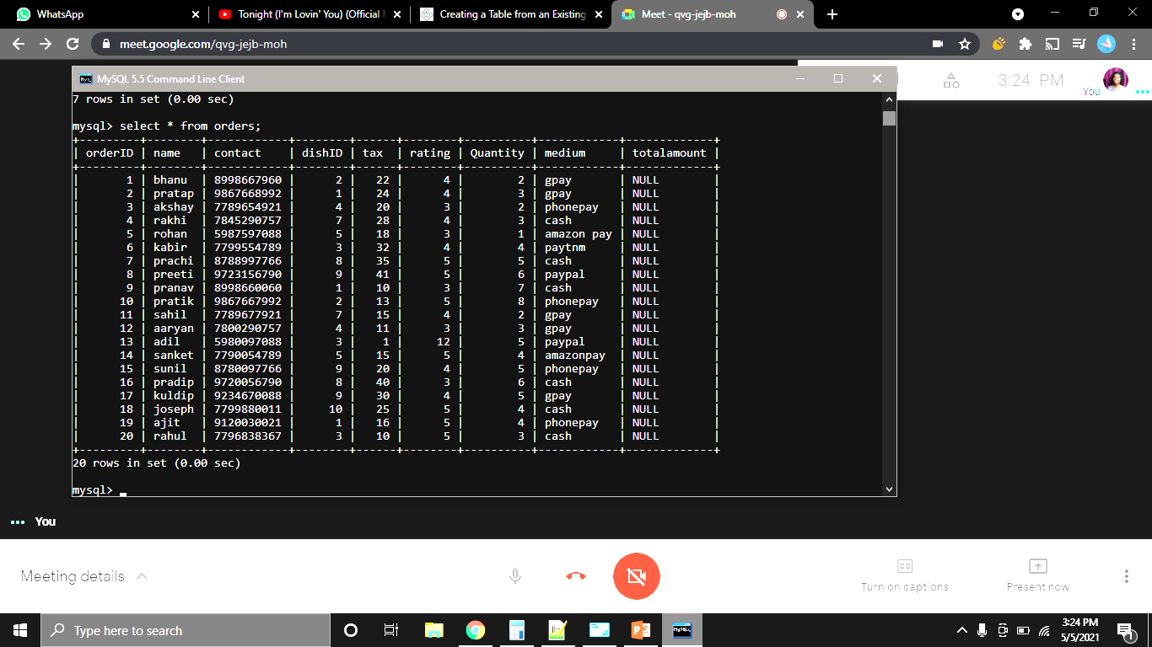
As we have started our startup
as fast food restaurant it is essential
to keep the data of orders ordered
by customers .
So this is how we are storing
information of orders.
Query to calculate how much money we made?
select sum((menu.price+orders.tax)*orders.quantity) as totalAmt from orders,menu where menu.dishID=orders.dishID;

Slide 8
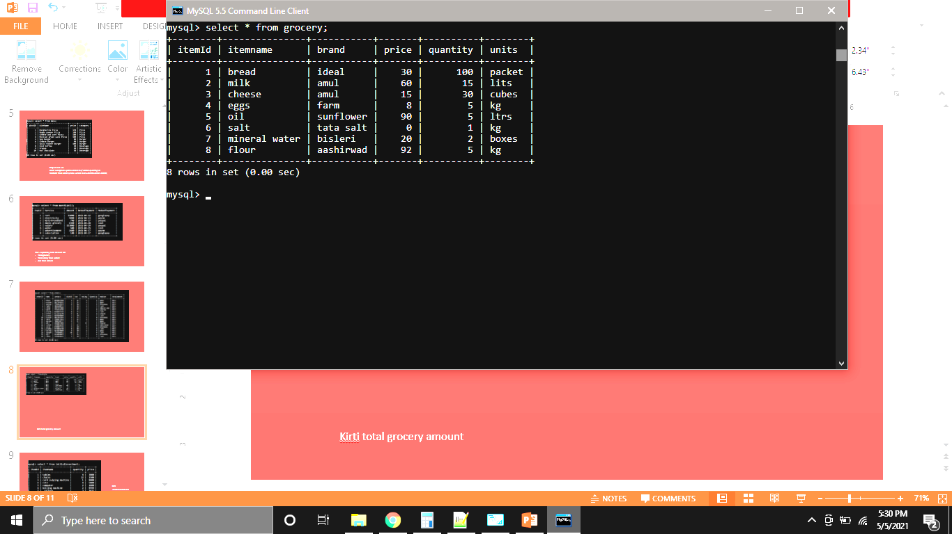
So, as we started a fast food restaurant we need groceries to prepare food . So this is the table for grocery.

Slide 9
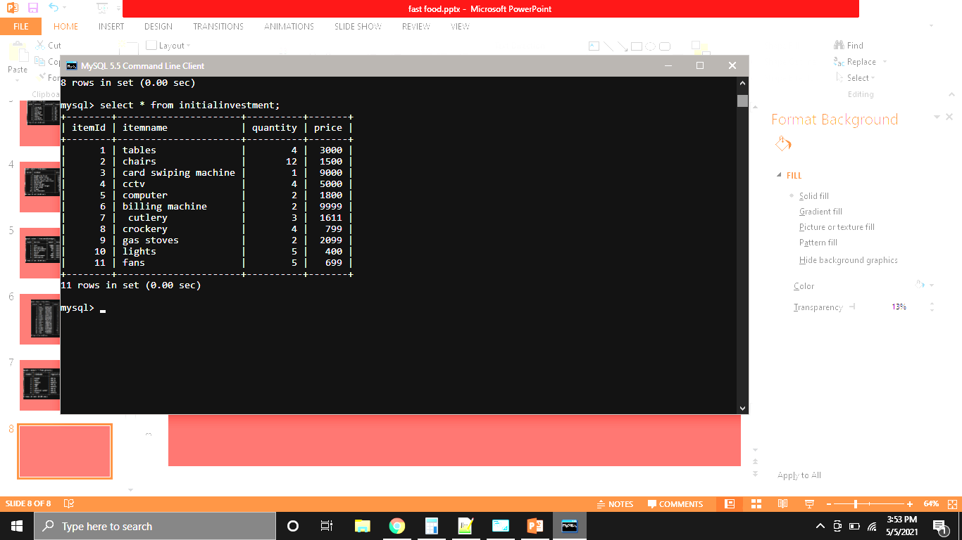
Initial investment is the amount required for starting up a business
so, this is the fund we need to start our fast food restaurant.

Slide 10
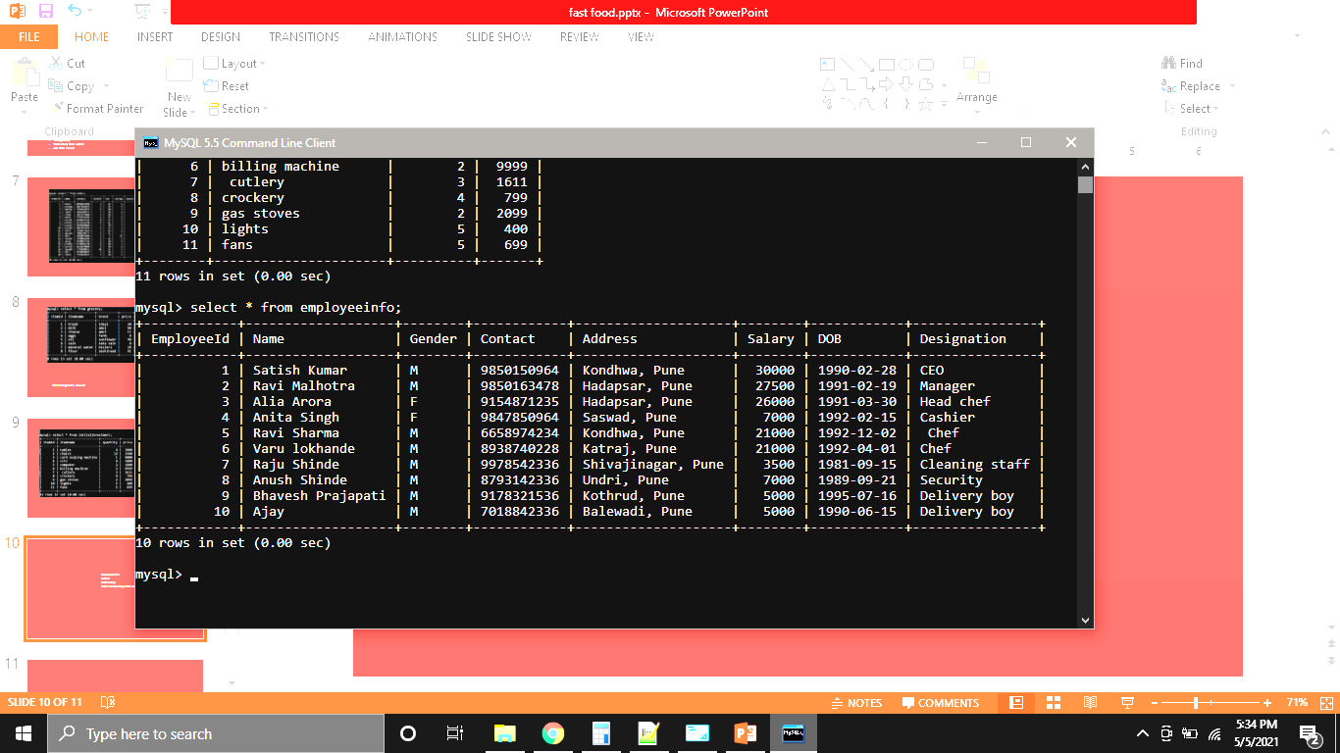
So, as we are starting a fast food restaurant we need employees to run
the restaurant and maintain the environment and
This is the how we are storing information of the employees
Total salary
select sum(salary) from employeeinfo;

Slide 11
What is view?
create view totalbill as select sum(Amount) as bill
from monthlybill;
create view totalorders as
select sum((menu.price+tax)*quantity) as totalAmt
from orders,menu;

Slide 12
NORMALISATION
1NF
Atomicity
Attribute domain
Each column must have unique name
Order doesn't matter
2NF
It should be in 1NF
there should be no partial dependency
3NF
It should be in 2NF
It should not have transitive dependency
(Data duplication reduced, Data integrity achieved)
BCNF
It should be in 3NF
For any dependency A->B ,A should be a super key
No prime attribute depended on non-prime attribute

Slide 13
Improvements
Anybody found any loophole which needs to be improved in our database?
1. Designation- Salary table
2. Mode of Payment table
3. Orders must have date
4. Repeated orders

Slide 14
BTS
alter table orders
modify contact bigint;
alter table grocery
modify itemname char not null;
alter table grocery
modify itemname varchar(30);

Slide 15
Thank You

