Slide 1
JOOLE
Sean Qin

Slide 2
introduction
Online marketplace for building products
User who can find the best products to meet their requirements
User who can market relevant products at the decision point

Slide 3
features
Login/ Signup/ Logout
Search Category/ ProductLine/ Product
Display Product List
Display Product Detial

Slide 4
Technologies
Frontend:
React
Axios
React-router-dom
Redux
Redux-thunk
Redux-devtool
Backend:
My-SQL
Spring-mvc
Spring JPA
Spring-security

Slide 5
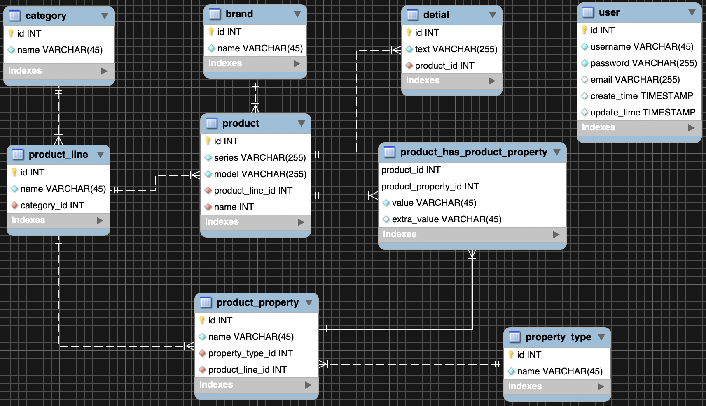
ER diagram

Slide 6
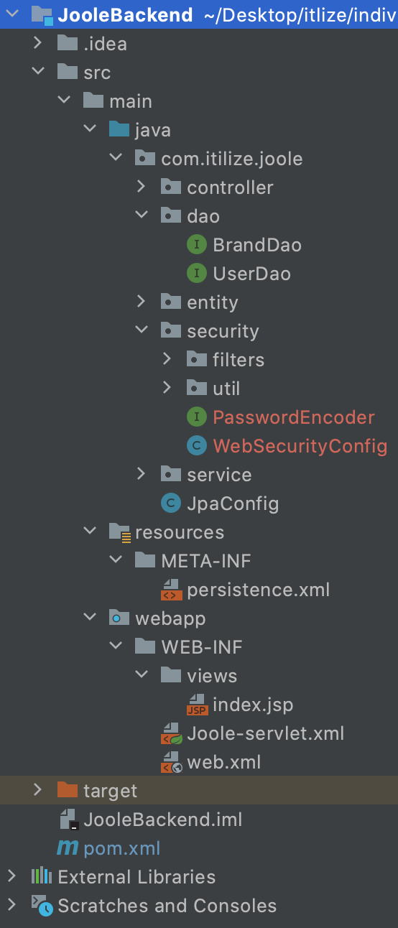
Backend structure
Controller
Dao (Repository)
Entity
Service
Security
META-INF
WEB-INF

Slide 7
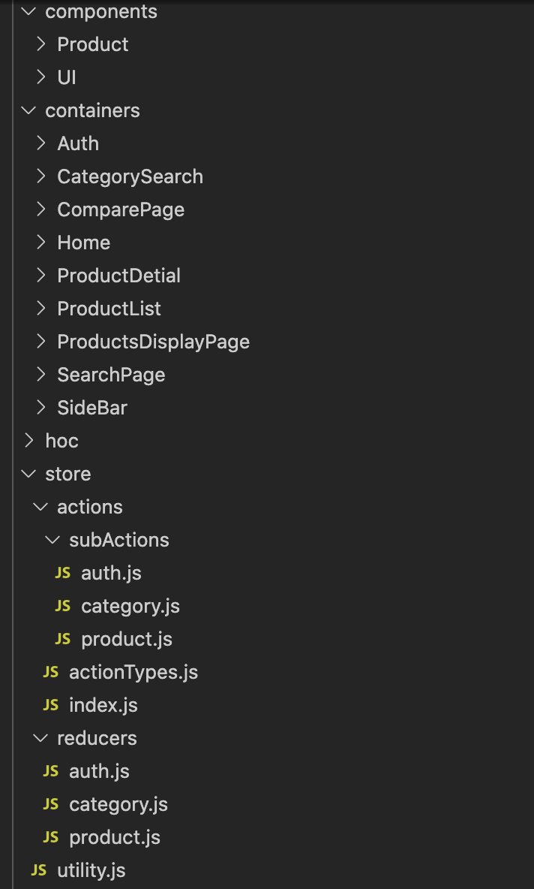
Frontend structure
Components
Containers
HOC (High Order Components)
Store
Actions
Reducers

Slide 8
Demo
http://localhost:3000/

Slide 9
Future improvement
Save and display the product image
Implement filter functions
Complete the Product Detail Page
Better organize of frontend components and routes
Solve bug of connection between frontend and backend
Improve UI
Improve performance

Slide 10
Q&A
Thanks

Slide 11
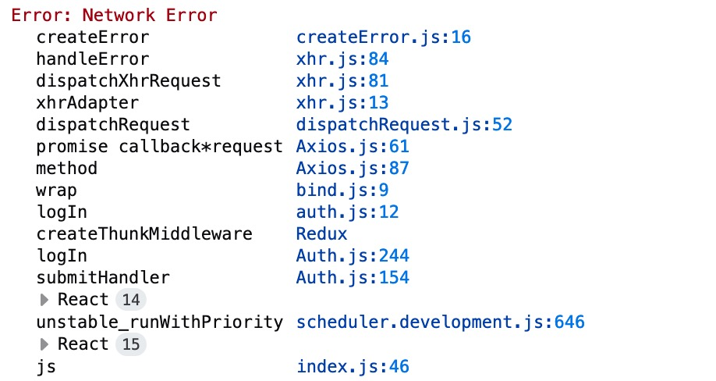
Connection error

