Slide 1
A Location Recommender System for Business Startup
Applied Data Science Capstone
IBM Data Science Professional Certificate
2019

Slide 2
Introduction/Business Problem
In the boroughs of Toronto (North York), there is a groceries contractor who provides fresh and high-quality groceries to places such as: Different types of Restaurants, Bakery, Breakfast Spot, Brewery and Café. The contractor wants to build a warehouse to store the groceries it buys from producers inside the borough, so that they will support more customers and also bring better "Quality of Service" to the old customers. For example, if the warehouse is close to those old and famous restaurants, then the vegetables and other groceries would be delivered to the restaurant in the right time without delay.
The contractor should build this warehouse where it is closest to its customers in order to minimize the cost of transportation in addition to the example above. Which neighborhood (in that borough) would be a better choice for the contractor to build the warehouse in that neighborhood. Finding the right neighborhood is our mission and our recommender system will provide this contractor with a sorted list of neighborhoods in which the first element of the list will be the best suggested neighborhood.

Slide 3
Data We Need
The location data will be the Toronto neighborhood data with its corresponding geographical data which will be scrape from Wikipedia website.
The data of Toronto is made up of the features Postal Code, Borough, Neighborhood, Latitude, and Longitude in the Borough of NORTH YORK which will be used to leverage the Foursquare Api to get the best location.

Slide 4
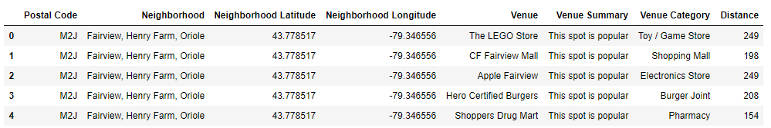
Data
Part 2: Data We Need
We will need data about different venues in different neighborhoods of that specific borough. In order to gain that information we will use "Foursquare" locational information. A typical request from Foursquare will provide us with the following information:

Slide 5
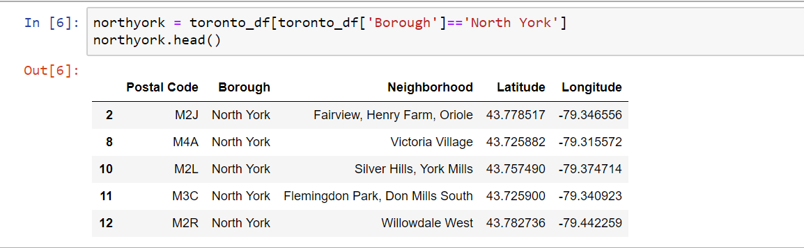
Main Article
1: Identifying Neighborhoods inside North York

Slide 6
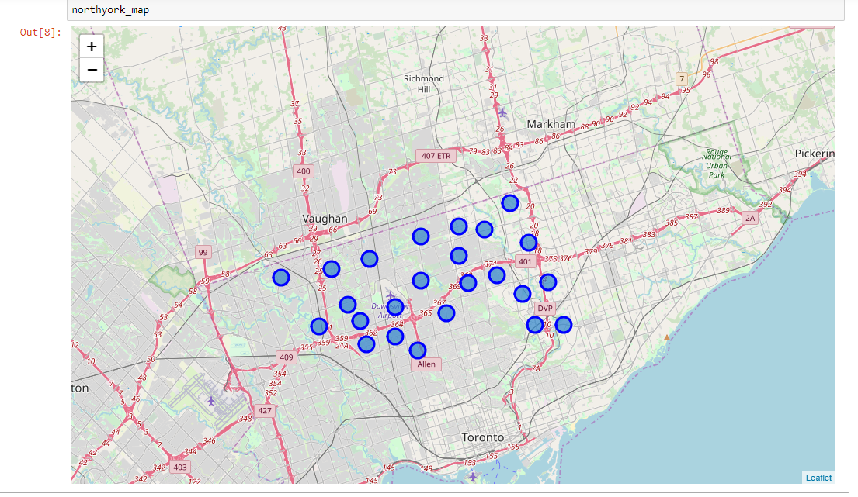
Main Article
Visualize the Borough of North York and its neighborhood in a map

Slide 7
Main Article
2: Connecting to Foursquare and Retrieving Locational Data for Each Venue in Every Neighborhood
After finding the list of neighborhoods, we then connect to the Foursquare API to gather information about venues inside each and every neighborhood. For each neighborhood, we have chosen the radius to be 1000 meter. It means that we have asked Foursquare to find venues that are at most 1000 meter far from the center of the neighborhood.

Slide 8
Main Article
3: Processing the Retrieved Data and Creating a DataFrome for All the Venues inside the Scarborough
When the data is completely gathered, we will perform processing on that raw data to find our desirable features for each venue. Our main feature is the category of that venue. After this stage, the column "Venue's Category" will be One-hot encoded and different venues will have different feature-columns. After On-hot encoding we will integrate all restaurant columns to one column "Total Restaurants" and all food joint columns to "Total Joints" column.

Slide 9
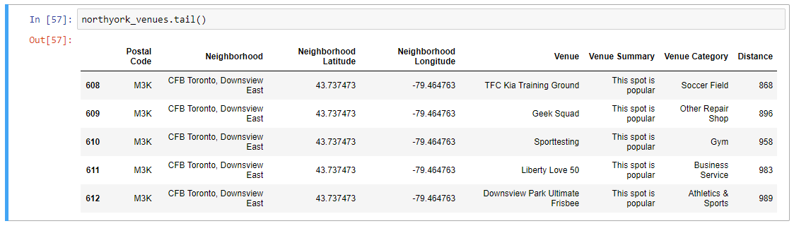
Main Article
3: Processing the Retrieved Data and Creating a DataFrome for All the Venues inside the Scarborough

Slide 10
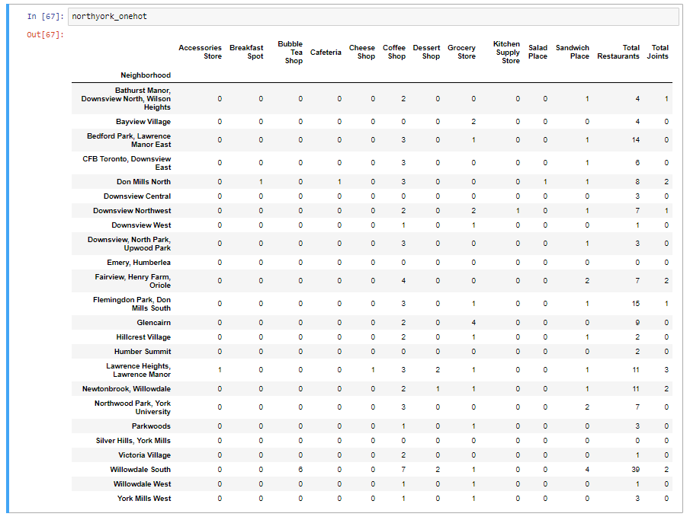
Now, the dataset is fully ready to be used for machine learning (and statistical analysis) purposes.

Slide 11
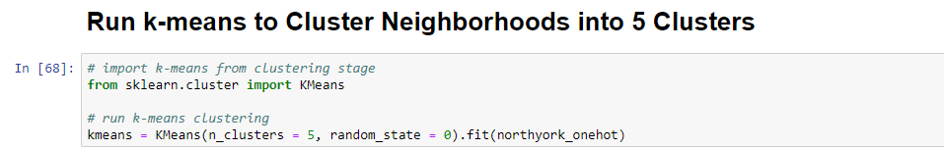
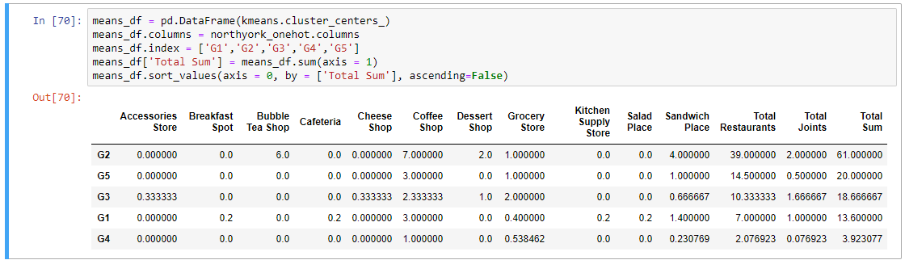
Main Article
4: Applying one of Machine Learning Techniques (K-Means Clustering)

Slide 12
Decision Making and Reporting Results
Now, we focus on the centers of clusters and compare them for their "Total Restaurants" and their "Total Joints". The group which its center has the highest "Total Sum" will be our best recommendation to the contractor. {Note: Total Sum = Total Restaurants + Total Joints.} This algorithm although is pretty straightforward yet is strongly powerful.

Slide 13
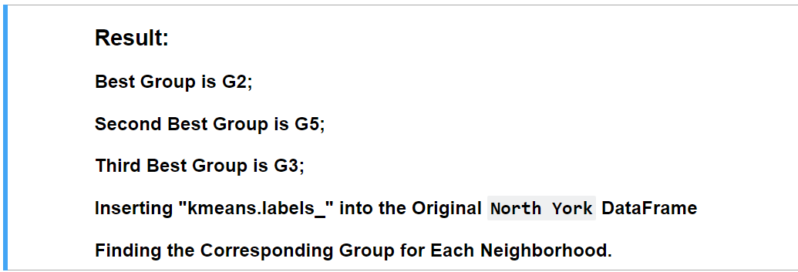
Decision Making and Reporting Results

Slide 14
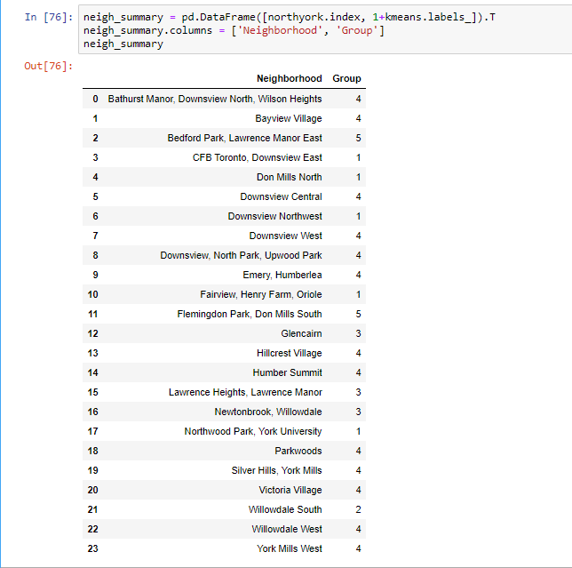
Decision Making and Reporting Results

Slide 15
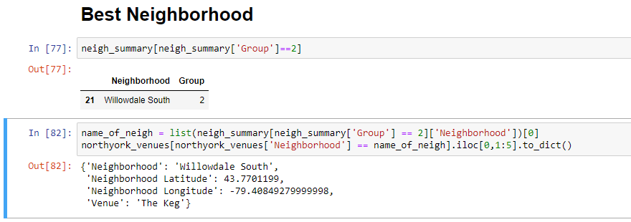
Decision Making and Reporting Results

Slide 16
Thank You

