Slide 1
Localized Lookups

Slide 2
Features
Supports Database Lookup tables and Enum(ReadOnly) lookups
Returns lookup values localized to language requested in accept-lang header
Management allows adding any number of localizations for each lookup value.
Extensible: supports adding lookups in other modules easily by registering new lookup type Enums on the lookup service.
Auto-create lookup tables controlled by a property.

Slide 3
Some Definitions
Lookup Types Enum
An enumeration of lookup types defined in the application.
Db Lookup types are stored and managed in the database require an JPA entity class
Enumeration lookups are simple java enum exposed in the same way as db lookups
Lookup Entity
Enum Lookup
Lookup Entity
Enum Lookup
Lookup Entity
Enum Lookup
Exposes less secure API to view lookup lists
Contains all service logic to handle business operations
Lookup Simple DTO
Lookup Controller
Db Lookup types require a repository interface to handle db operations
Lookup Repository
Lookup Service
Lookup DTO
Lookup Mapper
Exposes secured API to manage database lookups
Lookup Localized DTO
DB
Lookup Admin Controller
A mapper handles mapping entity/enum to dto and from dto to entity/enum
A implementation of the DTO containing translations for each value

Slide 4
Main Components
Lookup Types Enum
Enum_LK1
DB
Entity_LK1
Entity_LK1 Repository
Register Types
Lookup Service
Lookup Controller
Lookup Admin Controller

Slide 5
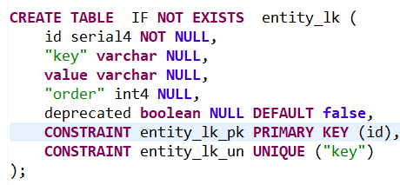
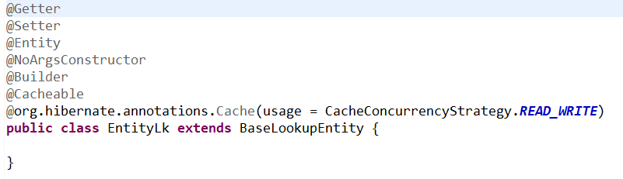
Integration Guide: Db managed lookups
Add entity table to your schema OR set app.lookups.auto-create=true
Define entity class , Cachable & extending BaseLookupEntity

Slide 6
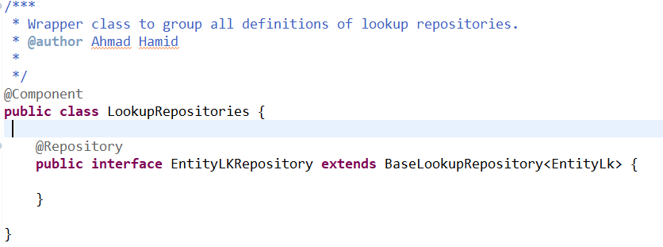
Integration Guide: Db managed lookups
Define repository wrapper class
Define entity repository extending BaseLookupRepository

Slide 7
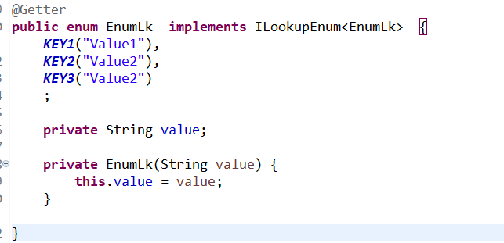
Integration Guide: Read-only/Enum lookups
Define enum implementing ILookupEnum

Slide 8
Integration Guide: Common
Define one or more enum of lookup Types implementing ILookupTypeEnum and register them with the lookup service
@Getter
@RequiredArgsConstructor
public enum LookupType implements ILookupTypeEnum<LookupType> {
EntityLK("Sample db lookup", EntityLk.class),
EnumLK("Sample enum lookup", EnumLk.class);
private final String description;
private final Class<? extends ILookup> lookupClass;
}

Slide 9
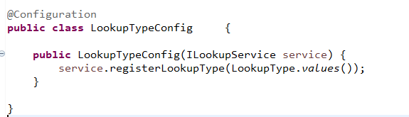
Integration Guide: Common
Call the registerLookupTypes on the LookupType

Slide 10
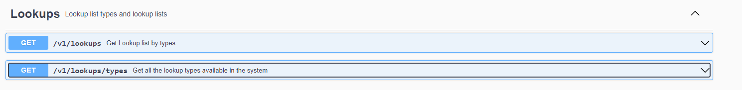
Lookups API

Slide 11
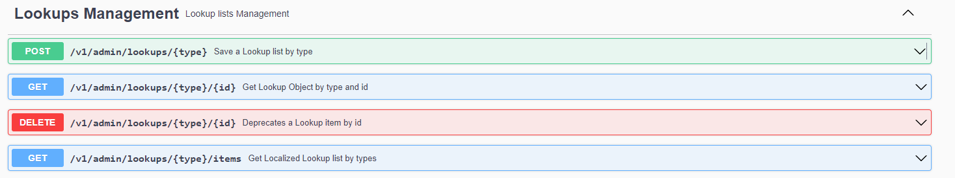
Lookup Management API

Slide 12
Localization
Add translation table to your schema OR set app.localization.auto-create=true
CREATE TABLE translation (
id serial4 NOT NULL,
"key" varchar NOT NULL,
locale varchar NULL,
value varchar NULL,
CONSTRAINT translation_pk PRIMARY KEY (id),
CONSTRAINT translation_un UNIQUE (key, locale)
);

Slide 13
// if (issuesExist) {
// predicate= root.join("aidCardIssues").get("status").get("id").in(finalStatusIds);
//
// } else {
// Subquery<Long> subQuery = query.subquery(Long.class);
// Root<AidCardIssue> issue = subQuery.from(AidCardIssue.class);
// subQuery.select(issue.get("aidCardApplication").get("id"));
// subQuery.where(issue.get("status").get("id").in(finalStatusIds));
//
// predicate = criteriaBuilder.not(root.get("id").in(subQuery));
// }

Slide 14
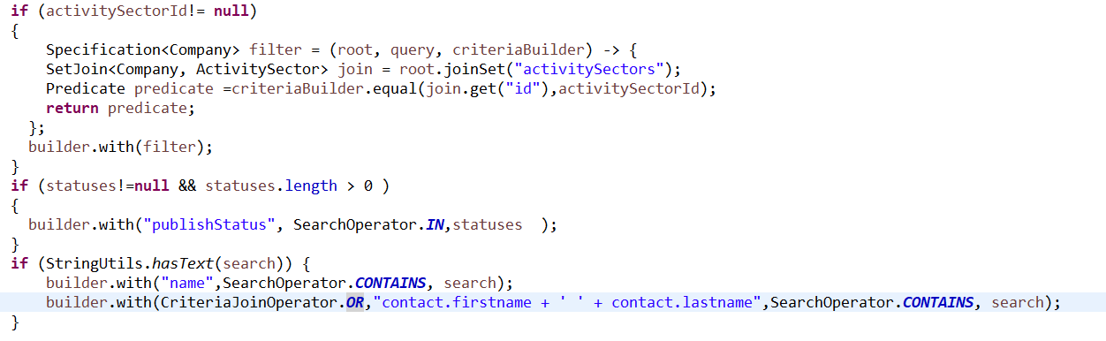

Slide 15
@Operation(summary = "Fetch Companies list", description = "Get a page of companies" ,hidden = true )
@Parameter(name = "search", description =
" <p>A search string of one or more expressions separated by comma , </p><ul>"
+ " <li>Expression is of the form [field][operator][value],...</li>"
+ " <li>Field can be a field name - or field.subfield if field is a subentity.</li>"
+ " <li>Operator can be any of Equal ':' / Not Equal '!' / Greater Than '>' / Less Than '<' / Greater Than or Equal '>:' Less Than or Equal '<:' Like '~' . </li>"
+ " <li>Value is a string format of the field data type and can be enclosed in punctuation marks(single quote.)</li>"
+ " <li>If operator is 'like' an * can be used as wild character, the like expression must be single qouted</ul>",allowEmptyValue = true,example ="name~'Siren*'" )
@ResponseStatus(HttpStatus.OK)
@GetMapping(value = "/search" )
@PreAuthorize($hasAuth + ApplicationPermissions.COMPANY_VIEW + $)
@Deprecated
public Page<CompanyListItemDTO> getCompaniesWithFullSearch(@PageableDefault(page = 0, size = 10) Pageable pageable,
@RequestParam(name = "search", required = false ) String search) {
log.info("Searching companies with criteria {} " , search);
Page<CompanyListItemDTO> companies = companyService.getCompanyList(pageable, search);
return companies;
}

