Slide 1


LAB REPORT NO:-04
LAB REPORT ON:-
Register Organization of CPU
SUMMITTED BY: SUMMITTED TO:
Name: Oshan Bajracharya Department Of ICT
Roll No: 230328 Date of Experiment:
Faculty: BE-Computer 2082-02-29
Group: B Date of Submission:
2082-03-05

Slide 2
TITLE : Register Organization of CPU
OBJECTIVE :
To implement 2-bit register organization of CPU making use of previously implemented ALU and simulate the working.
THEORY :
Key Components:
Registers (R0 to R7):
Small storage units to hold data temporarily.
Each register is 2-bit wide in this implementation.
Clock & Load Lines:
Clock synchronizes operations.
Load lines determine which register will receive new data.
3x8 Decoder:
Converts a 3-bit SELD (Select Destination) signal into 1-of-8 line to select which register to load.
Multiplexers (MUX):
SELA and SELB are 3-bit signals selecting source registers.
One MUX selects the register for A bus, another for B bus.
A bus & B bus:
Carry data from selected registers to the ALU.
Clock
Input
R1
R2
R3
R4
R5
R6
R7
Load
(7 lines)
SELA
MUX
MUX
SELB
A bus
B bus
3X8
decoder
Arithmetic
logic unit
(ALU)
OPR
SELD
3
3
3
5
Output
SELA
SELB
SELD
OPR

Slide 3
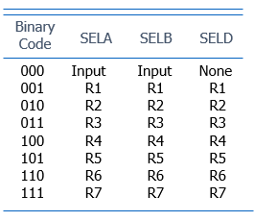
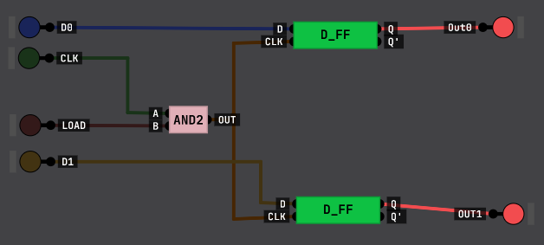
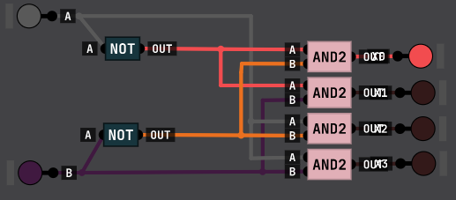
ALU (Arithmetic Logic Unit):
Performs operations like AND, OR, ADD, etc.
Controlled by OPR (operation code).
Output:
ALU result is sent back to the selected register using the SELD line.
Control Word (9 bits):
Combines all control signals:
SELA (3 bits): Select register for A input
SELB (3 bits): Select register for B input
SELD (3 bits): Select destination register
OPR (ALU operation code)
Functional Table :
COMPONENTS :
2-bit register with load line
2 to 4 decoder

Slide 4
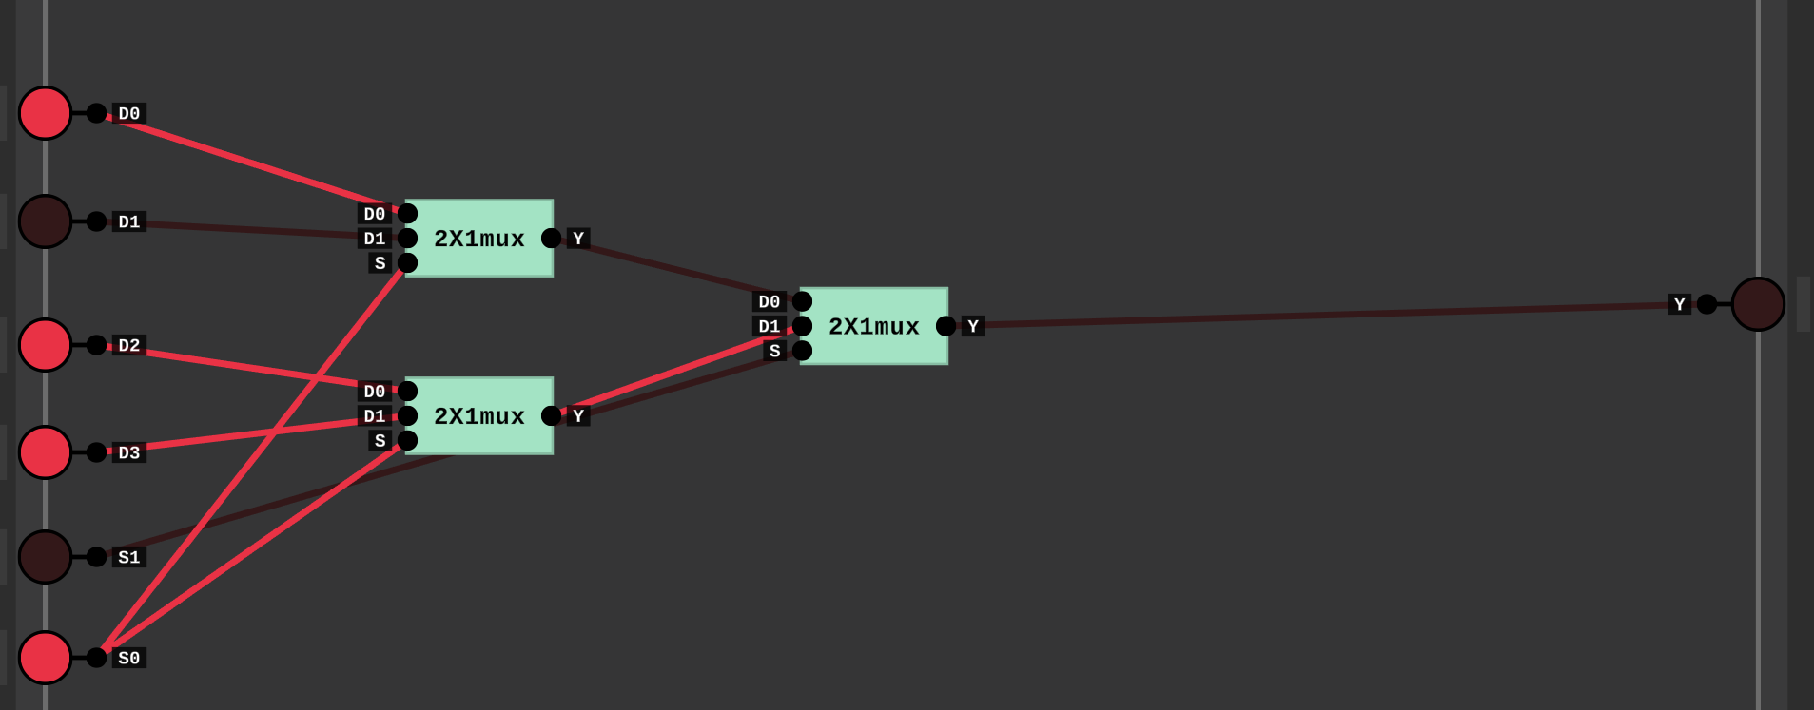
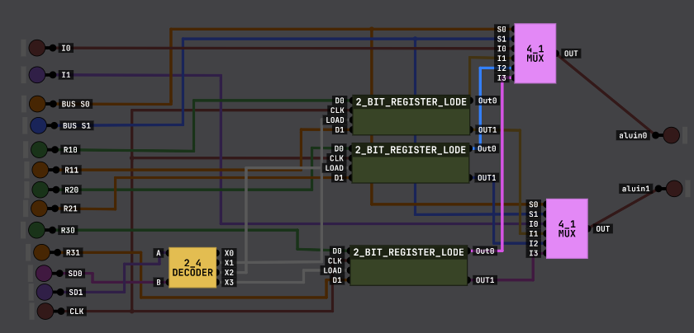
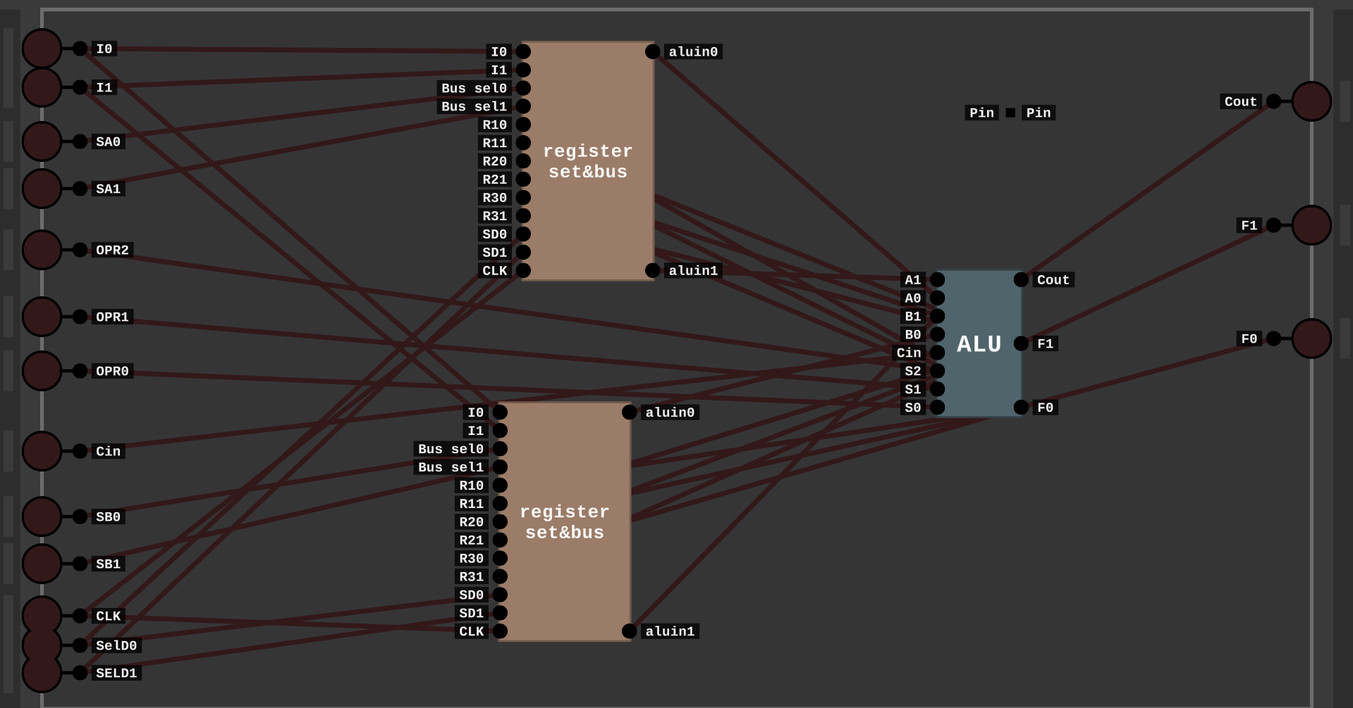

















4:1 Mux
Register set and bus
Final Register Organization

Slide 5
DISSCUSION :
The 2-bit register organization was implemented using registers, multiplexers, a decoder, and an ALU. Control signals were used to select source and destination registers. Data was transferred through buses to the ALU, where operations were performed and results were stored back in the selected register. The simulation confirmed correct operation of all components.
CONCLUSION :
The implementation of the 2-bit register organization was completed successfully. All components, including the register set, decoder, multiplexers, and ALU, functioned correctly according to the design. The control signals effectively managed the selection and operation processes. This project enhanced the understanding of internal CPU data movement and control logic. It demonstrated how registers interact through buses and how the ALU performs operations based on the control word. Overall, the project fulfilled its objective of simulating a working CPU register organization using basic digital design principles.

