Slide 1
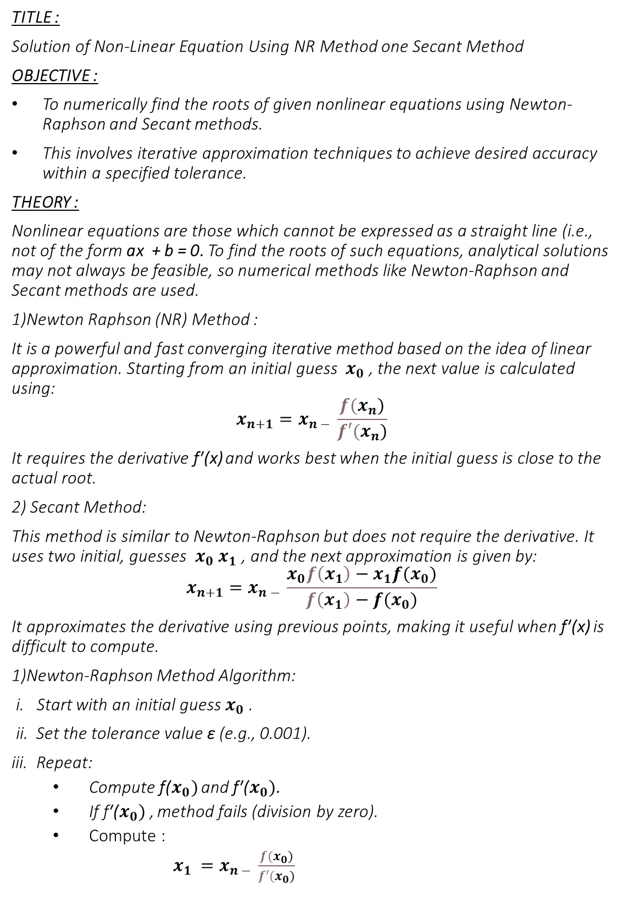
TITLE :
Solution of Non-Linear Equation Using NR Method one Secant Method
OBJECTIVE :
To numerically find the roots of given nonlinear equations using Newton-Raphson and Secant methods.
This involves iterative approximation techniques to achieve desired accuracy within a specified tolerance.
THEORY :
Nonlinear equations are those which cannot be expressed as a straight line (i.e., not of the form ax + b = 0. To find the roots of such equations, analytical solutions may not always be feasible, so numerical methods like Newton-Raphson and Secant methods are used.
1)Newton Raphson (NR) Method :
It is a powerful and fast converging iterative method based on the idea of linear approximation. Starting from an initial guess $x_{0}$ , the next value is calculated using:
$$x_{n+1}=x_{n − }\frac{f(x_{n})}{f′(x_{n})}$$
It requires the derivative f′(x) and works best when the initial guess is close to the actual root.
2) Secant Method:
This method is similar to Newton-Raphson but does not require the derivative. It uses two initial, guesses $x_{0}$ $x_{1}$​, and the next approximation is given by:
$$x_{n+1}=x_{n − }\frac{x_{0}f\left(x_{1}\right)−x_{1}f(x_{0})}{f\left(x_{1}\right)−f(x_{0})}$$
It approximates the derivative using previous points, making it useful when f′(x) is difficult to compute.
1)Newton-Raphson Method Algorithm:
i. Start with an initial guess $x_{0}$ .
ii. Set the tolerance value ε (e.g., 0.001).
iii. Repeat:
Compute f($x_{0})$ and f′($x_{0})$.
If f′($x_{0})$, method fails (division by zero).
Compute :
$x_{1 }=x_{n − }\frac{f(x_{0})}{f′(x_{0})}$

Slide 2
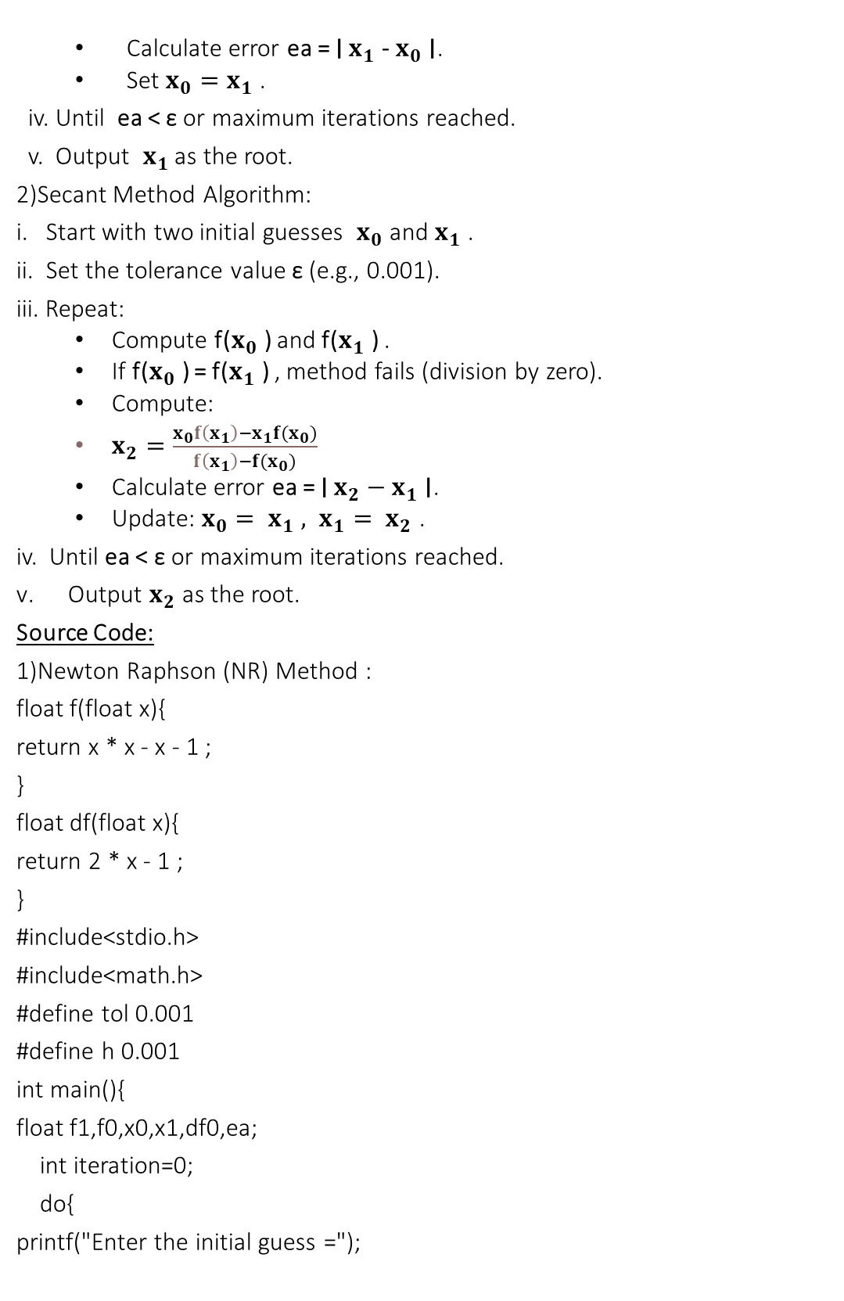
Calculate error ea = ∣ $x_{1}$- $x_{0}$∣.
Set ${x_{0}=x}_{1}$​.
iv. Until ea < ε or maximum iterations reached.
v. Output ​ $x_{1}$ as the root.
2)Secant Method Algorithm:
i. Start with two initial guesses $x_{0}$and $x_{1}$​.
ii. Set the tolerance value ε (e.g., 0.001).
iii. Repeat:
Compute f($x_{0}$) and f($x_{1}$) .
If f($x_{0}$) = f($x_{1}$) , method fails (division by zero).
Compute:
$x_{2}=\frac{x_{0}f\left(x_{1}\right)−x_{1}f(x_{0})}{f\left(x_{1}\right)−f(x_{0})}$
Calculate error ea = ∣ ${x_{2}−x}_{1}$∣.
Update: $x_{0}= x_{1} , x_{1}= x_{2}$​.
iv. Until ea < ε or maximum iterations reached.
Output $x_{2}$as the root.
Source Code:
1)Newton Raphson (NR) Method :
float f(float x){
return x * x - x - 1 ;
}
float df(float x){
return 2 * x - 1 ;
}
#include<stdio.h>
#include<math.h>
#define tol 0.001
#define h 0.001
int main(){
float f1,f0,x0,x1,df0,ea;
int iteration=0;
do{
printf("Enter the initial guess =");

Slide 3
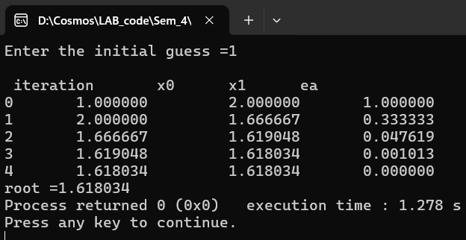
scanf("%f",&x0);
}
while(df(x0) ==0);
printf("\n iteration \t x0\t x1\t ea");
do{
f0=f(x0);
df0=df(x0);
x1=x0-f0/df0;
ea=fabs(x1-x0);
printf("\n%d \t%f \t %f \t%f",iteration,x0,x1,ea);
if(f(x1)==0)
break;
else
x0=x1;
iteration++;
}while(ea>tol);
printf("\nroot =%f",x1);
return 0;
}

Slide 4
2) Secant Method:
#include <stdio.h>
#include <math.h>
#define tol 0.001
float f(float x) {
return x * x - x - 1;
}
float df(float x) {
return 2 * x - 1;
}
int main() {
float x0,x1,f0,f1,x2,f2,ea;
int iteration =0;
while(1){
printf("Enter x0,x1 =");
scanf("%f%f",&x0,&x1);
if(f(x0)!=f(x1))
break;
else
printf("another guess");
printf("\n iteration \t x0\t x1\t ea");
}
do{
f0=f(x0);
f1=f(x1);
x2=(x0*f1-x1*f0)/(f1-f0);
f2=f(x2);
ea=fabs(x2-x1);
printf("\n%d \t%f \t %f \t%f",iteration,x0,x1,ea);
iteration++;

Slide 5
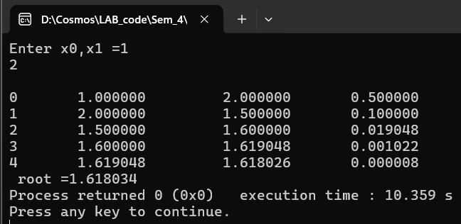
x0=x1;
x1=x2;
}while(ea >tol);
printf("\n root =%f ",x2);
return 0;
}
DISCUSSION AND CONCLUSION
In this lab, we implemented the Newton-Raphson and Secant methods to find the roots of nonlinear equations. The Newton-Raphson method, which used the function’s derivative, converged faster and gave accurate results when the initial guess was close to the root. The Secant method, which did not require the derivative, was easier to apply but converged more slowly. Both methods successfully approximated the roots within the desired tolerance, demonstrating their effectiveness for solving nonlinear equations numerically.

