Slide 1
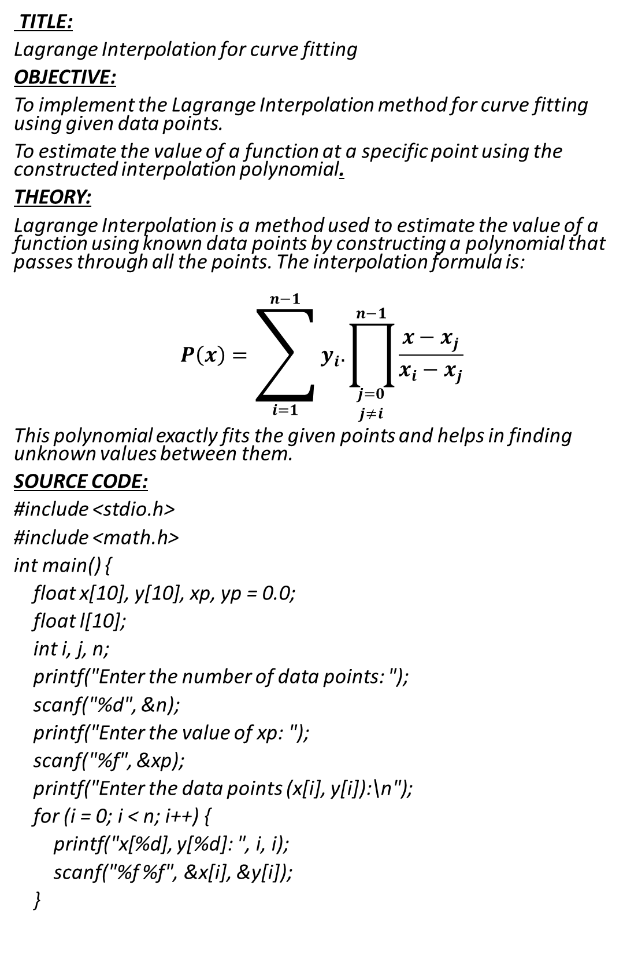
TITLE:
Lagrange Interpolation for curve fitting
OBJECTIVE:
To implement the Lagrange Interpolation method for curve fitting using given data points.
To estimate the value of a function at a specific point using the constructed interpolation polynomial.
THEORY:
Lagrange Interpolation is a method used to estimate the value of a function using known data points by constructing a polynomial that passes through all the points. The interpolation formula is:
$$P\left(x\right)=\sum_{i=1}^{n−1}{y_{i}.\prod_{\begin{aligned}j=0 \\ j≠i\end{aligned}}^{n−1}{\frac{x−x_{j}}{x_{i}−x_{j}}}}$$
This polynomial exactly fits the given points and helps in finding unknown values between them.
SOURCE CODE:
#include <stdio.h>
#include <math.h>
int main() {
float x[10], y[10], xp, yp = 0.0;
float l[10];
int i, j, n;
printf("Enter the number of data points: ");
scanf("%d", &n);
printf("Enter the value of xp: ");
scanf("%f", &xp);
printf("Enter the data points (x[i], y[i]):\n");
for (i = 0; i < n; i++) {
printf("x[%d], y[%d]: ", i, i);
scanf("%f %f", &x[i], &y[i]);
}

Slide 2
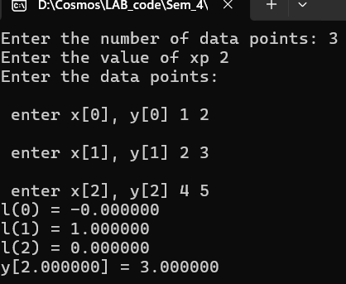
for (i = 0; i < n; i++) {
l[i] = 1.0;
for (j = 0; j < n; j++) {
if (j != i) {
l[i] = l[i] * (xp - x[j]) / (x[i] - x[j]);
}
}
yp += l[i] * y[i];
}
printf("\nLagrange basis polynomial values:\n");
for (i = 0; i < n; i++) {
printf("L[%d] = %.6f\n", i, l[i]);
}
printf("\nInterpolated value at x = %.4f is y = %.6f\n", xp, yp);
return 0;
}
OUTPUT :
DISCUSSION AND CONCLUSION
The Lagrange interpolation method was implemented to estimate the value of a function using given data points. the program successfully calculated the Lagrange basis polynomials and provided an accurate interpolated
value at the desired point. the method effectively demonstrated how curve fitting can be achieved through polynomial interpolation.

