Slide 1


LAB REPORT NO:-0
LAB REPORT ON:-
Eigenvalue and corresponding vector using Power Method
SUMMITTED BY: SUMMITTED TO:
Name:Oshan Bajracharya Department Of ICT
Roll No: 230328 Date of Experiment:
Faculty: BE-Computer 2082-02-19
Group: B Date of Submission:
2082-03-26

Slide 2
TITLE :
Eigenvalue and corresponding vector using Power Method
OBJECTIVE :
To understand and implement the Power Method for finding the largest eigenvalue and its corresponding eigenvector of a square matrix.
To demonstrate the use of iterative numerical techniques in solving eigenvalue problems using C programming.
THEORY :
The Power Method is an iterative technique used to find the largest eigenvalue and its corresponding eigenvector of a square matrix. Starting with an initial vector, the method repeatedly multiplies the matrix with the vector and normalizes the result. Over several iterations, the vector converges to the dominant eigenvector, and the scaling factor gives the dominant eigenvalue.
ALGORITHM:
1)Start
2)Input the order n of the square matrix.
3)Input the matrix A[n][n].
4)Input the initial guess vector X[n].
5)Set tolerance ε (e.g., 0.0001) and initialize eigenvalue λ = 0.
6)Repeat until convergence: a. Multiply Y = A × X b. Find the maximum absolute value in Y as the new λ c. Normalize Y by dividing each element by λ to get the new X d. Check if |λ - Previous_λ| < ε, if yes, break
7)Print the final eigenvalue λ and eigenvector X
8)Stop
SOURCE CODE :
#include <stdio.h>
#include <math.h> #define E 0.001
#define MAX_SIZE 10 int iteration = 0; void MatrixMultiply(float A[MAX_SIZE][MAX_SIZE], float X[MAX_SIZE], float Result[MAX_SIZE], int n) {
for (int i = 0; i < n; i++) {
Result[i] = 0;
for (int j = 0; j < n; j++) {
Result[i] += A[i][j] * X[j];
} } }
float Normalize(float Y[MAX_SIZE], float X[MAX_SIZE], int n) {
float max_val = fabsf(Y[0]);

Slide 3
for (int i = 1; i < n; i++) {
if (fabsf(Y[i]) > max_val) {
max_val = fabsf(Y[i]);
} }
for (int i = 0; i < n; i++) {
X[i] = Y[i] / max_val;
}
return max_val;
}
int main() {
float A[MAX_SIZE][MAX_SIZE], X[MAX_SIZE], Y[MAX_SIZE];
float Lambda_New = 0.0, Lambda_Old = 0.0; int n; printf("Order of Matrix (max %d): ", MAX_SIZE);
scanf("%d", &n); if (n <= 0 || n > MAX_SIZE) {
printf("Invalid matrix order. Please enter a value between 1 and %d.\n",MAX_SIZE);
return 1;
} printf("Enter the elements of the matrix A:\n");
for (int i = 0; i < n; i++) {
for (int j = 0; j < n; j++) {
printf("A[%d][%d]: ", i, j);
scanf("%f", &A[i][j]);
} } printf("\nEnter the elements of the initial eigenvector:\n");
for (int i = 0; i < n; i++) {
printf("X[%d]: ", i);
scanf("%f", &X[i]);
} do {
iteration++;
Lambda_Old = Lambda_New;
MatrixMultiply(A, X, Y, n);
Lambda_New = Normalize(Y, X, n);
} while (fabsf(Lambda_New - Lambda_Old) > E);

Slide 4
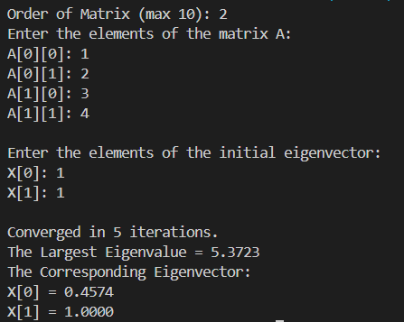
printf("\nConverged in %d iterations.\n", iteration);
printf("The Largest Eigenvalue = %.4f\n", Lambda_New);
printf("The Corresponding Eigenvector:\n");
for (int i = 0; i < n; i++) {
printf("X[%d] = %.4f\n", i, X[i]);
}
return 0;
}
OUTPUT :
DISCUSSION
In this experiment, the Power Method was implemented using C to compute the dominant eigenvalue and its corresponding eigenvector of a square matrix. The method involved repeated multiplication of a matrix with an initial vector, followed by normalization. The process was repeated until the change in eigenvalue between iterations was minimal. The algorithm showed good convergence when the dominant eigenvalue was distinct and the initial guess was appropriate.
CONCLUSION:
The experiment successfully showed how the Power Method can be used to solve eigenvalue problems through an iterative approach. It helped in understanding the concept of convergence and the importance of normalization in numerical methods. The main goal of finding the dominant eigenvalue and eigenvector was achieved using a simple and efficient algorithm.

