Slide 1
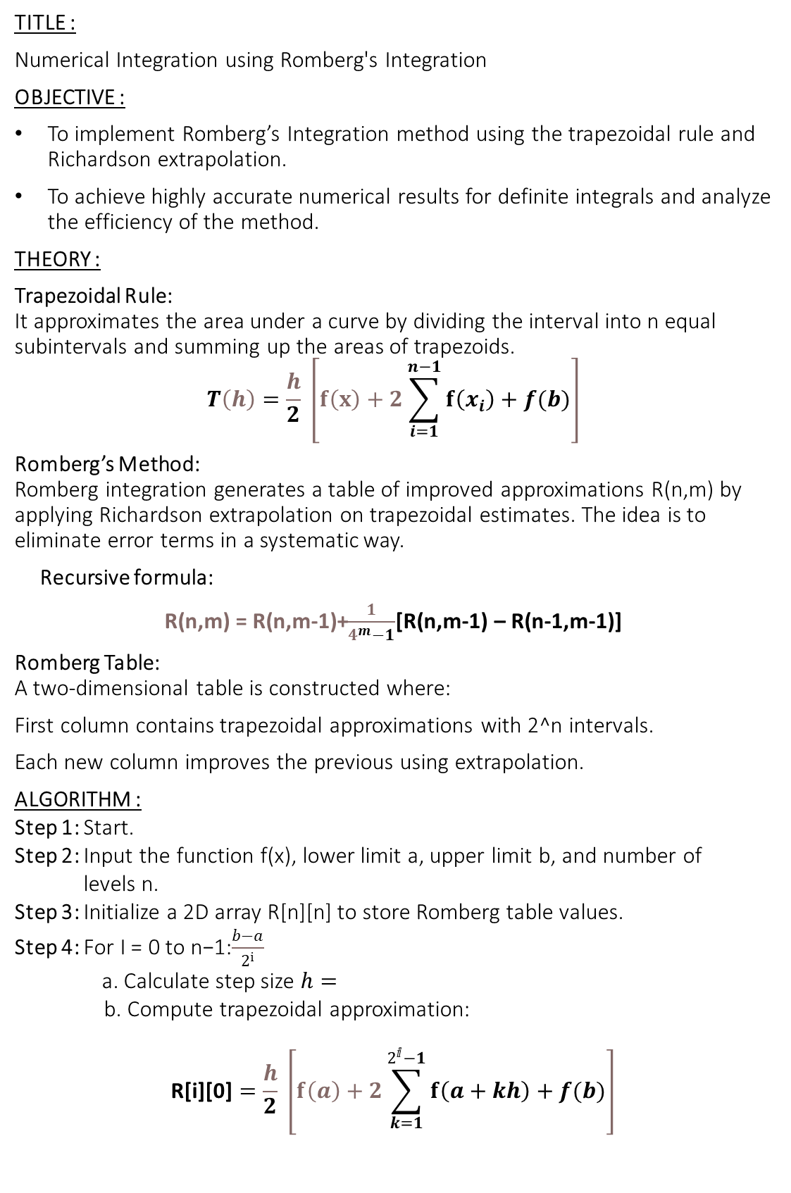
TITLE :
Numerical Integration using Romberg's Integration
OBJECTIVE :
To implement Romberg’s Integration method using the trapezoidal rule and Richardson extrapolation.
To achieve highly accurate numerical results for definite integrals and analyze the efficiency of the method.
THEORY :
Trapezoidal Rule: It approximates the area under a curve by dividing the interval into n equal subintervals and summing up the areas of trapezoids.
$$T\left(h\right)=\frac{h}{2} \left[f\left(x\right)+2\sum_{i=1}^{n−1}{f\left(x_{i}\right)+f(b)}\right]$$
Romberg’s Method: Romberg integration generates a table of improved approximations R(n,m) by applying Richardson extrapolation on trapezoidal estimates. The idea is to eliminate error terms in a systematic way.
Recursive formula:
R(n,m) = R(n,m-1)+$\frac{1}{4^{m}−1}$[R(n,m-1) – R(n-1,m-1)]
Romberg Table: A two-dimensional table is constructed where:
First column contains trapezoidal approximations with 2^n intervals.
Each new column improves the previous using extrapolation.
ALGORITHM :
Step 1: Start.
Step 2: Input the function f(x), lower limit a, upper limit b, and number of
levels n.
Step 3: Initialize a 2D array R[n][n] to store Romberg table values.
Step 4: For I = 0 to n−1:$\frac{b−a}{2^{i}}$
a. Calculate step size $h=$​ b. Compute trapezoidal approximation:
$$\text{R}\text{[}\text{i}\text{][0]}=\frac{h}{2} \left[f\left(a\right)+2\sum_{k=1}^{2^{ⅈ}−1}{f\left(a+kh\right)+f(b)}\right]$$

Slide 2
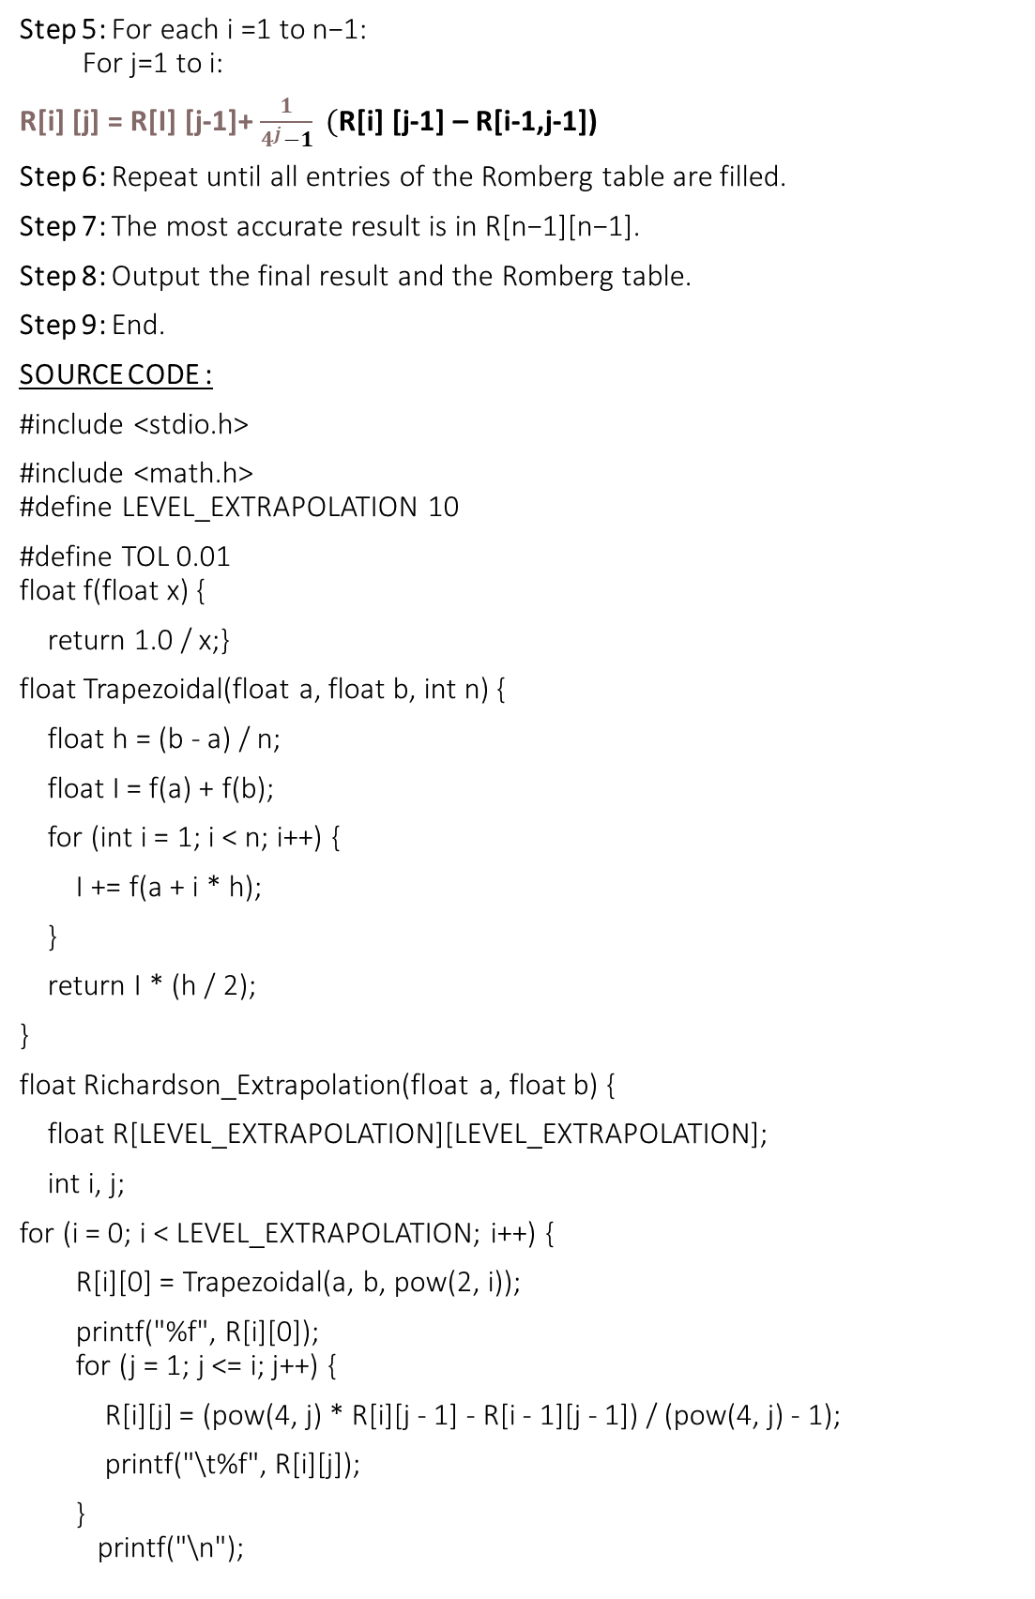
Step 5: For each i =1 to n−1: For j=1 to i:
R[i] [j] = R[I] [j-1]+ $\frac{1}{4^{j}−1} ($R[i] [j-1] – R[i-1,j-1])
Step 6: Repeat until all entries of the Romberg table are filled.
Step 7: The most accurate result is in R[n−1][n−1].
Step 8: Output the final result and the Romberg table.
Step 9: End.
SOURCE CODE :
#include <stdio.h>
#include <math.h> #define LEVEL_EXTRAPOLATION 10
#define TOL 0.01 float f(float x) {
return 1.0 / x;}
float Trapezoidal(float a, float b, int n) {
float h = (b - a) / n;
float I = f(a) + f(b);
for (int i = 1; i < n; i++) {
I += f(a + i * h);
}
return I * (h / 2);
}
float Richardson_Extrapolation(float a, float b) {
float R[LEVEL_EXTRAPOLATION][LEVEL_EXTRAPOLATION];
int i, j;
for (i = 0; i < LEVEL_EXTRAPOLATION; i++) {
R[i][0] = Trapezoidal(a, b, pow(2, i));
printf("%f", R[i][0]); for (j = 1; j <= i; j++) {
R[i][j] = (pow(4, j) * R[i][j - 1] - R[i - 1][j - 1]) / (pow(4, j) - 1);
printf("\t%f", R[i][j]);
} printf("\n");

Slide 3
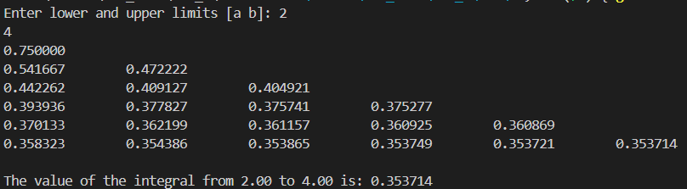
if (i > 0 && fabs(R[i][i] - R[i - 1][i - 1]) < TOL) {
return R[i][i];
}
} return R[LEVEL_EXTRAPOLATION - 1][LEVEL_EXTRAPOLATION - 1];
}
int main() {
float a, b, I;
printf("Enter lower and upper limits [a b]: ");
scanf("%f%f", &a, &b);
I = Richardson_Extrapolation(a, b);
printf("\nThe value of the integral from %.2f to %.2f is: %f\n", a, b, I);
return 0;
}
OUTPUT :
DISCUSSION AND CONCLUSION :
Romberg’s Integration method was successfully implemented to numerically evaluate the definite integral of f(x)=1/X The method used successive trapezoidal approximations combined with Richardson extrapolation to improve accuracy. The program generated a Romberg table and stopped when the result met the given tolerance. The approach provided accurate results efficiently, demonstrating the effectiveness of Romberg’s method for smooth functions.

