Slide 1


LAB REPORT NO:-04
LAB REPORT ON:-
Curve Fitting Using Regression Analysis
SUMMITTED BY: SUMMITTED TO:
Name: Oshan Bajracharya Department Of ICT
Roll No: 230328 Date of Experiment:
Faculty: BE-Computer 2082-02-29
Group: B Date of Submission:
2082-03-05

Slide 2
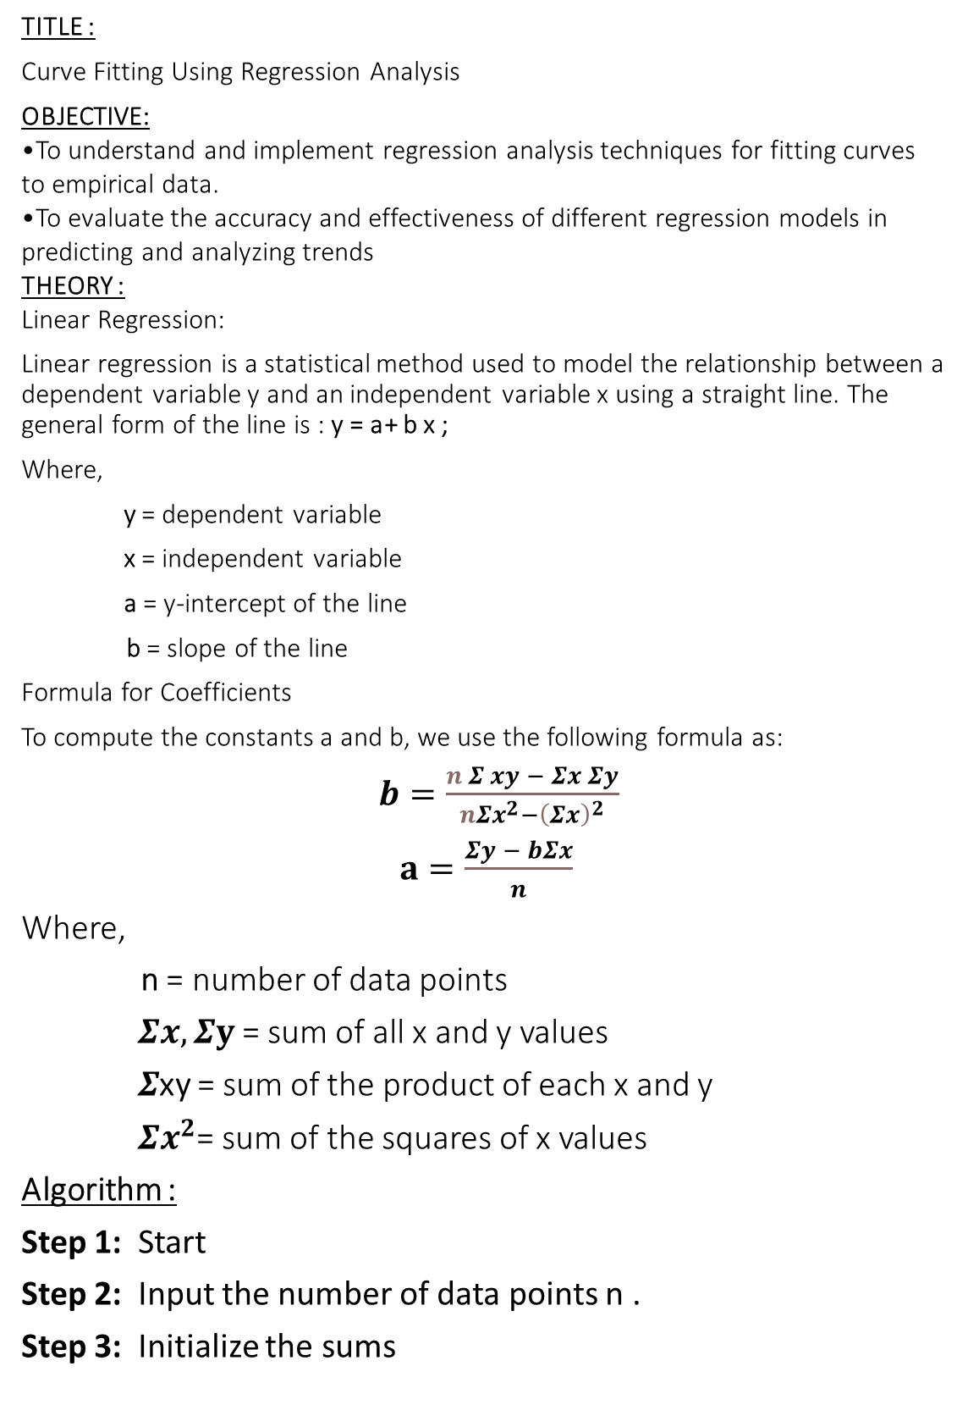
TITLE :
Curve Fitting Using Regression Analysis
OBJECTIVE:
To understand and implement regression analysis techniques for fitting curves to empirical data.
To evaluate the accuracy and effectiveness of different regression models in predicting and analyzing trends
THEORY :
Linear Regression:
Linear regression is a statistical method used to model the relationship between a dependent variable y and an independent variable x using a straight line. The general form of the line is : y = a+ b x ;
Where,
y = dependent variable
x = independent variable
a = y-intercept of the line
b = slope of the line
Formula for Coefficients
To compute the constants a and b, we use the following formula as:
$b=\frac{n Σ xy − Σx Σy}{{nΣx}^{2}−{\left(Σx\right)}^{2}}$
$a=\frac{Σy − bΣx}{n}$
Where,
n = number of data points
$Σx,Σy$= sum of all x and y values
$Σ$xy = sum of the product of each x and y
${ Σx}^{2}$= sum of the squares of x values
Algorithm :
Step 1: Start
Step 2: Input the number of data points n .
Step 3: Initialize the sums

Slide 3
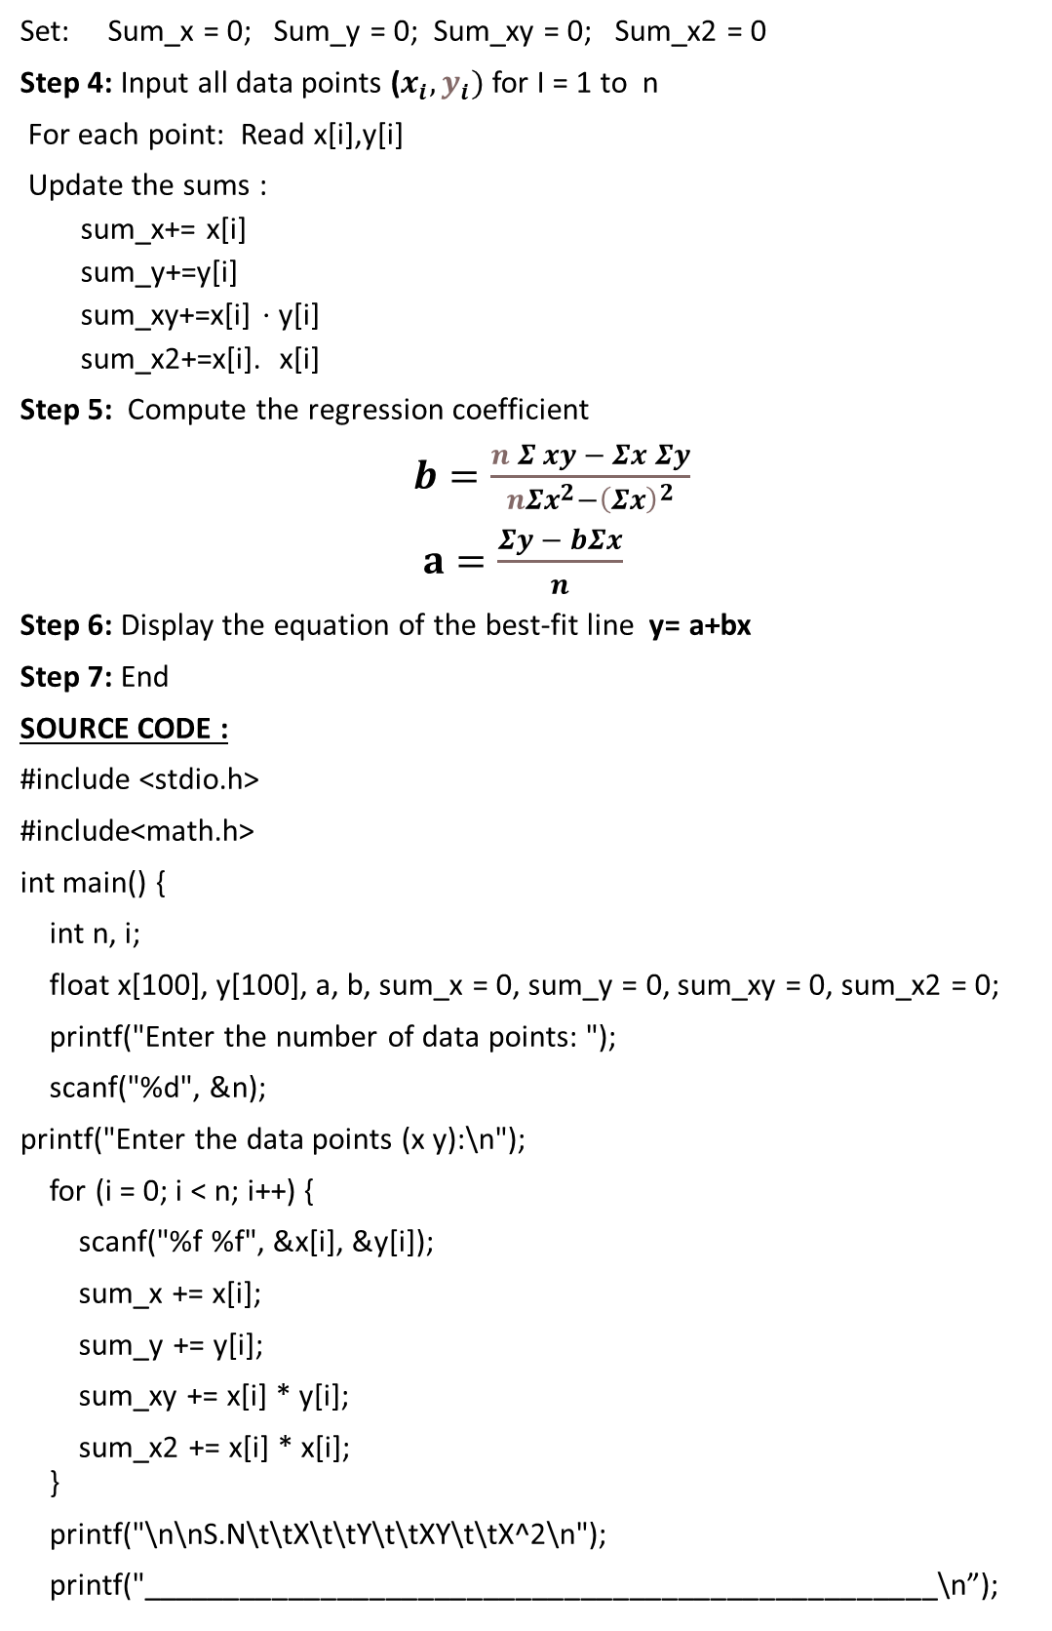
Set: Sum_x = 0; Sum_y = 0; Sum_xy = 0; Sum_x2 = 0
Step 4: Input all data points ($x_{i},y_{i})$ for I = 1 to n
For each point: Read x[i],y[i]
Update the sums :
sum_x+= x[i]
sum_y+=y[i]
sum_xy+=x[i] ⋅ y[i]
sum_x2+=x[i]. x[i]
Step 5: Compute the regression coefficient
$b=\frac{n Σ xy − Σx Σy}{{nΣx}^{2}−{\left(Σx\right)}^{2}}$
$a=\frac{Σy − bΣx}{n}$
Step 6: Display the equation of the best-fit line y= a+bx
Step 7: End
SOURCE CODE :
#include <stdio.h>
#include<math.h>
int main() {
int n, i;
float x[100], y[100], a, b, sum_x = 0, sum_y = 0, sum_xy = 0, sum_x2 = 0;
printf("Enter the number of data points: ");
scanf("%d", &n);
printf("Enter the data points (x y):\n");
for (i = 0; i < n; i++) {
scanf("%f %f", &x[i], &y[i]);
sum_x += x[i];
sum_y += y[i];
sum_xy += x[i] * y[i];
sum_x2 += x[i] * x[i]; }
printf("\n\nS.N\t\tX\t\tY\t\tXY\t\tX^2\n");
printf("_________________________________________________\n”);

Slide 4
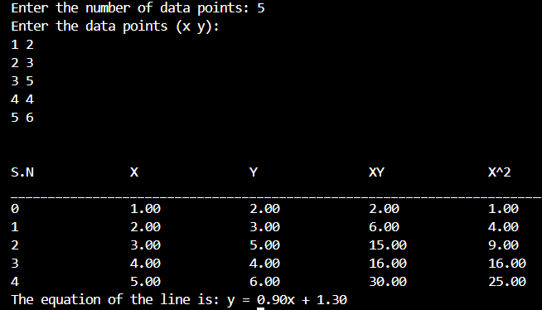
for (i = 0; i < n; i++) {
printf("%d\t\t%.2f\t\t%.2f\t\t%.2f\t\t%.2f\n",i, x[i], y[i], x[i] * y[i], x[i] * x[i]); }
b = (n * sum_xy - sum_x * sum_y) / (n * sum_x2 - sum_x * sum_x);
a = (sum_y - b * sum_x) / n; printf("The equation of the line is: y = %.2fx + %.2f\n", b, a); return 0;
}
OUTPUT :
//log10(y) = log10(a) + b * log10(x)
#include <stdio.h>
#include<math.h>
int main() {
int n, i;
float x[100], y[100], a, b, A, B, sum_x = 0, sum_y = 0, sum_xy = 0,
sum_x2 = 0;
printf("Enter the number of data points: ");
scanf("%d", &n);
printf("Enter the data points (x y):\n");
for (i = 0; i < n; i++) {
scanf("%f %f", &x[i], &y[i]);
sum_x += log(x[i]);
sum_y += log(y[i]);
sum_xy += log(x[i]) * log(y[i]);
sum_x2 += log(x[i]) * log(x[i]);

Slide 5
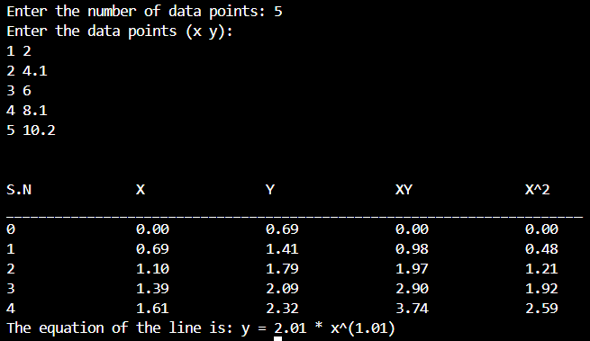
}
printf("\n\nS.N\t\tX\t\tY\t\tXY\t\tX^2\n");
printf("______________________________________________\ n");
for (i = 0; i < n; i++) {
printf("%d\t\t%.2f\t\t%.2f\t\t%.2f\t\t%.2f\n", i, log(x[i]), log(y[i]), log(x[i]) * log(y[i]), log(x[i]) * log(x[i])); }
b = (n * sum_xy - sum_x * sum_y) / (n * sum_x2 - sum_x * sum_x);
A = (sum_y - b * sum_x) / n;
a = exp(A);
printf("The equation of the line is: y = %.2fx^(%.2f)\n", b, a); return 0;
}
OUTPUT :
DISCUSSION & CONCLUSION :
The analysis was conducted to fit the curve using regression techniques. The data points were collected and transformed using logarithmic scales to linearize the relationship. Calculations were performed to determine the coefficients of the model, which successfully represented the relationship between variables. The results showed that the fitted equation accurately described the data trend, confirming the effectiveness of the method. Overall, the approach was validated and provided reliable predictions based on the observed data.

