Slide 1

A Project Proposal
On
CHATBOT INTEGRATION USING N8N WORKFLOW
Sangat Maharjan(230331)
Oshan Bajracharya(230328)
Jikmet Lama(230318)
Subodh Upreti(230335)
Department
ICT ,Cosmos College of Management and Technology

Slide 2
CONTENTS
INTRODUCTION
PROBLEM STATEMENT
OBJECTIVES
SCOPE OF RESEARCH
LITERATURE REVIEW
METHODOLOGY
EXPECTED OUTCOMES
1

Slide 3
Visual Suggestion: Include a background image of elegant jewelry or a sleek website interface.
INTRODUCTION
The way businesses interact with their customers has transformed drastically, with artificial intelligence (AI) playing a key role in this evolution. One such transformation is the adoption of AI-powered chatbots, which offer real-time, intelligent, and automated customer engagement. E-commerce platforms, in particular, are in boom recently and have benefited significantly from chatbot integration, enabling them to handle customer queries, provide personalized recommendations, and streamline user interactions without the need for constant human intervention.
This project proposes the integration of an AI-powered chatbot into the existing jewelry website using n8n, a powerful open-source workflow automation tool. The chatbot will serve as a virtual assistant capable of answering customer queries, providing product-related information, assisting with appointment bookings, and more. By leveraging n8n’s automation capabilities, the chatbot will not only respond intelligently but also perform backend tasks such as logging user inputs, sending emails, and updating records. The goal is to enhance user engagement, reduce manual workload, and improve overall customer satisfaction through a scalable and efficient system.
2

Slide 4
Problem Statement
In the competitive world of online retail, especially in industries like jewelry where trust and personalization are paramount. Visitors often have queries about product availability, pricing, and appointments. Despite the growing demand for instant support and personalized service in e-commerce, many small to medium-sized jewelry businesses lack the infrastructure to meet these expectations effectively. Manual responses are not scalable and are limited to business hours.
The current jewelry website, developed using the Blanxer platform, operates without any form of automated support or live chat capabilities. Visitors to the website who have questions regarding product details, pricing, availability, or appointment bookings must either wait for manual responses or navigate the site independently, which can lead to frustration and drop-offs. This creates a significant gap in the user experience and hinders the business’s ability to convert casual browsers into loyal customers.
3

Slide 5
OBJECTIVES
To develop and embed an AI-powered chatbot capable of handling basic customer interactions, such as product inquiries, appointment bookings, and frequently asked questions.
To leverage n8n’s workflow automation capabilities to perform backend tasks, including sending automated email confirmations, logging customer queries, and updating internal records.
To ensure 24/7 customer support availability through the chatbot, thereby reducing dependency on manual responses and improving response time.
To enhance the overall user experience on the website by providing instant, relevant, and intelligent assistance.
4

Slide 6
Scope of Research
Our Research emphasizes on defining both the technical and functional aspects. The project focuses on the design and implementation a chatbot which will be connected to backend automation workflows developed using the n8n tool. This scope includes creating chatbot dialogues to handle customer inquiries related to product availability, appointment bookings, frequently asked questions, and basic product guidance.
From a backend perspective, the research will cover the creation of workflows that automate responses, log user data, trigger email notifications, and update simple databases.
However, the scope does not extend to training custom machine learning models or integrating advanced AI features such as predictive analytics or voice-based interaction
5

Slide 7
Literature Review
Related Work
n8n Automation in Web Applications
Kaur (2023) demonstrated the role of n8n as a low-code automation tool that streamlines key backend processes like email handling, data logging, and API integration. This makes it especially useful for small web platforms aiming for scalability with minimal resources.
Flourishment of Customer Engagement
Similarly, Salesforce (2023) highlighted that AI chatbots improve engagement and satisfaction, with over 60% of customers preferring messaging-based support. The integration of a chatbot into the jewelry website ensures round-the-clock support and a smoother user experience, which directly impacts business growth.
6

Slide 8
Literature review
Research by Gartner (2024) indicates that AI chatbots can increase online sales conversion rates by up to 30% by providing instant responses and tailored recommendations, reducing customer wait times, and automating routine inquiries. Such benefits have encouraged many small and medium-sized enterprises to adopt chatbot technologies to stay competitive in the digital marketplace.
7

Slide 9
Literature Review
Related Theory
Automated Theory
Automation Theory focuses on how tasks traditionally done by humans can be delegated to machines or systems — improving efficiency, consistency, and scalability. In context of this project, automation theory underpins the idea that repetitive, rule-based tasks — such as responding to product inquiries, booking the products, and sending follow-up responses — can and should be automated using tools like n8n.
8

Slide 10
Literature review
Related Theory
Information Processing Theory
This theory explains how humans process information — how they perceive, interpret, store, and retrieve it. It is rooted in cognitive psychology and often compares the brain to a computer. In context to this project, the chatbot acts as a smart filter that simplifies user input and presents only the relevant information, making decision-making easier for users.
In summary, existing literature underscores the effectiveness of AI chatbots in improving customer engagement and operational efficiency, as well as the growing role of automation tools like n8n in enabling these technologies. This project builds upon these foundations by applying proven tools and methodologies to the specific context of a jewelry e-commerce website, aiming to enhance both user experience and business outcomes.
9

Slide 11
Methodology
Phase 1: Setting up Chatbot Interface. The first step involves selecting and setting up the chatbot interface that will interact with users on the jewelry website. Depending on available resources and complexity, options include no-code chatbot builders such as Landbot or Dialogflow, or an API-based integration with a large language model (e.g., OpenAI’s GPT). The chatbot will be designed to handle basic customer interactions including product inquiries, appointment scheduling, frequently asked questions, and general guidance. The user interface will be embedded seamlessly within the Blanxer-built website to ensure consistent branding and accessibility.
10

Slide 12
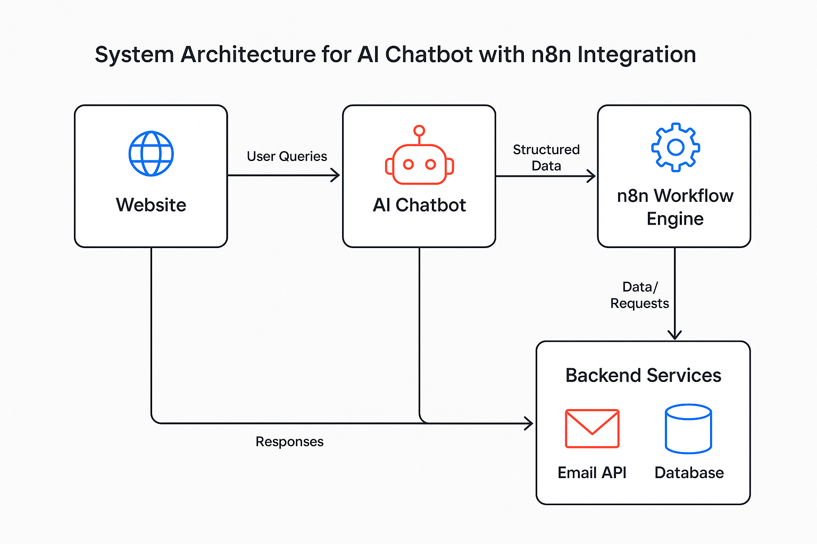
Methodology
11

Slide 13
Methodology
Phase 2: Workflow Automation Using n8n. In this phase, the n8n workflow automation platform will be utilized to create backend workflows triggered by chatbot inputs. These workflows will automate tasks such as: sending confirmation emails for appointments, logging customer queries in spreadsheets or databases, updating internal records, and potentially notifying human agents when required. n8n’s flexible, node-based system will allow for easy configuration and integration of APIs and services, facilitating smooth data exchange between the chatbot and backend systems.
12

Slide 14
Methodology
Phase 3: Testing , Feedback Collection and Iteration. After integration, comprehensive testing will be conducted to ensure the chatbot and workflows function as intended across various scenarios. User feedback will be gathered to identify issues related to chatbot understanding, response accuracy, and workflow reliability. Based on this feedback, iterative improvements will be made to enhance performance, usability, and customer satisfaction.
13

Slide 15
Expected Outcomes
The successful implementation of this project is anticipated to yield seamless chatbot integration providing a 24/7 assistance. This instant support is expected to enhance user experience by reducing wait times and offering personalized guidance.
Additionally, the use of n8n workflow automation will streamline backend processes such as sending automated email confirmations, logging customer interactions, and maintaining updated records.
Increased customer satisfaction resulting in flourishment of higher engagement and sales. Laying out a foundation for future AI upgrades which is to include more advanced features such as personalized product recommendations, order tracking, and live agent handoff.
14

Slide 16
References
[1]Gartner (2024). "Conversational AI in E-Commerce."
[2]Salesforce Research (2023). "Customer Service Trends."
[3]n8n Documentation. https://docs.n8n.io
[4]Blanxer Platform Docs. https://blanxer.com/docs
[5] OpenAI API IntegrationGuide.https://platform.openai.com/docs
15

