Slide 1
Capstone III Presentation
Project: Analysis of Account Balances of Clients
Presented by: Lemmy Oshenye

Slide 2
The dataset
The dataset being used contains scores from high school students in the U.S. For reference, the original dataset is here.
There are 45211 records across 17 fields, but there are only four fields being used in this analysis, as follows:
Marital
Education
Age
Balance

Slide 3
The research questions
There are two questions that will be addressed in this analysis.
Is there any correlation between age and account balance?
Is there a significant difference between account balance for clients who are single versus married or who have secondary versus tertiary education level?

Slide 4
The hypotheses
There are two hypotheses related to the previous research questions, as follows:
Hypothesis #1: The client age and account balance are not correlated. This means that a client who is older is not likely to have a higher balance than a younger client and vice versa .
Hypothesis #2: The marital status (single vs. married) has no impact on account balance. There will be no significant difference observed but the education level has an impact on account balance therefore there will be a significant difference observed.

Slide 5
How will the data test the hypotheses?
The data will be used to test the hypotheses in the following way:
Visualizations will show whether there is a correlation between account balance and age of clients
t-tests will show the significance of account balance differences for different types of marital status and education level

Slide 6
How will the findings be used?
This can be applicable to my recent job role as a business analyst at a Bank. I believe my employer will be interested in knowing the following:
Do clients save more with age?
Does the education level or marital status of clients allow them to accumulate more money or save more?
Knowing these things will be helpful in targeting products toward improving revenue .

Slide 7
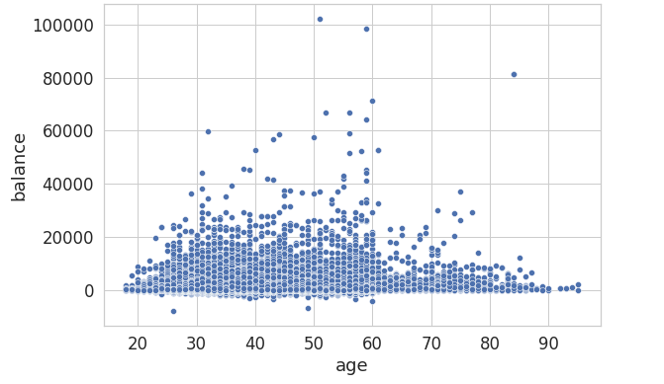
The analyses – hypothesis #1
For hypothesis #1, visualization were used to show whether there is a correlation between account balance and age of clients:
The visualization show strong correlations between each of the three subjects.

Slide 8
The analyses – hypothesis #2
For hypothesis #2, an independent samples t-test was used to support the hypothesis that the marital status has no impact on account balance but the education level has an impact on account balance.
The t-stat and p-values for education level and education level were as follows:
Marital Status
Statistic =- 3.7947482407889943, p-value = 0.00014801100623716576
Education level
statistic=-17.97585793512124, p-value = 6.158616290344418e-72
The t-test rejected the hypothesis that the the marital status has no impact on clients account balances but the education level has an impact on account balance. In fact, there is statistical evidence to the contrary! They both have an impact!

Slide 9
Project summary
Hypothesis #1 has been confirmed. There is no correlation between age and account balance. Older clients are not likely to have a higher balance than younger clients and vice versa .
Hypothesis #2 has been rejected. There is strong statistical evidence that married clients and clients with tertiary education level have better account balances.
For reference:
The proposal is here.
The Colab Notebook is here.

