Slide 1
Lecture 2
Summarizing the Sample

Slide 2
WARNING: Today’s lecture may bore some of you…
It’s (sort of) not my fault…I’m required to teach you about what we’re going to cover today.

Slide 3
I’ll try to make it as exciting as possible…
But you’re more than welcome to fall asleep if you feel like this stuff is too easy

Slide 4
Lecture Summary
Once we obtained our sample, we would like to summarize it.
Depending on the type of the data (numerical or categorical) and the dimension (univariate, paired, etc.), there are different methods of summarizing the data.
Numerical data have two subtypes: discrete or continuous
Categorical data have two subtypes: nominal or ordinal
Graphical summaries:
Histograms: Visual summary of the sample distribution
Quantile-Quantile Plot: Compare the sample to a known distribution
Scatterplot: Compare two pairs of points in X/Y axis.

Slide 5
Three Steps to Summarize Data
Classify sample into different type
Depending on the type, use appropriate numerical summaries
Depending on the type, use appropriate visual summaries

Slide 6
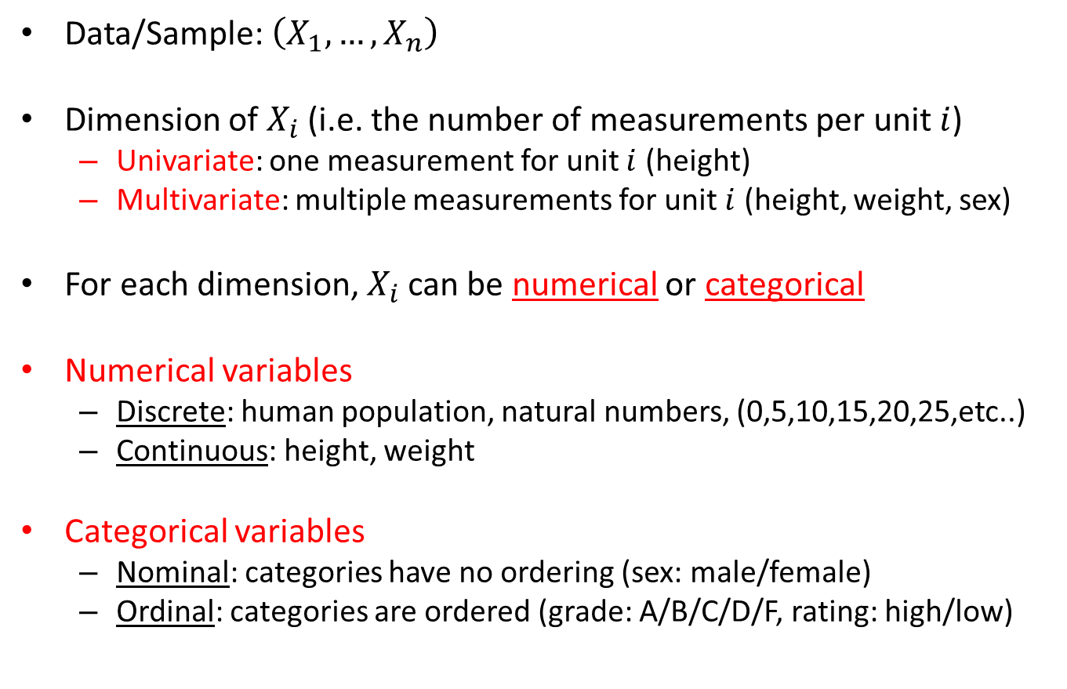
Data Classification
Data/Sample: $\left(X_{1},…,X_{n}\right)$
Dimension of $X_{i}$ (i.e. the number of measurements per unit $i$)
Univariate: one measurement for unit $i$ (height)
Multivariate: multiple measurements for unit $i$ (height, weight, sex)
For each dimension, $X_{i}$ can be numerical or categorical
Numerical variables
Discrete: human population, natural numbers, (0,5,10,15,20,25,etc..)
Continuous: height, weight
Categorical variables
Nominal: categories have no ordering (sex: male/female)
Ordinal: categories are ordered (grade: A/B/C/D/F, rating: high/low)

Slide 7
Data Types
For each dimension…
Numerical
Categorical
Continuous
Discrete
Nominal
Ordinal

Slide 8
Summaries for numerical data
Center/location: measures the “center” of the data
Examples: sample mean and sample median
Spread/Dispersion: measures the “spread” or “fatness” of the data
Examples: sample variance, interquartile range
Order/Rank: measures the ordering/ranking of the data
Examples: order statistics and sample quantiles

Slide 9
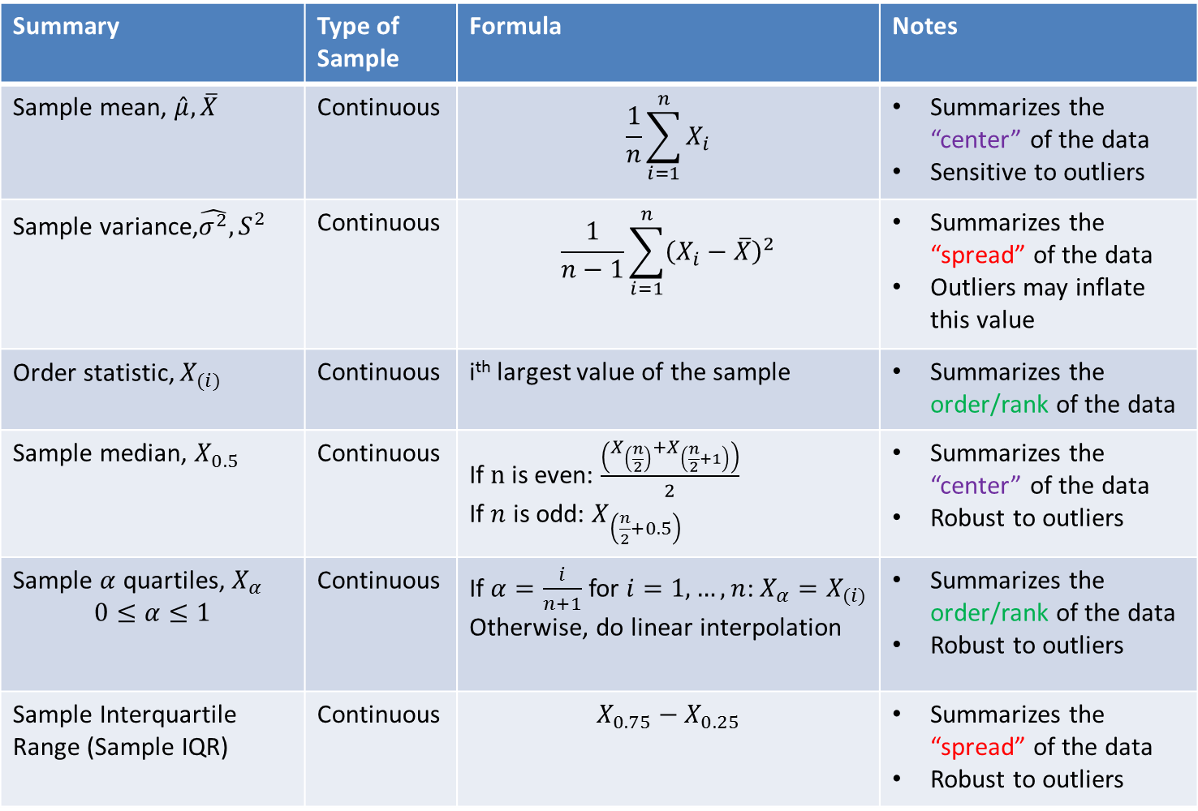
Summary | Type of Sample | Formula | Notes
Sample mean, $\hat{μ},\overline{X}$ | Continuous | $$\frac{1}{n}\sum_{i=1}^{n}{X_{i}}$$ | Summarizes the “center” of the data Sensitive to outliers
Sample variance,$\hat{σ^{2}},S^{2}$ | Continuous | $$\frac{1}{n−1}\sum_{i=1}^{n}{{\left(X_{i}−\overline{X}\right)}^{2}}$$ | Summarizes the “spread” of the data Outliers may inflate this value
Order statistic, $X_{(i)}$ | Continuous | i^{th} largest value of the sample | Summarizes the order/rank of the data
Sample median, $X_{0.5}$ | Continuous | If $n$ is even: $\frac{\left(X_{\left(\frac{n}{2}\right)}+X_{\left(\frac{n}{2}+1\right)}\right)}{2}$ If $n$ is odd: $X_{\left(\frac{n}{2}+0.5\right)}$ | Summarizes the “center” of the data Robust to outliers
Sample $α$ quartiles, $X_{α}$ $$0≤α≤1$$ | Continuous | If $α=\frac{i}{n+1}$ for $i=1,…,n$: $X_{α}=X_{(i)}$ Otherwise, do linear interpolation | Summarizes the order/rank of the data Robust to outliers
Sample Interquartile Range (Sample IQR) | Continuous | $$X_{0.75}−X_{0.25}$$ | Summarizes the “spread” of the data Robust to outliers

Slide 10
Multivariate numerical data
Each dimension in multivariate data is univariate and hence, we can use the numerical summaries from univariate data (e.g. sample mean, sample variance)
However, to study two measurements and their relationship, there are numerical summaries to analyze it
Sample Correlation and Sample Covariance

Slide 11
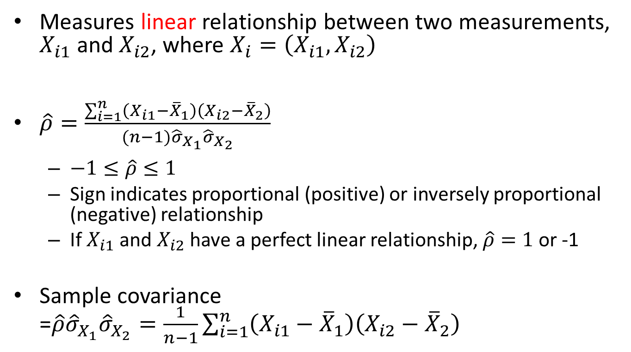
Sample Correlation and Covariance
Measures linear relationship between two measurements, $X_{i1}$ and $X_{i2}$, where $X_{i}=\left(X_{i1},X_{i2}\right)$
$\hat{ρ}=\frac{\sum_{i=1}^{n}{\left(X_{i1}−{\overline{X}}_{1}\right)\left(X_{i2}−{\overline{X}}_{2}\right)}}{(n−1){\hat{σ}}_{X_{1}}{\hat{σ}}_{X_{2}}}$
$−1≤\hat{ρ}≤1$
Sign indicates proportional (positive) or inversely proportional (negative) relationship
If $X_{i1}$ and $X_{i2}$ have a perfect linear relationship, $\hat{ρ}=1$ or -1
Sample covariance =$\hat{ρ}{\hat{σ}}_{X_{1}}{\hat{σ}}_{X_{2}}=\frac{1}{n−1}\sum_{i=1}^{n}{\left(X_{i1}−{\overline{X}}_{1}\right)\left(X_{i2}−{\overline{X}}_{2}\right)}$

Slide 12
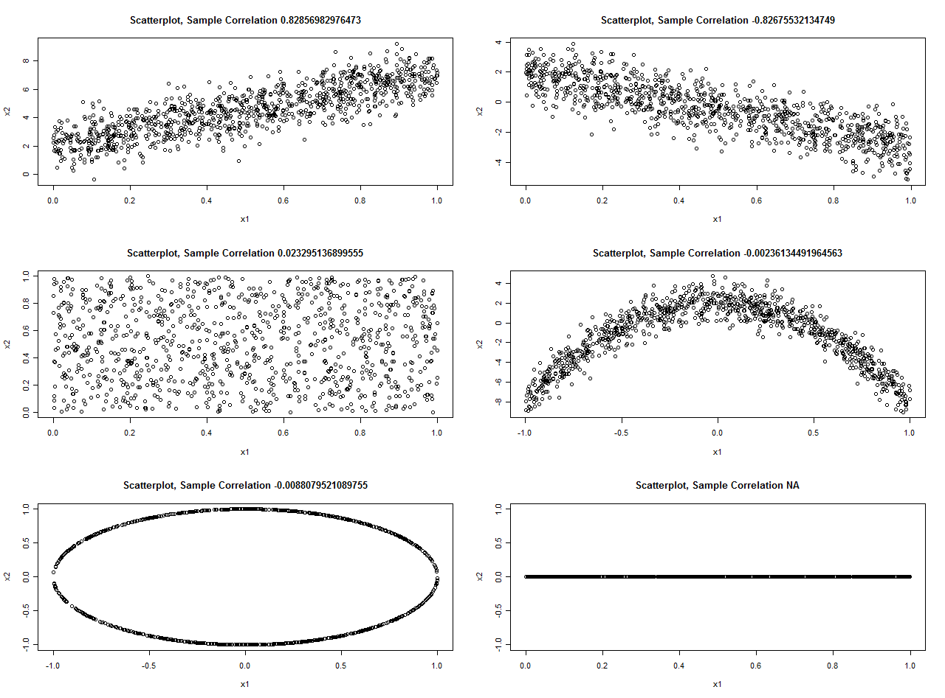

Slide 13
How about categorical data?

Slide 14
Summaries for categorical data
Frequency/Counts: how frequent is one category
Generally use tables to count the frequency or proportions from the total
Example: Stat 431 class composition
a
 | Undergrad | Graduate | Staff
Counts | 17 | 1 | 2
Proportions | 0.85 | 0.05 | 0.1

Slide 15
Are there visual summaries of the data?
Histograms, boxplots, scatterplots, and QQ plots

Slide 16
Histograms
For numerical data
A method to show the “shape” of the data by tallying frequencies of the measurements in the sample
Characteristics to look for:
Modality: Uniform, unimodal, bimodal, etc.
Skew: Symmetric (no skew), right/positive-skewed, left/negative-skewed distributions
Quantiles: Fat tails/skinny tails
Outliers

Slide 17
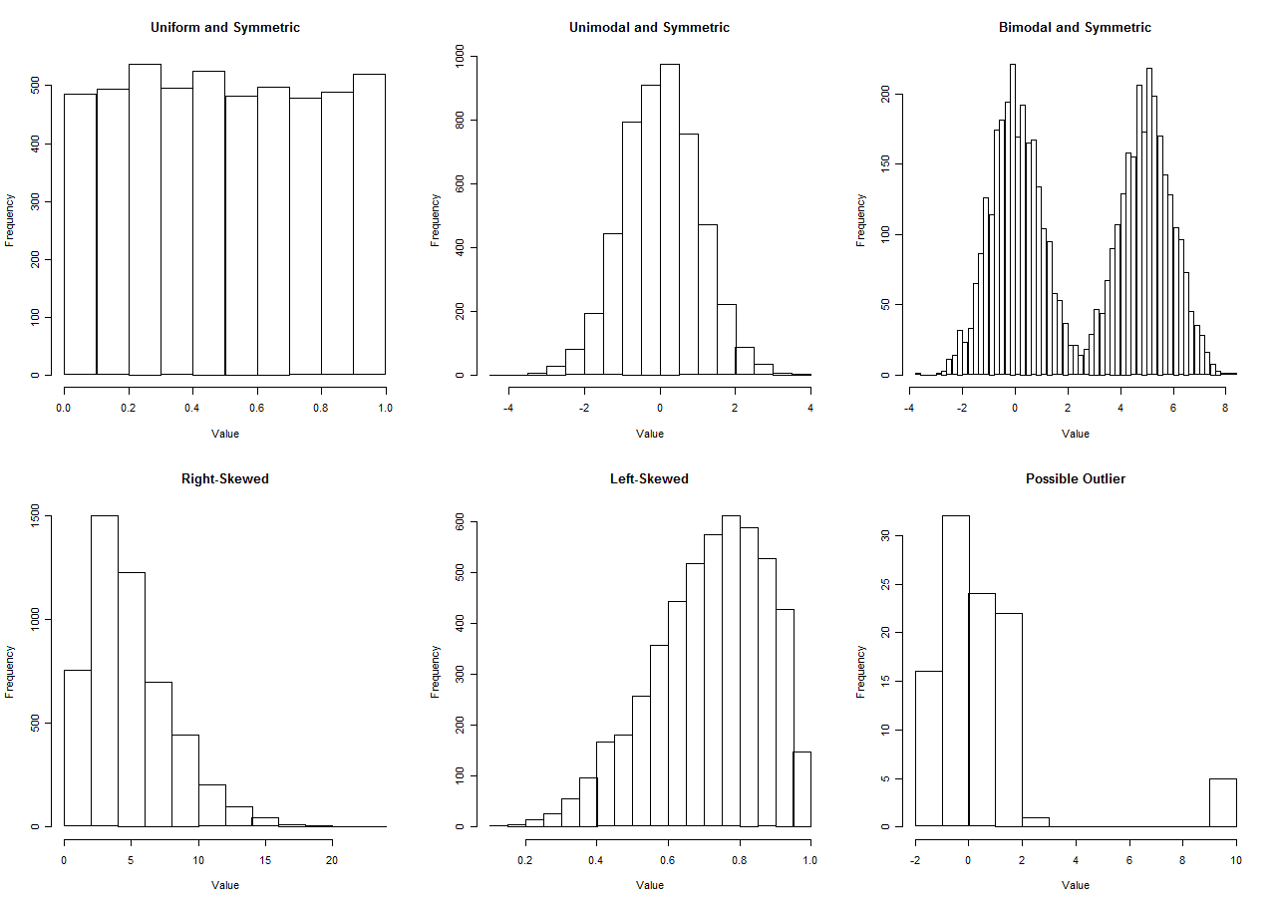

Slide 18
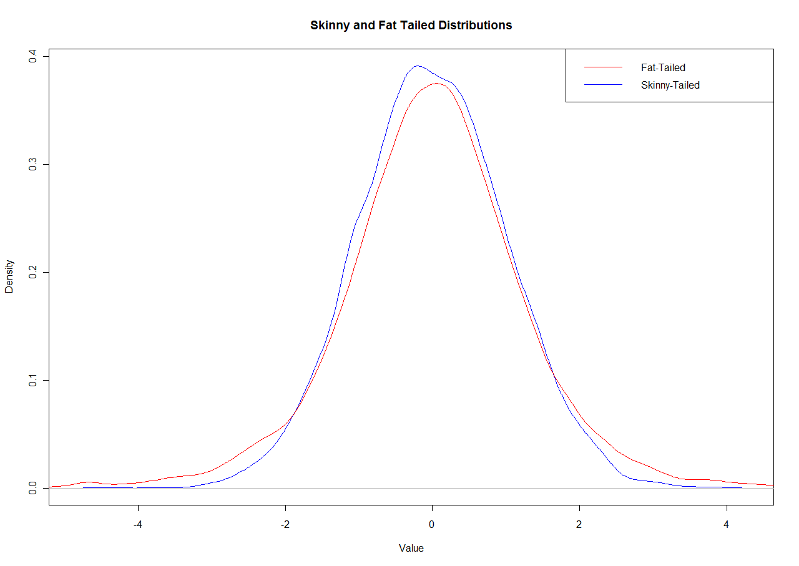

Slide 19
Boxplots
For numerical data
Another way to visualize the “shape” of the data. Can identify…
Symmetric, right/positive-skewed, and left/negative-skewed distributions
Fat tails/skinny tails
Outliers
However, boxplots cannot identify modes (e.g. unimodal, bimodal, etc.)

Slide 20
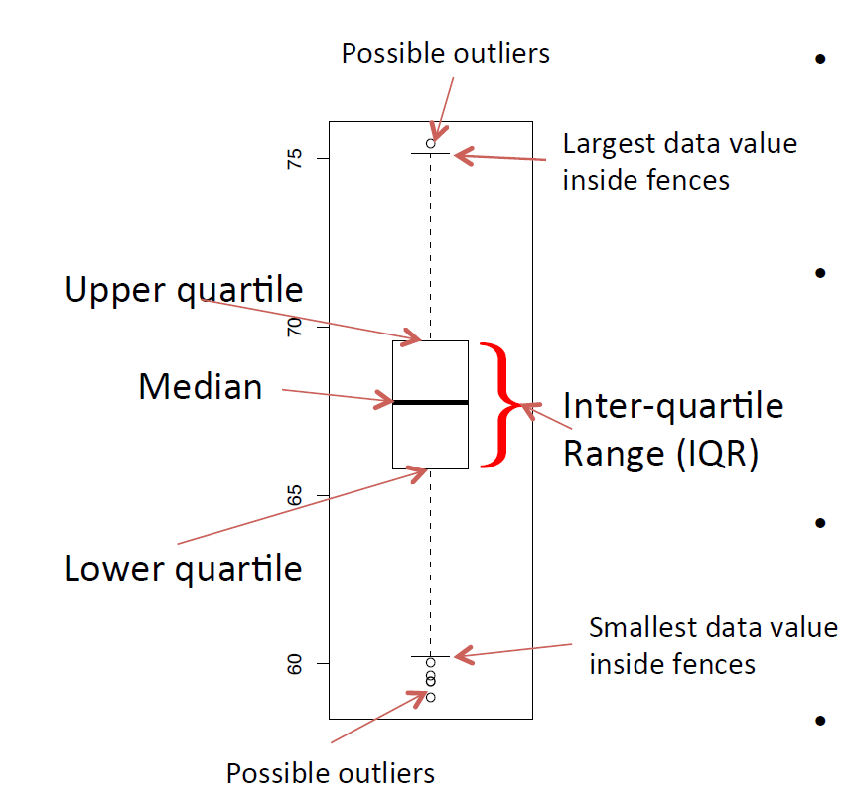
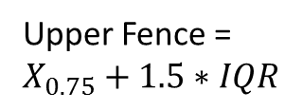
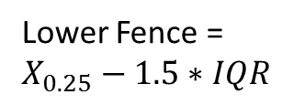
Upper Fence = $X_{0.75}+1.5∗IQR$
Lower Fence = $X_{0.25}−1.5∗IQR$

Slide 21
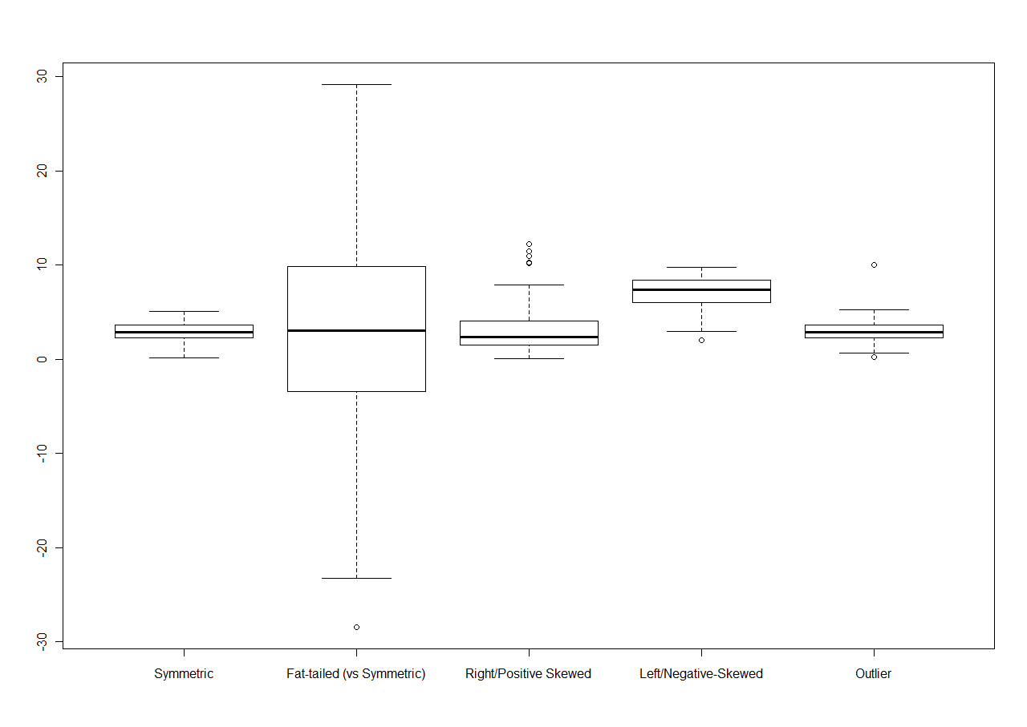

Slide 22
Quantile-Quantile Plots (QQ Plots)
For numerical data: visually compare collected data with a known distribution
Most common one is the Normal QQ plots
We check to see whether the sample follows a normal distribution
This is a common assumption in statistical inference that your sample comes from a normal distribution
Summary: If your scatterplot “hugs” the line, there is good reason to believe that your data follows the said distribution.

Slide 23
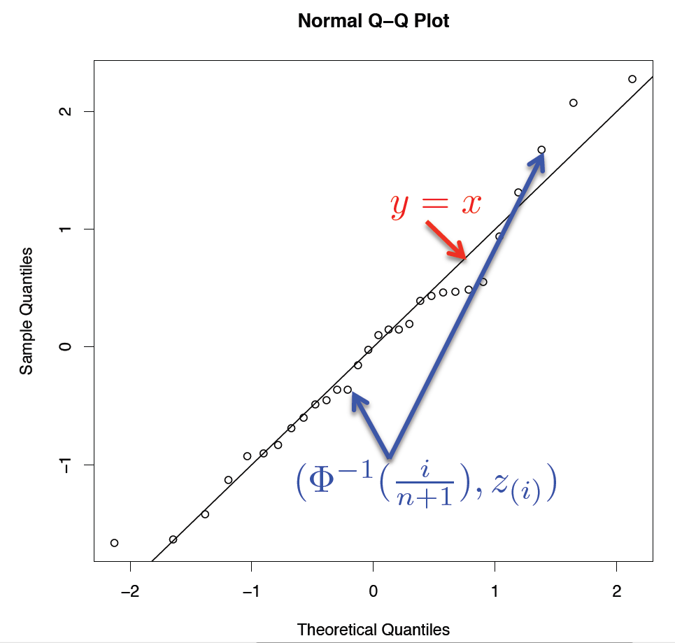

Slide 24
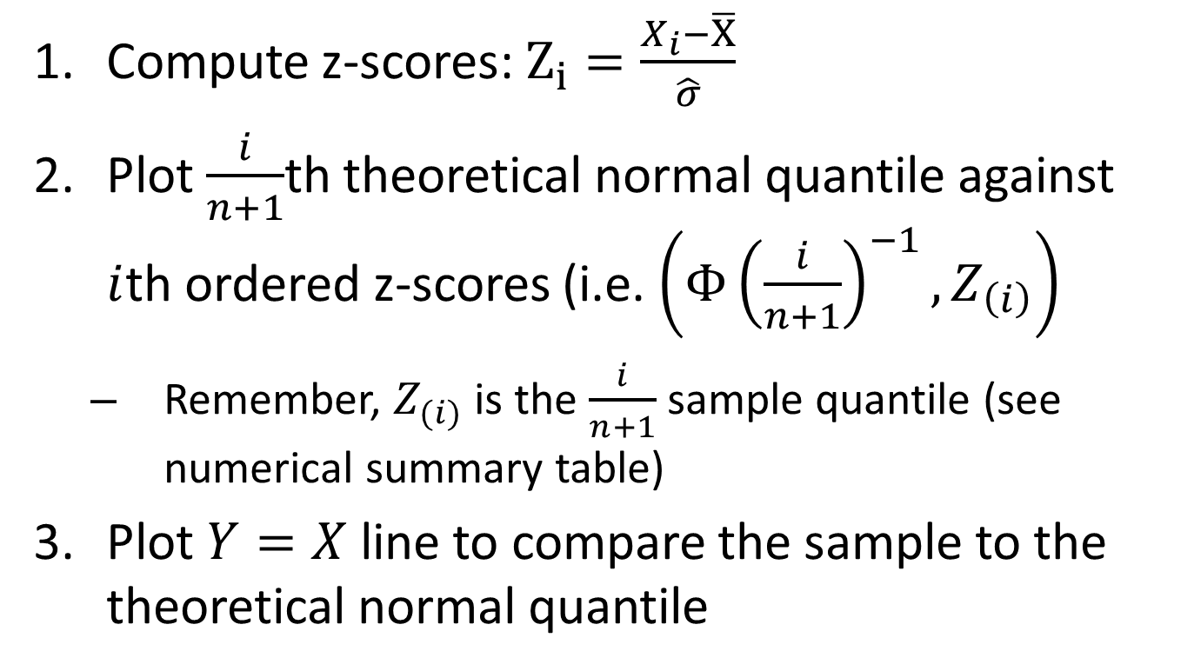
Making a Normal QQ plot
Compute z-scores: $Z_{i}=\frac{X_{i}−\overline{X}}{\hat{σ}}$
Plot $\frac{i}{n+1}$th theoretical normal quantile against $i$th ordered z-scores (i.e. $\left(Φ{\left(\frac{i}{n+1}\right)}^{−1},Z_{\left(i\right)}\right)$
Remember, $Z_{(i)}$ is the $\frac{i}{n+1}$ sample quantile (see numerical summary table)
Plot $Y=X$ line to compare the sample to the theoretical normal quantile

Slide 25
If your data is not normal…
You can perform transformations to make it look normal
For right/positively-skewed data: Log/square root
For left/negatively-skewed data: exponential/square

Slide 26
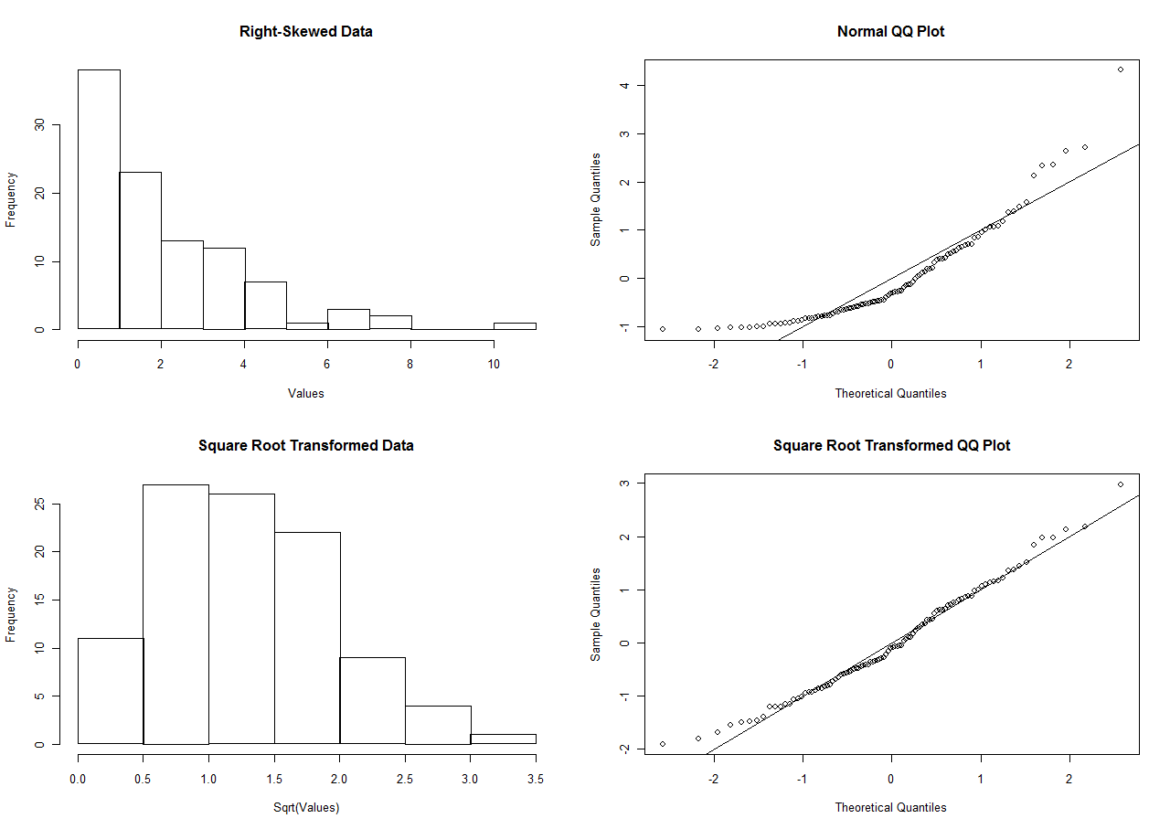

Slide 27
Comparing the three visual techniques
Histograms
Boxplots
QQ Plots
Advantages:
With properly-sized bins, histograms can summarize any shape of the data (modes, skew, quantiles, outliers)
Disadvantages:
Difficult to compare side-by-side (takes up too much space in a plot)
Depending on the size of the bins, interpretation may be different
Advantages:
Don’t have to tweak with “graphical” parameters (i.e. bin size in histograms)
Summarize skew, quantiles, and outliers
Can compare several measurements side-by-side
Disadvantages:
Cannot distinguish modes!
Advantages:
Can identify whether the data came from a certain distribution
Don’t have to tweak with “graphical” parameters (i.e. bin size in histograms)
Summarize quantiles
Disadvantages:
Difficult to compare side-by-side
Difficult to distinguish skews, modes, and outliers

Slide 28
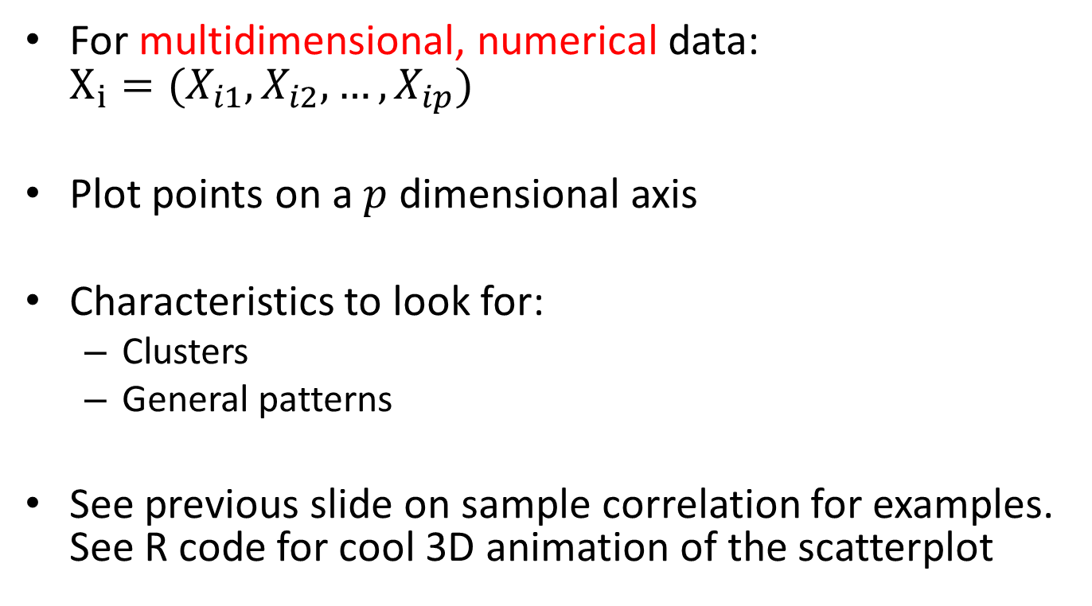
Scatterplots
For multidimensional, numerical data: $X_{i}=(X_{i1},X_{i2},…,X_{ip})$
Plot points on a $p$ dimensional axis
Characteristics to look for:
Clusters
General patterns
See previous slide on sample correlation for examples. See R code for cool 3D animation of the scatterplot

Slide 29
Lecture Summary
Once we obtain a sample, we want to summarize it.
There are numerical and visual summaries
Numerical summaries depend on the data type (numerical or categorical)
Graphical summaries discussed here are mostly designed for numerical data
We can also look at multidimensional data and examine the relationship between two measurement
E.g. sample correlation and scatterplots

Slide 30
Extra Slides

Slide 31
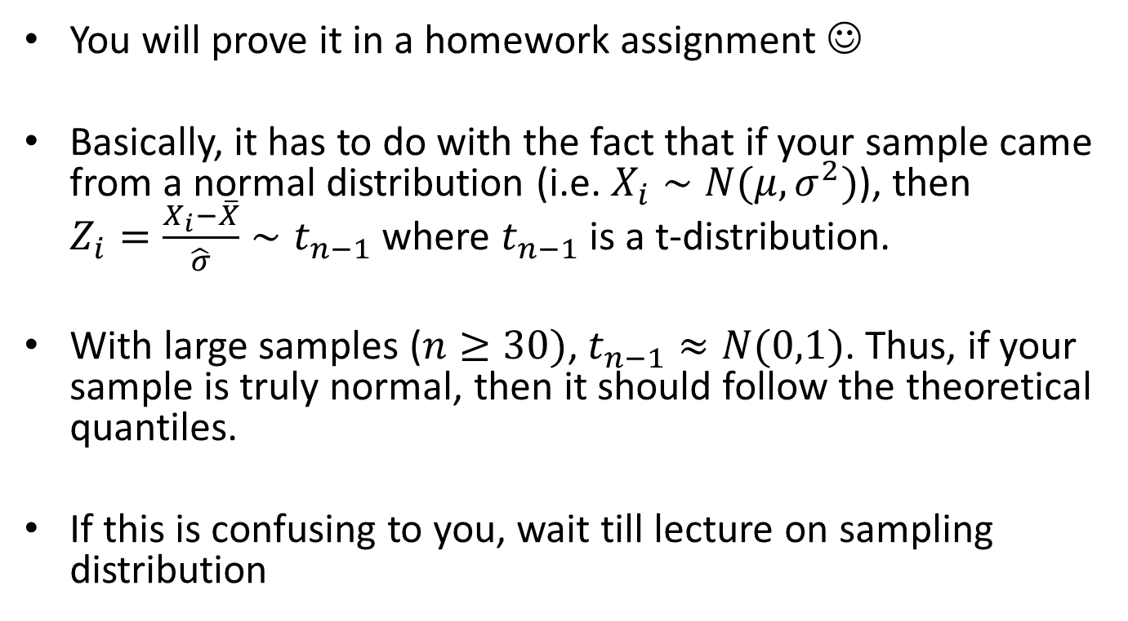
Why does the QQ plot work?
You will prove it in a homework assignment ☺
Basically, it has to do with the fact that if your sample came from a normal distribution (i.e. $X_{i}∼N(μ,σ^{2})$), then $Z_{i}=\frac{X_{i}−\overline{X}}{\hat{σ}}∼t_{n−1}$ where $t_{n−1}$ is a t-distribution.
With large samples ($n≥30)$, $t_{n−1}≈N(0,1)$. Thus, if your sample is truly normal, then it should follow the theoretical quantiles.
If this is confusing to you, wait till lecture on sampling distribution

Slide 32
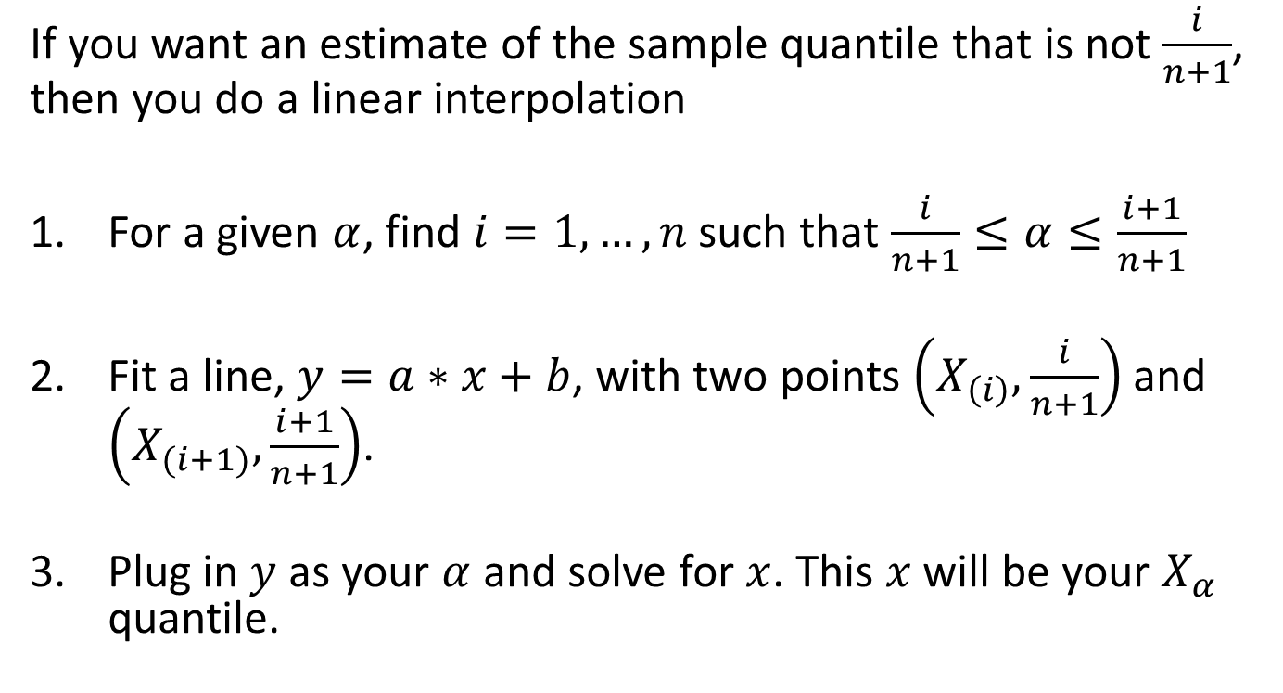
Linear Interpolation in Sample Quantiles
If you want an estimate of the sample quantile that is not $\frac{i}{n+1}$, then you do a linear interpolation
For a given $α$, find $i=1,…,n$ such that $\frac{i}{n+1}≤α≤\frac{i+1}{n+1}$
Fit a line, $y=a∗x+b$, with two points $\left(X_{\left(i\right)},\frac{i}{n+1}\right)$ and $\left(X_{(i+1)},\frac{i+1}{n+1}\right)$.
Plug in $y$ as your $α$ and solve for $x$. This $x$ will be your $X_{α}$ quantile.

Slide 33
