Slide 1
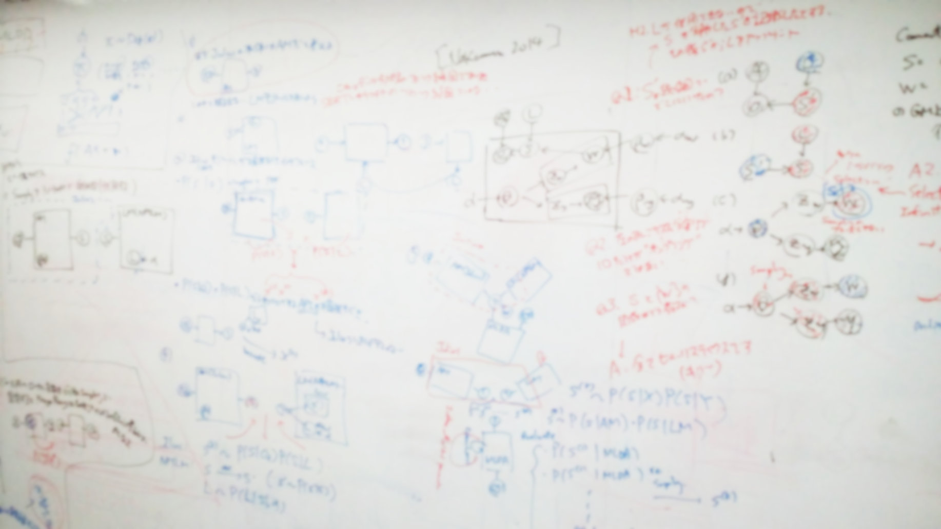
The University of Electro-Communications
Nakamura Laboratory
The University of Electro-Communications
Nakamura Laboratory

