Slide 1


Python - Operators
Trainer ：A Oshimaga

Slide 2

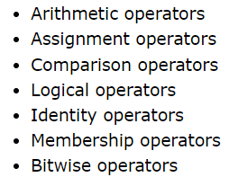
Types of operator

Slide 3
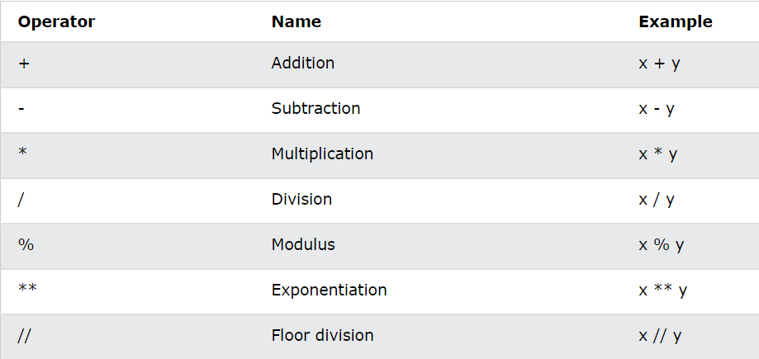
Arithmetic Operators

Slide 4
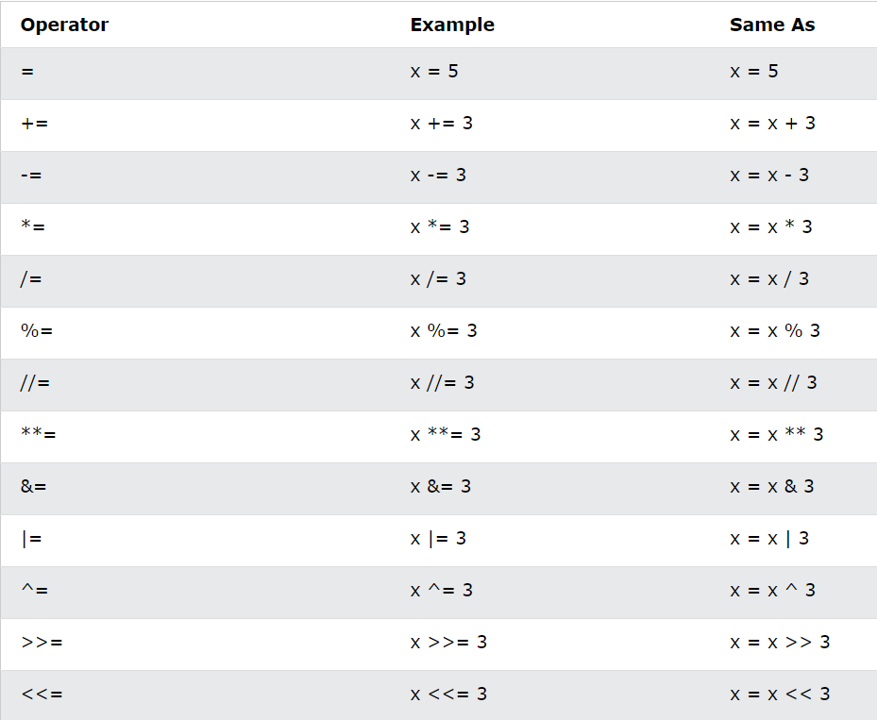
Assignment Operators

Slide 5
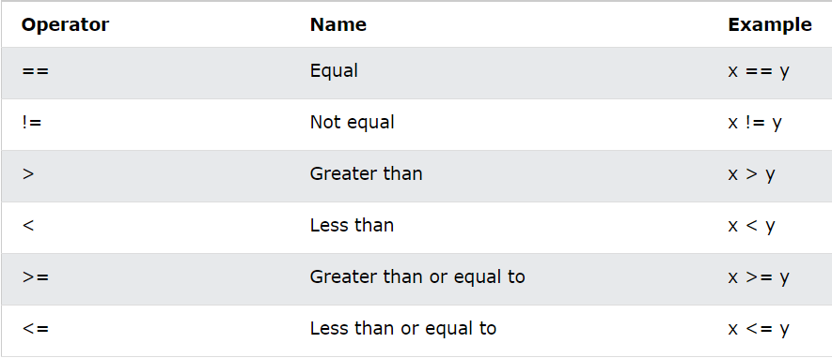
Comparison Operators

Slide 6
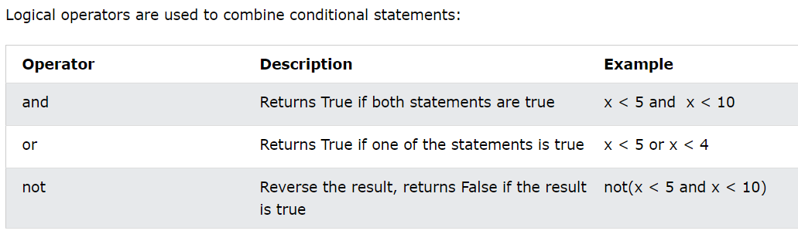
Logical Operators

Slide 7
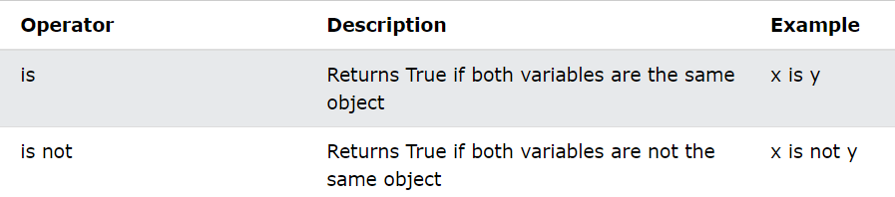
Identity Operators

Slide 8
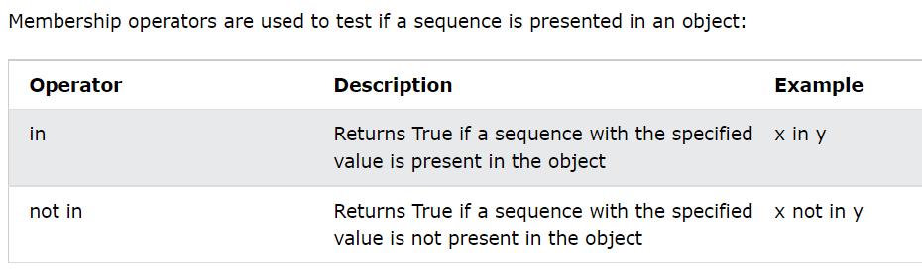
Membership Operators

Slide 9
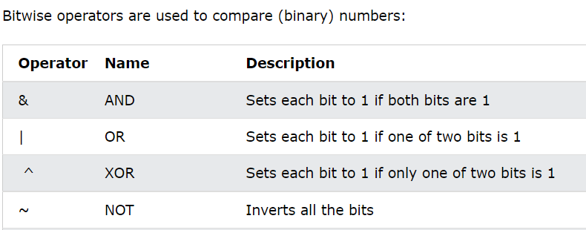
Bitwise Operators

Slide 10


