Slide 1
OOPS Concept-basics
Trainer: Oshimaga Abdul Sukur

Slide 2
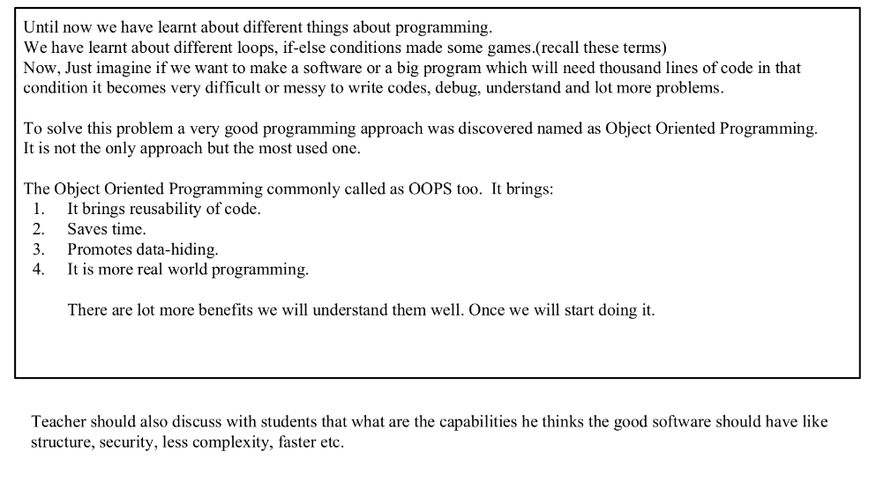

Slide 3
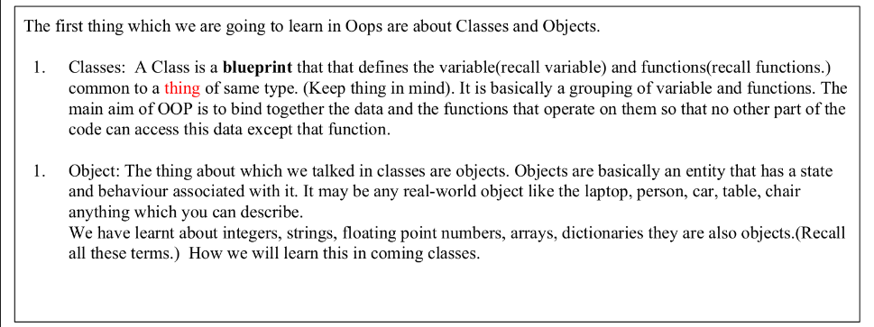

Slide 4
Examples:
Class: Human Object: Man, Woman
Class: Fruit Object: Apple, Banana, Mango, Guava wtc.
Class: Mobile phone Object: iPhone, Samsung, Moto
Class: Food Object: Pizza, Burger, Samosa

Slide 5
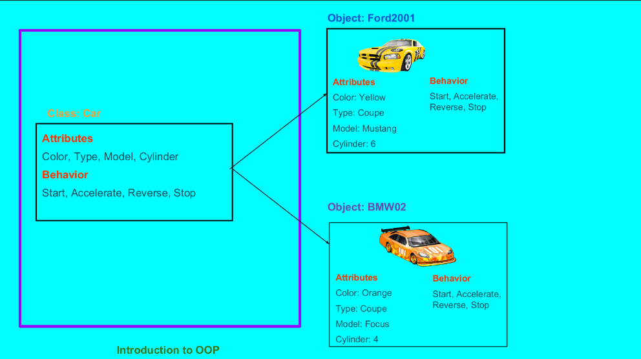

Slide 6
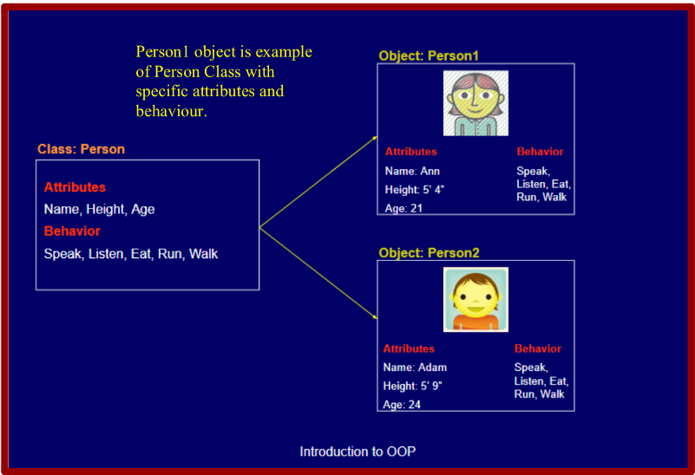

Slide 7
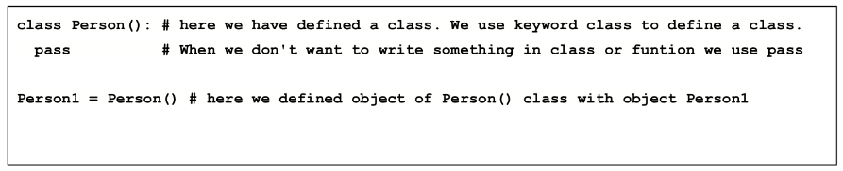
Implementation:

Slide 8
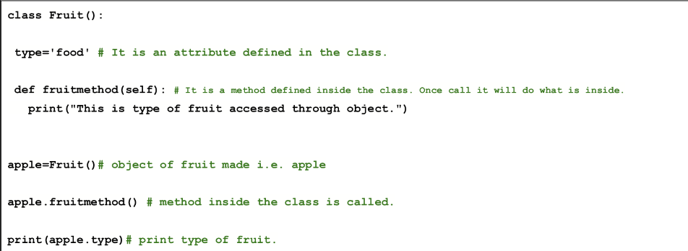

Slide 9

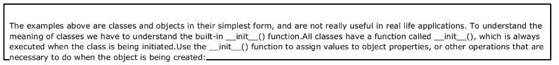

Slide 10
