Slide 1
Making A Change Through Boycott
Prepared By:
Osid Abu Al-Rub (1183096)
Hamzeh Hawwash (1180470)
Hashem Abu Al-Teen (1172660)
Supervised By:
Dr. Samer Al-Zain

Slide 2
01
02
Table of Contents
03
Introduction
Technologies Used
Related Work
04
System Analysis
05
System Design
06
Conclusion

Slide 3
— Chuck D
“The best way to boycott is to build you own”

Slide 4
01
Introduction

Slide 5
Overview
Phones and technology is always around us nowadays
We can use it for good in multiple fields, like boycotts
French products boycott in October 22nd, 2020 and Iranian tobacco boycott in 1891
Create account, use it to join communities and create/view posts and campaigns
Scan products to ensure you are always supporting your cause
Share boycotts and movements to other social media apps
We are not a social media app

Slide 6
Objective & Motivation
Our motivation is to provide the people with a platform that only focuses on solving issues and changing the world. And ensure that we are not wasting people’s time with an endless sea of posts
Our objective is to bring like-minded people together and make their voices heard. We want to be the stepping stone for change

Slide 7
02
Background Information

Slide 8
Tech Stack
Timeframe and scalability aspects are taken into consideration before choosing this tech stack
● Adobe XD: A UI/UX design tool that is vector-based.
● React Native: write Javascript for android, IOS, and web from a single codebase.
● Nodejs: It’s a way for the developer to write and run Javascript on the server-side
● Typescript: A superset of Javascript that builds upon it by giving you types.
● MySQL: Relational database management system built on structured query language.

Slide 9
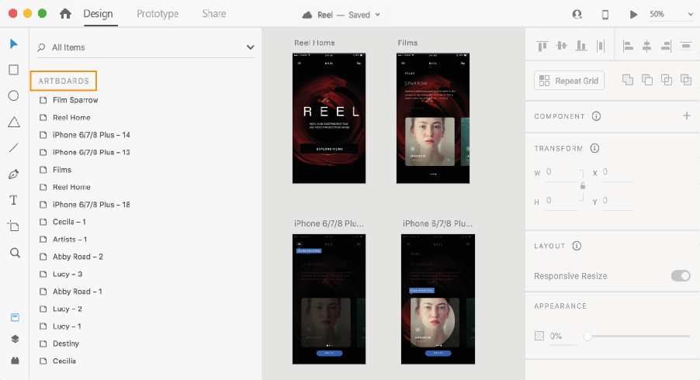
Adobe XD
A beginner friendly tool used for creating user interfaces
Most notable features:
Vector Based
Repeat Grid
Components
Figure 1: Adobe XD UI

Slide 10
React Native
React-Native is a famous mobile application framework built on Javascript that allows you to build android and IOS apps simultaneously
Before react native, developers used to wrap their Javascript-based application with something called a “webview” to use it as a mobile application.
Still gave web experience for mobile users (which is not ideal)
React native will use true native components at runtime via something called the bridge (e.g. TextView For android, UITextView for IOS, etc…)

Slide 11
React Native (cont)
Advantages
Disadvantages
Community driven
Optimal code reuse and cost-saving
Live reload
Hard to debug
Difficult to determine UI
Still immature

Slide 12
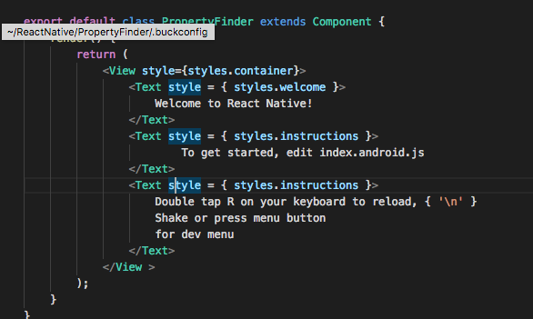
React Native (cont)
React native syntax is called JSX. It is represented in an opening and closing tags
Figure 2: JSX syntax

Slide 13
NodeJS
Open-source, runtime environment for running Javascript application outside of the browser
Used by famous companies like LinkedIn and Uber
Mainly used for building backend services
Scalable
Nodejs is non-thread blocking. Providing I/O operations without blockage
Has event loop. Which delegates work to system kernel (usually multi-threaded) and allows for non-thread blockage

Slide 14
Typescript
it is a superset of Javascript that provides static types and is compiled to plain Javascript at runtime
Why we need types:
Catch errors early before code deployment
Refactor code easily
Diminish the need for a human brain to remember necessary types

Slide 15
MySQL
Relational Database Management System that is responsible for handling and saving data
Powered by oracle
Open-source
Easy to learn and use

Slide 16
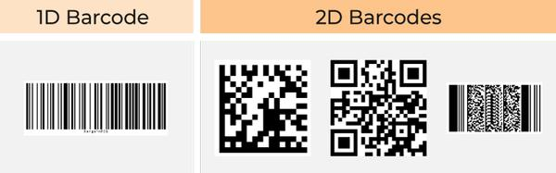
Barcodes
Barcodes are black and white lines/symbols that are read by a scanner
There’s two types of barcodes:
1D barcodes
2D barcodes
Because products have 1D barcodes, we will be using them.
Figure 3: Barcodes

Slide 17
03
Related Work

Slide 18
Similar Apps
These are few of the existing applications that deliver parts of the features our app has:
Buycott :
Explore and join campaigns.
Suggest a new product.
Scan products.
QR & Barcode scanner :
Scan barcodes and gives info on the products.
Facebook :
Share posts and thoughts about the campaigns via Facebook groups, pages or personal profiles.

Slide 19
Problems
Buycott
Old application with last update in 2016.
Lacks any user generated content.
QR & Barcode Scanner
Only include scanning codes.
Shows barcode number only after scanning
Facebook
Silencing voices
Privacy concerns

Slide 20
Our advantages
Our app includes features included in the previous apps with more :
Scan products and get detailed info.
Focus on user generated content.
Browse, create, manage and join campaigns.
Up-to-date application built using the latest technologies in the market.
Full privacy on user's data.
Freedom of speech.

Slide 21
04
System Analysis

Slide 22
System Analysis
System analysis model for the mobile app. It will include :
use case diagram.
sequence diagram.
user and system requirements, and some other diagrams.
The diagrams are needed to showcase and simplify the process that the application is built upon, and the user-system requirements are needed to clarify what are the features exactly and how they are going to be used with details.

Slide 23
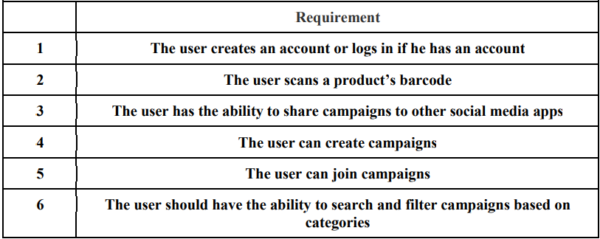
User Requirements
Those are the main user requirements in our app.
Table 1: Requirements table

Slide 24
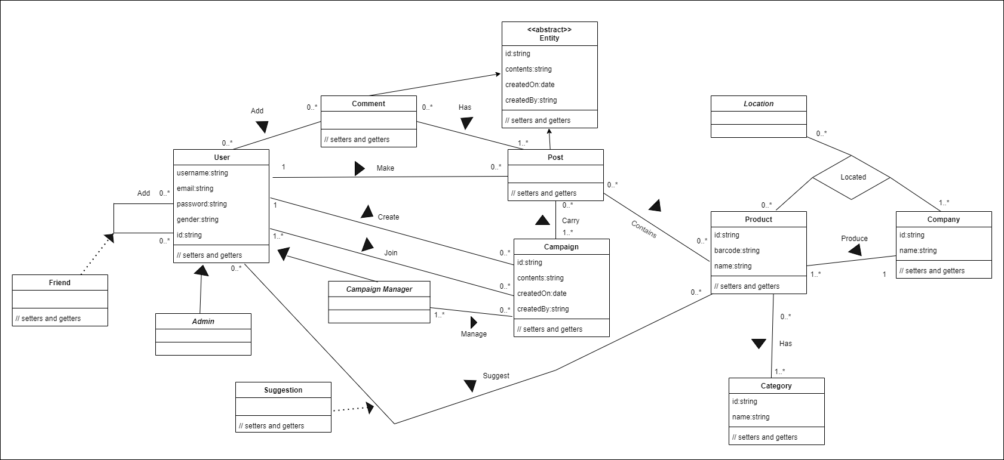
User Requirements (cont)
Figure 4: Use case diagram

Slide 25
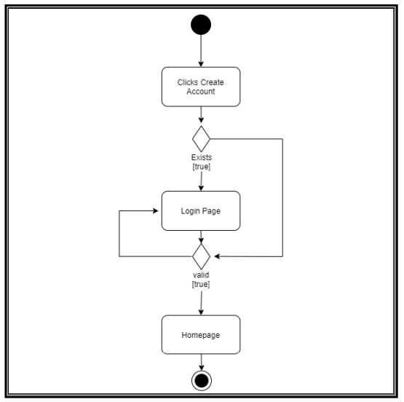
Activity Diagram 1
Creating account activity
Figure 5: Create account activity

Slide 26
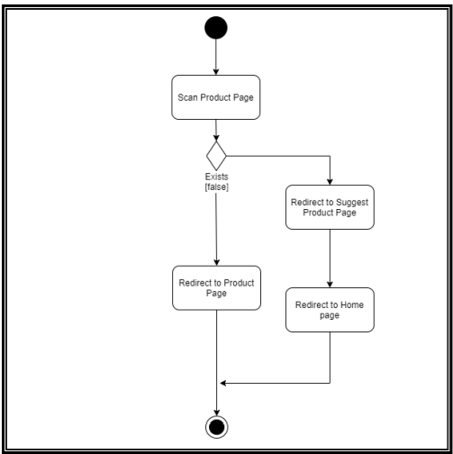
Activity Diagram 2
scanning the product activity
Figure 6: Scanning product activity

Slide 27
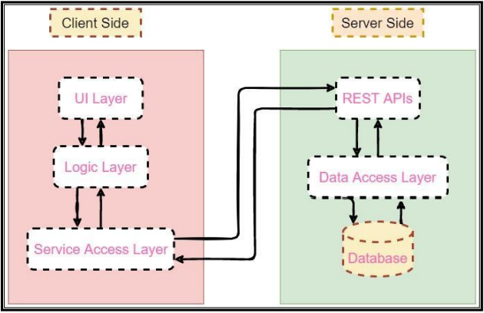
Software Architecture
The application architecture diagram is a high-level diagram that shows the application basic structure, it consists of the following:
Figure 7: Architecture

Slide 28
05
System Design

Slide 29
User Interface
All interfaces are done using Adobe XD.
Features such ass Repetition Grid & Components are used to make things easier and faster.
The export feature is used to output high definition interfaces.
Some interfaces were inspired from famous apps to give the user a feeling of familiarity.
User Experience was also taken into consideration, such as decluttering, offloading tasks, correct usage of colors, and much more.

Slide 30
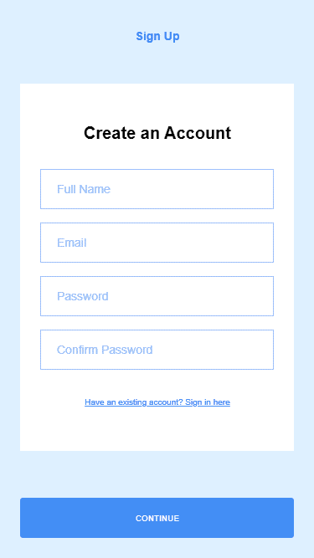
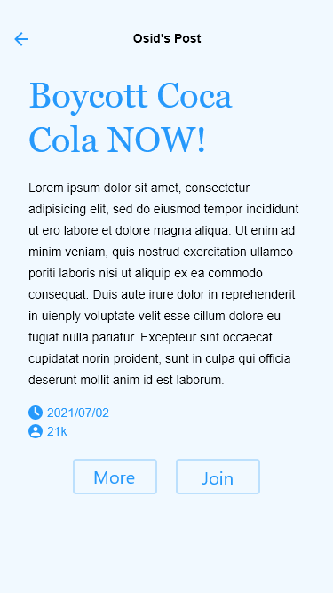
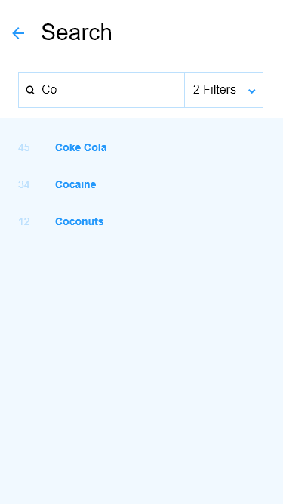
User Interface (cont)
Registering for an account interface
Interface for the Post section
Searching for a specific campaign/product
Figure 8: Register
Figure 9: Post
Figure 10: Search

Slide 31
06
Conclusion & Work Plan

Slide 32
Conclusion & Complexities
Boycotting is the way to change for people. The main idea of this project and is to help ordinary people fight without a weapon or violence.
Complexities faced/are going to face:
All technologies used in development are new to us, and will be learned from scratch.
Debugging will prove to be a challenge as we’ll be debugging for several platforms at once.

Slide 33
Work Plan
Table 2: Work Plan
 | Goals | Time
1 | Review Report & Requirements | One Week
2 | Frontend Code & Testing | Four Weeks
3 | Backend Code & Testing | Six Weeks
4 | Integration & Testing | Three Weeks
5 | E2E Testing | Two Weeks

Slide 34
Thanks For Listening
Please keep this slide for attribution
Do you have any questions?
addyouremail@freepik.com
+91 620 421 838
yourcompany.com

