Slide 1

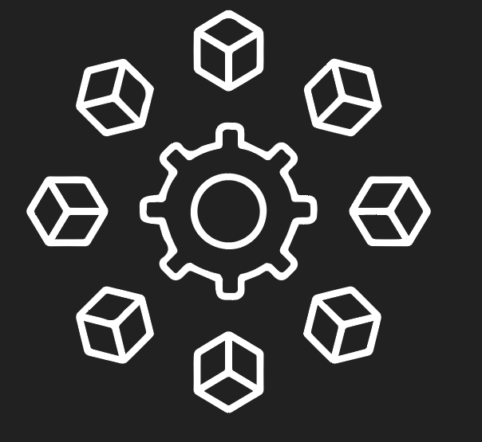
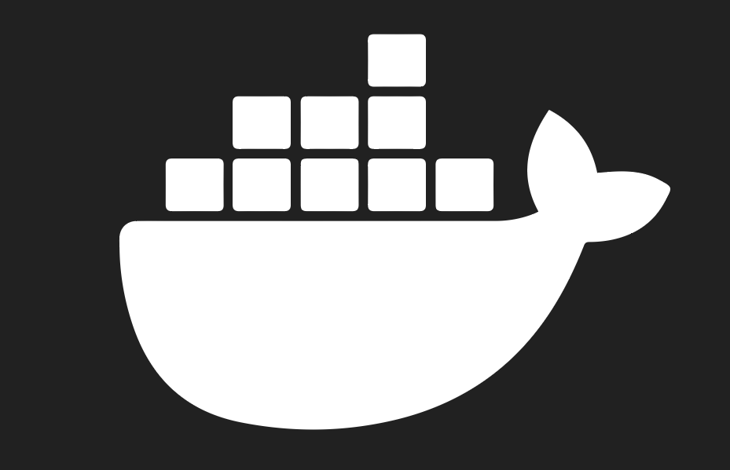
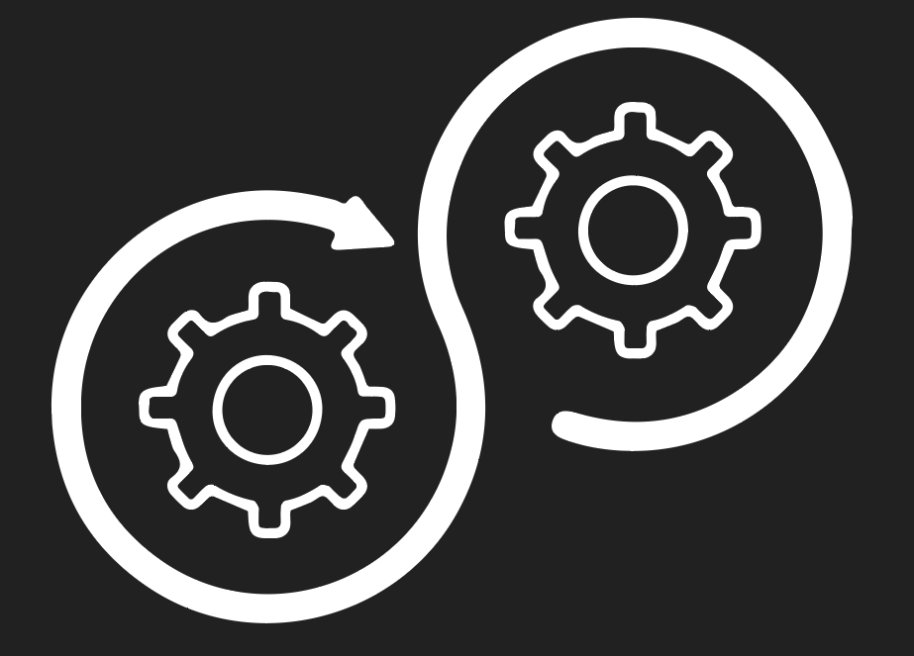



Cloud Deployment for Microservices
done by Osipciuc Ion
for Orange Slovensko

Slide 2
1
Task

Slide 3
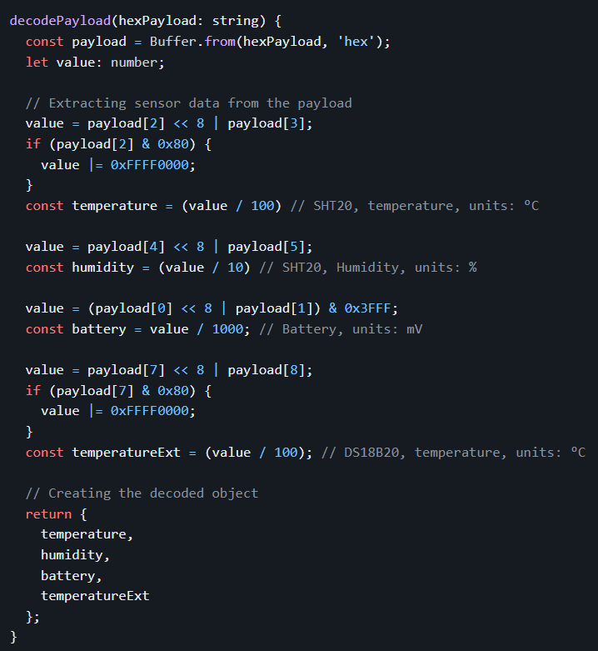
Implement JavaScript/TypeScript decoder logic
Result:
In: “cbb409c401990109857fff”
Out: { "temperature": 25, "humidity": 40.9, "battery": 2.996, "temperatureExt": 24.37 }

Slide 4
2
Task

Slide 5
Implement a REST API for decoding HEX payload
I created a Node.Js application to run a Web Server using Express framework. The purpose of this application was to implement a REST API that exposes the endpoint /decode for decoding the payload received from Dragino LHT65 devices.

Slide 6
3
Task

Slide 7
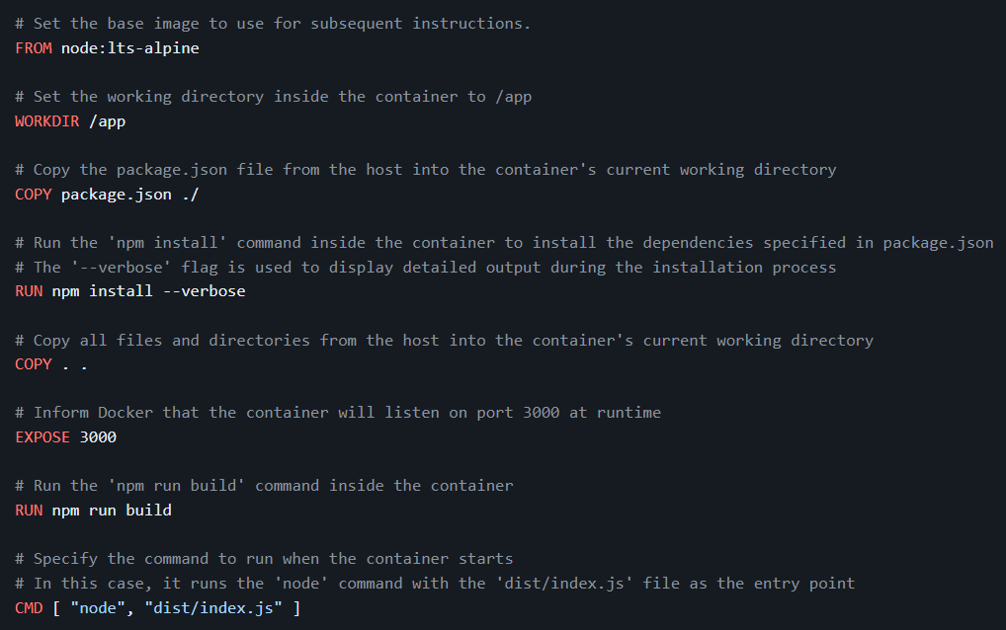
Dockerfile for the REST API
At this step I created a Dockerfile, where I defined the steps to build and run the microservices.

Slide 8
4
Task

Slide 9
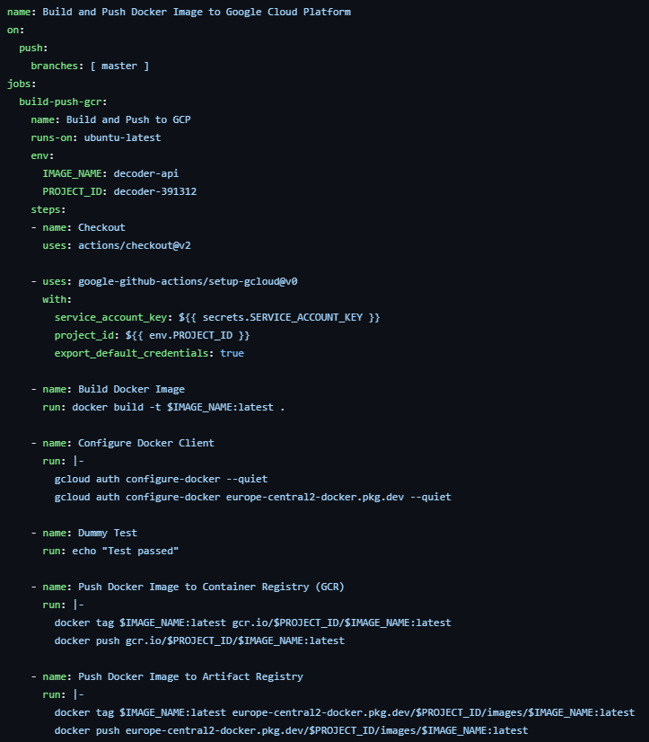
Deploy microservices to cloud
Then, I set up the CI/CD pipeline using Github Actions, defining a workflow file that specifies the stages and steps of the pipeline.
Also, I added steps in the workflow to push the build Docker image to the Container Registry and Artifact Registry on GCP:

Slide 10
Overcoming Challenges
During this assignment, I faced challenges in the first task when I had to understand how the solution should be implemented, but everything became clearer when I documented myself from the sources attached to the exercise.
Another challenge was choosing the necessary tools for deploy, which gave me a bit of a headache, because the documentation is not updated for them. In the end I chose instruments with which I have direct experience, which made my task easier.
My reaction after opening the task document
My reaction after carefully reading the requirements

Slide 11
Conclusions
By following this approach, I automated the building, testing and deployment of our microservices using Github Actions and Google Cloud Platform.

