Slide 1
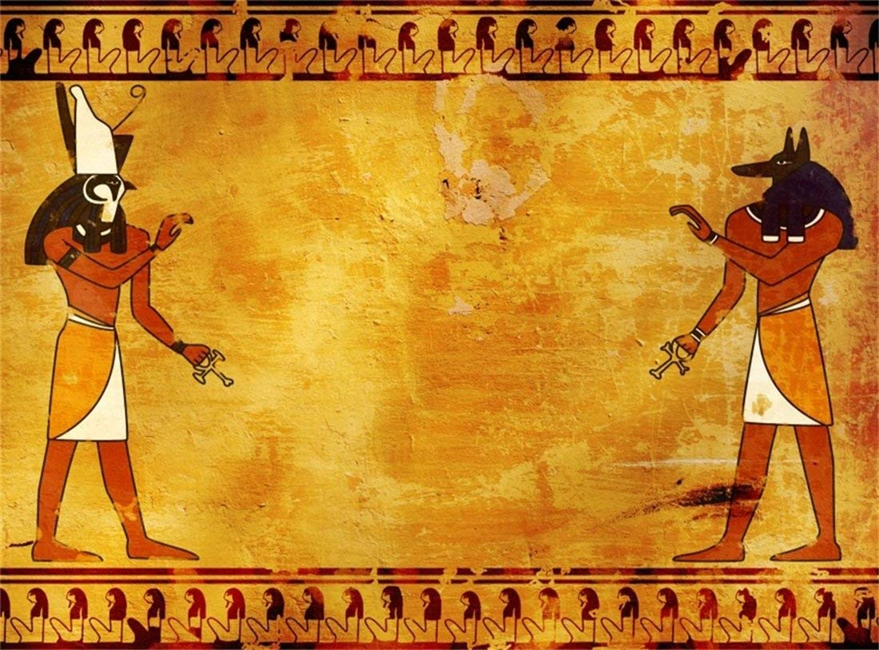
Osiris’s Namelists
Assorted Stellaris namelists inspired by history & more:
American
Ancient Egyptian
Astronomy & Science
Arabian
ChatGPT’s Cool Names
Medieval
See mod description below for details.
All made with Osiris’s namelist mod generator

Slide 2
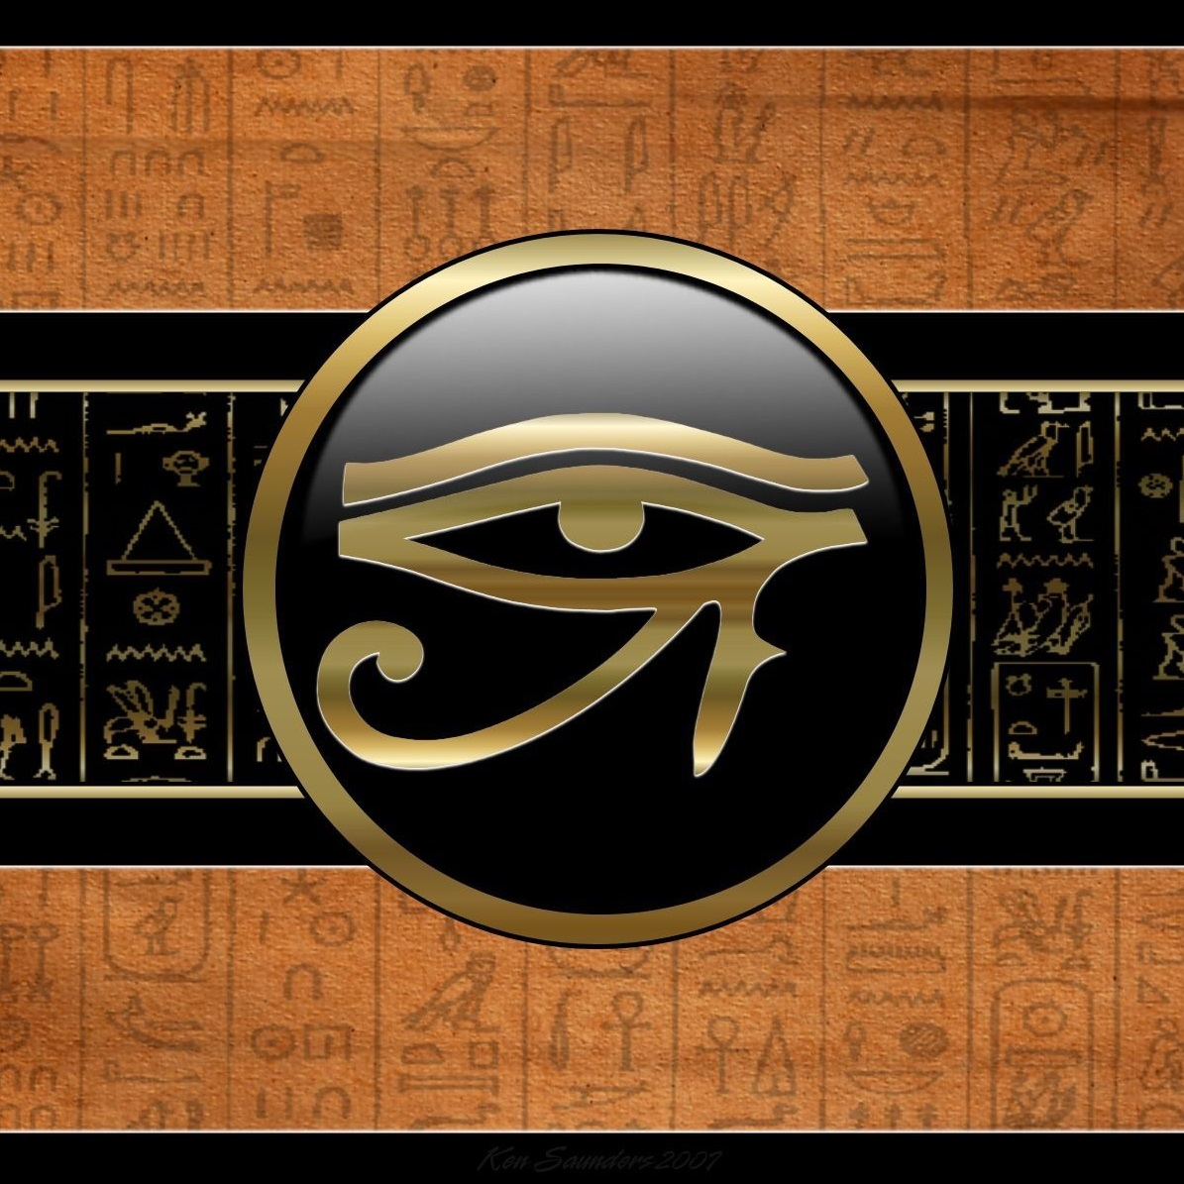
Osiris’s Empires
Ancient Civilizations

Slide 3
Osiris’s Empires
Human Diaspora

