Slide 1


Introduction to Git
Terje Sandstrøm
Development Techniques MVP
Solidify AB
Blog: http://hermit.no
@OsirisTerje

Slide 2

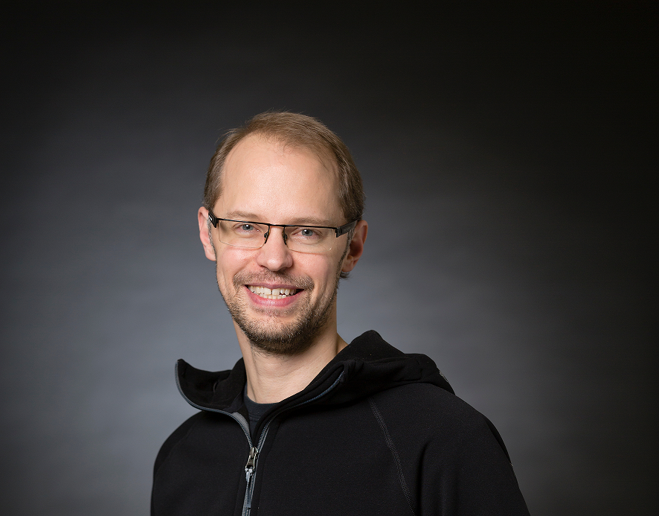



A ton of Credits
Taavi Koosaar
DevOps Consultant, Solidify AB
Dev Tech MVP
@melborp |
Gian Maria Ricci
Italy
Dev Tech MVP
@alkampfer
Jens Målare
DevOps Consultant, Solidify AB
www.codewrecks.com
SHAMELESSLY
borrowed from
Richard Banks
Visual Studio ALM MVP, Australia
http://www.Richard-banks.org
Http://www.readify.net/
Which again has …….
SHAMELESSLY
borrowed from
SCOTT CHACON
2020: Github R&D Manager
(https://github.com/schacon/git-presentations
http://git-scm.com
Book: https://git-scm.com/book/en/v2

Slide 3
git is
NOT AN
EVOLUTION
of existing VC systems
1

Slide 4
It is a
RETHINK

Slide 5
git is
NOT A
SOURCE CONTROL
SYSTEM
2

Slide 6
git is a
CONTENT
CONTROL SYSTEM

Slide 7
GIT DESIGN

Slide 8
a
TOOLKIT
for a DVCS

Slide 9
many chainable
COMMANDS

Slide 10
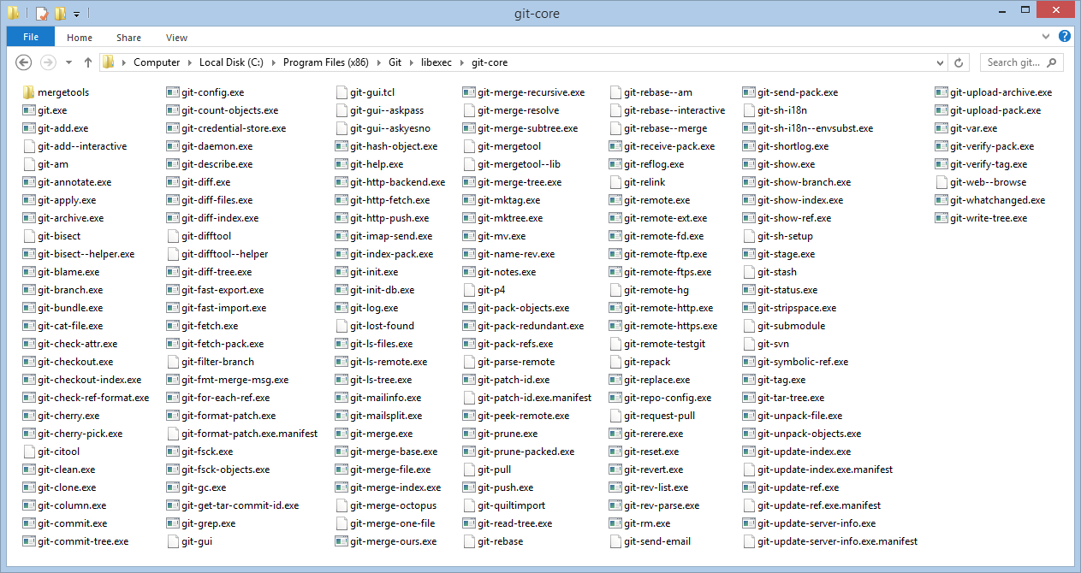
YIKES!!!!

Slide 11
Traditional GIT is:
big on the
POWER
small on the
friendly
Frustration
Time

Slide 12
Easier tools
Visual Studio, Visual Studio Code w/extensions
SourceTree
Fork
Git Kraken
Tower

Slide 13

Git fully integrated into Visual Studio and TFS

Slide 14

Fully integrated Git support
Team Explorer
TFS SCC Provider
Git SCC Provider
TFVC Object Model
LibGit2 / LibGit2Sharp
Team Foundation Server / Service
Local Repo
Project 1
Project 2
Issues
Project Mgmt
Build
…
Issues
Project Mgmt
Build
…
3rd Party
3rd Party
Other Remote Git Repo
Eclipse
XCode
Shell
Eclipse
TFVC
Git
Shell
…
…
Git-TF

Slide 15
most version control
systems store and track
CHANGES
(e.g. TFVC, SVN, mercurial)

Slide 16
Time
C1
C2
C3
C4
C5
A
∆1
∆3
∆4
B
∆2
∆4
C
∆1
∆2

Slide 17
Git stores
SNAPSHOTS
of content

Slide 18
Snapshots are stored in a
DIRECTED ACYCLIC GRAPH
(i.e. a graph database)

Slide 19
Time
C1
C2
C3
C4
C5
A
A’
A’
A’’
A’’’
B
B
B’
B’
B’’
C
C’
C’’
C’’
C’’

Slide 20
Snapshots are not copies!

Slide 21
Git thinks of its data more like a series of snapshots of a miniature filesystem.
With Git, every time you commit, or save the state of your project, Git basically takes a picture of what all your files look like at that moment and stores a reference to that snapshot.
To be efficient, if files have not changed, Git doesn’t store the file again, just a link to the previous identical file it has already stored.
Git thinks about its data more like a stream of snapshots.

Slide 22
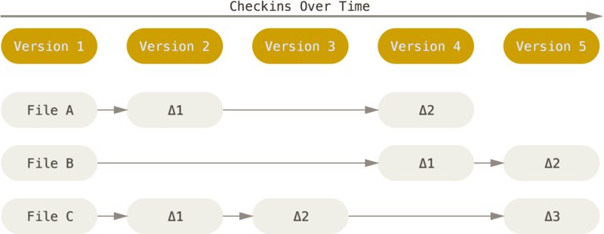
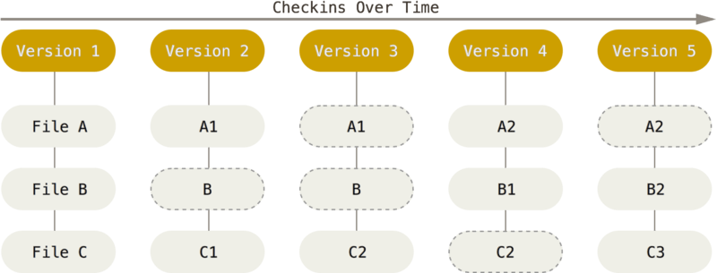

Slide 23
Git is a distributed system

Slide 24


Git repo(sitory)
Some remote site
Git repo(sitory)
Github
Git repo(sitory)
Azure DevOps
Cloning
Fetch, Pull, Push
Git repo(sitory)
Local
Git repo(sitory)
Local
Commit, (Stage), Add
Workspace
Code
Workspace
Workspace
Workspace

Slide 25
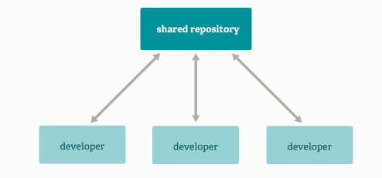
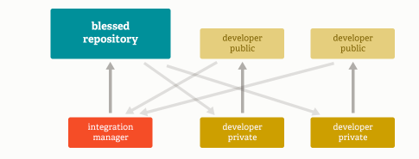
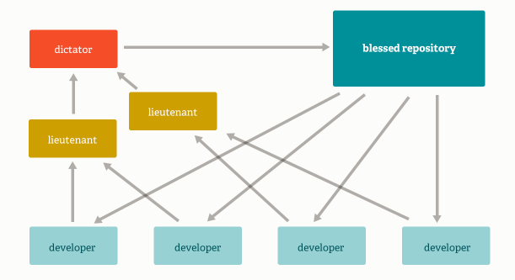
Repository models
Integration Manager Workflow
Aka Github-style, Open Source
Std
Massive Projects

Slide 26
Repo
Repo
Repo
Repo
Repo
Repo
Repo
Repo
Repo
Repo
Notes:
The “same” repo can exist in multiple places, still they can all be combined together. They can have different states, different commits, different branches and tags, still, they can be all combined together.
You can even take a commit from a repo that has diverged long time ago, and bring that into another much more recent one.

Slide 27
Git has integrity
Every commit is immutable
Every commit has been check-summed
The checksum is the reference/pointer value, the key, to the commit
It is a 40 char hex SHA-1hash, looking like
(Often only the 8 first is being shown or even used)
24b9da6552252987aa493b52f8696cd6d3b00373
Notes:
Since the reference/pointer value is equal to the check-sum, you can’t “loose” a commit. Git will always know if the commit being transferred, copied, moved or whatever, is a valid commit or not.

Slide 28
Git is local first
Notes:
This is where you work. This is where everything happens. Even when you work on a server, it is “local first” on the server.

Slide 29
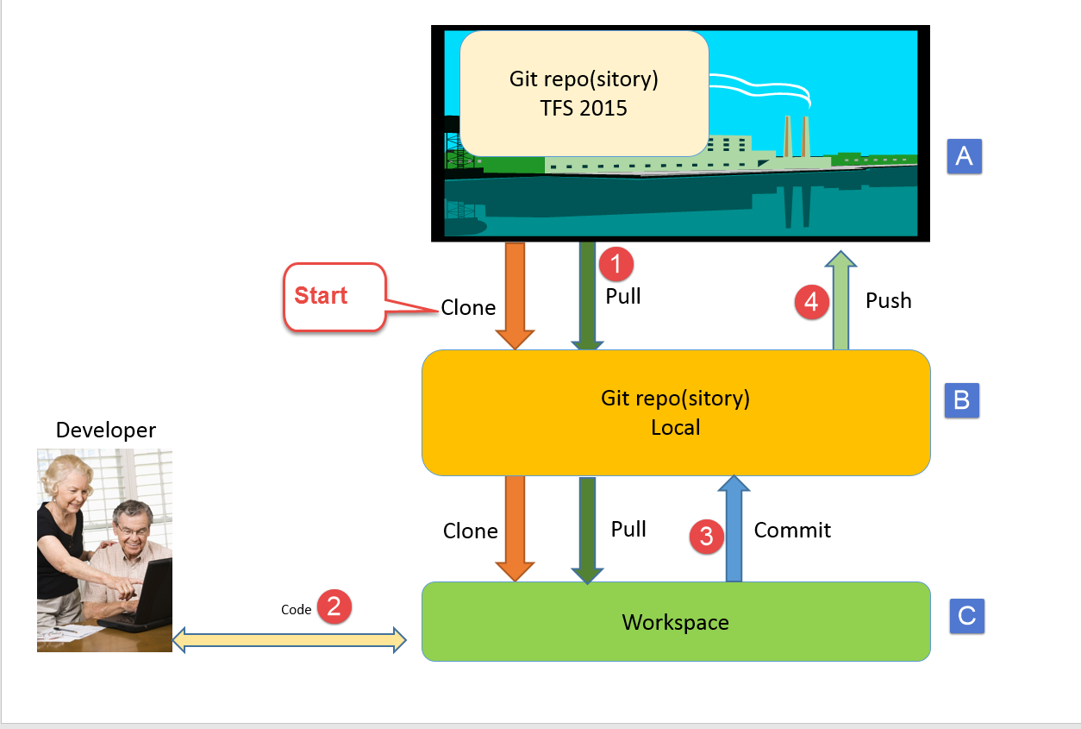
The fundamental git workflow
Remote
Git Repository
Notes:
See https://terjesandstrom.github.io/ASurvivalGuideToGit

Slide 30
SHORT DEMO 1
Notes:
Run Trainer

Slide 31
Exercise 1.1
Get the tooling right

Slide 32
Exercise 1.1 wrap up
All have tools working
Creation of local repos using Git Init works
Standard setup for a new repo
With gitignore and readme
Be aware of the different gitignore variants
See http://hermit.no/how-to-find-the-best-gitignore-for-visual-studio-and-azure-devops/
Two different ways of starting up a new repo

Slide 33
Terms with different meanings
Action | TFS VC | Git | VS Git
Open a file | Checkout | NA, you just open it | Marked as touched (like checkout in TFS VC)
Get latest files from server | Get Latest | Fetch + Pull | Fetch + Pull
Send files to server/repo | Checkin | Commit + Push | Commit + Push
Update all (two above) | NA | NA | Sync Does Pull + Push, may trigger a merge
Move focus to another branch | Manually change folder in SC | Checkout | Switch

Slide 34
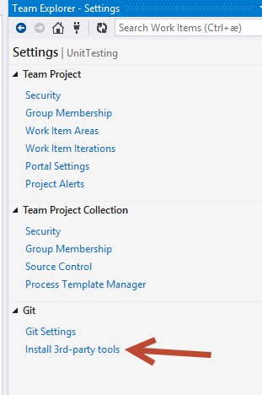
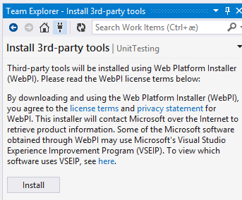
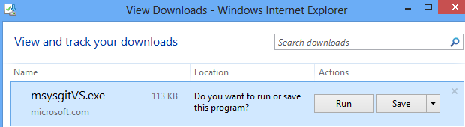
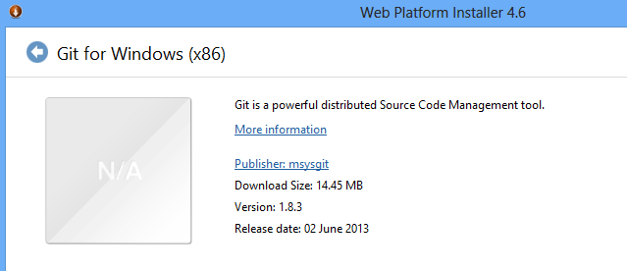
Setup

Slide 35
Git in the Enterprise
Git is small
Enterprises are big
Enterprises are many small gits

Slide 36
Keep the git repo’s small
NO BINARIES IN SOURCE CONTROL !!!!!!!!!!!!
Use Nuget (or some other package manager) to keep binaries out
Publish your own libraries to a Nuget feed
Start with a «private/team» nuget feed, like: MyGet http://www.myget.org/ , Github packages, or Azure Devops packages.

Slide 37
Exercise 1.2
Remotes and sizing

Slide 38
Wrap up : Exercise 1.2
Linux size is 2.75 GB
Openshift is 1.08 GB
VSCode is 275 MB
VS Code Python is 100 MB
NUnit3TestAdapter is 3.4 MB (with 8 years history)

Slide 39
Git unfriendly file types
Binary files can not be compressed
This means copies are created for any change
Files like:
Exe, dll
Gif, jpg, really any image file
Files already compressed, zip, pptx
Packages from e.g. nuget, npm and so on

Slide 40
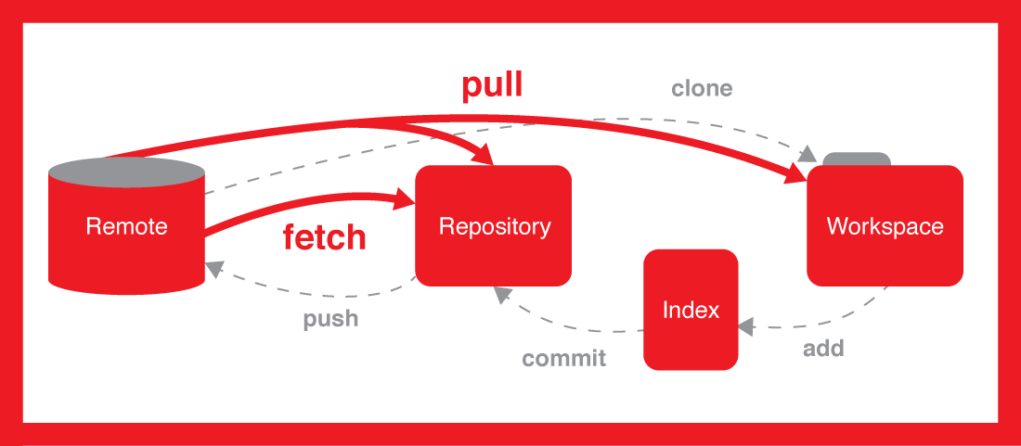

Notes:
Short break, anyone ?

Slide 41
Remote Repository
Push
Fetch
Git repo
Local Repository
Pull
Commit
Index/Staging area
Checkout
Workspace
Add
Notes:
Note: git commit –a automatically stages modified and removed files

Slide 42
GIT STates
Modified means that you have changed the file but have not committed it to your database yet.
Staged means that you have marked a modified file in its current version to go into your next commit snapshot.
Committed means that the data is safely stored in your local database.

Slide 43
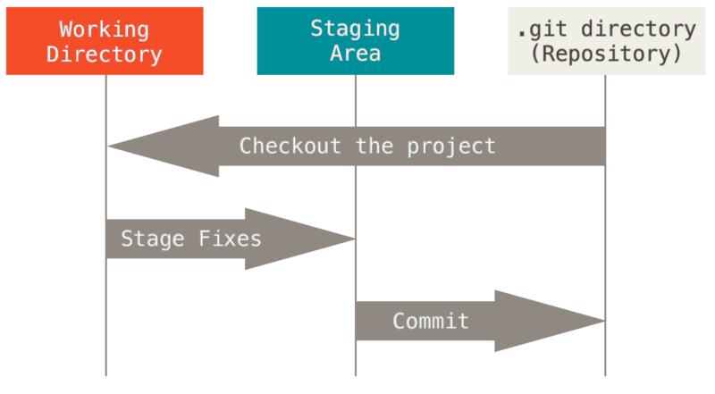
Notes:
You need to be aware that this is what happens, but often it is “behind the scenes”. Many systems regard Commit as meaning both staging and the real underlying commit.
And mostly you don’t really care.
And, the “staging area”, is just another file stored inside your .git directory.
Note: The staging area is *not* part of what is being transferred during a clone operation.

Slide 44
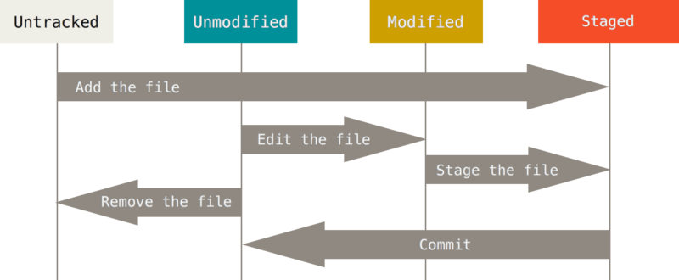
States
---------------------------Tracked------------------------------
https://git-scm.com/book/en/v2/Git-Basics-Recording-Changes-to-the-Repository
https://codingbee.net/git/git-file-states

Slide 45
Git status
Exercise 1.3

Slide 46
Managing a System with Git and Nuget
Split System into multiple Applications
Place each application in its own Git repository
Given they can have separate releases
Use a package manager to publish the binaries locally (within the company)
Use automatic package restore to retrieve them on build

Slide 47
MONOrepos
Pro:
Simplifies dependency management
Large scale refactoring
Unified versioning…. Sort of….
Con:
Require own tooling, e.g. Git VFS (supported by Azure DevOps, currently not by Github)
Complexity and rules to assure “things are done right”
Slow downloads
Tracking things down may be very cumbersome
Monorepos are not a fix for a lack of structure or a need to set up structure
Notes
Google uses its own server based implementation (see https://dl.acm.org/doi/10.1145/2854146 for more info)

Slide 48
MONO repos
Linux kernel:
Not a mono repo, but a mono tree
Notes
See https://blog.ffwll.ch/2017/08/github-why-cant-host-the-kernel.html

Slide 49
Migrating from (or coexisting with) TFSVC to GIT
Use Git-tf: https://gittf.codeplex.com/
(Download: http://www.microsoft.com/en-us/download/details.aspx?id=30474)
Clone a TFSVC TP or parts of a TP, into a git repo
Shallow clone or Deep Clone
Works on Windows and Mac
Solidify- Terje Sandstrøm 2020

Slide 50
Splitting and merging repos
Split a repo:
Merge two repos:
Multiple ways:
1) simple with dual remote repos and just merge them
2) Git subtree
http://stackoverflow.com/questions/1425892/how-do-you-merge-two-git-repositories
Solidify- Terje Sandstrøm 2020

Slide 51
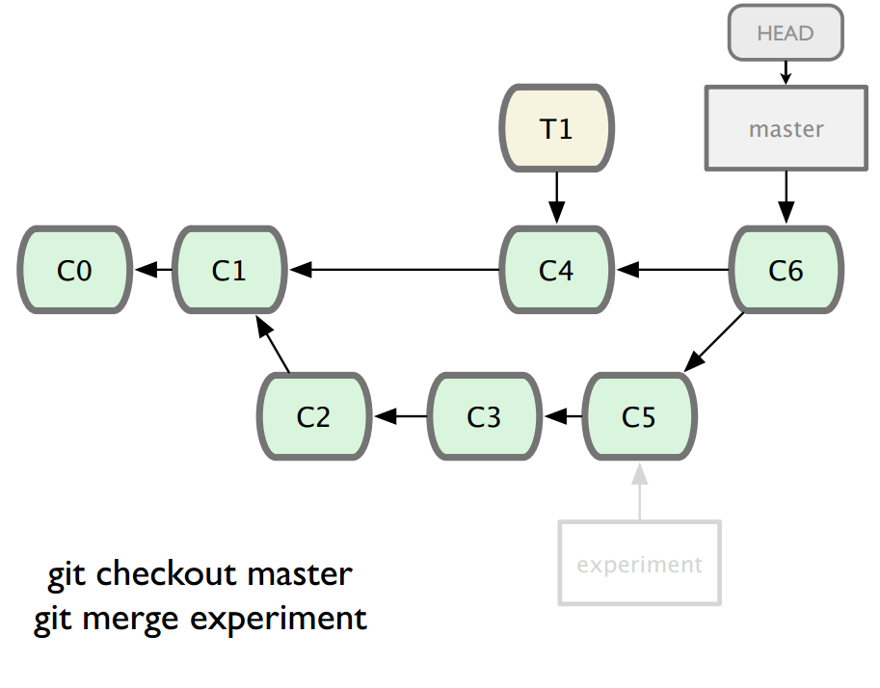
Git repo(sitory)
GitHub/CodePlex/Bitbucket
Git repo(sitory)
TFS 2020
Git repo(sitory)
Local
Fetch, Pull, Push
Git repo(sitory)
Local
Git repo(sitory)
Local
Commit, (Stage), Add
Code
Workspace
Solidify- Terje Sandstrøm 2020

Slide 52
The future of Version Control in TFS
Then:
We had: Source Safe
We got : TFS VC
Now:
We have: TFS VC
We got: Git
Future: Microsoft hasn’t said, but we can assume.....
Solidify- Terje Sandstrøm 2020

Slide 53
The End
http://geekswithblogs.net/Terje

