Slide 1
Section 2
SOLIDIFY
Branching, merging, tags
Terje Sandstrøm
Microsoft Development Technologies MVP
March 2020

Slide 2
What is a git branch ?
Notes:
We’re going to go through a scenario to understand how branches work and what they are

Slide 3
Exercise 2.1

Slide 4
What is a git branch ?
A pointer to a commit
What is a git Tag ?
A pointer to a commit
So what is the difference between a Tag and a branch?
A branch can move (with the commits), a tag doesn’t move

Slide 5
Let us look at how branches and merges affects the repo

Slide 6
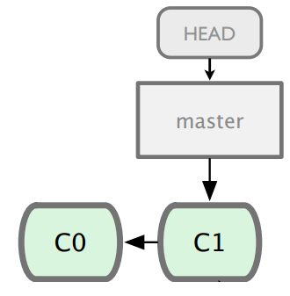
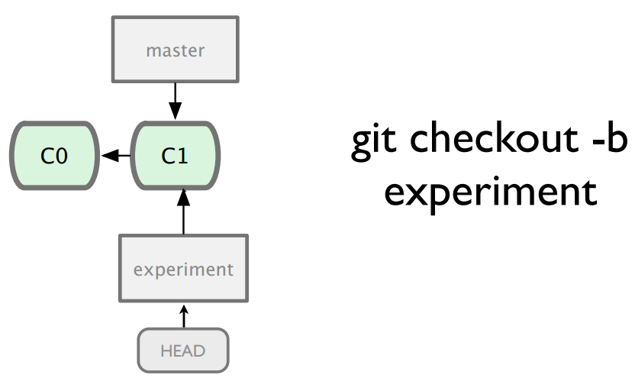
Git repo
Local Repository
Refs
Workspace
Notes:
Now we create a new branch, named experiment. It points to C1. Notice, it *only* affects the refs part of the git repo. What does that mean?

Slide 7
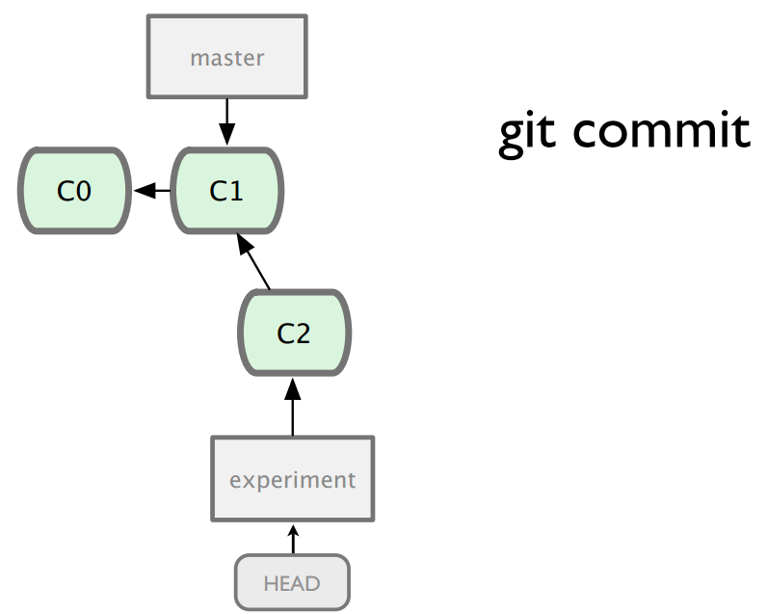
Git repo
Local Repository
Refs
Workspace
Notes:
We add a new commit C2 to the experiment branch. The experiment branch now points to C3. The workspace was changed, and so was the whole repo.

Slide 8
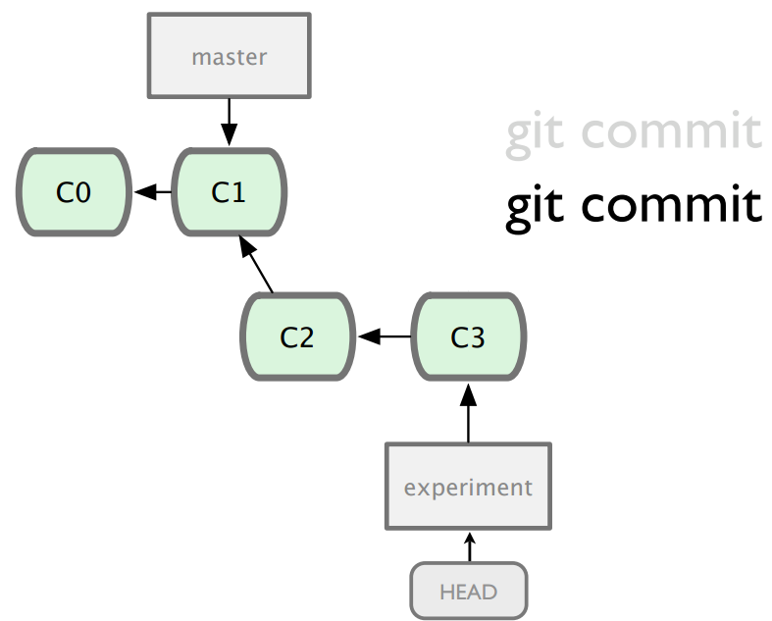
Git repo
Local Repository
Refs
Workspace
Notes:
Let’s add another one

Slide 9
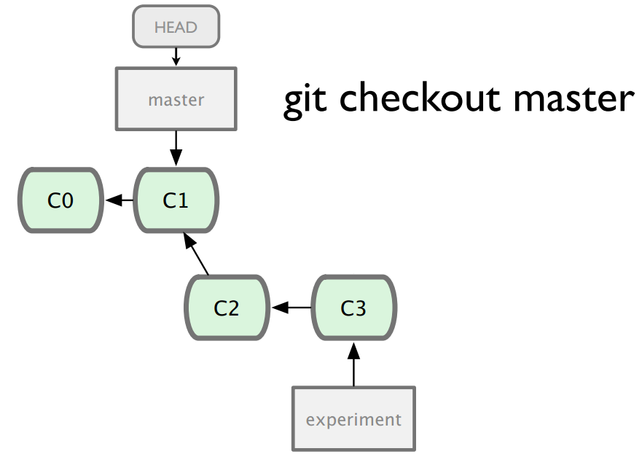
Git repo
Local Repository
Workspace
Notes:
Lets go back to master. What changed now? Only a small part of the workspace. The C2 and C3 was eliminated so that C1 is what remains in the workspace. Imagine they each contain a single file.

Slide 10
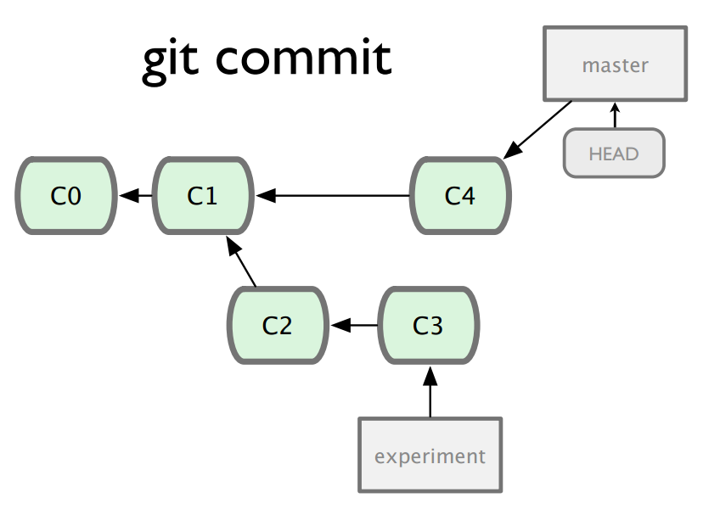
Git repo
Local Repository
Refs
Workspace
Notes:
Adding C4 to master

Slide 11
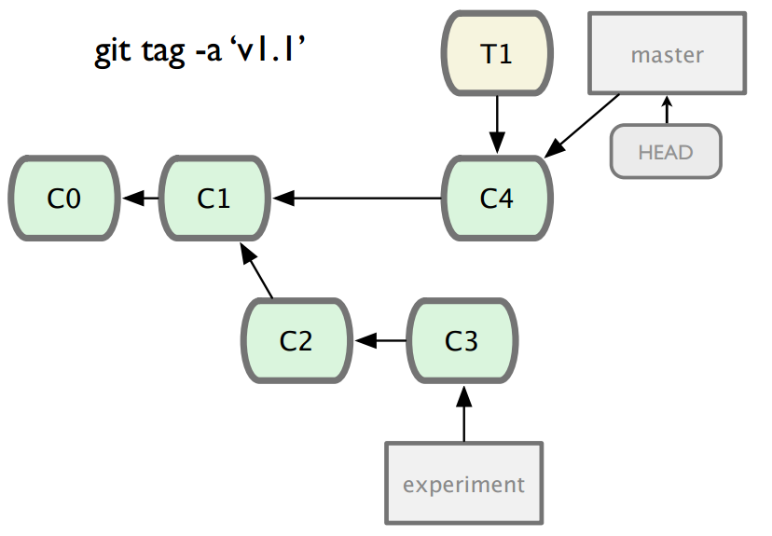
Git repo
Local Repository
Refs
Workspace
Notes:
Adding a tag to mark C4. It only affects the refs.

Slide 12
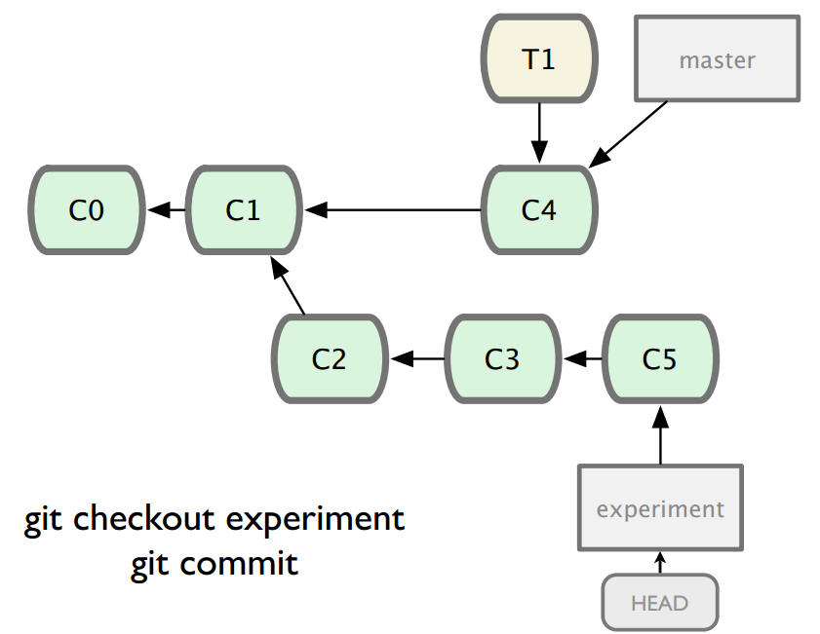
Git repo
Local Repository
Refs
Workspace
Notes:
Move back to experiment and commit one more

Slide 13
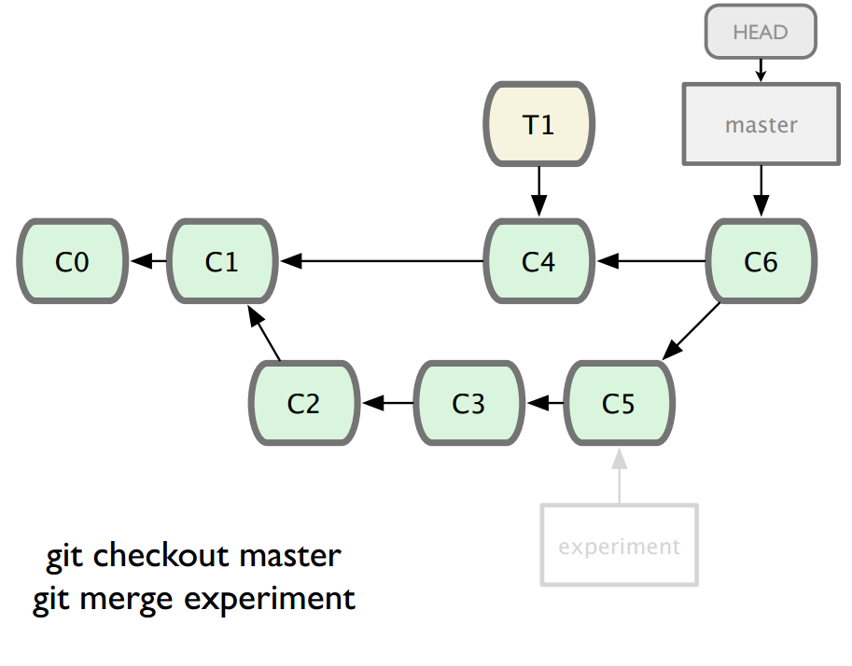
Git repo
Local Repository
Refs
Workspace
git commit
Notes:
Now we merge experiment into master, which creates another commit, the merge commit.

Slide 14
Git repo
Local Repository
Refs
Workspace
git commit
Notes:
Let’s take a closer look at what affects what.

Slide 15
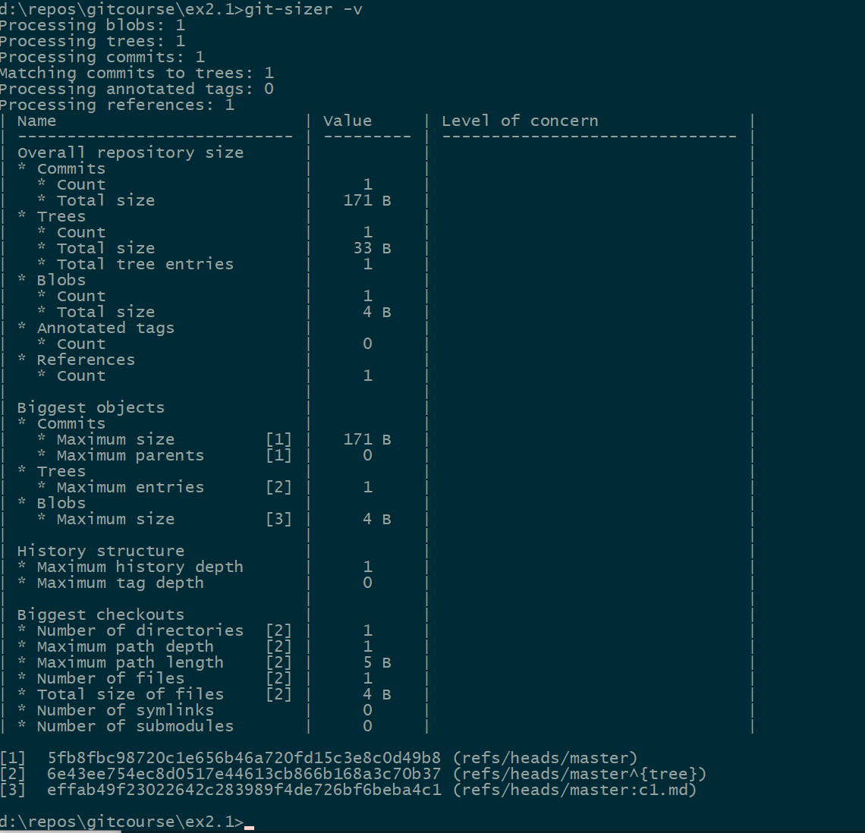
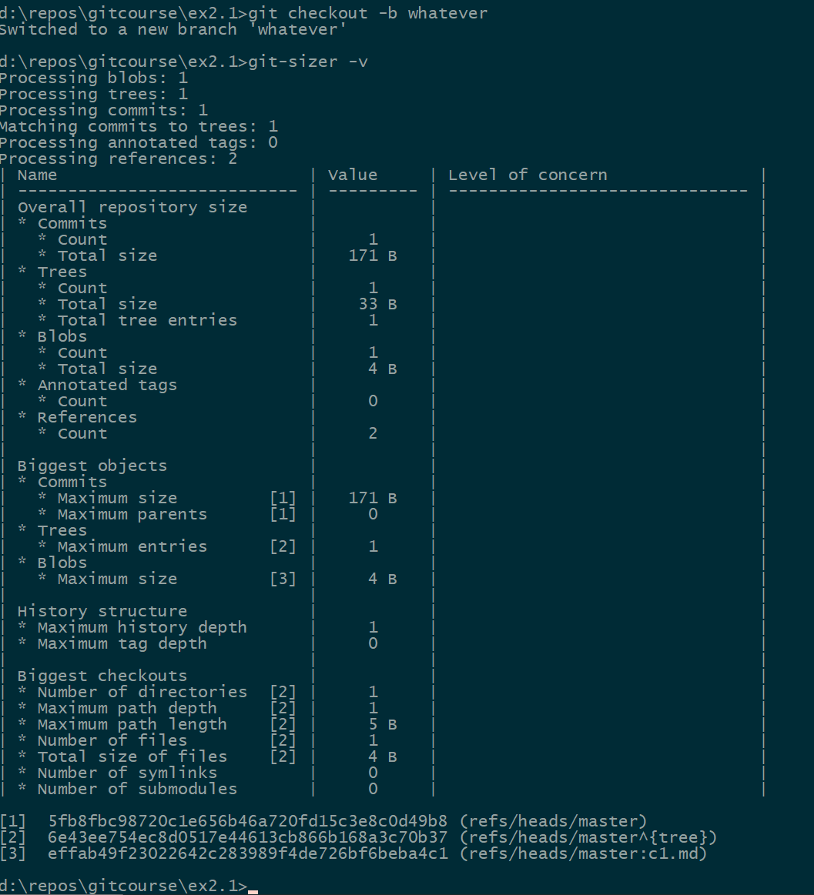
Git branches are lightweight
Git checkout -b

Slide 16
What is a merge strategy ?
Explicit – adds another commit
Recursive (default)
Ours
Theirs
Patience
Diff-algorithm=[patience|minimal|histogram|myers]
Ours
Resolve
Octopus (for multiple branches, e.g. multiple topic branches together first)
Subtree
Implicit
Fast-forward merges
Rebases

Slide 17
Exercise 2.2
A closer look at merging

Slide 18
Exercise 2.2 wrap up
Fast Forward merging
If you can, prefer this

Slide 19
Exercise 2.3
Branch naming conventions

Slide 20
Stashing

Slide 21
You are in the middle of some work, and then you need to go back to something else.
You don’t want to add your stuff into the current branch, not just yet.
So, you can then Stash it, which means to “put it into temporary storage”.

Slide 22
Exercise 2.4
Stashing

Slide 23

Source Control
Avoid branches with long life spans.
Notes:
Why shouldn’t we have multiple long lived branches in source control?
If you think if your work as delta off of a master…the size of the delta increases as your branch incorporates more and more work. As the size of your team grows, the amount of work hidden from each other increases. And the chances that your assumptions about the state of the code hold true decreases the more you use long lived branches. If you merge your code back to master frequently, you demonstrate the direction you’re taking the code. When you merge your code more frequently to master, the pain of integration happens at the beginning instead of the end of your work. This allows you to find issues faster and fix them at the earliest possible moment. Merging your code frequently also results in fewer merge conflicts. If you’re developing a large feature, consider using feature flags so that you can continue to merge your code frequently.
Create a plan on how to switch the source control location from Azure DevOps to GitHub.
Let’s assume you have already uploaded your codebase to GitHub from Azure DevOps. First, start by editing your existing build definition. When you initially configured the build definition, you selected Azure DevOps as the source for your code. You would now change the “Get sources” item to select GitHub. This, in turn, will require you to authenticate to GitHub (if you have not previously done so). Finally, you select the specifics for your Repository and Default branch. The rest of the build and release process remains unchanged.

Slide 24
Branching strategies
Gitflow
Github flow
Trunk based

Slide 25
Gitflow
Vincent Driessen at nvie (https://nvie.com/posts/a-successful-git-branching-model/)
Basic idea:
Using a Develop branch as pseudo-master
All feature branches merge to the Develop branch (aka Integration branch)
Master branch used only for releases
Using tags to mark the releases
Prepare a release by branching from Develop, when ready merge back to develop, and to master
Have a branch naming convention
Tools exist for enforcing this, e.g. Jakob Ehn’s Visual Studio gitflow extension
https://marketplace.visualstudio.com/items?itemName=vs-publisher-57624.GitFlowforVisualStudio2019

Slide 26


Slide 27
Github Flow
“GitHub flow is a lightweight, branch-based workflow that supports teams and projects where deployments are made regularly.”
https://guides.github.com/introduction/flow/

Slide 28
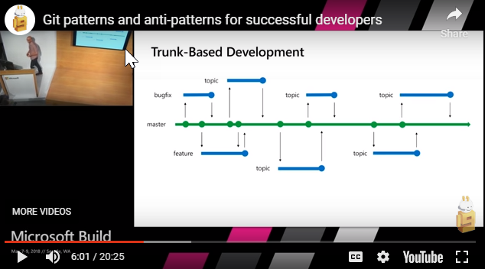
Trunk based development
Trunk based means ”Close to master”
Use short lived branches, one per TASK
Topic == Task
One task <-> One branch
One developer <-> One branch
Reduces merge conflicts
Use Feature flags to ”hide” non-ready features
See the full video by Edward Thomson here: https://youtu.be/t_4lLR6F_yk
Also see https://trunkbaseddevelopment.com/ and https://guides.github.com/introduction/flow/

Slide 29
Merging tactics
Scenario: When working on a branch X, and you want to merge to master
Start by merging FROM master to your branch X
That way you get to clean up any merge conflicts before you do the final merge.
Notice: This is a requirement when doing Pull Requests!
If you are unsure about that merge:
Create a merge branch from your branch: Xmerge
Merge from master to Xmerge
Fix conflicts, and if happy:
Merge Xmerge into X
This will then be a forward merge
Finally merge to master
And now there should be no conflicts

Slide 30

Branch advice
Create a good habit by:
Do no work in master

Slide 31
Git remote add origin <url>
Local
Remote
Git init
(do some work)
Repo create uninitialized
When you start something new, start locally
Git push -u
Git clone
Repo create initialized
(or existing repo)
When there already exist something
Git clone
Git init
(do some work)
Repo create initialized
(e.g. inadvertent)
When you just missed a bit
Git pull origin master - -allow-unrelated-history

