Slide 1
Section 3
SOLIDIFY
Pull Requests with a policy
Terje Sandstrøm
Microsoft Development Technologies MVP
March 2020

Slide 2
Code workflow
Codebase
Code
Local build
Local test
Commit/Push
CI Build

Slide 3
Protecting your codebase
Codebase
Pull
Request
Code
Local build
Local test
Commit/Push
CI Build

Slide 4
What IS a pull request
A request to open the protection gate to your codebase for your code changes
A request to the server to allow your code to be merged into the target branch
The target branch is the branch you are protecting with a PR policy

Slide 5
What does a pull request do?
Grab your code
Do a test merge with the target branch
Do a build of the merged code
The build may (*should*) include tests
Verify that all policy requirements are fulfilled
Resolve the pull request automatically, by automerge with the target branch, optionally deleting the pull request branch
https://www.visualstudio.com/en-us/docs/git/pull-requests

Slide 6
What are PR policies
Requirements that must be met
Examples:
A build or a set of builds must run green. They can contain a series of steps, and all must pass
Code must have been reviewed and accepted by someone else than yourself

Slide 7
PR Policy Azure Devops

Slide 8
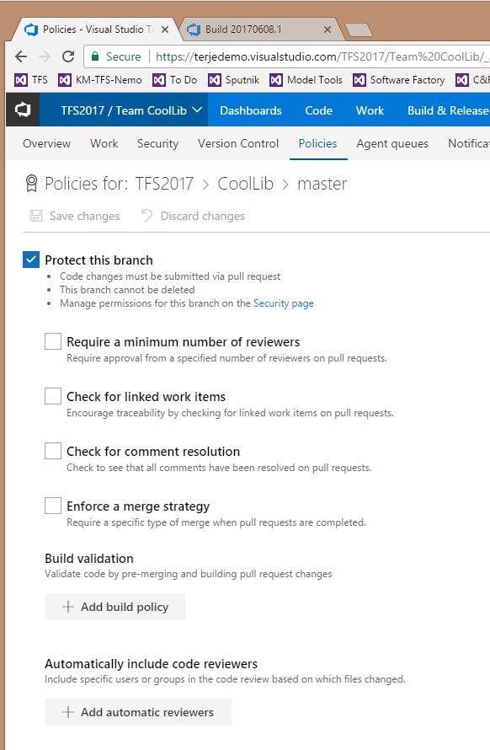
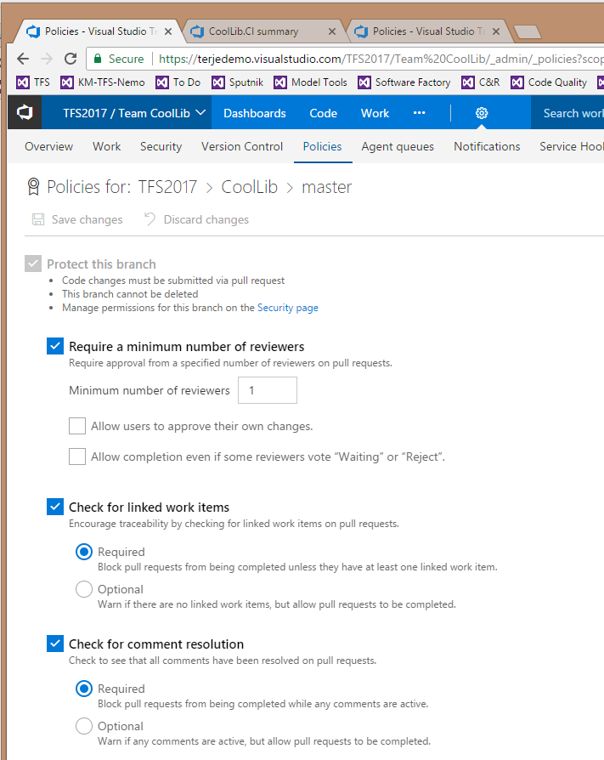
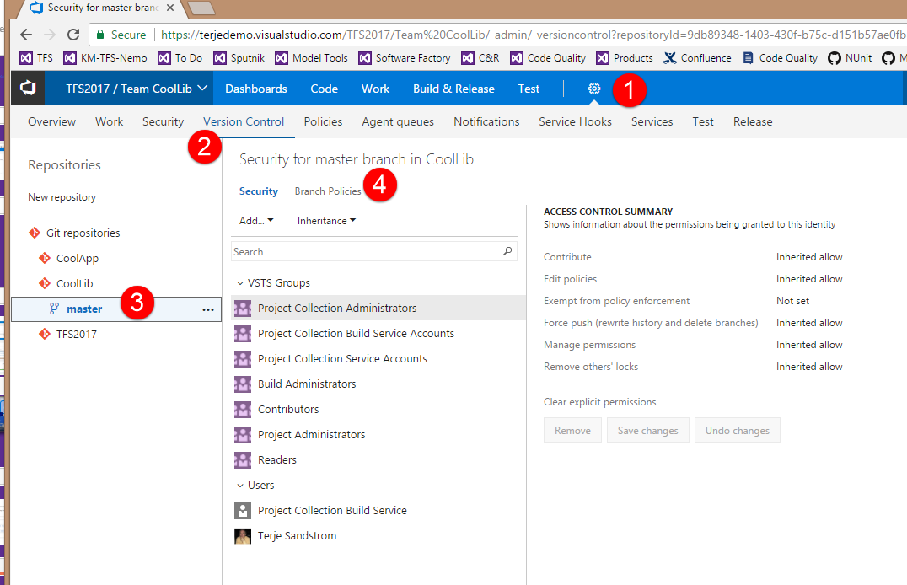
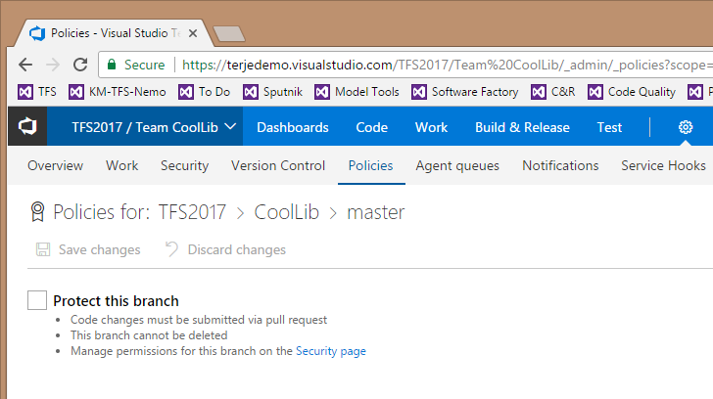
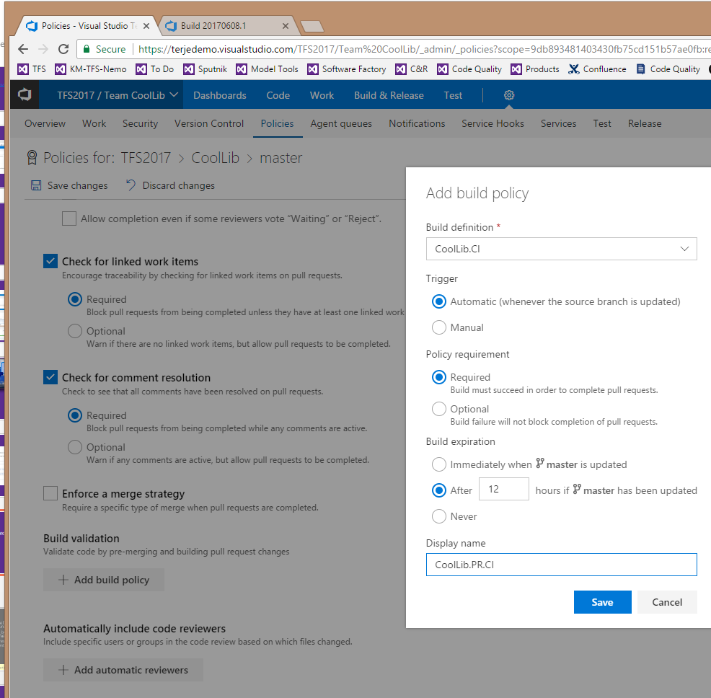
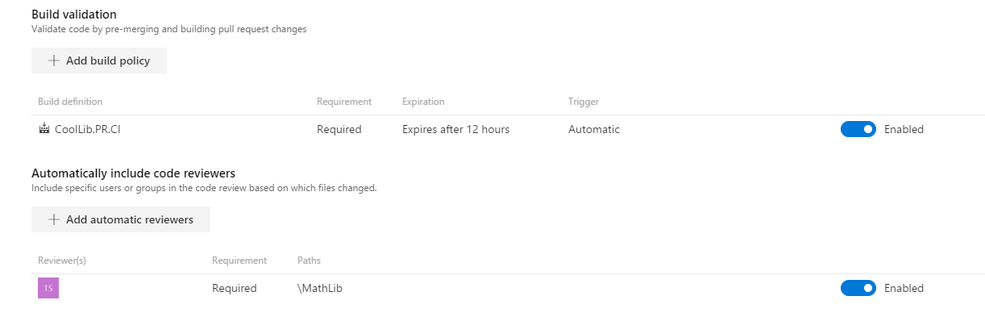
Setting up a PR policy

Slide 9
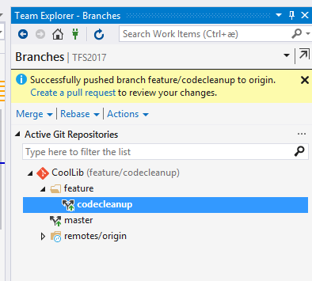
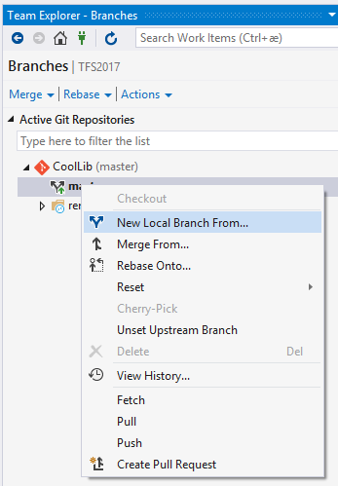
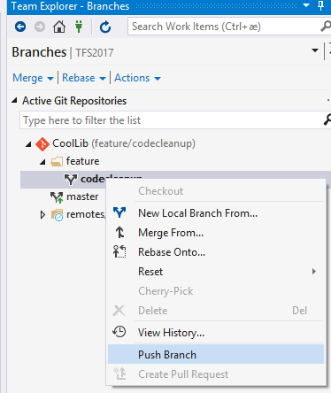
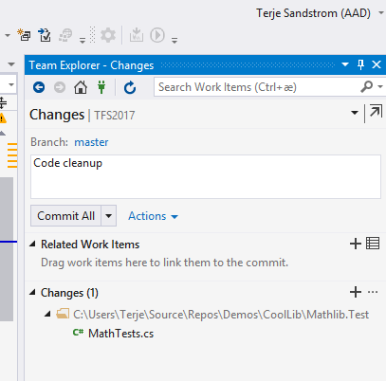
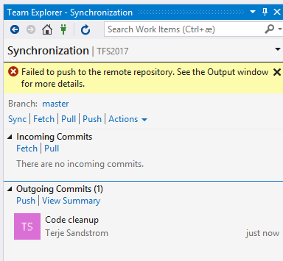
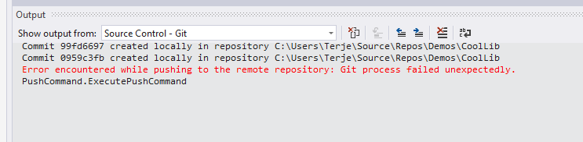
Doing a code change with a PR policy in effect

Slide 10
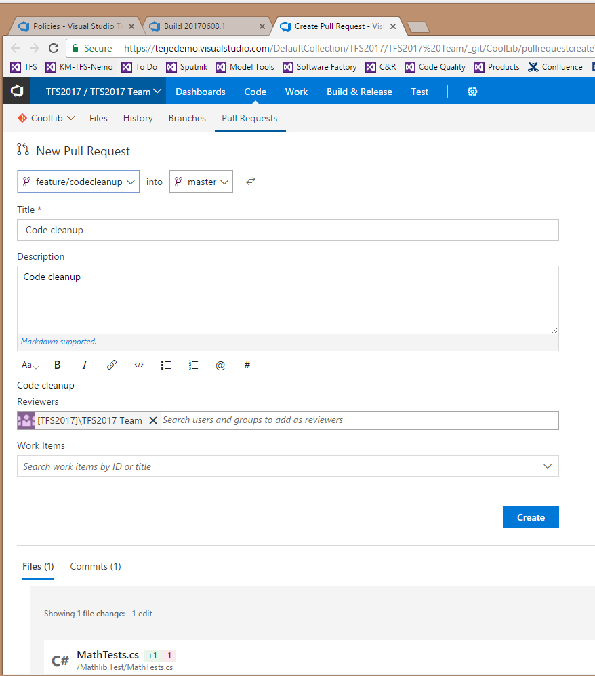
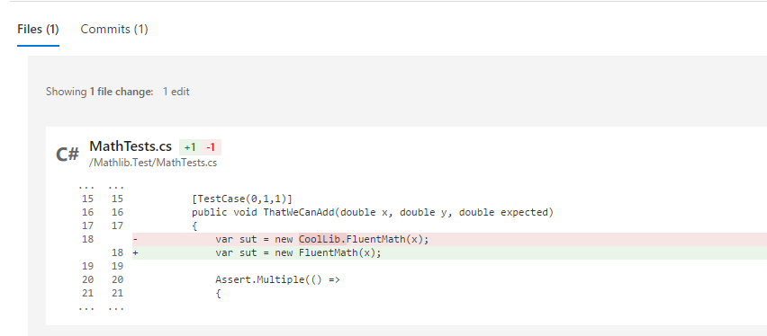
Doing a code change with a PR policy in effect

Slide 11
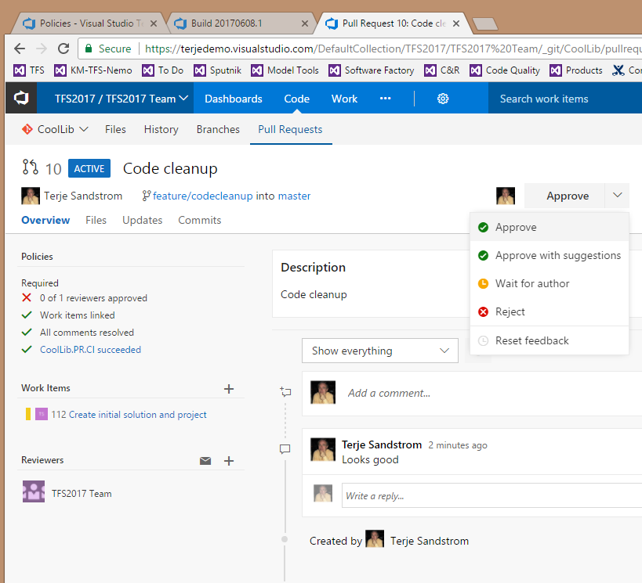
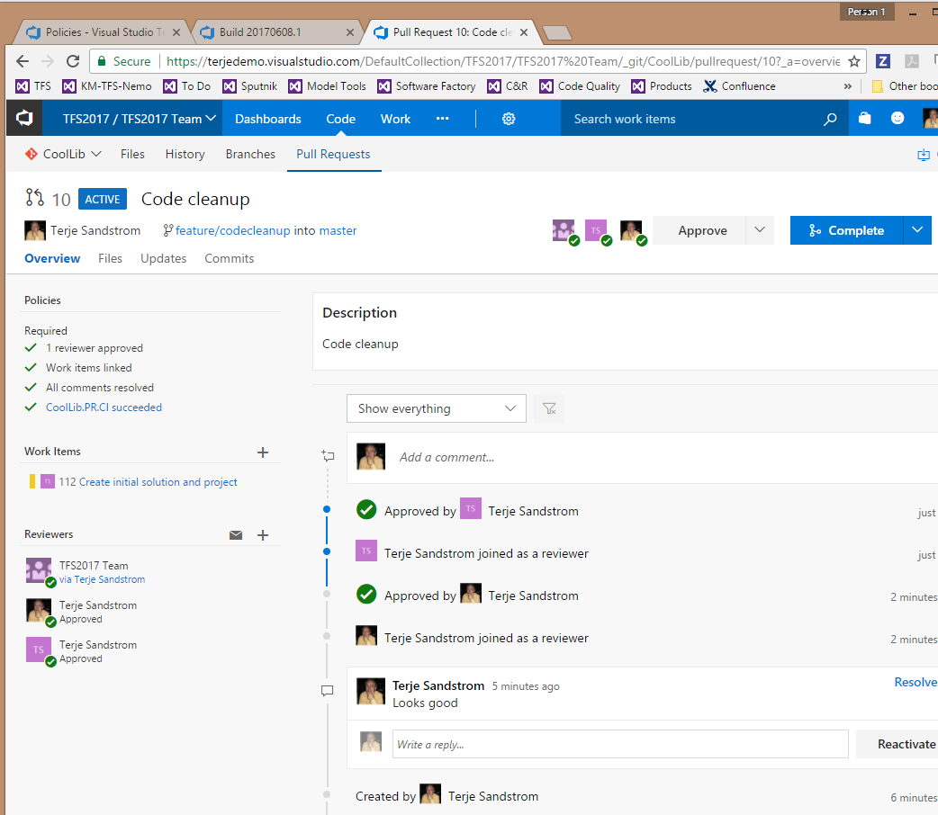
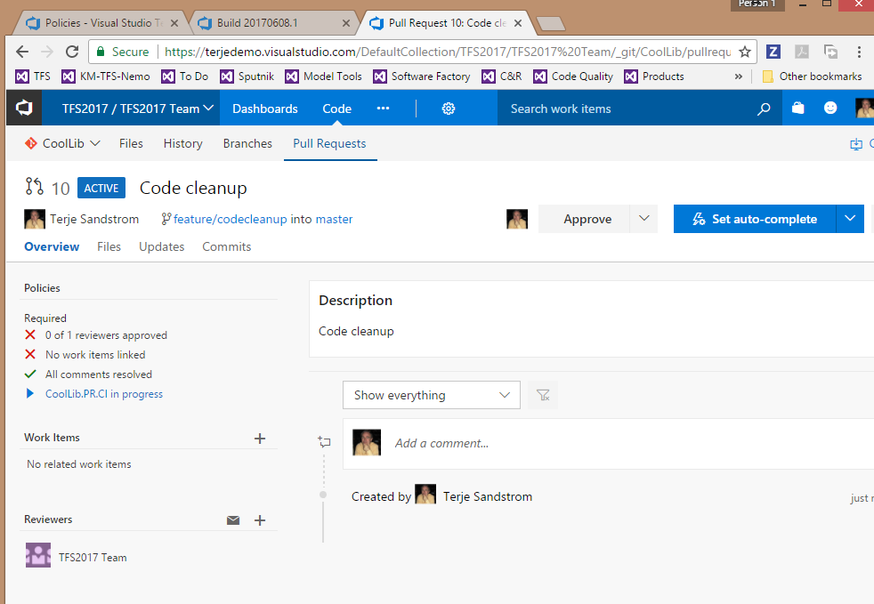
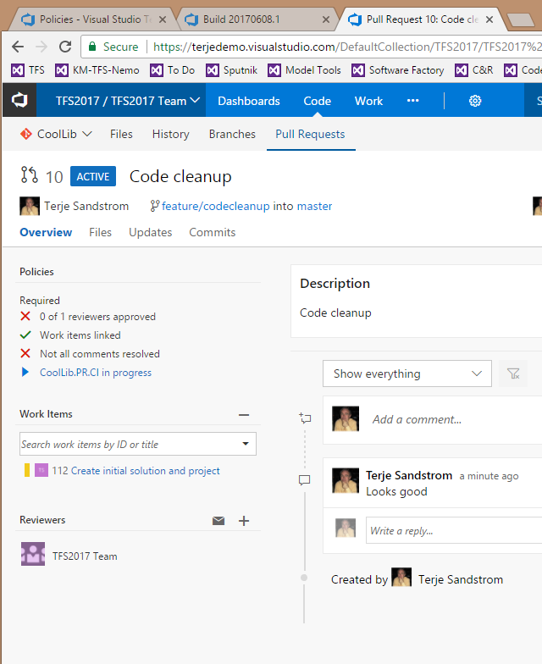
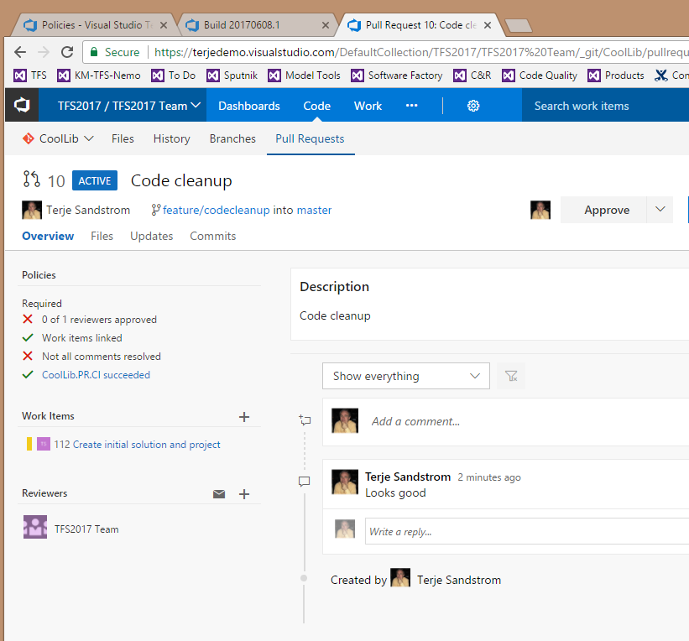
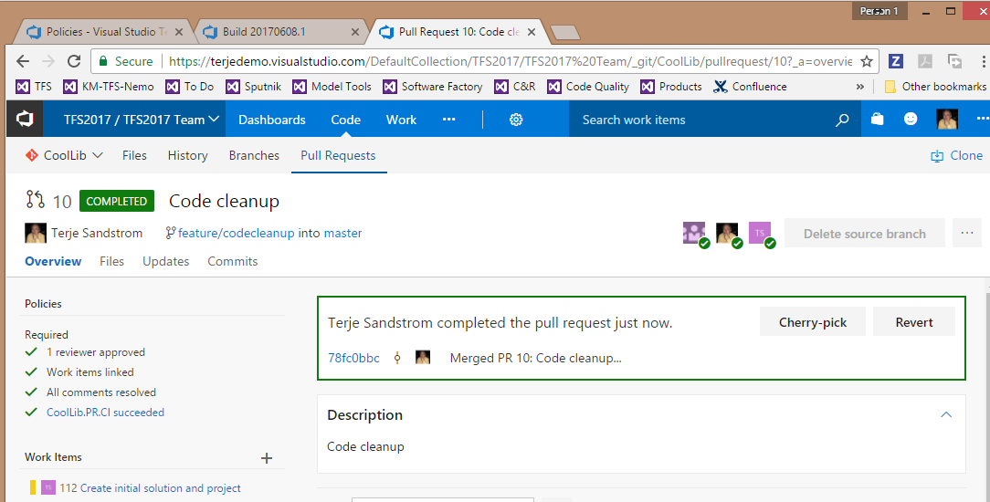
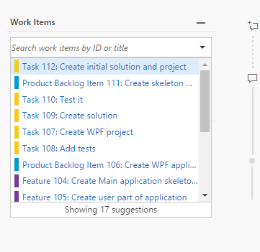
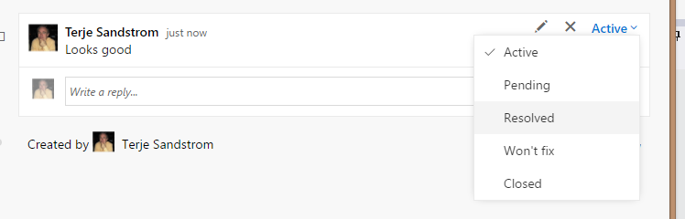
PR

Slide 12
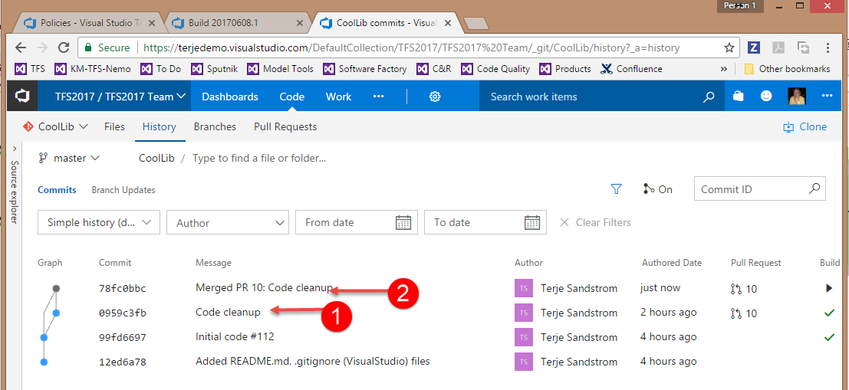
What happened in source

Slide 13
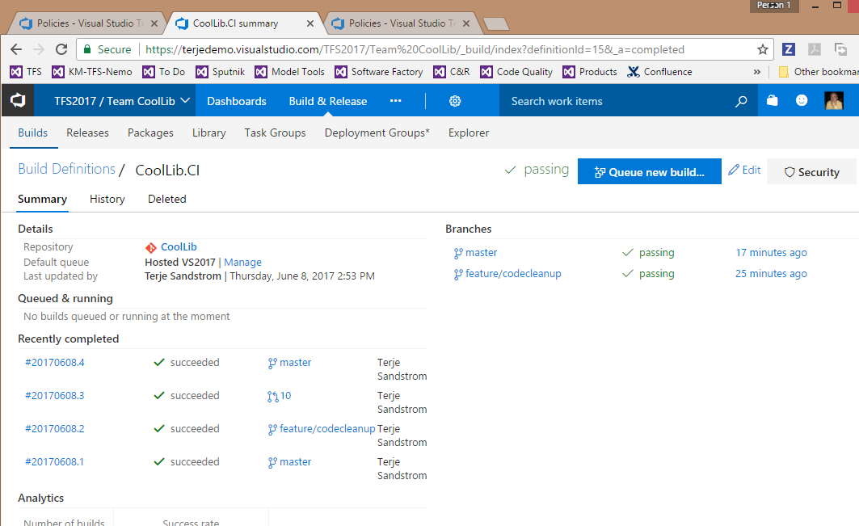
What happened in build

Slide 14
PR Policy GitHub

Slide 15
See Exercise 3.1

