Slide 1

Rebasing
Terje Sandstrøm, 2020

Slide 2

Functionality of a rebase
When you make a new commit, that commit is a child of the former commit in the same branch, its parent.
When you merge two branches, you move the branch pointer forward - and if there is a need for a merge commit, it will be added as a child of its two parents.
Rebasing is when you figure out that you don't like your parents, and decide to swap them out for someone else.
The pointer from a commit to its parent is called the "base". Rebasing switches that base pointer to another commit parent.

Slide 3
Technicality of a rebase
Git doesn't do exactly that. What is described above is the functional aspect of what a rebase is.
What it really does is to replay the commit(s) involved onto the end of the other target parent.

Slide 4
Experiment
C3
C2
master
C1

Slide 5
Purpose of rebasing
You are a developer doing a change in your branch, based on the latest code
Before pushing, you observe someone else has changed master.
You want to “pretend” you still work on the latest changes
You pull down master, and do a rebase of your branch onto that.

Slide 6
Can rebase cause merge conflicts?
Yes

Slide 7
Dangers of rebasing
It changes history
Don’t rebase if you already have pushed the branch
Don’t rebase branches that you have pulled down (tracked)
You can rebase ONTO these branches though!

Slide 8

Benefits of rebasing
You get a more linear history
You might avoid merge commits
If there are no conflicts

Slide 9
Exercise 3b

Slide 10
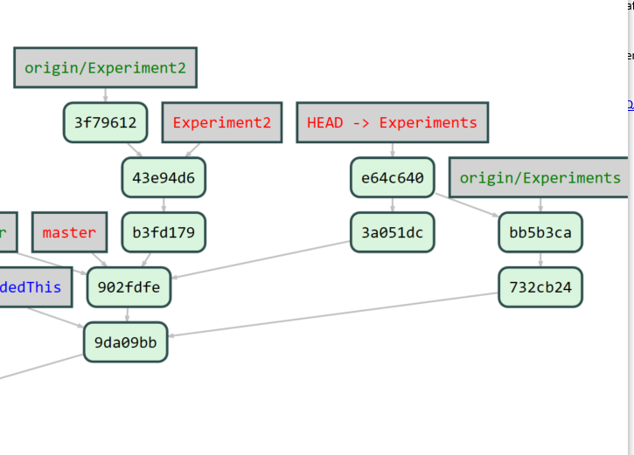
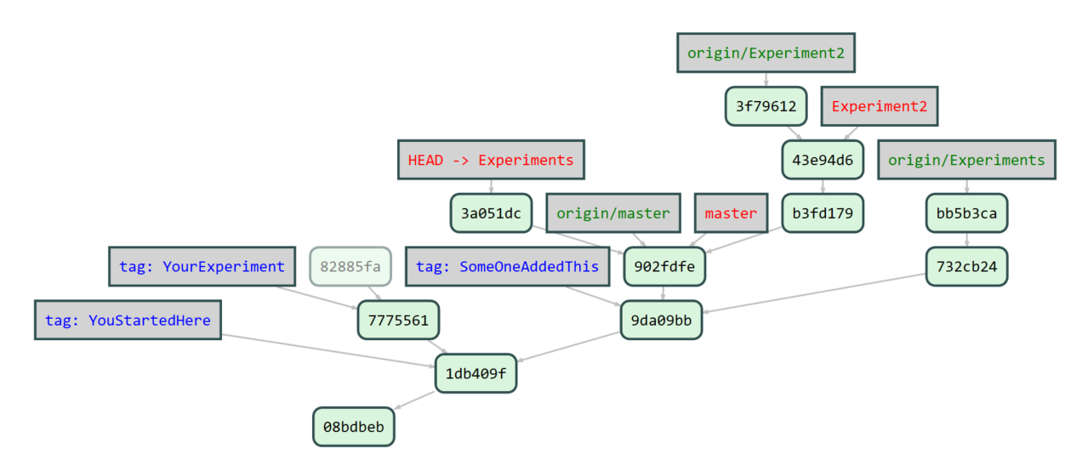
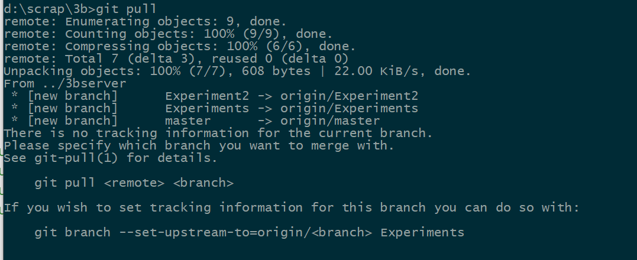
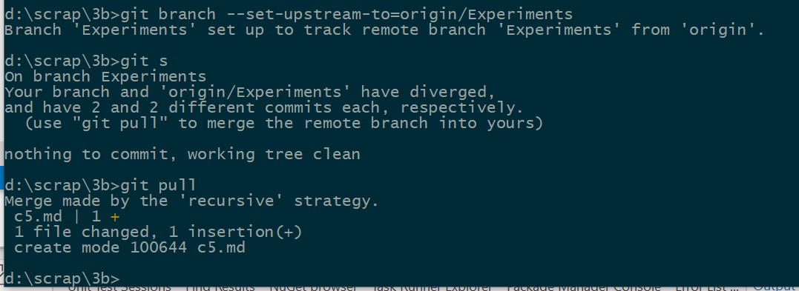
Rebasing a branch that has a Remote

Slide 11
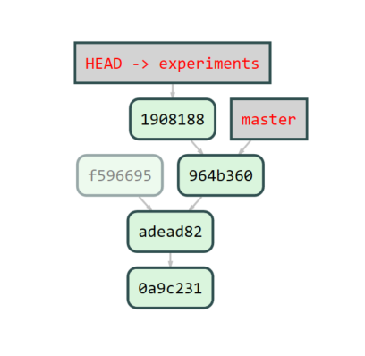
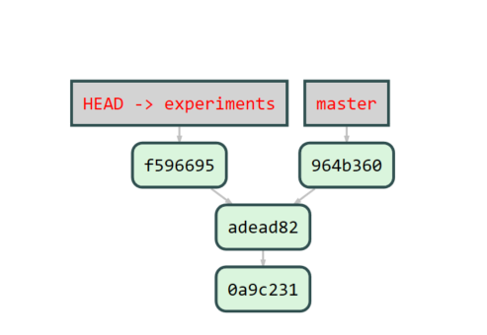
We are on branch Experiment
Git rebase master:
Rebase C3 on C2
C3’
C3
C2
C1

