Slide 1
Using Tensorboard with RL

Slide 2
What is Tensorboard?
Tensorflow’s visualization toolkit

Slide 3
Why Tensorboard?
Tracking and visualizing metrics such as loss and accuracy
Visualizing the model graph (ops and layers)
Viewing histograms of weights, biases, or other tensors as they change over time
Projecting embeddings to a lower dimensional space
Displaying images, text, and audio data
Profiling TensorFlow programs
And much more

Slide 4
Simple Tensorboard with MNIST
https://www.youtube.com/watch?v=eBbEDRsCmv4
Make summary: tf.scalar, tf.image, tf.histogram, …
Merge summary: tf.merge, tf.merge_all
Create writer: tf.summary.FileWriter(name, sess.graph)
Get summary: sums = sess.run(summaries, feed_dict)
Write summary: writer.add_summary(sums, step)

Slide 5
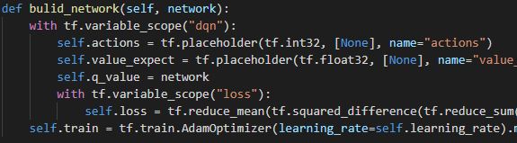
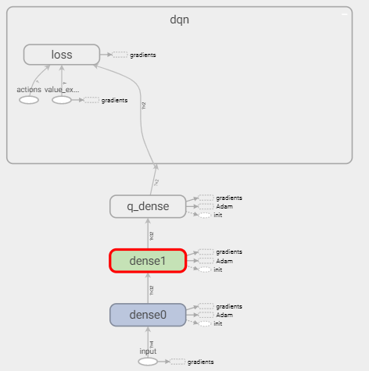
Tensorboard with RL
Visualize model’s graph with tf.variable_scope(name)
cartpole.py 6-23
dqn.py 14-21

Slide 6
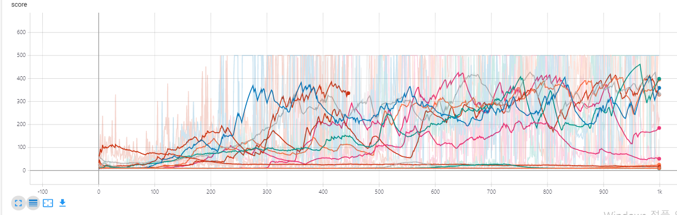
Tensorboard with RL
Visualize model’s loss and score
tf.scalar(scalar tensor)
Only supports tensor
cartpole.py 38-42, 70-71

Slide 7
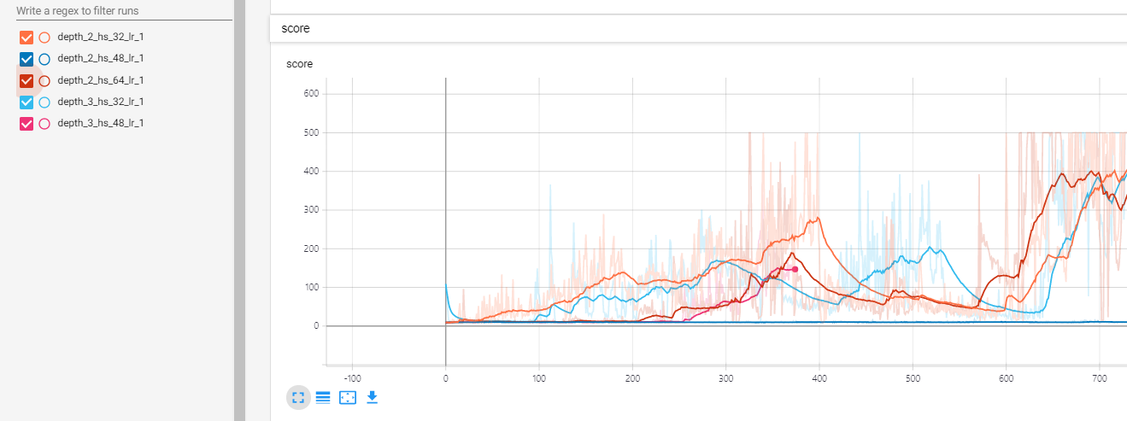
Tensorboard with RL
Visualize different model’s graphs all together
Hyperparameter tuning
cartpole.py 78-104

Slide 8
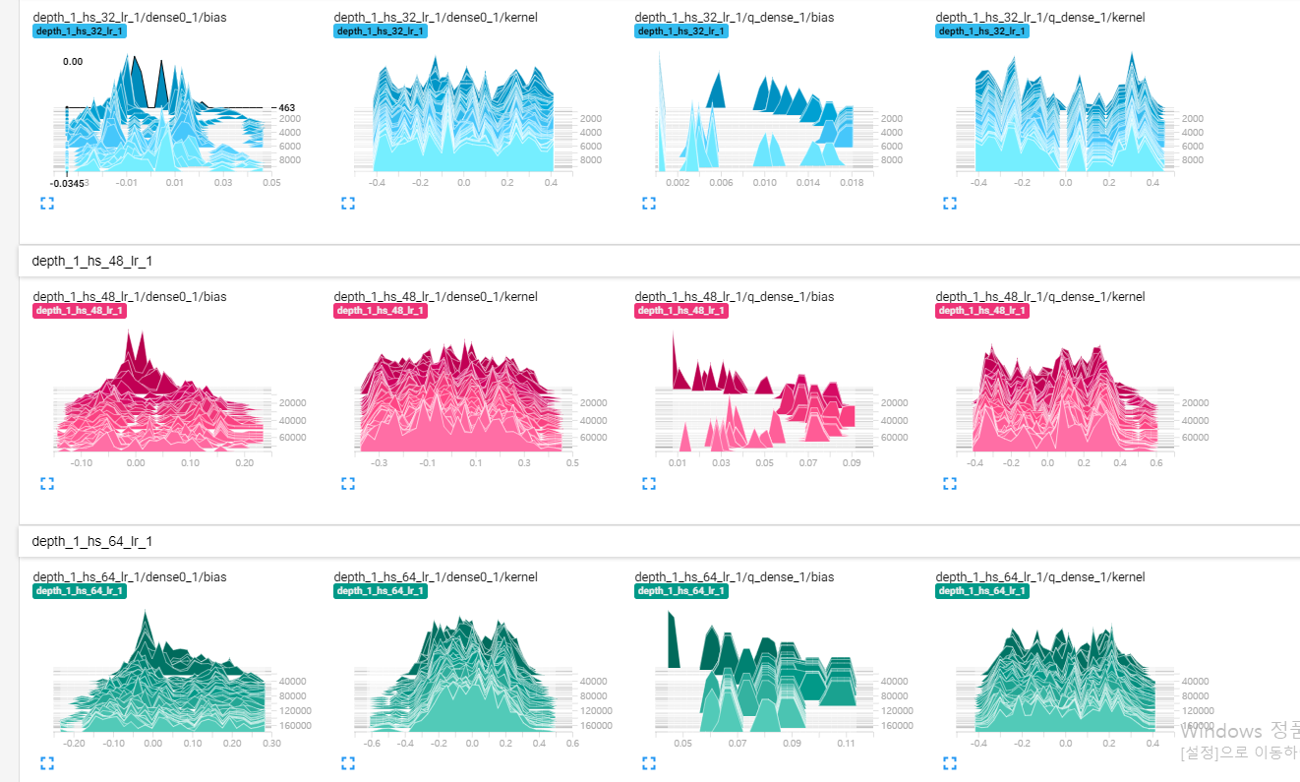
Tensorboard with RL
Visualize model’s tensor
tf.histogram(tensor)
cartpole.py 6-23

Slide 9
Show logs on web
Use command on cmd or anaconda prompt
tensorboard --logdir=“relative path”
Open localhost:6006 on web

Slide 10
Github link
https://github.com/Osj1614/tensorboard_guide

