Slide 1
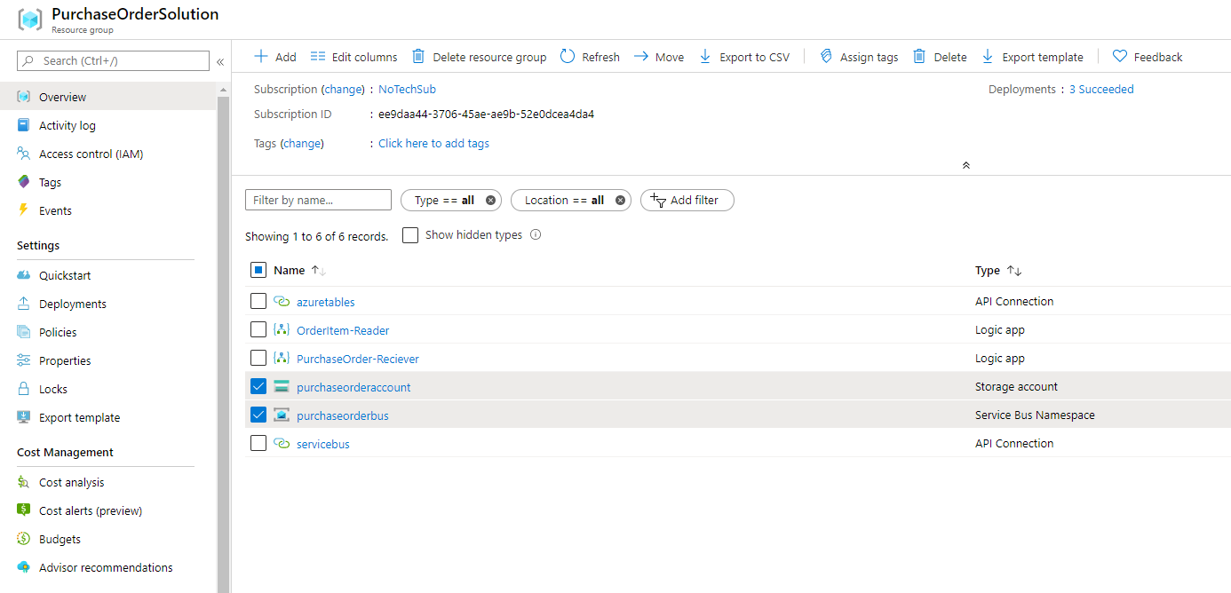
We will start of by extracting some of the arm template of our project. Select your storage account and Service Bus in your resource group. Press the ”Export template” button in the top right.

Slide 2
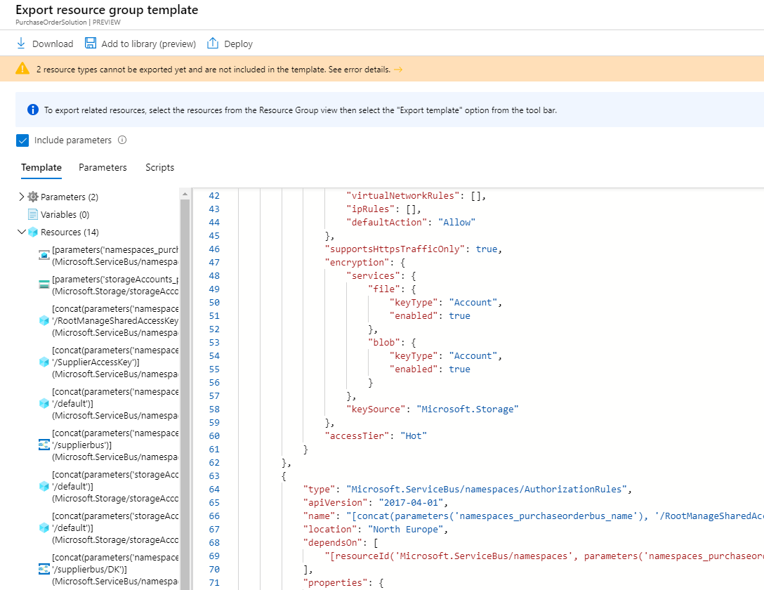
This template includes the resources you chose to extract. Some resources are devided into multiple subresources. For example, ”Microsoft.ServiceBus/namespaces/AuthorizationRules” is not a visible resource in your resource group. It does not exists on the resource group level, but requires a serivcebus namespace to exist. Once you’ve inspected all resources, press download.

Slide 3
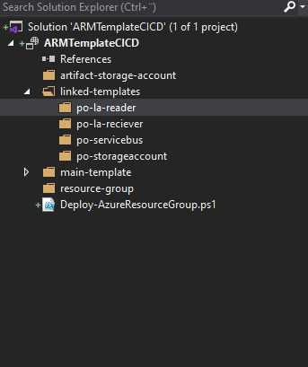
We want our pipeline to deploy a resource group, a storage account to store our artifacts and the main template which deploys our linked templates.
Create a new Visual Studio project,select project type ”Resource Group Deployment---” and select empty project.
You will end up with a powershell script and an arm template depoyment file with a complementary parameter file.
The folder hierarchy should look like this, the most important part is to seperate our linked template from the remaining files, since those are the templates we will copy to a storage account.

Slide 4
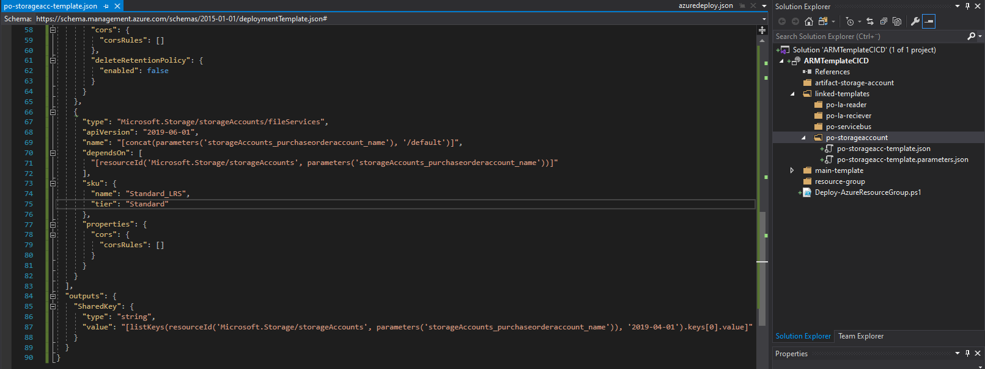
We will have to make some changes to our arm templates for redeployment, these changes might vary depending on the resource you want to redeploy.
Create a new deployment and parameter file under the storageaccount folder in the linked template folder. Simply copy and paste your storage account resorce, and any resource which refers to the storage account in the ”dependsOn” section from the template you downloaded from the Azure Portal.
Initiate the parameter file with the same parameter as your deployment file. Lastly add a shared key reference to the outputs of your template. We will need this shared key during the deployment of our Logic App.

Slide 5
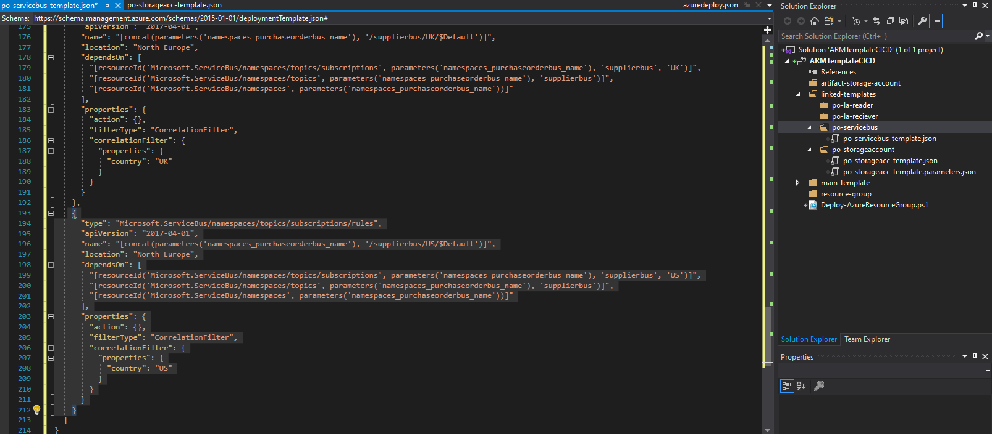
Follow the same procedure for the Serivce Bus, Simply copy and paste the namespace resource and any resource which dependsOn that Service Bus namespace.
Service Buses are not as straightforward to redeploy compared to the Storage Account, there are some necessary modifications. Remove all instances of the ”Microsoft.ServiceBus/namespace/topics/subscription/rules” resource from your template. This type of resource are not redeployable in its current format.

Slide 6
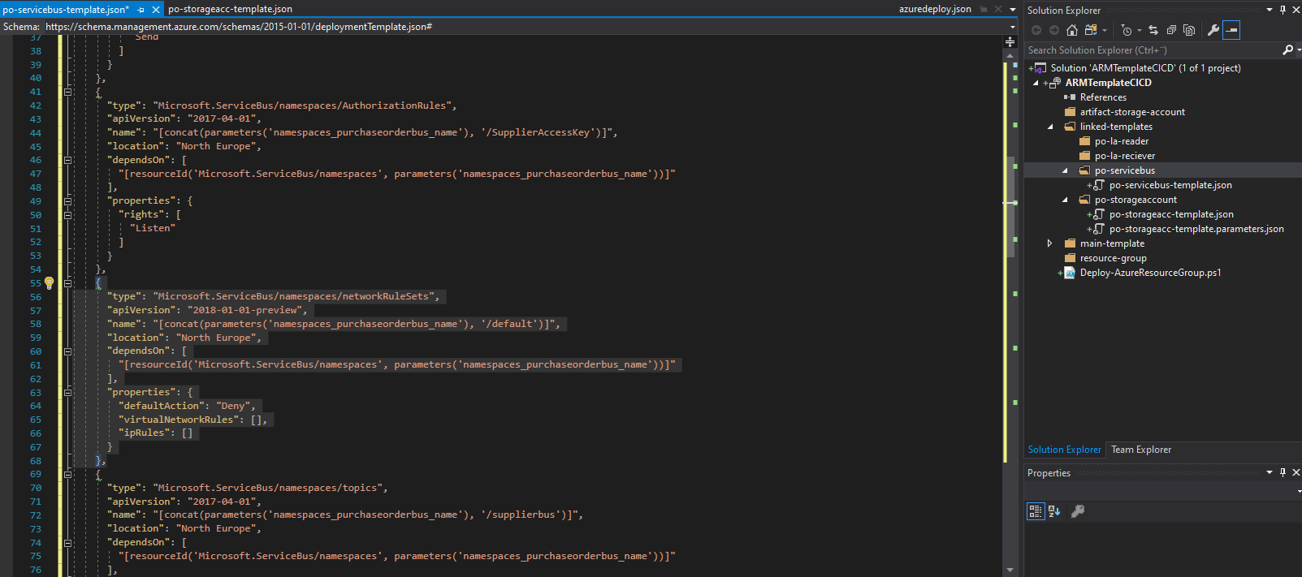
Another resource which are not redepoyable is the ”Microsoft.ServiceBus/namespace/networkRuleSets”. As this resource is set to the default value, we can simply remove it from our template and allow ARM to handle that creation during deployment.

Slide 7
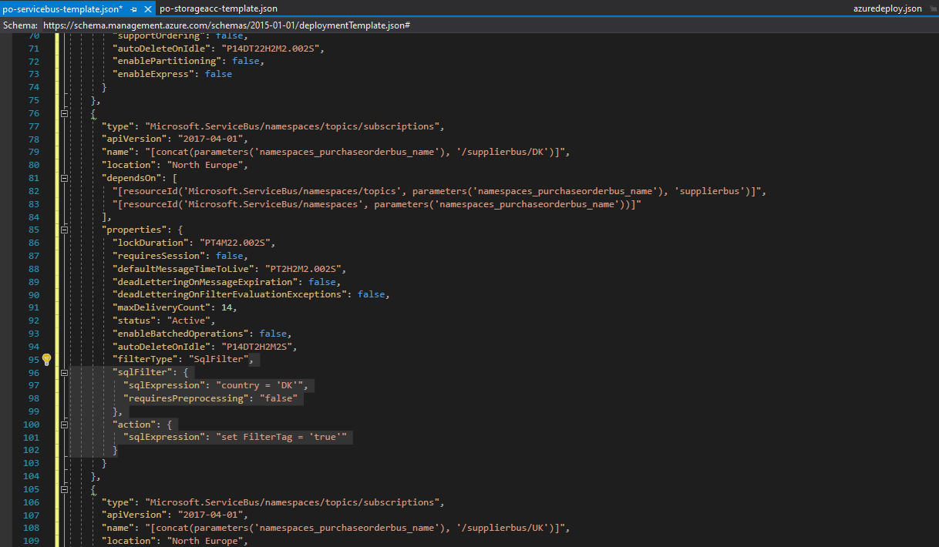
The /rule resource is not allowed to be redeployed as a $Default rule, but we still want our subscriptions to filter messages in our new deployment. Add the following property to each /topic/subsciptions in this arm template. But change the expected country value of the sqlExpression depending on the subscription name.

Slide 8
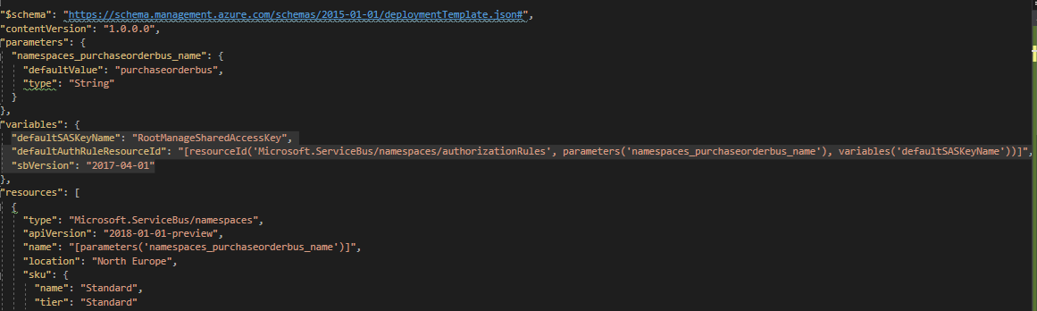
Logic apps will require a Service Bus connectionstring, meaning we need to output that connectionstring from this template deployment. To get that connectionstring we chose to define the defaultSASKeyName and AuthRuleResourceId in variables.

Slide 9
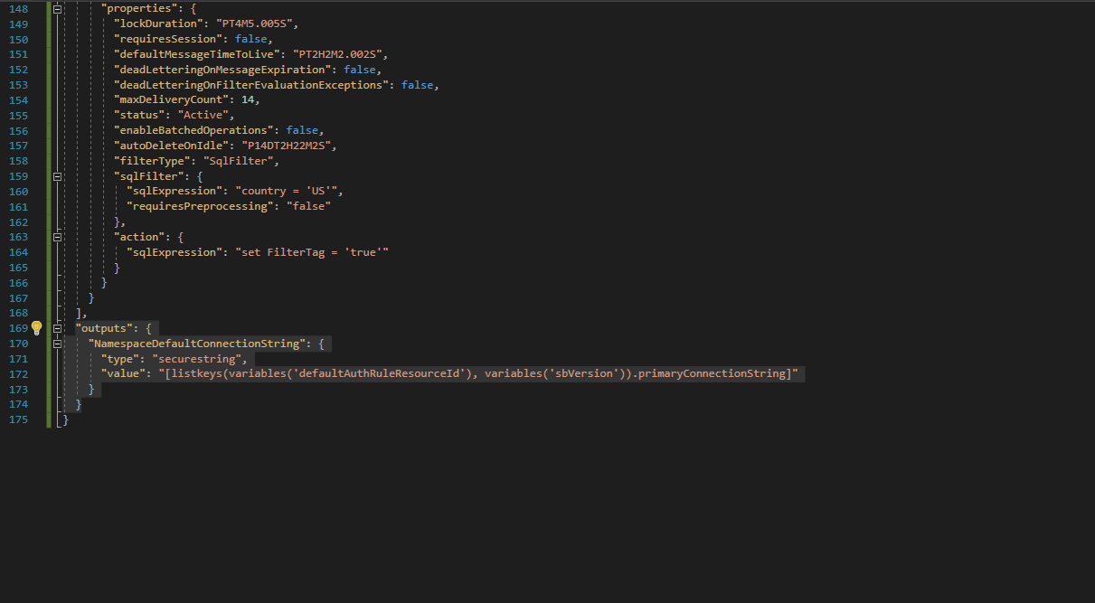
We use the listkeys of this Service Bus by refering to the ruleResourceId and extracting its primaryConnectionstring.

Slide 10
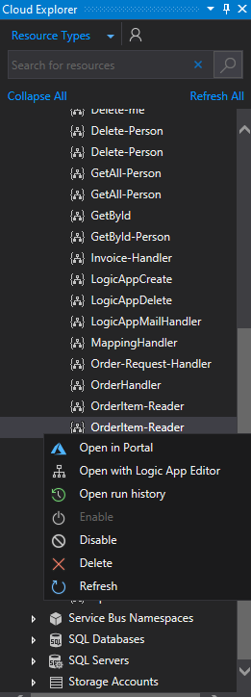
Now we have the Storage Account and ServiceBus ready for redeployment. We still have our logic apps to redeploy.
The extraction of logic apps from the portal are tedious because of hard coded resource dependencys and the extraction sometimes leave the template with undeployable resources. To get a redepoyable logic app ARM template we recommend using the cloud explorer in visual studio to locate the logic app in your subscription and use the ”Azure Logic Apps Tools” to open the logic app in visual studio.
The ARM template you get when you download the template with
”Azure Logic Apps Tools” is ready for redeployment, with all the necesary parameters and api connectors, its practicly completly ready for redeployment, unlike the ARM template you extract from the portal.
As these templates are redeployable, you can practicly drag and drop them into the the appropriate logic app folder in your vs project.

Slide 11
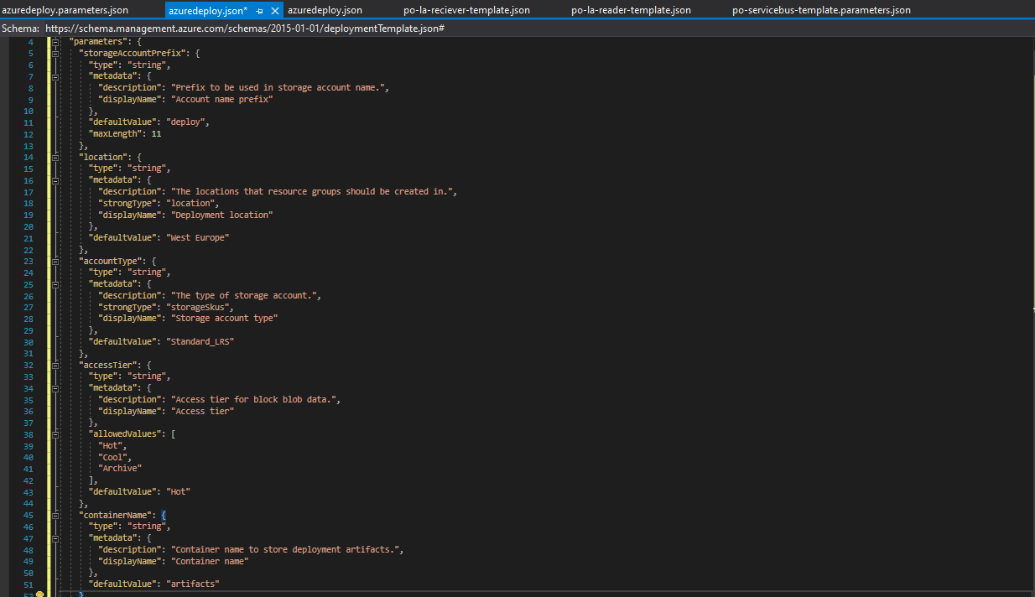
Now we have all the linked arm template ready for redeployment, but we are still missing the ARM templates which handles the actual deployment. This Arm template will be responsable for storing the ”linked template” artifacts, and will be deployed before the main deployment.
These are the expected parameter.

Slide 12
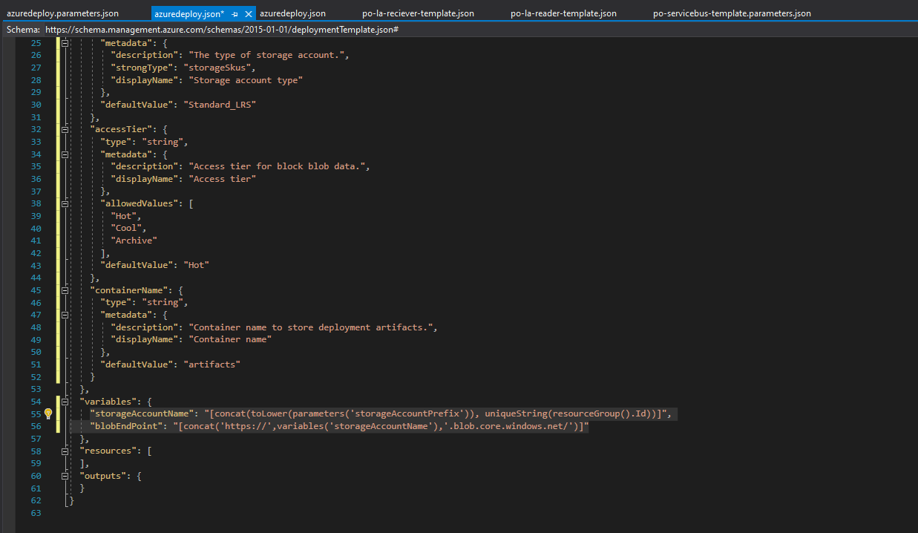
We initiate variables to get a in the unique string in our accountName and generate a blobEndPoint

Slide 13
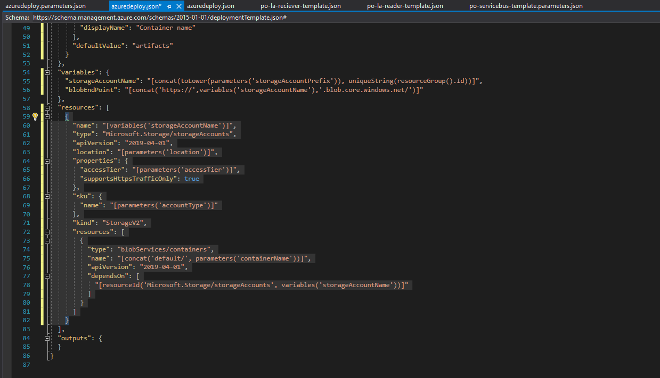
This is a standard storage account resource deployment with a blob container

Slide 14
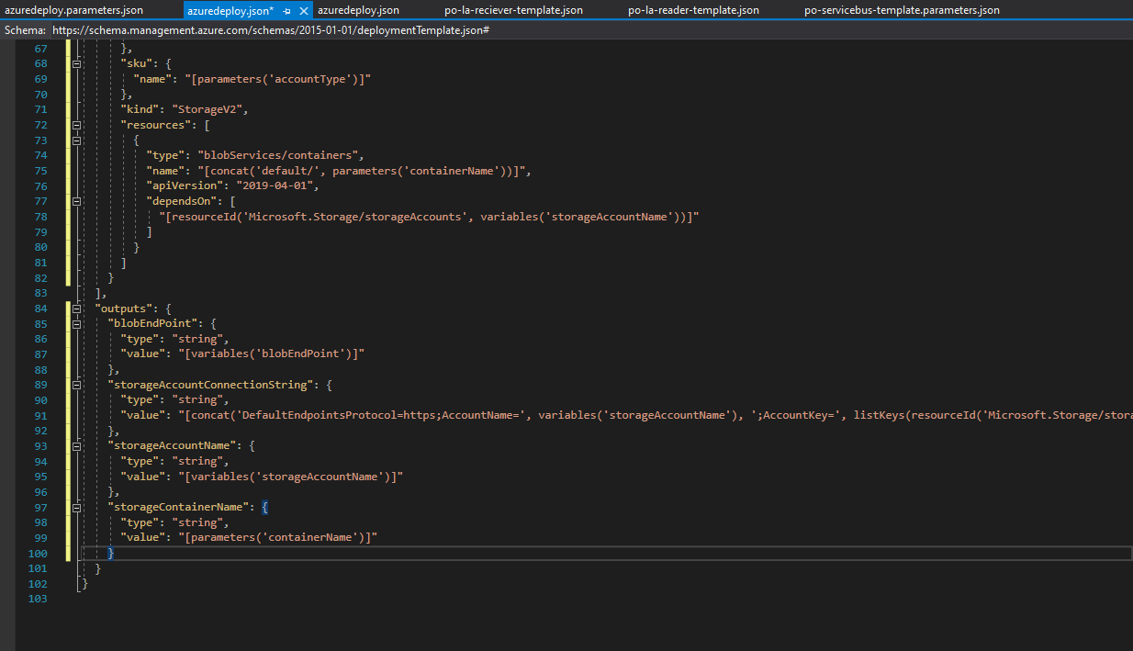
We are going to need these variables as output when fetching the artifacts from our main deployment template in the pipeline. Create a parameter file to match this template. The artifact storage account is now ready for deployment.

Slide 15
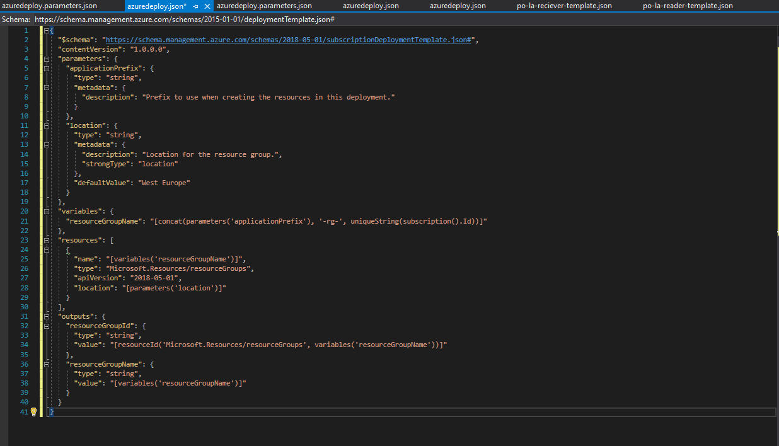
The resource group deployment template simply deploys a resource group, since we will deploy to the subsciption level in our pipeline, we want to ensure the creation of this resource group. Match the paramters in a paramterfile, and you’re done

Slide 16
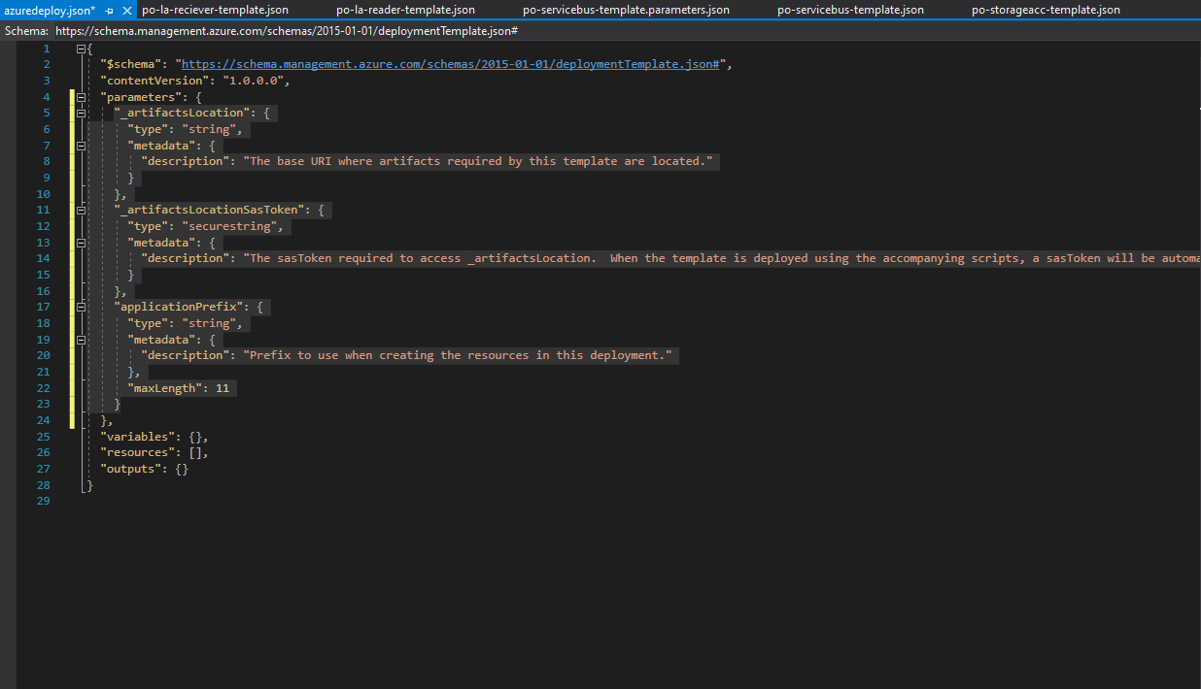
This is the main template, and will be responsable for fetching the artifacts from a storage account blob and deploy them into a resource group. To access these artifacts, we will need location and sastoken parameters. The application prefix is optional, but useful when depoying resource cross resource groups.

Slide 17
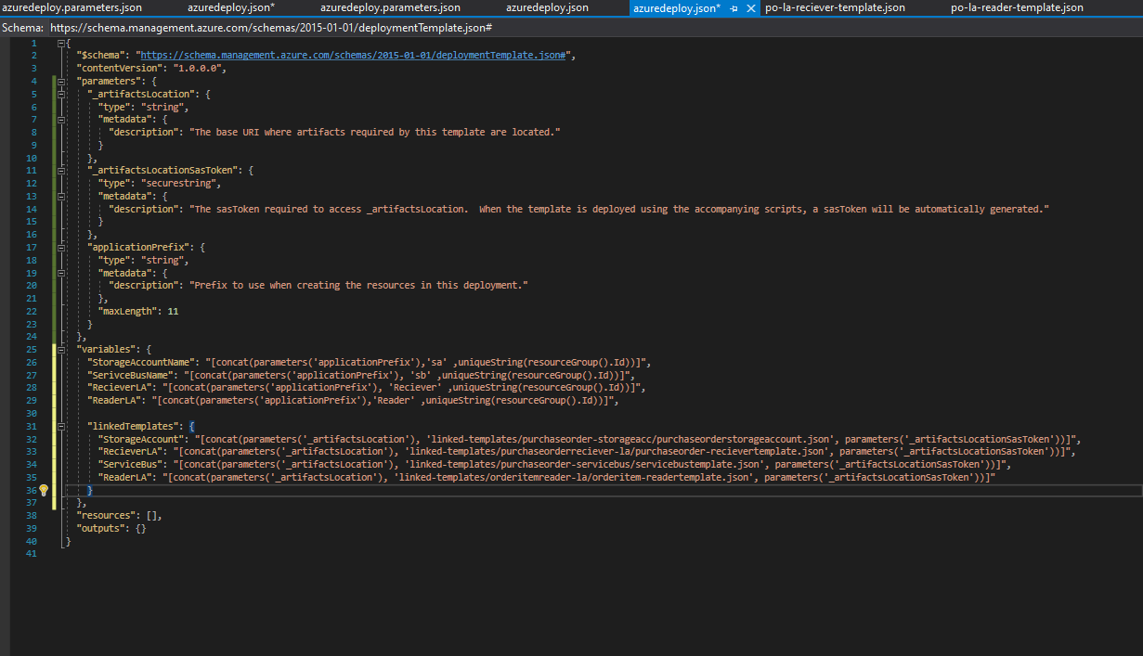
In our variables we are going to generate unique resource names and define the artifactlocation to each of those resources.
The linkedTemplates might change depending on how you chose to structure the template files. Define the second paramter of the concat string depending on your naming convention and folder structure.

Slide 18
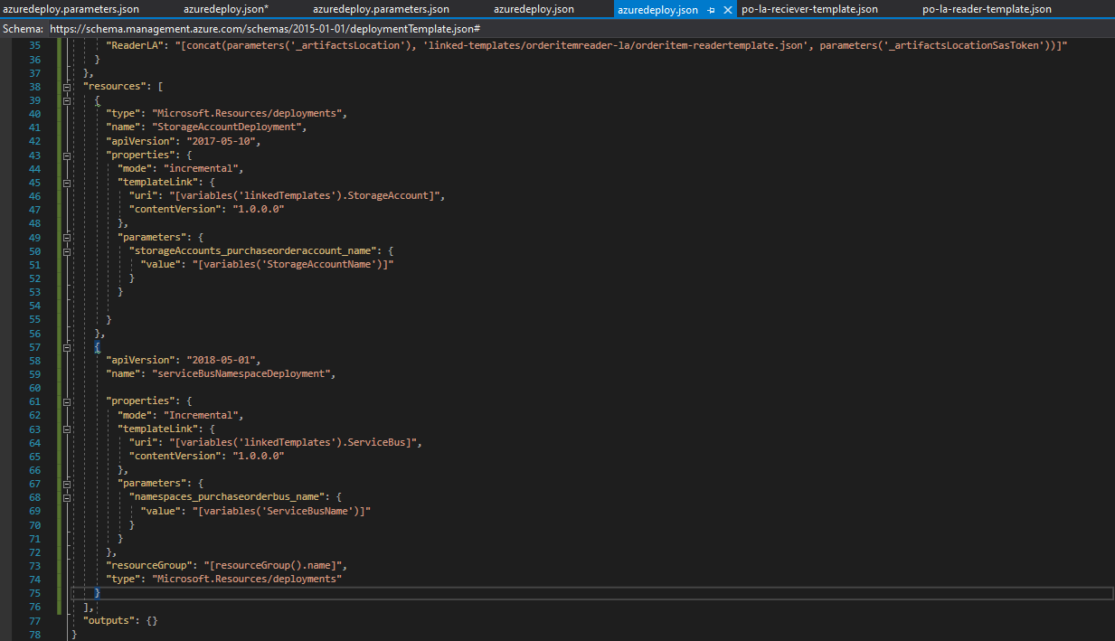
We are going to add two ”Microsoft.Resources/deployments” resources, one for the po storage account template and one for the service bus template. The templateURIs are defined in the recently created variables.

Slide 19
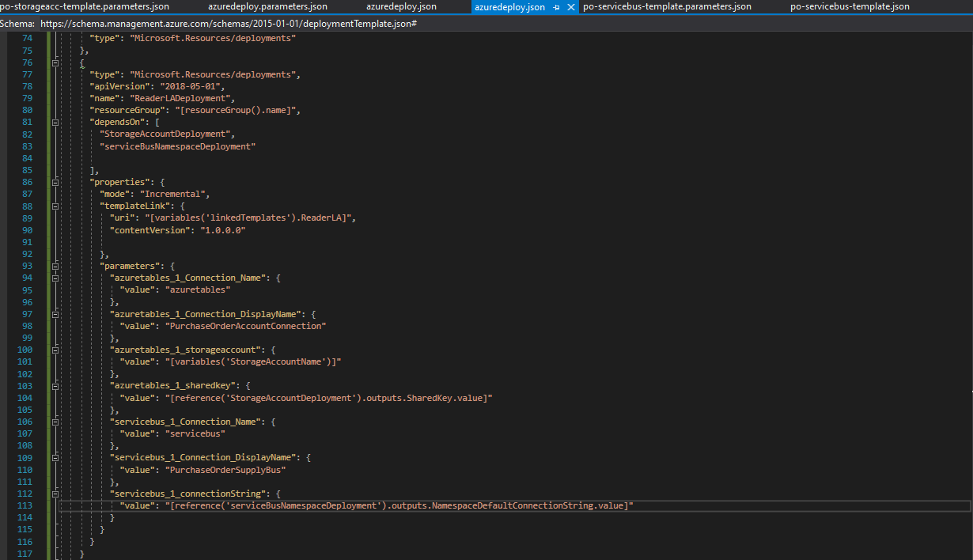
The logic apps follow the same resource template structure, exept with more parameters and parameters depending on the output of prevous deployment. By using ”dependsOn”, this LA deployment will wait on the deployment of ”StorageAccountDeployment” and ”serviceBusNamespaceDeployment”.This is required since the logic app needs the outputs of those deployments. The deployment of your LA will fail if those outputs are incorrect.

Slide 20
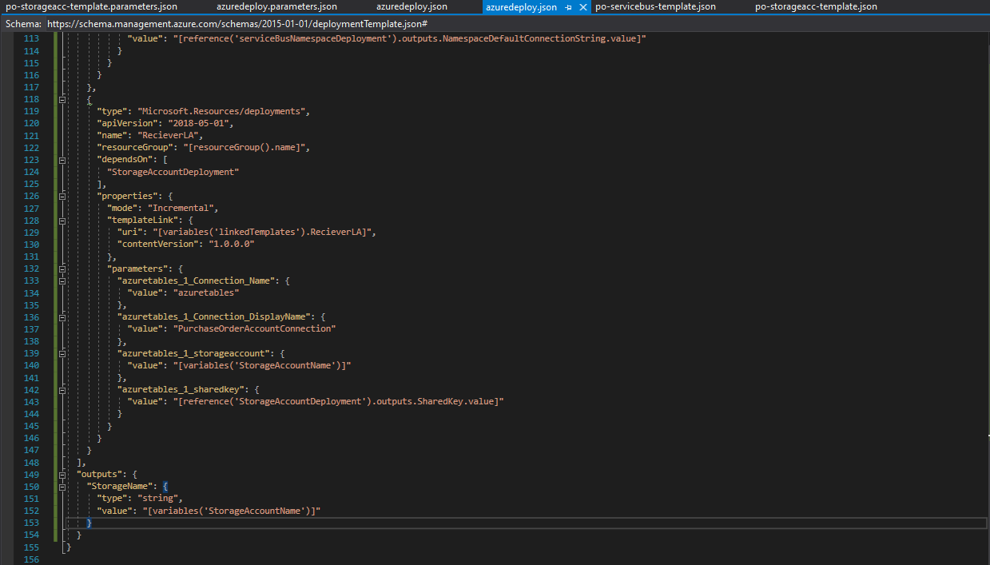
The ”Reciever” Logic App follow the same syntax as the previous LA deployment, but with less parameters.
As you might have noticed when configuring the po storage account template, there where no ”table” resource. It is currently not possble to create tables with templates. To solve this issue, we will use powershell in our pipline to create these tables. We are passing the storage account name as the output of this main deplyoment to add tables in the pipeline with powershell.

Slide 21
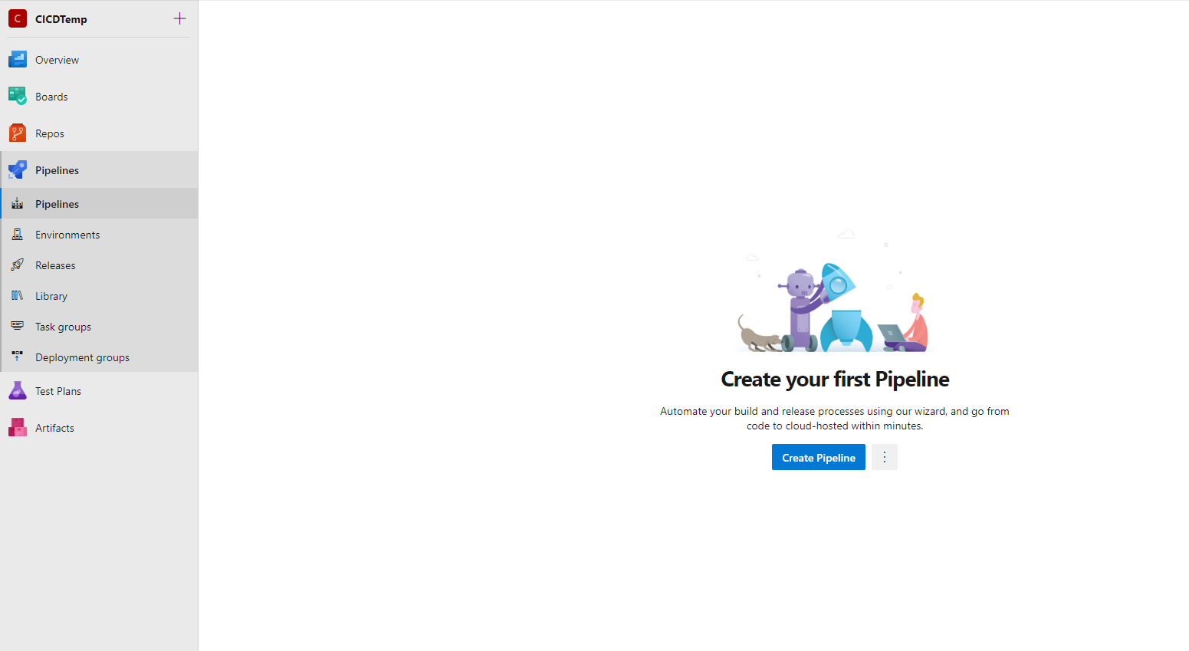
Now you are completely done with the setup of your arm template deloyment. We can now start setting up the build pipeline.

Slide 22
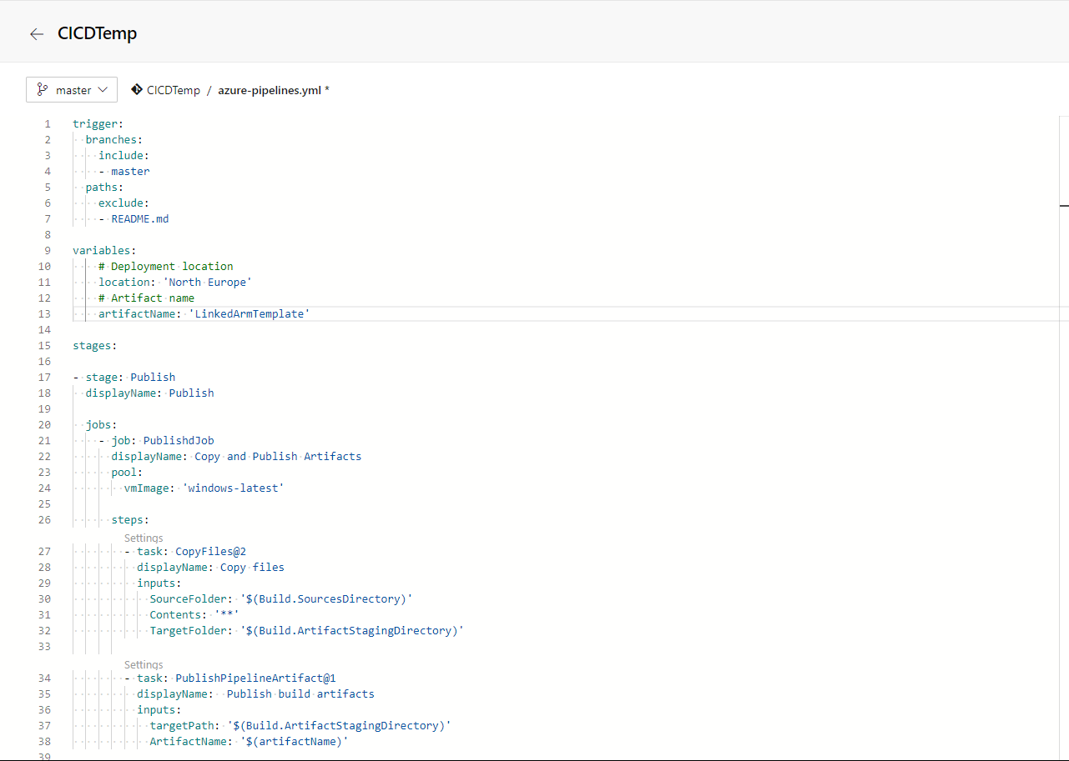
We define the pipeline to trigger on commits to the master branch, and what files to exclude.
The first task ”CopyFiles2” copies all files from sourcesdirectory to the staging directory and the secound task publishes those artifacts

Slide 23
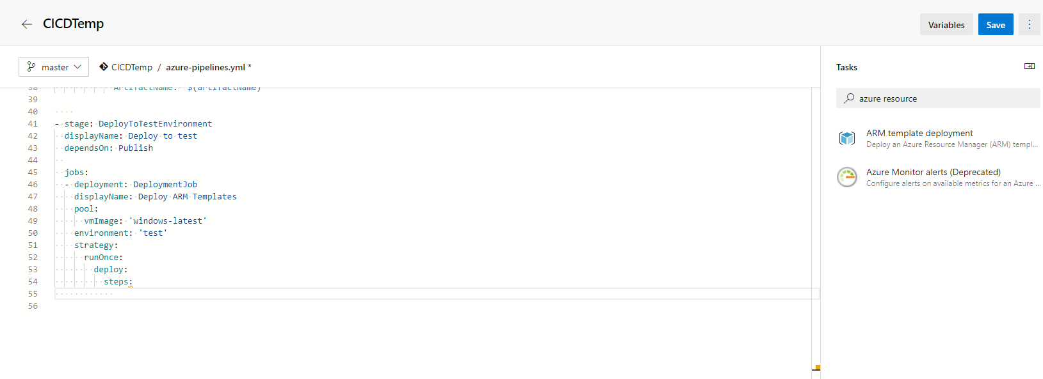
To find the inputs of tasks you can search the task menu, select the task you want to try, enter anything in the options and press ok. By doing this a task will be created in your .yml and you can get a better view of those inputs.

Slide 24
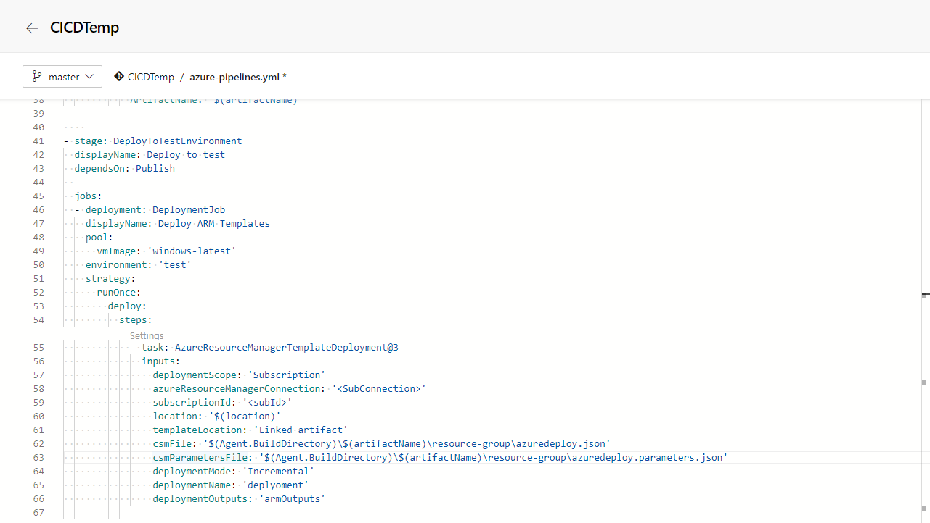
This template will deploy the resource group template, you can manage verification of your subscription by searching for the task ”ARM Template Deployment”. This first deployment task will simply deploy the resource group you defined in your project.

Slide 25
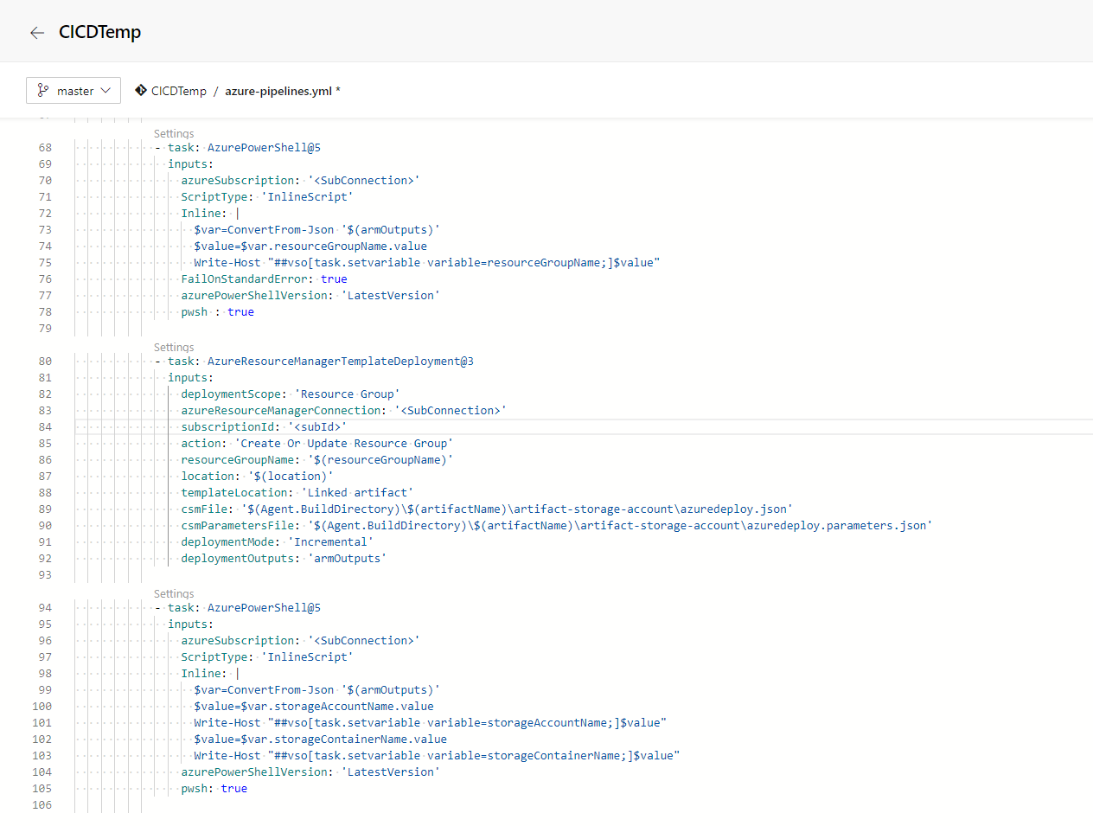
The next task is a inline powershell scripts which takes the output from the previous deployment(resourceGroupName) and stores that in a environmental variable. The next task is a deployment which deploys the artifact-storage-account, which outputs its name and blobname. The last powershell task stores those outputs as environmental variables.

Slide 26
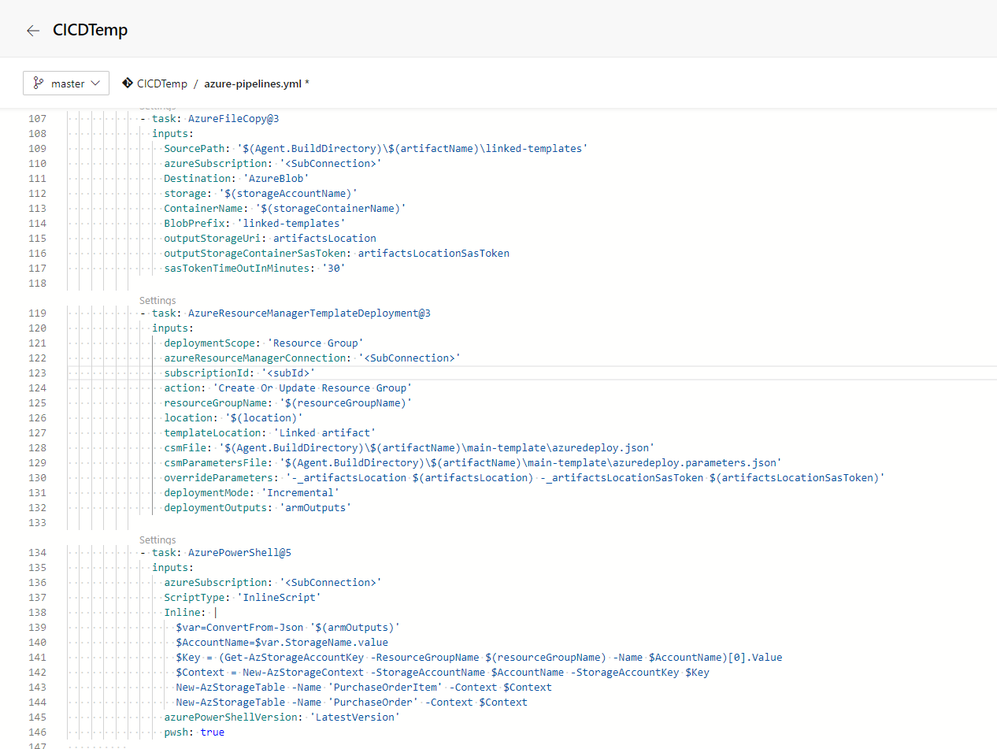
The AzureFileCopy task takes the linked template folder of the previously initiated artifacts and copies that content into a storage blob in the recently deployed artifact storage account. The tasks also creates a sastoken which lasts 30 minutes.
With this sas token we can deploy the main template which with the storageURI can locate the linked templates required to allow the main template to find the linked templates. Finally we take the po-storage-account name from the main template outputs and with powershell, create two tables called ”PurchaseOrderItem” and PurchaseOrder

Slide 27
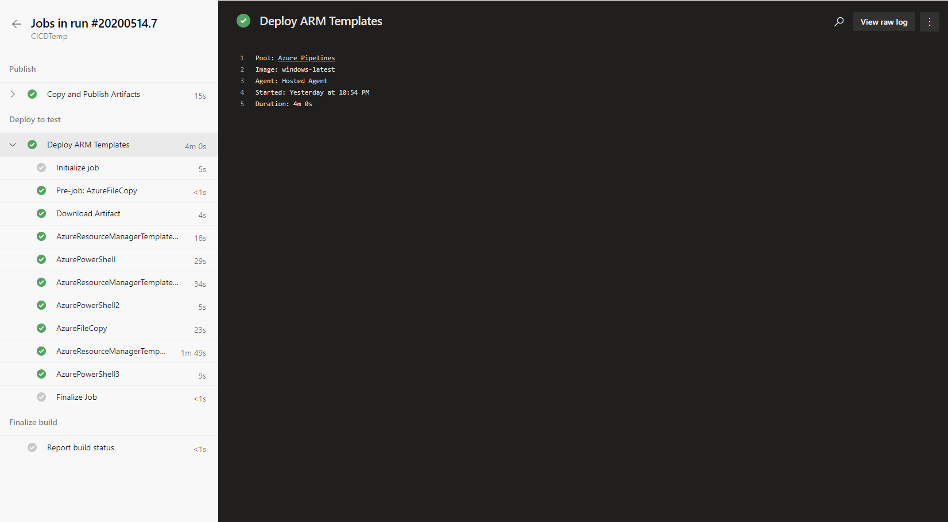
Save the pipeline. It will be added to the master branch of your repository. And since the yaml is set to trigger on new commits, the pipeline will trigger immediately.

Slide 28
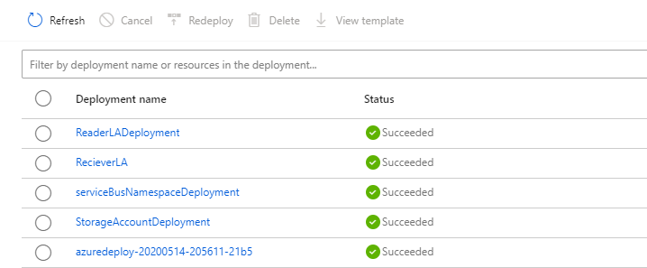
Verify the deployment by entering the new Resource Group and press ”Deployments”
You can analyse these resources to verify outouts and inputs if you’re having issues with your deployments.
There are many things you can do with a arm template. Such as include or exclude specific resources in a deployment, make more hardcoded variables into parameters to make your template more generic, override template parameters conditinally.
This is a short example of how you can prepare extracted templates for redeployment and set up a build pipeline for CI CD.

