Slide 1
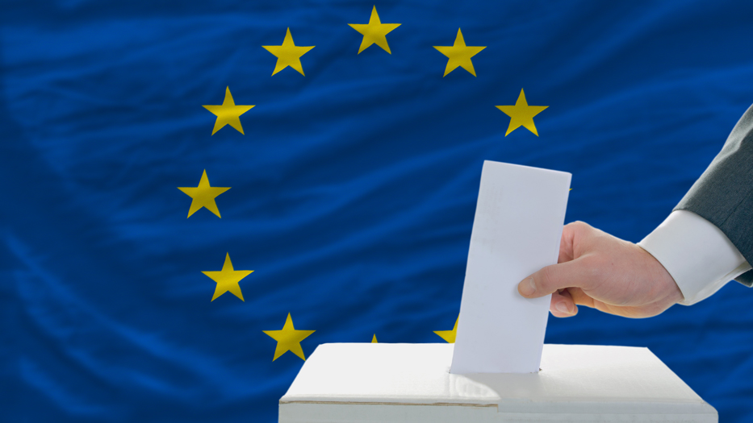

A Machine Learning Approach: Predicting Voter Turnout in the 2019 European Parliament Election
Oskar Krafft, Amin Oueslati and Benedikt Korbach
Berlin, 08.12.2022
Notes:
Welcome to our short project presentation. In our project, we predicted and explained the voter turnout of the 2019 European elections using a machine-learning approach.

Slide 2
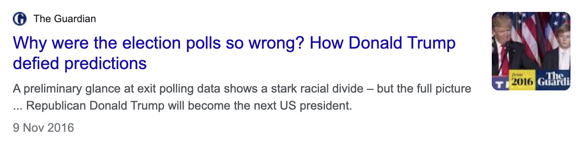
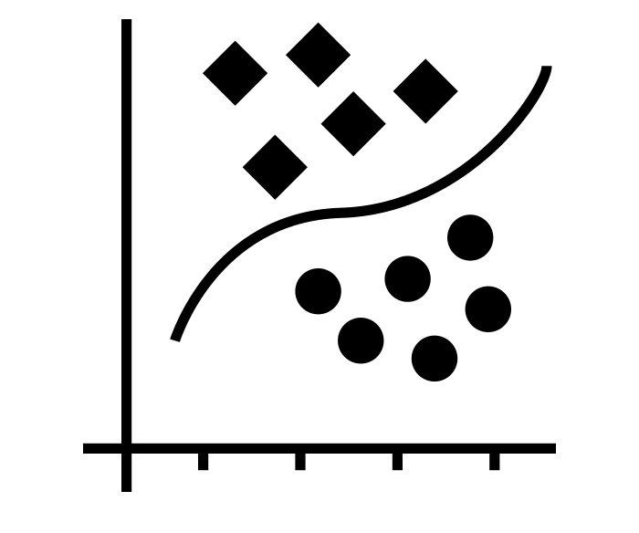
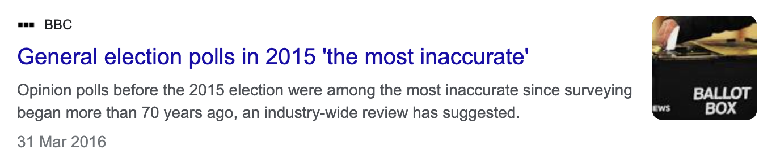

Using Machine Learning Models to Predict Voter Turnout in the 2019 European Parliament Election
PROJECT BACKGROUND
Motivation
Project Goals
Project Goal #1: Predicting Voter Turnout
4
Project Goal #2: Explaining Voter Turnout
Data
Eurobarometer 2019: European Parliament Post-Election Survey
Notes:
Predicting voter turnout is an essential task for polling institutes, researchers, and political organizations. Accurate predictions can help inform campaign strategies and policies and improve our understanding of the factors that drive voting behaviour. However, polling institutes and researchers often rely on surveys and other data sources that may not accurately capture the relevant information or may be subject to bias.
Our project tackles these challenges using a machine-learning approach to predict voter turnout in the 2019 European elections. For this aim, we used data from the Eurobarometer, which is a large-scale survey conducted by the European Commission. It includes data on a wide range of topics, including political attitudes and behaviour, for a representative sample of over 27,000 individuals from across the European Union.
We identified two main project goals: Firstly, predicting voting turnout using multiple machine learning models, and, secondly, explaining voting turnout by identifying the most relevant factors that influence our predictions.

Slide 3

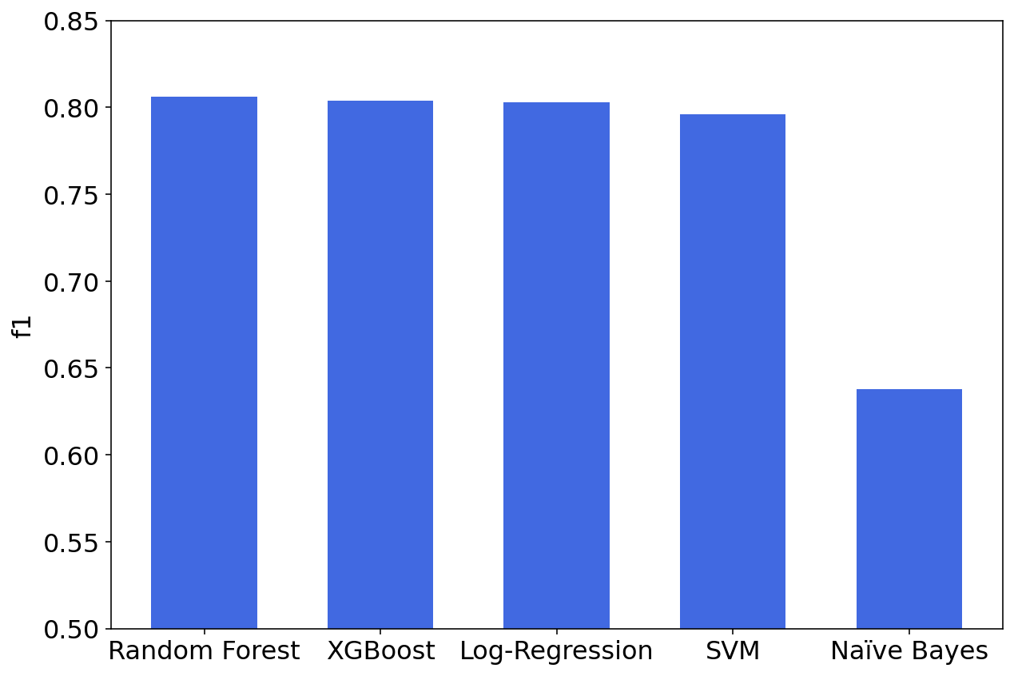




Project Goal #1: Predicting Voter Turnout
PREDICTING
Models
Results
Baseline
Model Performance (F1 score)
Logistic Regression
Advanced
Random Forest
Naïve Bayes
Support Vector Machine
XGBoost
Notes:
To accomplish our first goal of predicting voter turnout, we employed different Machine Learning models. We created one baseline model: Logistic Regression; and four more advanced models: Random Forest, Naïve Bayes, Support Vector Machine, and XGBoost.
To assess the accuracy of the predictions, one crucial metric we used was the F1 score. This metric provides a numerical measure of how well the algorithms performed on the data.
The results of the prediction models, as illustrated in the bar chart, firstly show that all models perform similarly well, except for Naïve Bayes. Furthermore, we can observe that only two of our advanced algorithms, random forest and XGBoost, slightly outperform our baseline logistic regression model.

Slide 4
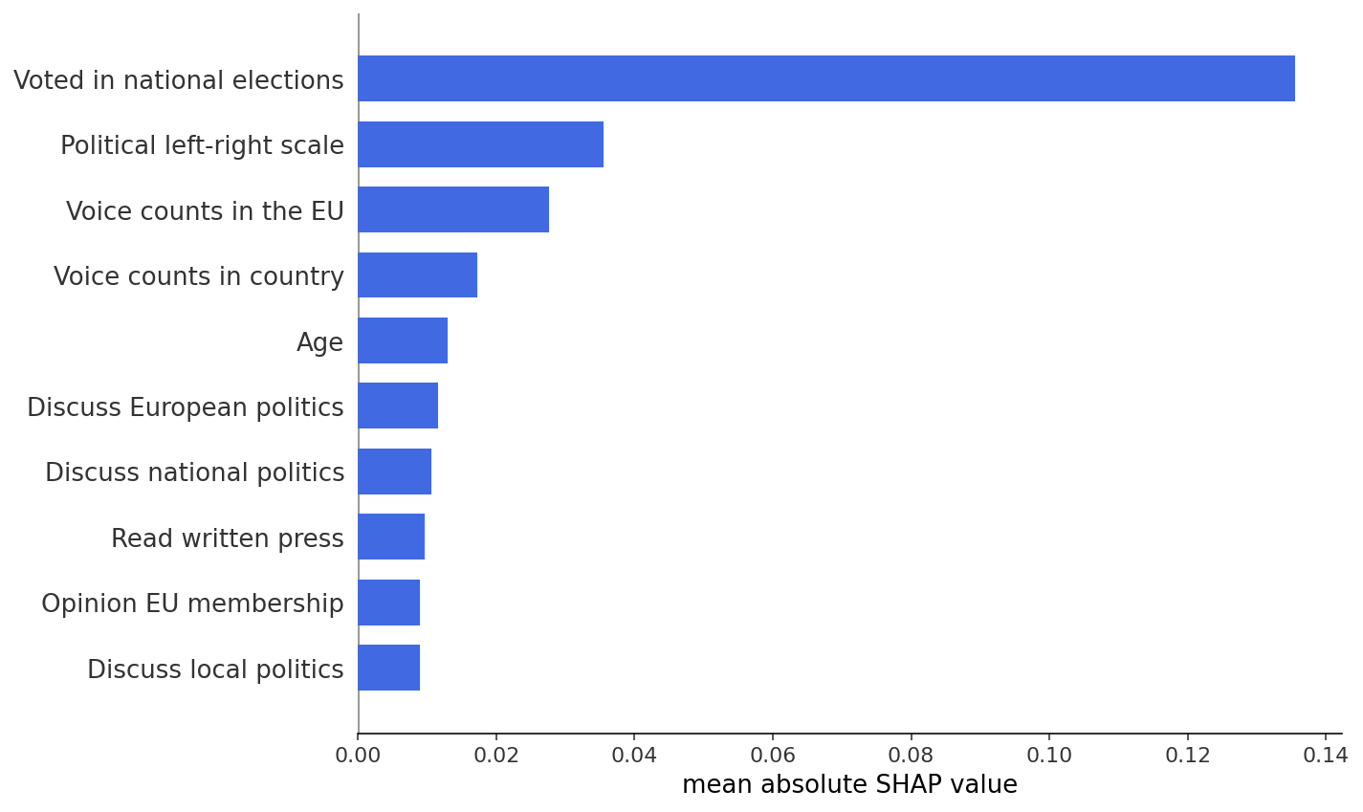

Project Goal #2: Explaining Voter Turnout
EXPLAINING
Model
Results
Global Feature Importance
Notes:
In order to better understand our predictions, we used SHAP, a state-of-the-art method of Explainable Machine Learning, to identify the most relevant factors in our data for predicting voter turnout.
As you can see in the bar chart, the most influential factor by far was whether people have voted in the last national election. Other relevant features include political orientation, whether respondents believe their voice matters, age, and political interest.

Slide 5
Takeaways
1
In our case, predicting voting propensity does not necessarily require complex models. Instead, basic statistical methods like a logistic regression can generate solid predictions.
2
When designing their surveys and constructing their models, polling institutes and researchers should ensure to include those features we have identified as most important for voter turnout.
Notes:
Our study leaves us with two main takeaways.
First, the results of our study indicate that predicting voter turnout does not necessarily require complex models. Instead, basic statistical methods, such as logistic regression, can generate solid predictions of voting turnout. Thus, polling institutes and researchers can use comparatively simple and inexpensive methods to make accurate predictions.
Secondly, the explanation of our prediction highlights the importance of including the most relevant factors in surveys and models. In our case, the most predictive feature was whether people have voted in the last national election. Hence, to improve the accuracy of predictions, polling institutes and researchers should make sure to include more information on previous voting behaviour, especially in national elections.

