Slide 1
Deep Learning Applications in Python
Dr. MERT NAKIP
Reference books:
Introduction to Machine Learning with Python, Andreas C. Müller & Sarah Guido
Deep Learning for Time Series Forecasting, Jason Brownlee

Slide 2
DATASET / DATA / FEATURE
Dataset:
  A collection of data.
  The dataset includes the information about the application and the environment of the application.
Data:
  Data are simply units of information.
  Data is being collected by sensing device or organ that includes both useful and irrelevant or redundant information and must be processed to be meaningful
Feature:
  A single point of data.
  Feature is an individual measurable property or characteristic of a phenomenon being observed.

Slide 3
FEATURES
PROBLEM:
Classification: Dogs vs. Cats
Data:
Label | Number of Teeth | Does have tail? | Color
Dog | 42 | Yes | Yellow
Dog | 41 | Yes | Black
Cat | 30 | Yes | Brown & White
Cat | 29 | Yes | Black
Cat | 30 | Yes | Yellow
Dog | 42 | Yes | Black & Brown
Cat | 30 | Yes | Brown
?
We need feature selection methods in order to select important features.

Slide 4
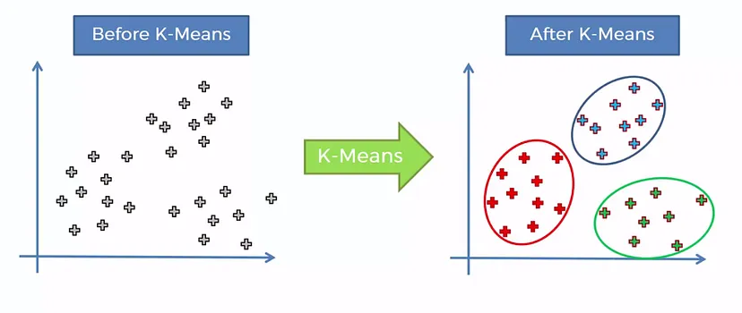
Unsupervised Learning
K-means Clustering

Slide 5
Unsupervised Learning
Principal Component Analysis
Dimensionality Reduction: Simplifies models by reducing the number of features, which can improve computational efficiency.
Visualization: Helps in visualizing high-dimensional data by projecting it into 2D or 3D spaces.
Noise Reduction: Removes less important features, which can reduce the effect of noise in the data.
Avoiding Overfitting: Reduces the risk of overfitting by limiting the number of features used in a model.

Slide 6
Unsupervised Learning
Principal Component Analysis
Standardization: Scale the data so that each feature contributes equally to the analysis.
This is usually done by centering (subtracting the mean) and scaling (dividing by the standard deviation).
Covariance Matrix Calculation: Calculate the covariance matrix to understand how features relate to each other.
This matrix reveals the variance and the relationships between different features.
Eigenvalues and Eigenvectors: Compute the eigenvalues and eigenvectors from the covariance matrix.
Eigenvalues represent the magnitude of variance explained by each principal component.
Eigenvectors define the direction of the principal components.
Principal Components Selection: Sort the eigenvalues in descending order and select the top components that account for the most variance.
The corresponding eigenvectors are the principal components.
Projecting Data:
Transform the original data onto the new axes defined by the selected principal components.

Slide 7
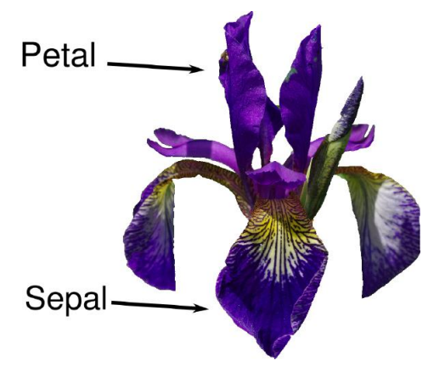
Dataset
from sklearn.datasets import load_iris
iris_dataset = load_iris()
print(iris_dataset['DESCR'][:193] + "\n...")
print("Keys of iris_dataset: \n{}".format(iris_dataset.keys()))
print("Feature names: \n{}".format(iris_dataset['feature_names']))
print("Target names: {}".format(iris_dataset['target_names']))
print("Type of data: {}".format(type(iris_dataset['data'])))
print("Shape of data: {}".format(iris_dataset['data'].shape))
print("First five columns of data:\n{}".format(iris_dataset['data'][:5]))
print("Target:\n{}".format(iris_dataset['target']))
Petal and Sepal Related Features
Different Species of Irises

Slide 8
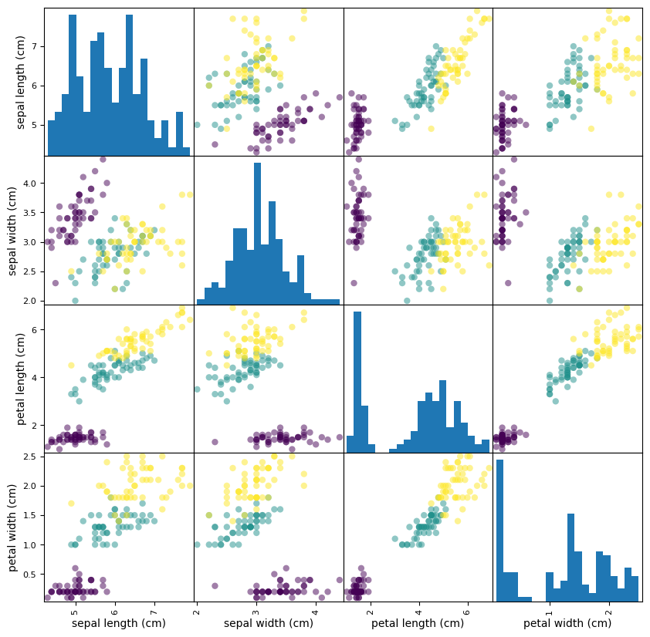
Analyzing Data
import pandas as pd
X = iris_dataset['data’]
Y = iris_dataset[‘target']
iris_dataframe = pd.DataFrame(X, columns=iris_dataset.feature_names)
grr = pd.plotting.scatter_matrix(iris_dataframe, c=y, figsize=(10, 10), marker='o', hist_kwds={'bins': 20})

Slide 9
PCA
from sklearn.decomposition import PCA
pca = PCA(n_components=2)
X_pca = pca.fit_transform(X)
import matplotlib.pyplot as plt
plt.figure(figsize=((10, 5))
plt.scatter(X_pca[:, 0], X_pca[:, 1], c=y)
plt.xlabel('Principal Component 1’)
plt.ylabel('Principal Component 2’)
plt.title('PCA of Iris Dataset’)
plt.show()

Slide 10
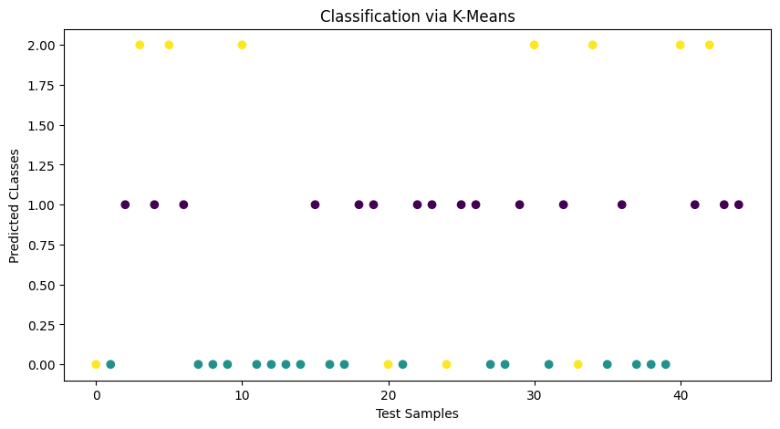
K-means
from sklearn.model_selection import train_test_split
from sklearn.cluster import KMeans
X_train, X_test, y_train, y_test = train_test_split(X, y, test_size=0.3, random_state=0)
kmeans = KMeans(n_clusters=3, random_state=0).fit (X_train)
cluster_centers = kmeans. cluster_centers_
print(cluster_centers)
y_pred = kmeans.predict(X_test)
plot_classification(y_pred, y_test, model_name='K-Means')

Slide 11
Plot Function
def plot_classification(y_pred, y_true, model_name):
plt.figure(figsize=(10, 5))
plt.scatter(range(len(y_pred)), y_pred, marker='o', c=y_true)
plt.xlabel('Test Samples')
plt.ylabel('Predicted Classes')
plt.title('Classification via '+model_name)
plt.show()

Slide 12
Plot Clusters of K-means
from scipy.spatial.distance import cdist
centers = kmeans.cluster_centers_
centers_pca = pca.transform(centers
radii = []
for i in range(kmeans.n_clusters):
points_in_cluster = X_pca[labels == i]
distances = cdist([centers_pca[i]], points_in_cluster, 'euclidean’)
radii.append(distances.max())

Slide 13
Plot Clusters of K-means
plt.figure(figsize=(10, 5))
sns.scatterplot(x='PC1', y='PC2', hue='Cluster', data=df, palette='viridis', marker='o', s=100, edgecolor='k', legend='full’)
plt.scatter(centers_pca[:, 0], centers_pca[:, 1], s=200, c='red', marker='X', edgecolor='black', label='Centers’)
for i, radius in enumerate(radii):
circle = plt.Circle((centers_pca[i, 0], centers_pca[i, 1]), radius, color='gray', alpha=0.3, linestyle='--') plt.gca().add_artist(circle)
plt.title('K-means Clustering with Cluster Centers and Radii (PCA-reduced)’)
plt.xlabel('Principal Component 1’)
plt.ylabel('Principal Component 2’)
plt.legend(title='Cluster', loc='upper right’)
plt.show()

Slide 14
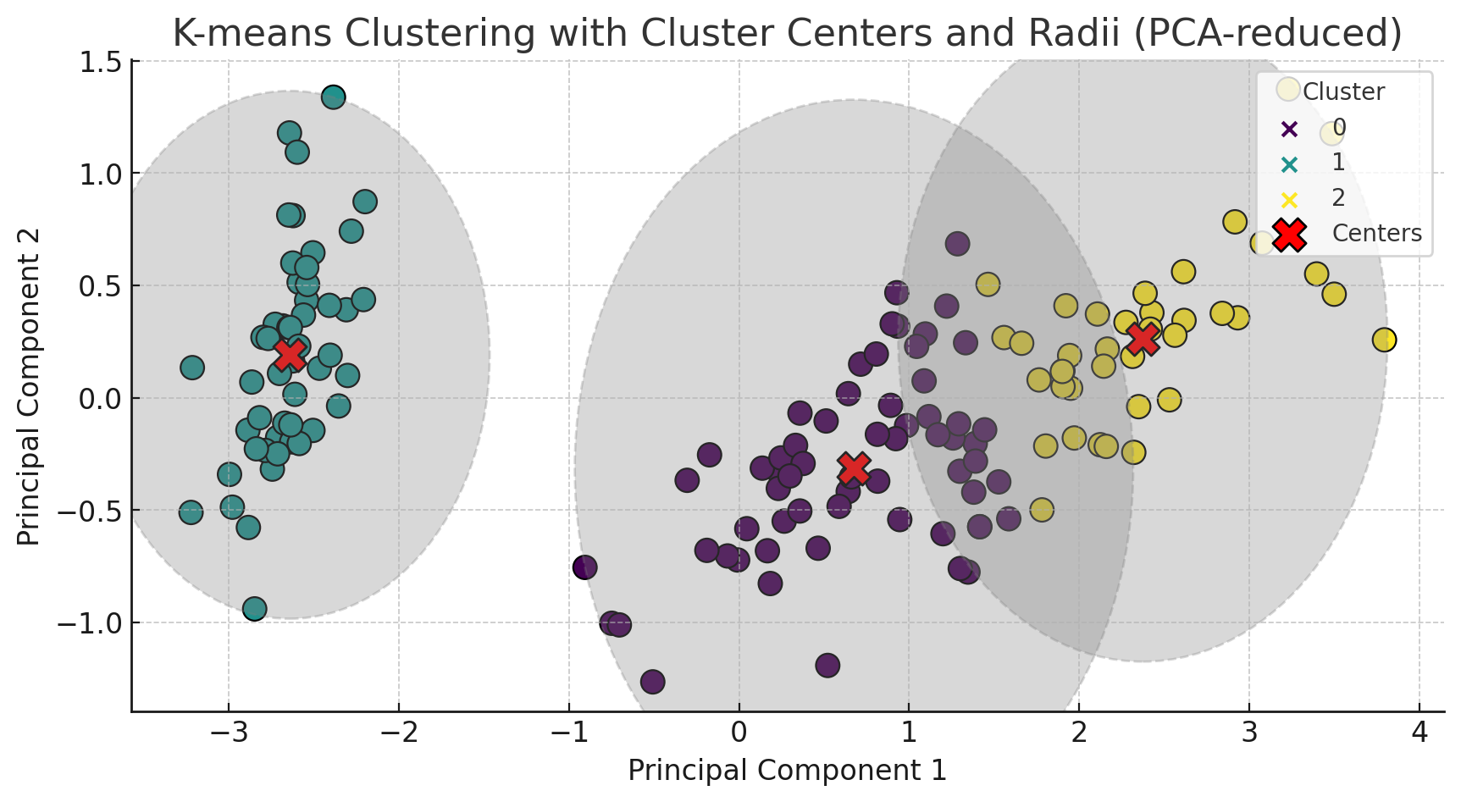
Plot Clusters of K-means

Slide 15
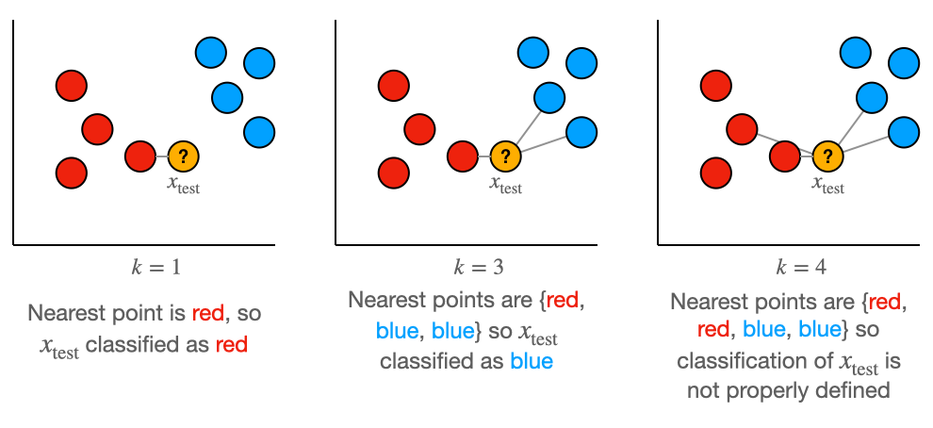
K-Nearest Neighbors
from sklearn.neighbors import KNeighborsClassifier
knn = KNeighborsClassifier(n_neighbors=1)
knn.fit(X_train, y_train)
y_pred_knn = knn.predict(X_test)
plot_classification(y_pred_knn, y_test, model_name=‘KNN')

Slide 16
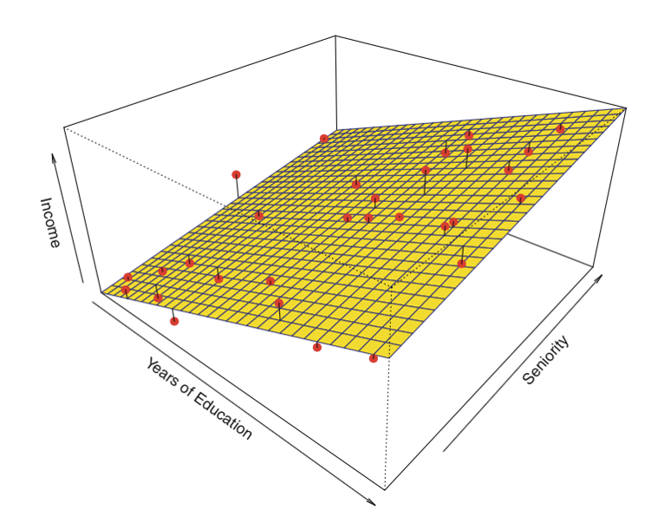
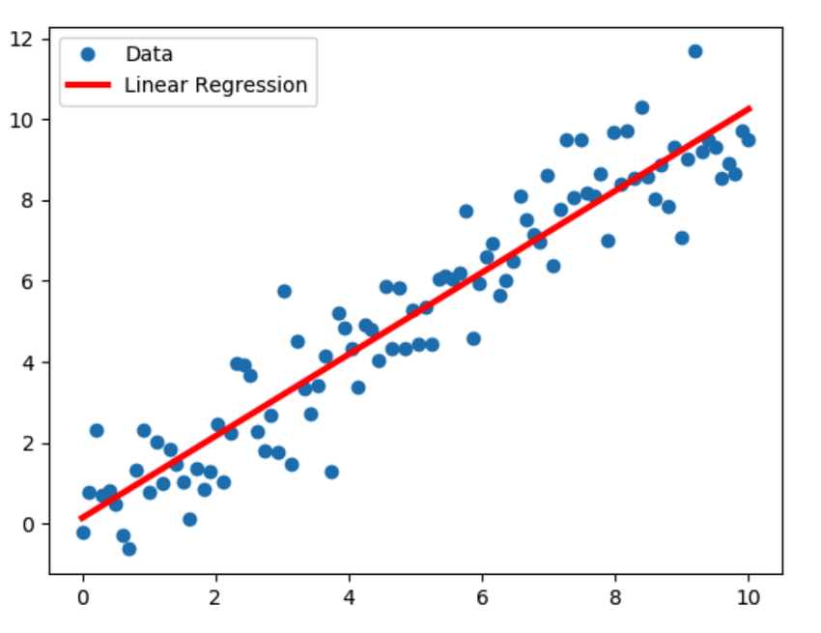
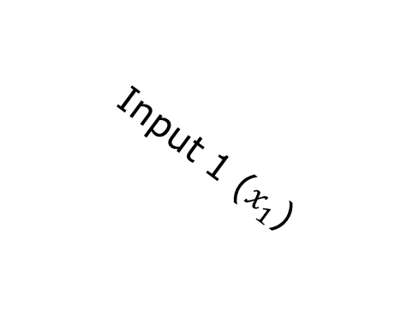
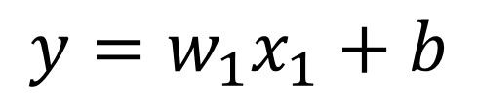

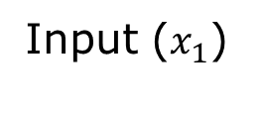
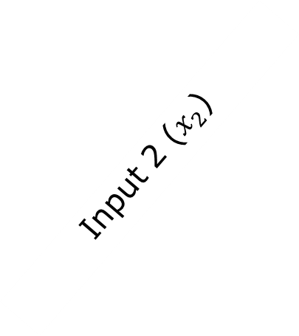
Linear Regression (LR)
Linear Assumption: LR does not support anything else. You may need to transform data to make the relationship linear.
Remove Noise: LR assumes that your input and output variables are not noisy.
Remove Collinearity. LR will over-fit your data when you have highly correlated input variables.
Gaussian Distributions. Linear regression will make more reliable predictions if your input and output variables have a Gaussian distribution.
Rescale Inputs: LR will often make more reliable predictions if you rescale input variables using standardization or normalization.
Output
Output
Input 2 ($x_{2}$)
Input 1 ($x_{1}$)
Input ($x_{1}$)
$$y=w_{1}x_{1}+w_{2}x_{2}+b$$
$$y=w_{1}x_{1}+b$$
http://sphweb.bumc.bu.edu/otlt/MPH-Modules/BS/R/R5_Correlation-Regression/R5_Correlation-Regression4.html
https://www.researchgate.net/figure/Linear-Regression-model-sample-illustration_fig3_333457161

Slide 17
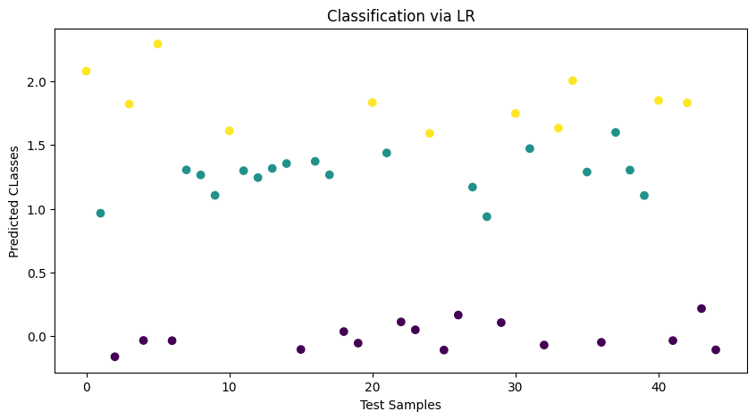
Linear Regression
from sklearn.linear_model import LinearRegression
lr = LinearRegression()
lr.fit(X_train, y_train)
y_pred_lr = lr.predict(X_test)
plot_classification(y_pred_lr, y_test, model_name='LR')

Slide 18
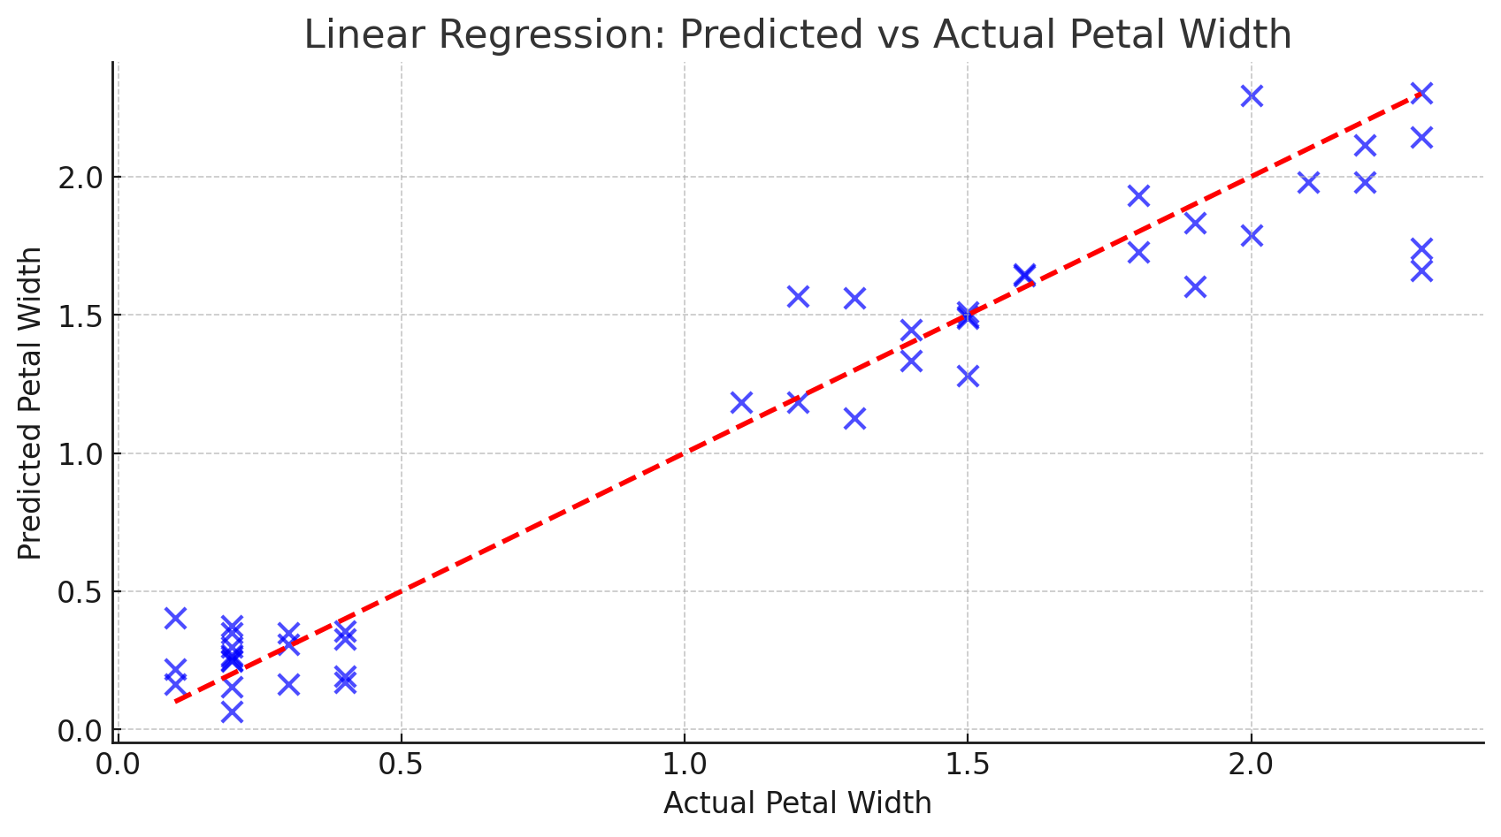
Linear Regression
plt.figure(figsize=(10, 5))
plt.scatter(y_test, y_pred_lr, color=‘blue’, edgecolor=‘k’, s=70, alpha=0.7)
plt.plot([min(y_test), max(y_test)], [min(y_test), max(y_test)], color=‘red’, linestyle=‘—’, lw=2)
plt.title(‘Linear Regression: Predicted vs Actual Petal Width’)
plt.xlabel(‘Actual Petal Width’)
plt.ylabel(‘Predicted Petal Width’)
plt.show()

Slide 19
Thresholding
def thresholding(y_pred):
y_pred_class = y_pred.copy()
y_pred_class[y_pred<0.5] = 0
y_pred_class[y_pred>0.5] = 1
y_pred_class[y_pred>1.5] = 2
return y_pred_class

Slide 20
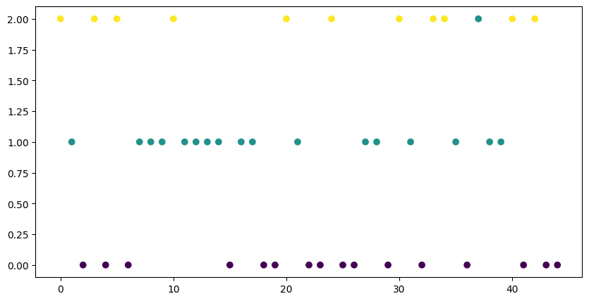
Linear Regression
y_class_lr = thresholding(y_pred_lr)
plot_classification(y_class_lr, y_test, model_name='LR')

Slide 21

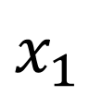




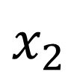

Adaptive Linear Neuron (Adaline)
Same with the Linear Regression
$1$
$b$
$x_{1}$
$w_{1}$
Σ
$y$
$w_{2}$
$x_{2}$
$$y=w_{1}x_{1}+w_{2}x_{2}+b$$

Slide 22
Adaline
from keras.layers import Input, Dense
from keras import Model
num_features = X.shape[1]
input_layer = Input(shape=(num_features, ))
linear_neuron = Dense(1)(input_layer)
adaline = Model(inputs=[input_layer], outputs=[linear_neuron])
adaline.compile(optimizer= ‘sgd’, loss= ‘mse’)
training_history = adaline.fit(X_train, y_train, epochs=10, batch_size=X_train.shape[0], validation_data=(X_test, y_test), verbose=1)
y_pred_adaline = adaline.predict(X_test)

Slide 23
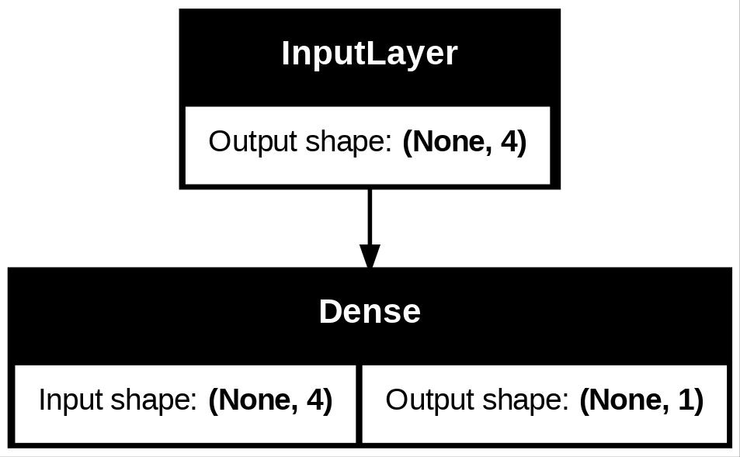
Plot Model Structure
import tensorflow as tf
tf.keras.utils.plot_model(adaline, to_file=‘adaline.jpg’, show_shapes=True)

Slide 24
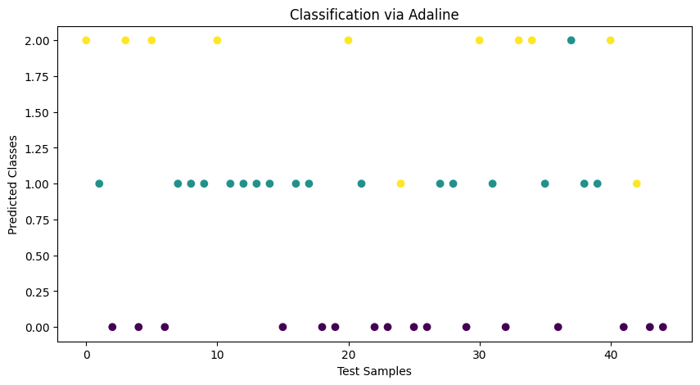
Adaline Results
y_adaline_class = thresholding(y_pred_adaline)
plot_classification(y_adaline_class, y_test, model_name='Adaline')

Slide 25
Nonlinear Neuron
from keras.layers import Input, Dense
from keras import Model
input_layer = Input(shape=(num_features, ))
neuron = Dense(1, activation=‘relu’)(input_layer)
nonlinear_neuron = Model(inputs=[input_layer], outputs=[neuron])
nonlinear_neuron.compile(loss=‘mse’, optimizer=‘adam’)
training_history = nonlinear_neuron .fit(X_train, y_train, epochs=10, batch_size=X_train.shape[0], validation_data=(X_test, y_test), verbose=1)
y_pred_neuron = nonlinear_neuron.predict(X_test)
plot_classification(y_pred_neuron, y_test, model_name='Nonlinear Neuron')

Slide 26
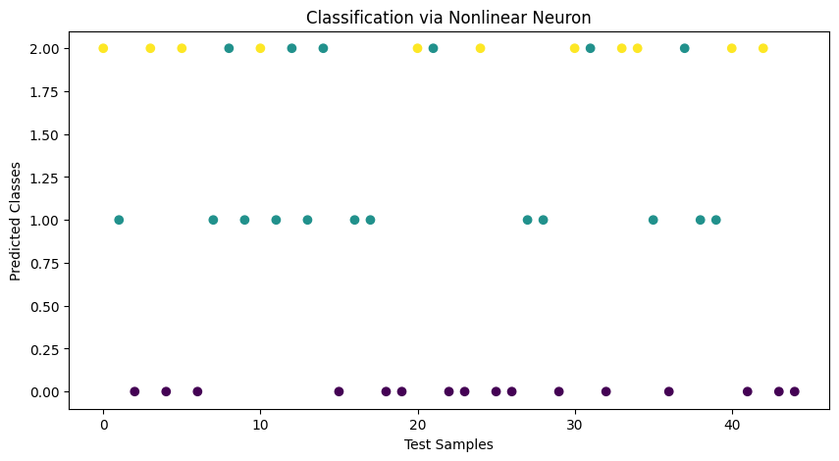
Nonlinear Neuron Results
y_neuron_class = thresholding(y_pred_neuron )
plot_classification(y_neuron_class, y_test, model_name='Nonlinear Neuron')

Slide 27
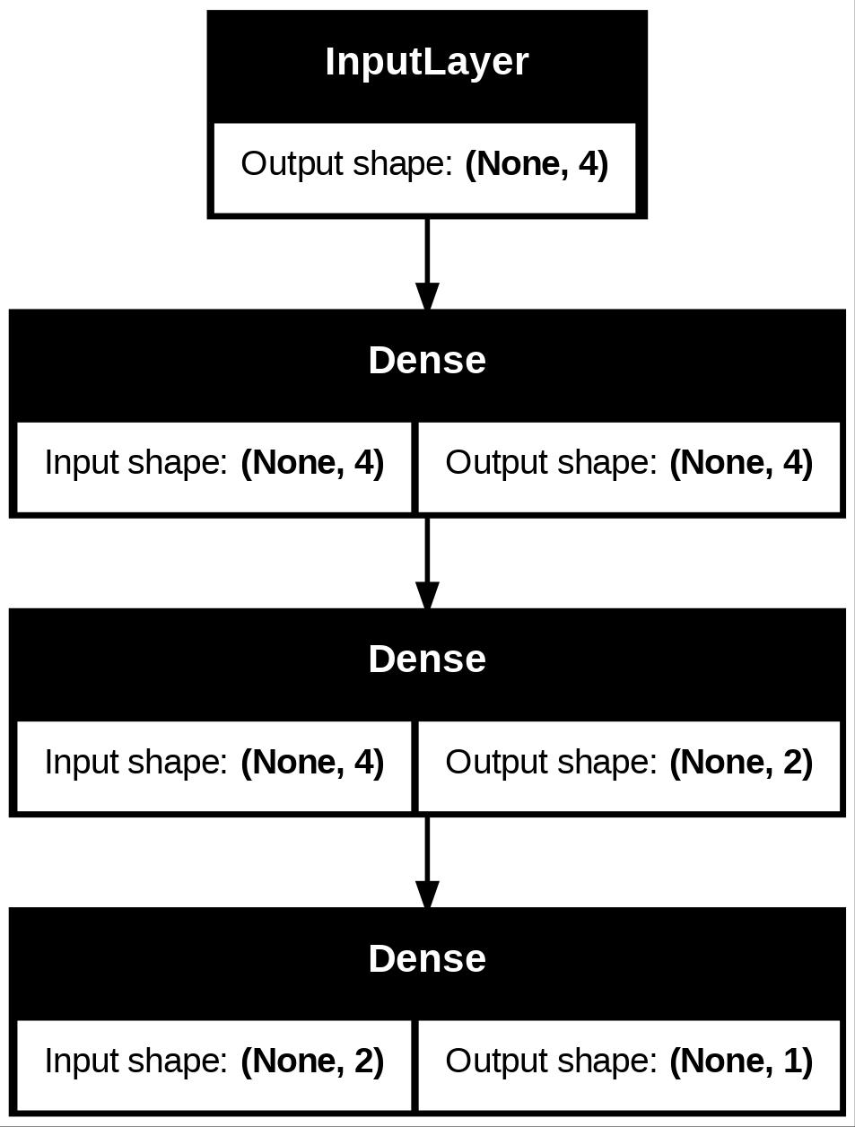
Multilayer Perceptron
input_layer = Input(shape=(num_features, ))
hidden_layer_1 = Dense(num_features, activation='relu')(input_layer)
hidden_layer_2 = Dense(int(num_features/2), activation='relu')(hidden_layer_1)
output_layer = Dense(1, activation=‘relu’)(hidden_layer_2)
mlp = Model(inputs=[input_layer], outputs=[output_layer])
mlp.compile(loss=‘mse’, optimizer=‘adam’)
tf.keras.utils.plot_model(mlp, to_file=‘mlp.jpg’, show_shapes=True)
mlp.fit(X_train, y_train, epochs=100, batch_size=X_train.shape[1], validation_data=(X_test, y_test), verbose=1)
y_pred_mlp = mlp.predict(X_test)

Slide 28
MLP Results
plot_classification(y_pred_mlp, y_test, model_name='MLP’)
y_mlp_class = thresholding(y_pred_mlp)
plot_classification(y_mlp_class, y_test, model_name='MLP')

Slide 29
Multilayer Perceptron with Dropout
from keras.layers import Dropout
input_layer = Input(shape=(num_features, ))
hidden_layer_1 = Dense(num_features, activation='relu')(input_layer)
hidden_layer_2 = Dense(int(num_features/2), activation='relu')(hidden_layer_1)
dropout_layer = Dropout(0.5)(hidden_layer_2)
output_layer = Dense(1, activation=‘relu’)(dropout_layer)
mlpd = Model(inputs=[input_layer], outputs=[output_layer])
mlpd.compile(loss=‘mse’, optimizer=‘adam’)
mlpd.fit(X_train, y_train, epochs=100, batch_size=X_train.shape[1], validation_data=(X_test, y_test), verbose=2)
y_pred_mlpd = mlpd.predict(X_test)

Slide 30
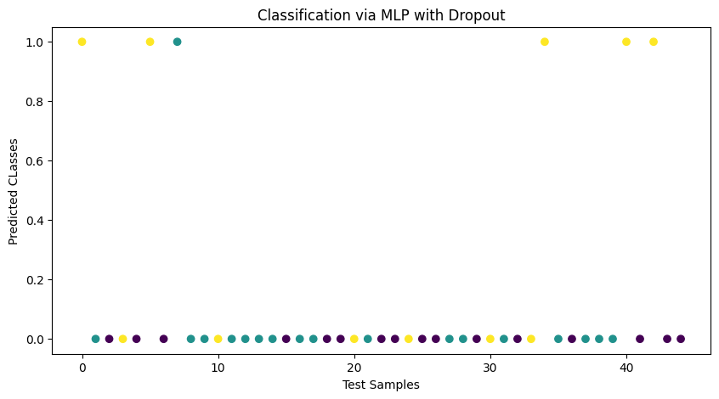
Multilayer Perceptron with Dropout
y_class_mlpd = thresholding(y_pred_mlpd)
plot_classification(y_class_mlpd, y_test, model_name='MLP with Dropout')

Slide 31
One Hot Encoding
Class 0 | Class 1 | Class 2
1 | 0 | 0
0 | 1 | 0
0 | 0 | 1
y_train_one_hot = np.zeros((y_train.shape[0], 3))
for i in range(y_train.shape[0]):
y_train_one_hot[i, y_train[i]] = 1
y_test_one_hot = np.zeros((y_test.shape[0], 3))
for i in range(y_test.shape[0]):
y_test_one_hot[i, y_test[i]] = 1

Slide 32
MLP Classifier
input_layer = Input(shape=(num_features, ))
hidden_layer_1 = Dense(num_features, activation='relu')(input_layer)
hidden_layer_2 = Dense(int(num_features/2), activation='relu')(hidden_layer_1)
output_layer = Dense(3, activation='softmax')(hidden_layer_2)
mlp_class = Model(inputs=[input_layer], outputs=[output_layer])
mlp_class.compile(loss='categorical_crossentropy', optimizer='adam’)
mlp_class.fit(X_train, y_train_one_hot, epochs=100, batch_size=X_train.shape[1], validation_data=(X_test, y_test_one_hot), verbose=2)
y_pred_mlpc = mlp_class.predict(X_test)

Slide 33
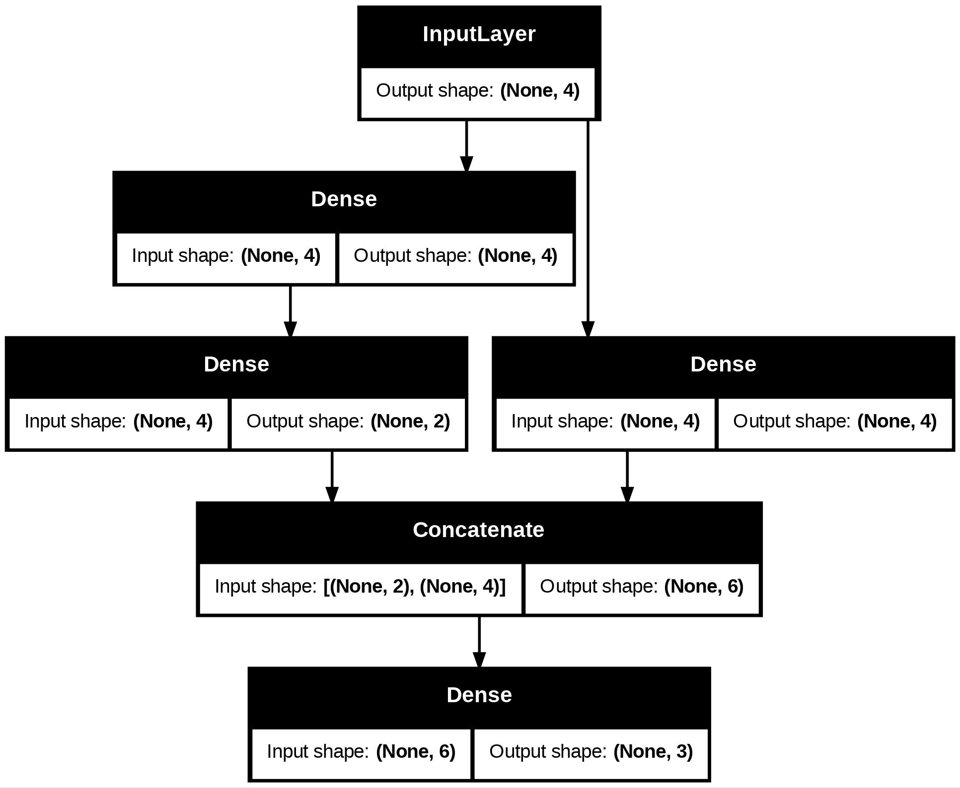
Residual Neural Network
from keras.layers import Concatenate
input_layer = Input(shape=(num_features, ))
# first path
hidden_layer_1_1 = Dense(num_features, activation='relu')(input_layer)
hidden_layer_1_2 = Dense(int(num_features/2), activation='relu')(hidden_layer_1_1)
# second path
hidden_layer_2_1 = Dense(num_features, activation=‘sigmoid')(input_layer)
# output layer
concat_layer = Concatenate(axis=-1)([hidden_layer_1_2, hidden_layer_2_1])
output_layer = Dense(3, activation=‘softmax’)(concat_layer)
res_mlp = Model(inputs=[input_layer], outputs=[output_layer])
res_mlp.compile(loss=‘categorical_crossentropy’, optimizer=‘adam’)

Slide 34
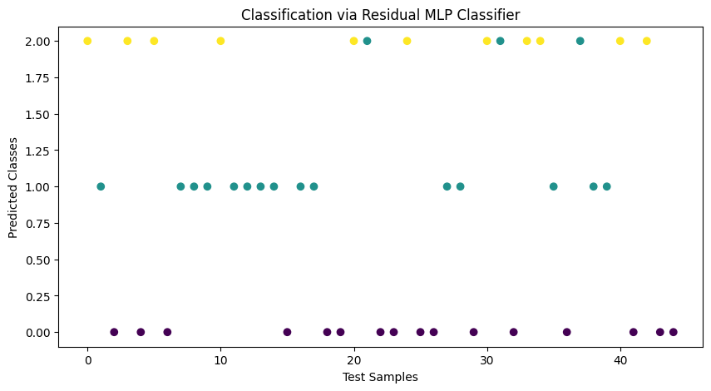
Residual Neural Network
res_mlp.fit(X_train, y_train_one_hot, epochs=100, batch_size=X_train.shape[1], validation_data=(X_test, y_test_one_hot))
y_pred_res_mlp = res_mlp.predict(X_test)
y_res_mlp_class = np.argmax(y_pred_res_mlp, axis=1)
plot_classification(y_res_mlp_class, y_test, model_name='Residual MLP Classifier')

Slide 35
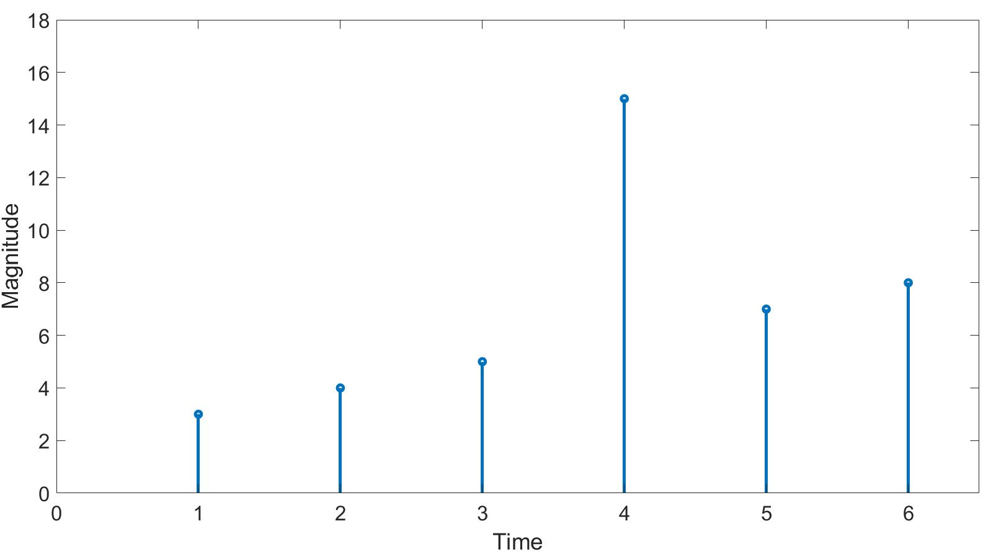
Time Series Data
Number of Past Samples: 3
Number of Forecast Steps: 1
samples
sampling
interval
past
[input sequence]
future
[output]

Slide 36
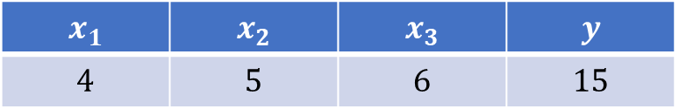
Time Series Data
$$x_{1}$$ | $$x_{2}$$ | $$x_{3}$$ | $$y$$
$$4$$ | $$5$$ | $$6$$ | $$15$$
samples
input sequence
output

Slide 37
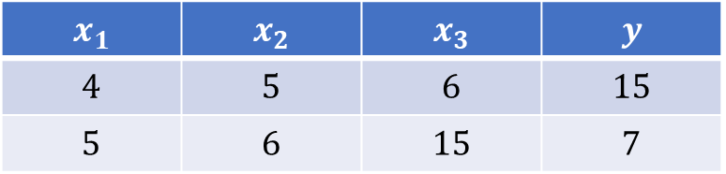
Time Series Data
$$x_{1}$$ | $$x_{2}$$ | $$x_{3}$$ | $$y$$
$$4$$ | $$5$$ | $$6$$ | $$15$$
$$5$$ | $$6$$ | $$15$$ | $$7$$
samples
input sequence
output

Slide 38
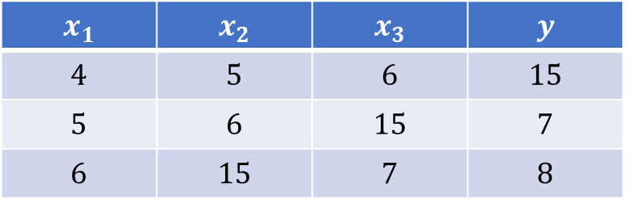
Time Series Data
$$x_{1}$$ | $$x_{2}$$ | $$x_{3}$$ | $$y$$
$$4$$ | $$5$$ | $$6$$ | $$15$$
$$5$$ | $$6$$ | $$15$$ | $$7$$
$$6$$ | $$15$$ | $$7$$ | $$8$$
samples
input sequence
output

Slide 39
Time Series Data for Supervised Methods
def split_sequence(sequence, n_past, n_steps):
  X = []
  y = []
  for i in range(n_past, len(sequence)-n_steps):
    input_seq = sequence[i-n_past:i]
    output_seq = sequence[i:i+n_steps]
    X.append(input_seq)
    y.append(output_seq)
  return array(X), array(y)

Slide 40
Weather Data
# https://www.kaggle.com/datasets/prasad22/weather-data/data
file_name = ‘weather_data.csv’
df = pd.read_csv(file_name, parse_dates=["Date_Time"])
df = df.set_index("Date_Time").sort_index()
df.head()
phoenix_df = df[df["Location"] == "Phoenix"]
phoenix_df = phoenix_df.rename(
columns={
"Temperature_C": "Temperature",
"Humidity_pct": "Humidity",
"Precipitation_mm": "Precipitation",
"Wind_Speed_kmh": "Wind_Speed",
}
)
phoenix_df.head()

Slide 41
Weather Data
temp = phoenix_df[‘Temperature’].values
humd = phoenix_df[‘Humidity’]
prec = phoenix_df[‘Precipitation’]
wind = phoenix_df[‘Wind_Speed’]
n_past = 14
n_steps = 1
X_humd, y_humd = split_sequence(humd, n_past, n_steps)
X_prec, y_prec = split_sequence(prec, n_past, n_steps)
X_wind, y_wind = split_sequence(wind, n_past, n_steps)
X_temp, y_temp = split_sequence(temp, n_past, n_steps)
X = np.concatenate([X_temp, X_humd, X_prec, X_wind], axis=1)
y = y_temp.copy()

Slide 42
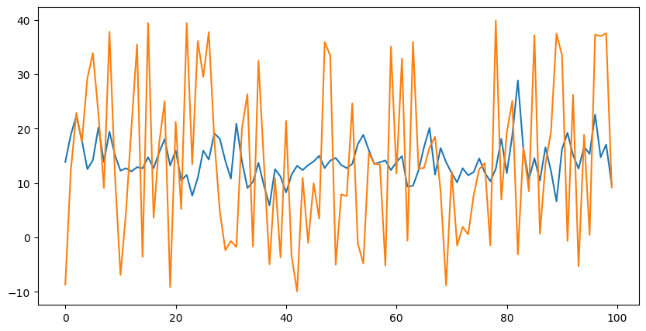
MLP for Forecasting
X_train, X_rem, y_train, y_rem = train_test_split(X, y, train_size=0.7, shuffle=False)
X_val, X_test, y_val, y_test = train_test_split(X_rem, y_rem, test_size=0.5, shuffle=False)
num_features = X.shape[1]
input_layer = Input(shape=(num_features, ))
hidden_layer_1 = Dense(num_features, activation='relu')(input_layer)
hidden_layer_2 = Dense(int(num_features/2), activation='relu')(hidden_layer_1)
hidden_layer_3 = Dense(int(num_features/4), activation='relu')(hidden_layer_2)
output_layer = Dense(1, activation='relu')(hidden_layer_3)
mlp = Model(inputs=[input_layer], outputs=[output_layer])
mlp.compile(loss='mse', optimizer='adam’)
train_hist = mlp.fit(X_train, y_train, epochs=50, batch_size=256, validation_data=(X_val, y_val), verbose=2)
y_pred = mlp.predict(X_test)
plt.figure(figsize=(10, 5))
plt.plot(y_pred[:100])
plt.plot(y_test[:100])

Slide 43
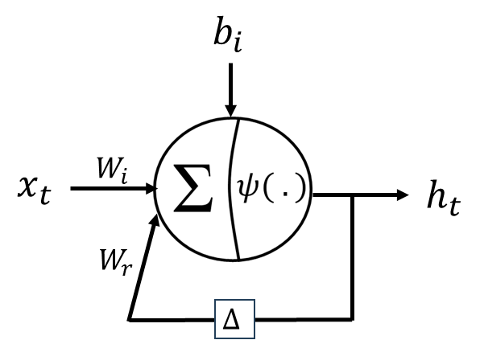
Recurrent Neuron
from keras.layers import SimpleRNN
input_layer = Input(shape=(n_past, X.shape[-1], ))
recurrent_layer = SimpleRNN(1, activation=None)(input_layer)
recurrent_neuron = Model(inputs=[input_layer], outputs=[recurrent_layer])
recurrent_neuron.compile(loss='mse', optimizer='adam’)
recurrent_neuron.fit(X_train, y_train, epochs=5, batch_size=256, validation_split=0.2, verbose=1)
y_pred_rn = recurrent_neuron.predict(X_test)

Slide 44
Recurrent Neural Network
from keras.layers import Flatten
input_layer = Input(shape=(n_past, X.shape[-1], ))
recurrent_layer = SimpleRNN(X.shape[-1], activation='sigmoid')(input_layer)
flatten_layer = Flatten()(recurrent_layer)
# Fully Connected Layers
hl_1 = Dense(X.shape[-1], activation='sigmoid')(flatten_layer)
hl_2 = Dense(int(X.shape[-1]/2), activation='sigmoid')(hl_1)
output_layer = Dense(1)(hl_2)
rnn = Model(inputs=[input_layer], outputs=[output_layer])
rnn.compile(loss='mse', optimizer='adam’)
rnn.fit(X_train, y_train, epochs=5, batch_size=256, validation_split=0.2, verbose=1)

Slide 45
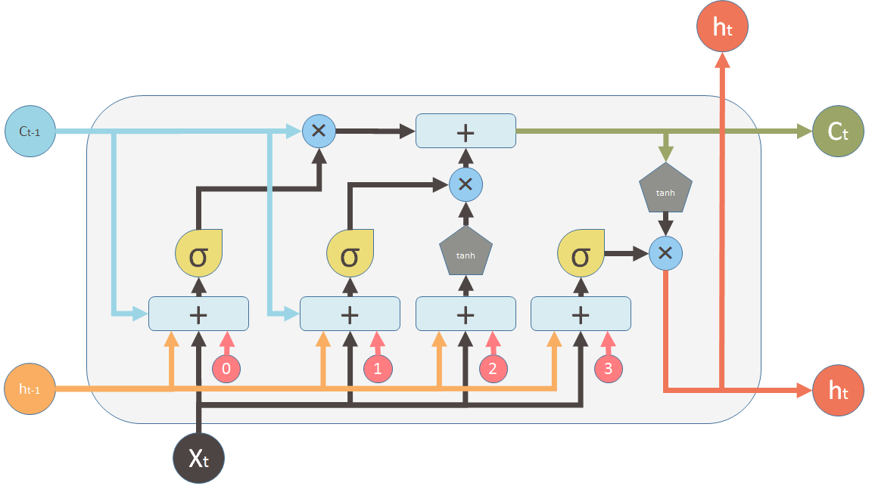
Long Short-Term Memory (LSTM)
from keras.layers import LSTM
input_layer = Input(shape=(n_past, X.shape[-1], ))
lstm_layer = LSTM(X.shape[-1])(input_layer)
flatten_layer = Flatten()(lstm_layer)
# Fully Connected Layers
hl_1 = Dense(X.shape[-1], activation='sigmoid')(flatten_layer)
hl_2 = Dense(int(X.shape[-1]/2), activation='sigmoid')(hl_1)
output_layer = Dense(1)(hl_2)
lstm = Model(inputs=[input_layer], outputs=[output_layer])
lstm.compile(loss='mse', optimizer='adam', metrics=['mae', 'mape’])
lstm.fit(X_train, y_train, epochs=5, batch_size=256, validation_split=0.2, verbose=1)

Slide 46
Hyperparameter Tuning
def build_model(hp):
input_layer = Input(shape=(n_past, X.shape[-1], ))
lstm_layer = LSTM(units=hp.Int("units_lstm", min_value=4, max_value=36, step=16))(input_layer)
flatten_layer = Flatten()(lstm_layer)
# Fully Connected Layers
hl_1 = Dense(hp.Int("units", min_value=4, max_value=36, step=16),
activation=hp.Choice('activation', values=['relu', 'sigmoid']))(flatten_layer)
hl_2 = Dense(int(X.shape[-1]/2), activation='sigmoid')(hl_1)
output_layer = Dense(1)(hl_2)
lstm = Model(inputs=[input_layer], outputs=[output_layer])
lstm.compile(loss='mse', optimizer='adam', metrics=['mae', 'mape'])
return lstm

Slide 47
Hyperparameter Tuning
Grid Search
grid_search = GridSearch(build_model,
objective='val_loss',
max_trials=5,
executions_per_trial=1,
directory='hyperparameter_search',
project_name='grid_search_lstm')
grid_search.search(X_train, y_train, epochs=5,
validation_split=0.2)
print(f"Best Hyperparameters from Grid Search: {grid_search.get_best_hyperparameters()[0].values}")

Slide 48
Hyperparameter Tuning
Random Search
random_search = RandomSearch(build_model,
objective='val_loss',
max_trials=5,
executions_per_trial=1,
directory='hyperparameter_search',
project_name='random_search_lstm')
random_search.search(X_train, y_train, epochs=5,
validation_split=0.2)
print(f"Best Hyperparameters from Random Search: {random_search.get_best_hyperparameters(

Slide 49
Hyperparameter Tuning
Random Search
bayesian_opt = BayesianOptimization(build_model,
objective='val_loss',
max_trials=5,
executions_per_trial=1,
directory='hyperparameter_search',
project_name='bayesian_opt_lstm')
bayesian_opt.search(X_train, y_train, epochs=5,
validation_split=0.2)
print(f"Best Hyperparameters from Bayesian Optimziation: {bayesian_opt.get_best_hyperparameters()[0].values}")

Slide 50
Regularization & Early Stopping
from keras.callbacks import EarlyStopping
from keras.regularizers import l1, l2, l1_l2
early_stopping = EarlyStopping(monitor='val_loss', patience=3, restore_best_weights=True)
input_layer = Input(shape=(num_features, ))
hl1 = Dense(3, 'relu', kernel_regularizer=l1(0.1))(input_layer)
hl2 = Dense(5, 'relu', kernel_regularizer=l2(0.1), bias_regularizer=l1_l2(0.1, 0.1))(hl1)
output_layer = Dense(3, activation='softmax')(hl2)
mlp_classifier = Model(inputs=[input_layer], outputs=[output_layer])
mlp_classifier.compile(loss='categorical_crossentropy', optimizer='sgd’)
mlp_classifier.fit(X_train, y_train_one_hot, epochs=300, batch_size=16, validation_split=0.2, verbose=1, callbacks=[early_stopping])

