Slide 1

PostGIS
GEO in your DB
Vincent Picavet
Oslandia

Slide 2
Context

Slide 3

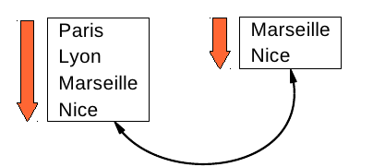
Bisonvert.net
  Car-sharing free software
Goal :
  match people doing the same journey
Current method
  Match from/to via names

Slide 4
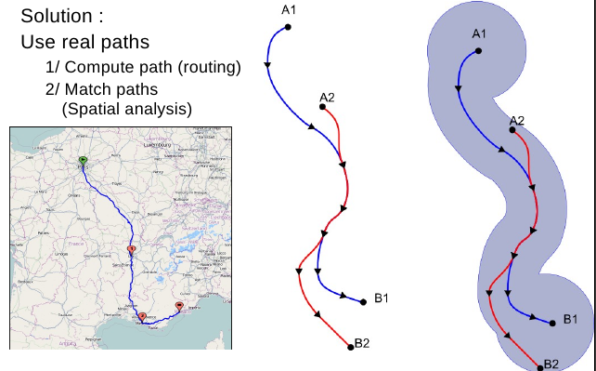

Slide 5
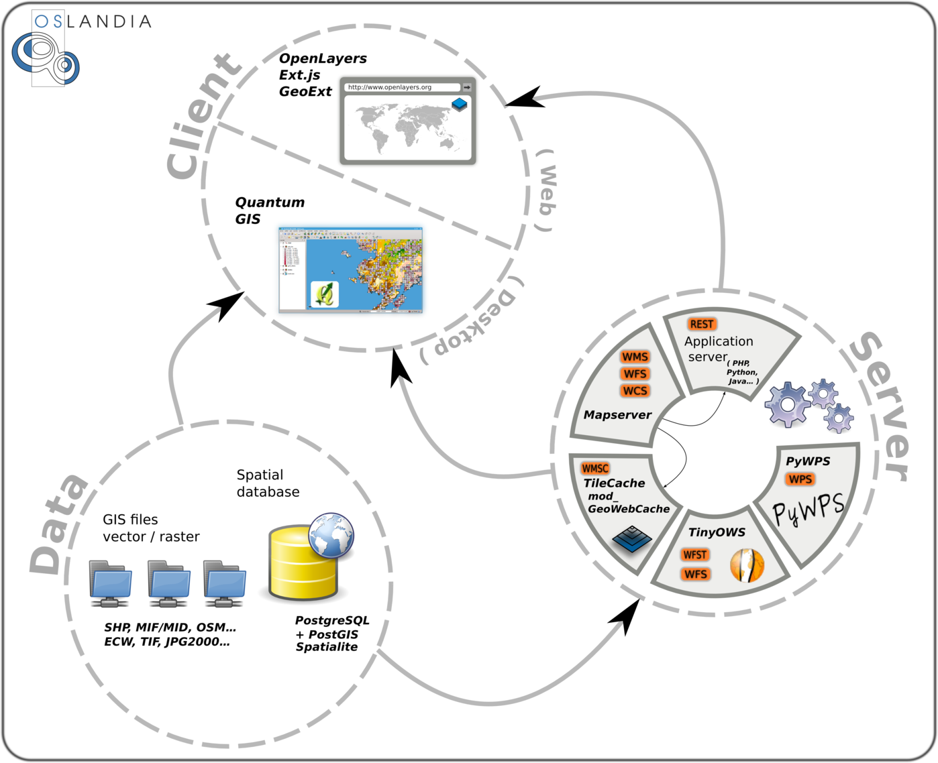

Slide 6
PostGIS Project

Slide 7

Spatial
RDBMS
Geometry + attributes = «feature»
SQL queries
Attributes
Spatial
High load
Big data
Long and complex processing
Acceptable performances
Respect standards

Slide 8

Standards
International standards
Specifications
OGC SFS (Simple Feature for SQL)
ISO SQL/MM part 3
What's in :
Geometry types
Spatial functions prototypes
Tables and additional processing for
referential integrity

Slide 9
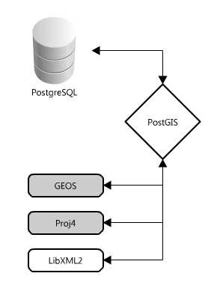
Overview
Plugin PostgreSQL
Written in C
Based on external libs →
Implements OGC SFS 1.1
+ ISO SQL/MM
+ lots of extra features
Gdal

Slide 10
History
2001 first alpha version
2003 version 0.8 – production ready
2005 version 1.0
                Core rewrite, LWGEOM
                OGC SFS 1.1 compatibility
2006 version 1.2
                Aim at ISO SQL/MM (curves, ST_ prefixes…)
2009 version 1.4
                PSC and OSGeo incubation
2011 version 1.5.3
                Geodesy
2012 version 2.0
                Raster
2013 version 2.1
                3D

Slide 11
Users
Public users
IGN : French nat. geographical institute
IRSN : Institut de Radioprotection et de
sûreté Nucléaire
EEA : European Environment Agency
NOAA …
Private sector
France Telecom, Infoterra, Digital
Globe, Mediapost, Mappy, NY Times…
Heroku !
A lot of others !

Slide 12
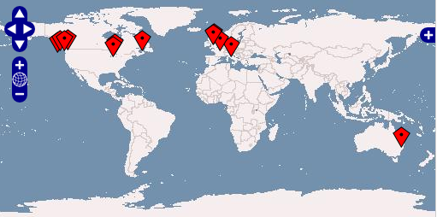
Community
Worldwide
Thousands of users
Very active postgis-users ML
Commiters :
LisaSoft
OpenGeo
Oslandia
CadCorp
Paragon Corporation
Refractions Research
Sandro Santilli
Sirius
Some others and individuals…

Slide 13




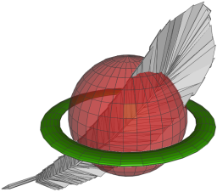
What else ?
Oracle spatial (and locator)
ESRI ArcSDE
IBM DB2
MS SQL Server (>2008)
Actian
Spatialite
Sybase (last version)

Slide 14
Basics

Slide 15
Geometry
Geometry (or HEWKB)
Native database storage
Binary format with
hexadecimal encoding
WKT (Well Known Text)
Textual representation
Dimensions
2D, 3D, or 4D
Projection system id (SRID)

Slide 16

Point
POINT (10 10)

Slide 17
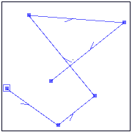
Line
LINESTRING
(
0 5, 5 1, 9 4, 2 14, 14 13, 4 4
)

Slide 18
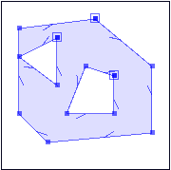
POLYGON
(
(9 13,13 9,13 3,4 2,1 4,1 12, 9 13),
(5 11,5 6,1 9,5 11),
(10 7, 10 4, 6 4, 8 8, 10 7)
)
Polygon
1) Mandatory first ring is external ring
2) Rings coordinates must be closed

Slide 19
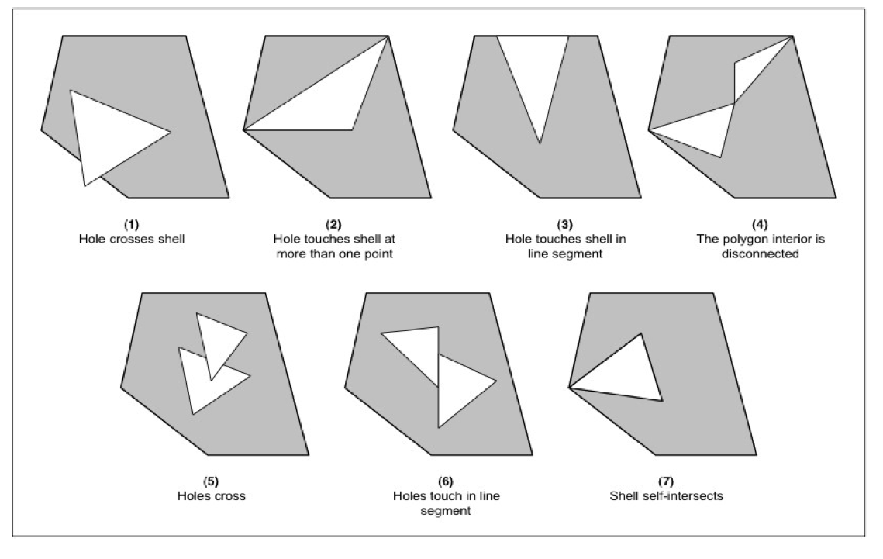
SFS (in)validity

Slide 20


Multi / Aggregate
Different projection
systems cannot be mixed
Neither can different
dimensions
MULTIPOINT
MULTILINESTRING
MULTIPOLYGON
GEOMETRYCOLLECTION

Slide 21
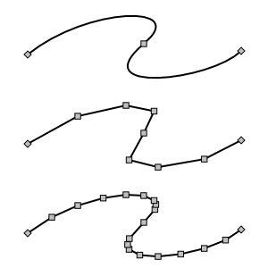
Curves
«curves» types :
    CIRCULARSTRING
    COMPOUNDCURVE
    MULTISURFACE

Slide 22
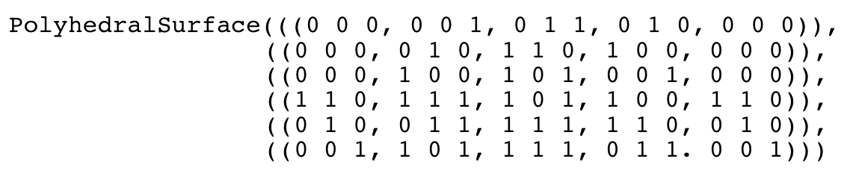
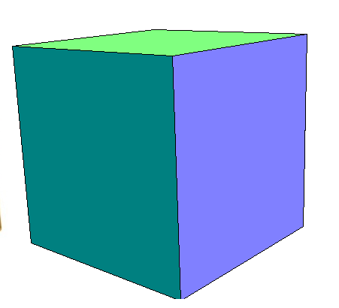
PolyhedralSurface

Slide 23
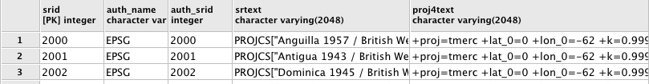
metadata
geometry_columns : spatial fields catalog
spatial_ref_sys: projection systems catalog
geography_columns : geography fields view

Slide 24
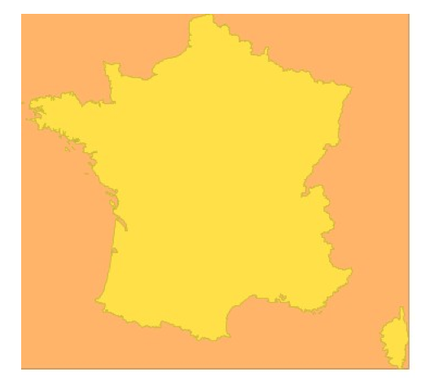
Spatial index
Better spatial filter performance
Geometry approximation with bbox
Spatial index creation :
geometry
bbox
CREATE INDEX index_name ON table_name
USING GIST(geom_column_name);

Slide 25
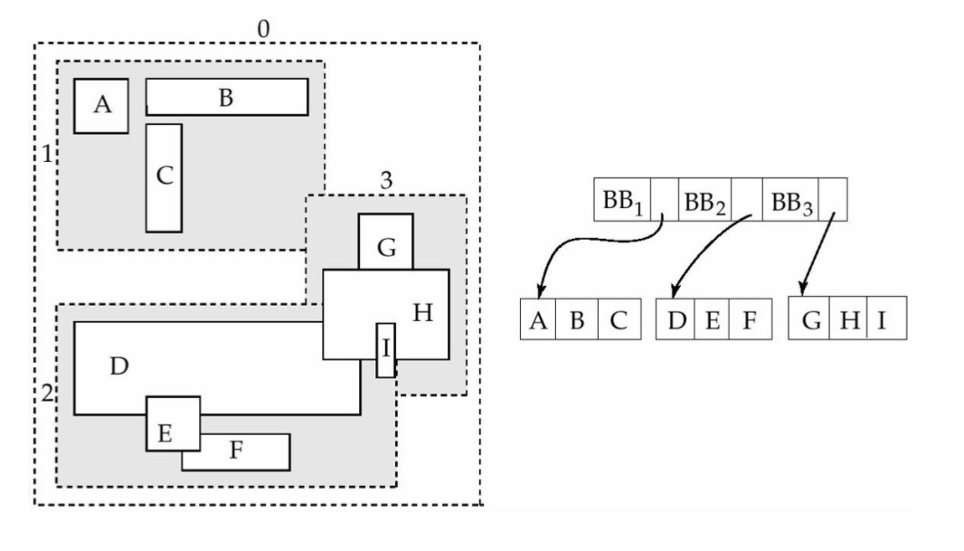
R-TREE
Bounding boxes are grouped
in regions of the index

Slide 26
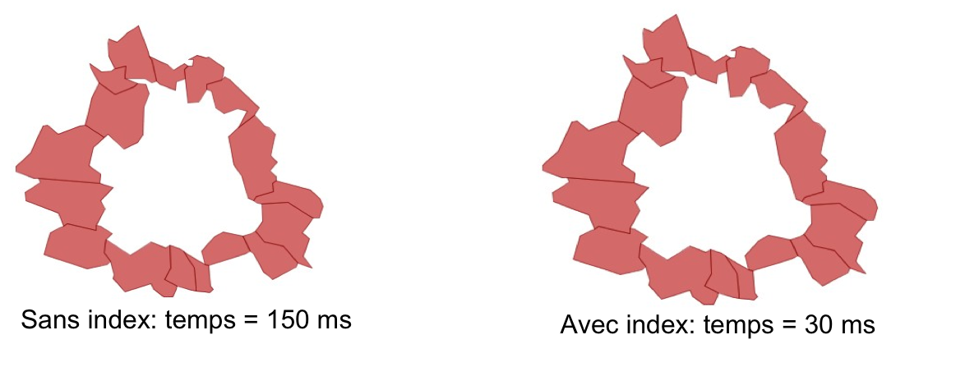
Indexes / perf
SELECT
c1.nom
FROM
communes c1, communes c2
WHERE
c2.nom = 'Toulouse'
AND ST_Touches(c1.the_geom, c2.the_geom);

Slide 27
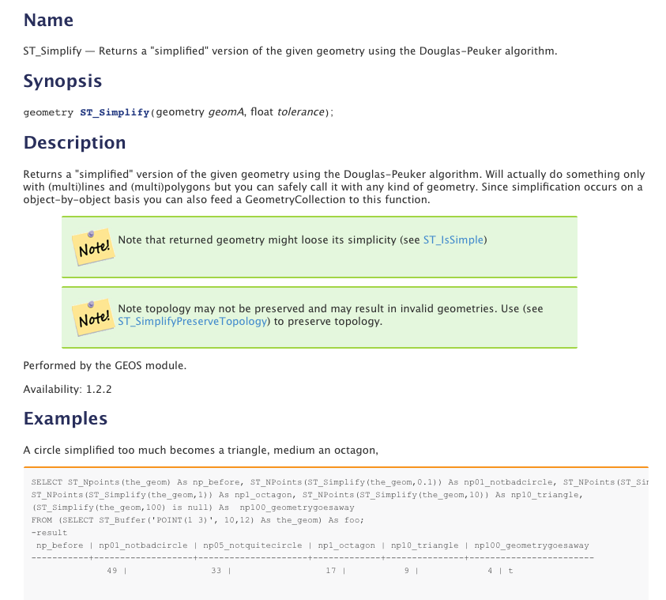
Documentation
Documentation:
Regina Obe,
Kevin Neufeld
Improved in 1.4

Slide 28
Functions

Slide 29
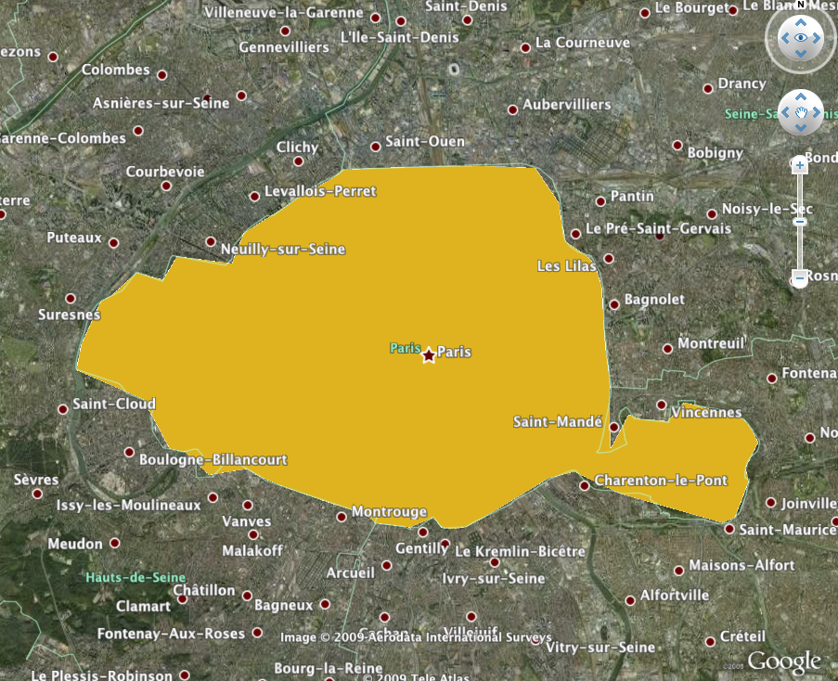
KML
SELECT ST_AsKML(the_geom, 5)
FROM dept
WHERE code_dept='75' ;

Slide 30
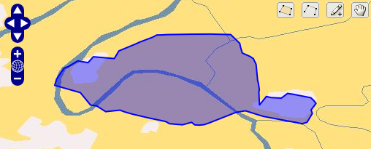
GeoJSON
SELECT ST_AsGeoJSON(
ST_Transform(the_geom, 4326), 5)
FROM dept
WHERE
code_dept='75' ;

Slide 31
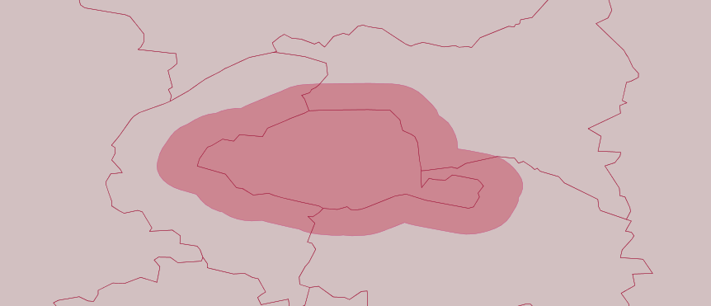
Buffer
SELECT ST_Buffer(the_geom, 2500)
FROM dept
WHERE code_dept='75';

Slide 32
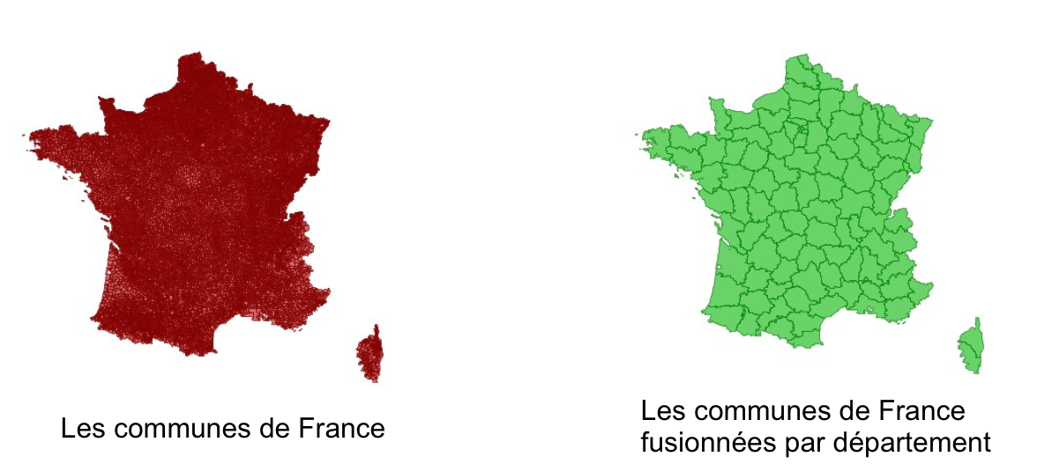
Aggregate
SELECT ST_Union(the_geom)
FROM commune
GROUP BY code_dept;
Geometries for departments
built from communes
Geometries
for communes

Slide 33
Intersection
SELECT nom_dept
FROM dept
WHERE ST_Intersects(the_geom,
(SELECT ST_Buffer(the_geom, 2500)
FROM dept WHERE code_dept='75')
);
Results :
PARIS
HAUTS-DE-SEINE
SEINE-SAINT-DENIS
VAL-DE-MARNE

Slide 34
Distance
SELECT code_dept, round(
ST_Distance(ST_Centroid(the_geom),
(SELECT ST_Centroid(the_geom)
FROM dept WHERE code_dept='75')) / 1000) AS distance
FROM dept ORDER BY distance LIMIT 4;
Results:
    75|0
    92|7
    93|12
    94|13

Slide 35
Creation
SELECT nom_dept
FROM dept
WHERE St_Within(
  GeometryFromText('POINT(600440 2428685)'
  , 27572), the_geom);
Result : PARIS

Slide 36
Import GML
SELECT ST_AsText(
ST_GeomFromGML(
'<gml:Point srsName="EPSG:27572">
<gml:pos srsDimension="2">
600440 2428686
</gml:pos>
</gml:Point>'
)
);
Result: POINT(600440 2428686)

Slide 37
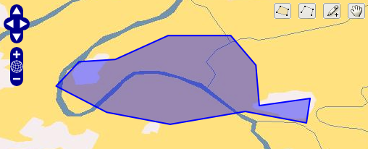
Generalization
Algorithm : Douglas-Peuker
SELECT ST_AsGeoJSON(
ST_Transform(
ST_Simplify(the_geom, 800),
4326), 5)
FROM dept WHERE code_dept='75';

Slide 38
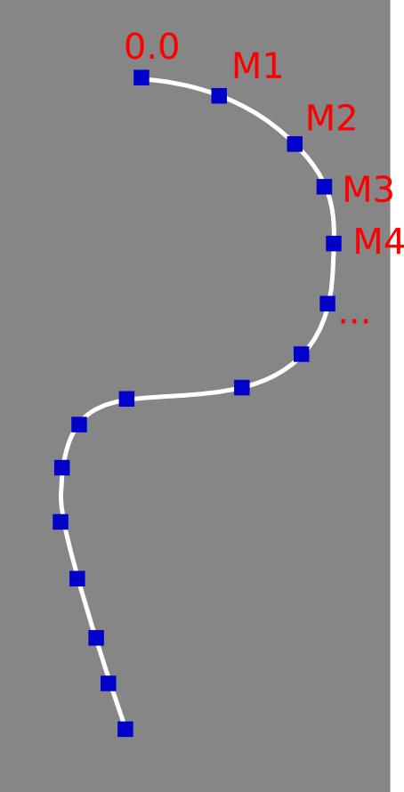
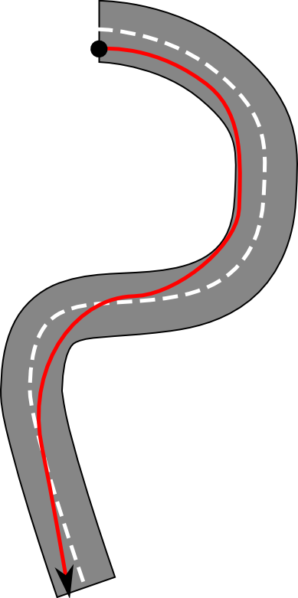
Linear referencing
Functions for linear
referencing (Road
network for example)
Aka LRS
ST_line_interpolate_point(linestring, location)
ST_line_substring(linestring, start, end)
ST_line_locate_point(LineString, Point)
ST_locate_along_measure(geometry, float8)

Slide 39
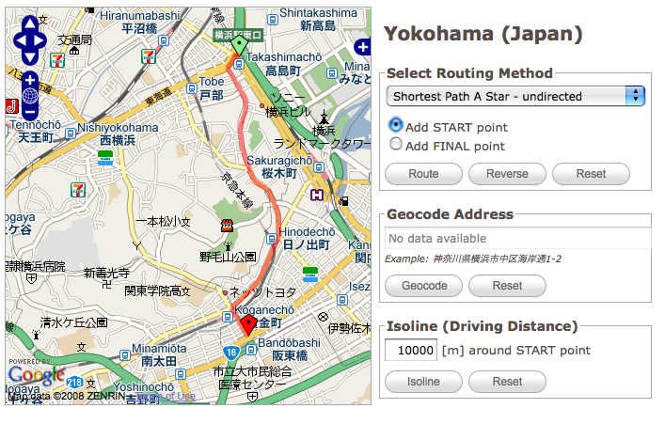
PgRouting
PgRouting, additional module for graph routing

Slide 40
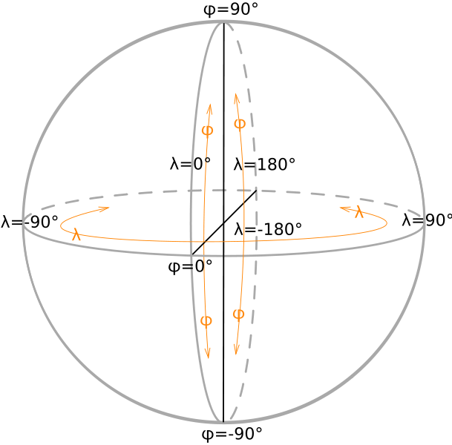
Gegraphy
Type 'geography' : latitude, longitude
  = «geodetic support»
Functions for this type
  Area, distance, indexation
  Only a subset
Import and export functions
  GML, KML, GeoJSON
Use it or not according to use case

