Slide 1

A New Dimension to PostGIS : 3D
Oslandia Team
FOSS4G 2013 – Nottingham

Slide 2

E-PLU Project

Slide 3
2010
2013
2015

Slide 4
PostGIS
GEOS
SFCGAL
CGAL

Slide 5
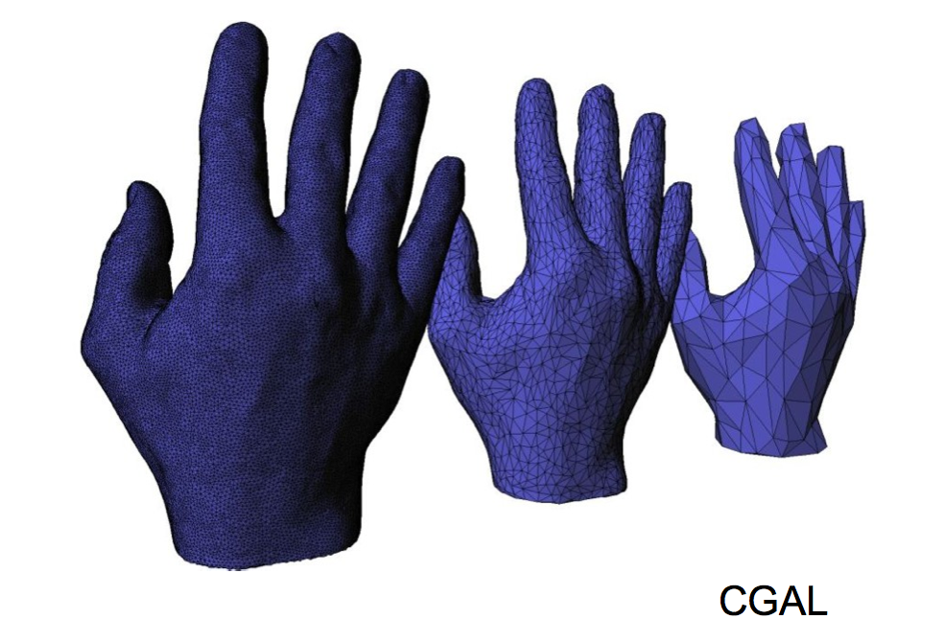

Slide 6
PostGIS
GEOS
SFCGAL
CGAL

Slide 7
ST_3DIntersection
ST_Tesselate
ST_3DArea
ST_Extrude
ST_ForceLHR
ST_Orientation
ST_MinkowskiSum
ST_StraightSkeleton
SFCGAL functions

Slide 8
ST_3DIntersection
ST_Tesselate
ST_3DArea
ST_Extrude
ST_ForceLHR
ST_Orientation
ST_MinkowskiSum
ST_StraightSkeleton
SFCGAL functions

Slide 9
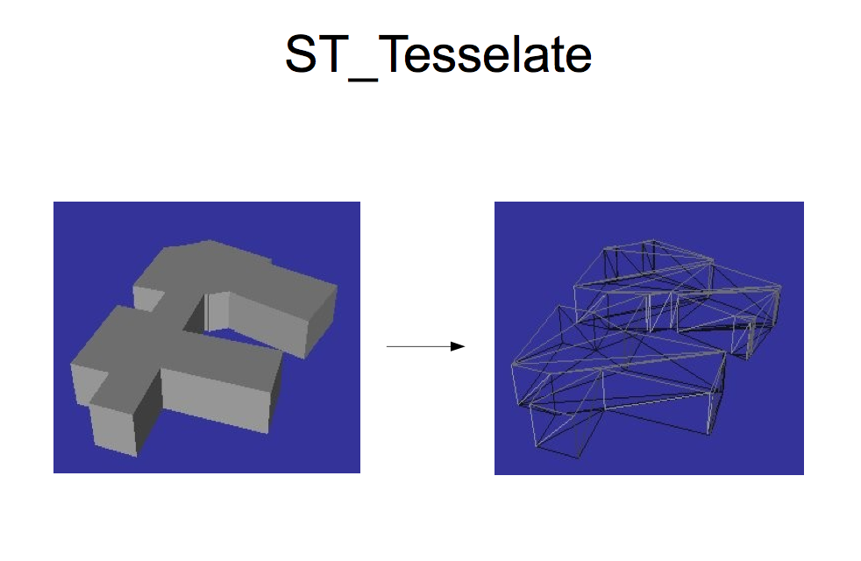

Slide 10
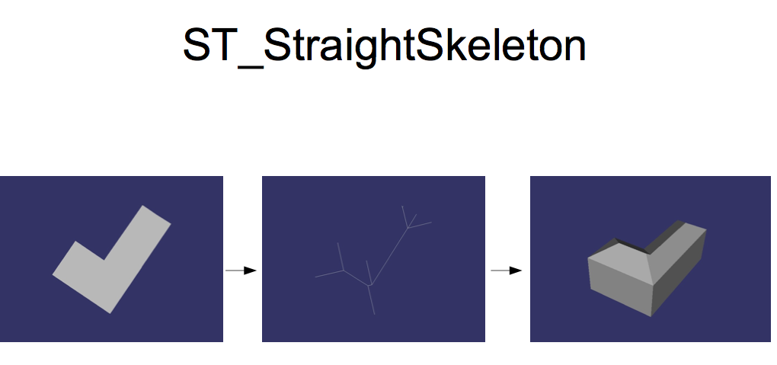
2D Building
Footprint
Straight Skeleton
Extrusion
& roof computation

Slide 11
ST_Intersects
ST_3DIntersects
ST_Intersection
ST_Area
ST_Distance
ST_3DDistance
Both GEOS & SFCGAL

Slide 12
SET postgis.backend = 'geos' ;
SET postgis.backend = 'sfcgal' ;

Slide 13
Regress tests PostGIS for GEOS OK
GardenTest PostGIS OK
3D Invalid geometry proof OK
Wide user community not yet

Slide 14
SFCGAL perfomances similar to GEOS ones for 2D
(but with SFCGAL we gain arbitrary precision)

Slide 15
SFCGAL perfomances similar to GEOS ones for 2D
(but with SFCGAL we gain arbitrary precision)
But some 3D computation could take time.

Slide 16
ISO 19107:2013
ISO 19125:2013

Slide 17
ὁράω

Slide 18
QGIS
Horao
OSG
OpenGL

Slide 19
https://vimeo.com/74869530

Slide 20
QGIS
PostGIS
Horao
OSG
GEOS
SFCGAL
OpenGL
CGAL

Slide 21
PostGIS www.postgis.org
SFCGAL www.sfcgal.org
Horao www.horao.net
QGIS www.qgis.org

Slide 22
2010
2013
2015

Slide 23

www.oslandia.com
https://github.com/Oslandia/presentations
https://github.com/Oslandia/Workshops

