Slide 1

Going spatial with PostGIS
Hugo Mercier − Oslandia

Slide 2
Oslandia
Open source GIS experts
  Training
  Consulting
  Support
  Development
Techs
  PostGIS
  QGIS
  Mapserver, ...

Slide 3
Outline
PostGIS basics
Topology
Rasters
Point cloud
3D

Slide 4
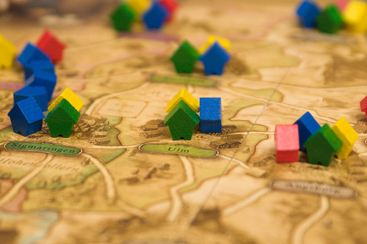
PostGIS
Geographical Information System extension to PostgreSQL
Storage and analysis

Slide 5

Spatial RDBMS
Vector data (geometry):
  Points, lines, polygons, volumes
Raster data:
  Georeferenced array of pixels
SQL Queries on
  Attributes
  Geometries / rasters

Slide 6

PostGIS project : standards
International standards
Specifications
  OGC SFS (Simple Feature for SQL)
  ISO SQL/MM part 3
What's in :
  Geometry types
  Spatial functions prototypes

Slide 7
PostGIS 2.0
Released in 2012
Brings :
  Rasters
  Topology
Other extensions
  PgRouting
  Point cloud

Slide 8
PostGIS Geometries
0D : Points
1D : Linestrings
2D : Polygons
3D : PolyhedralSurfaces (2.0)
… and functions to manipulate them
  ST_MakePoint, ST_MakeLine
  ST_PointN, ST_ExteriorRing, etc.

Slide 9
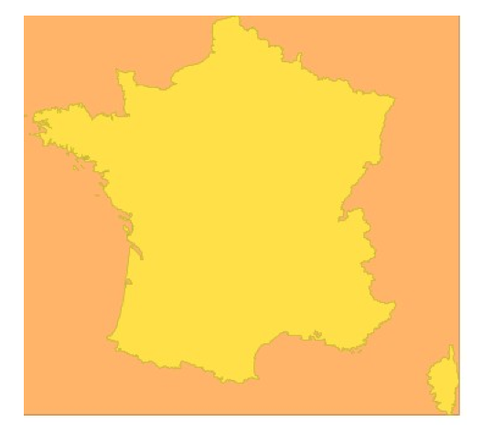
Spatial index
Better spatial filter performance
Geometry approximation with bbox
Spatial index creation :
geometry
bbox
CREATE INDEX index_name ON table_name
USING GIST(geom_column_name);

Slide 10
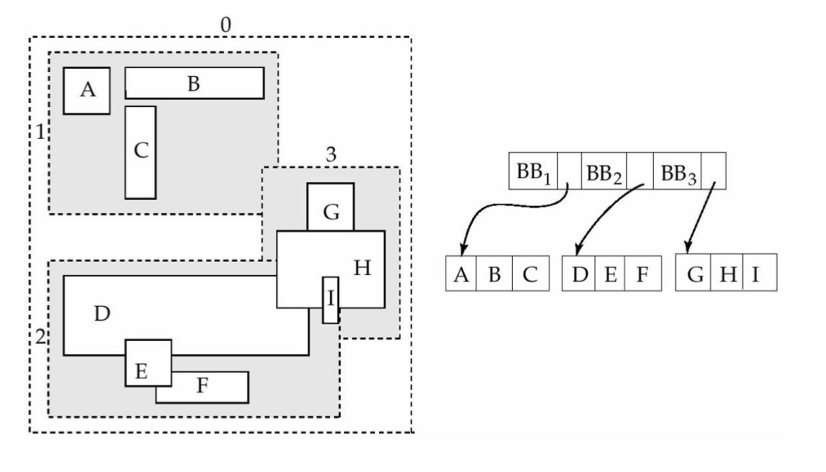
Spatial index : R-tree
Bounding boxes are grouped
in regions of the index

Slide 11
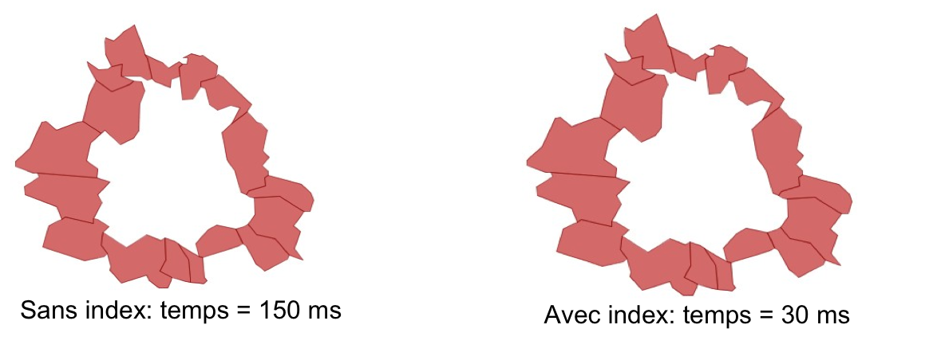
Spatial index
SELECT
c1.name
FROM
cities c1, cities c2
WHERE
c2.name = 'Toulouse'
AND ST_Touches(c1.geom, c2.geom);

Slide 12
I/O functions
WKB/WKT (OGC)
Import / export tools
  Shp2pgsql, pgsql2shp (ESRI shapefiles)
GeoJSON, GML, KML, SVG X3D
  ST_GeomFrom[WKB,WKT,GeoJSON,GML...]
  ST_As[WKB,WKT,GeoJSON,GML,...]
LINESTRING(0 0,10 10)
0102000000020000000000000000000000000000000000000000000000000024400000000000002440

Slide 13
Relationship and measurements
ST_Length, ST_Area
ST_Distance
ST_Intersects, ST_Covers, ST_Contains
Operators on bboxes :
  A && B : A intersects B
  A &&& B : the same in 3D
  A << B : A to the left of B
  A ~ B : A contains B
  ...

Slide 14
Processing
ST_Buffer(geom, radius)
ST_Intersection(geomA, geomB)
ST_Union(geom set)
ST_Transform(geom, SRID) : reprojection

Slide 15
Processing
ST_ConvexHull
ST_Simplify : Douglas-Peucker algorithm
ST_Difference
ST_Split
ST_Snap

Slide 16
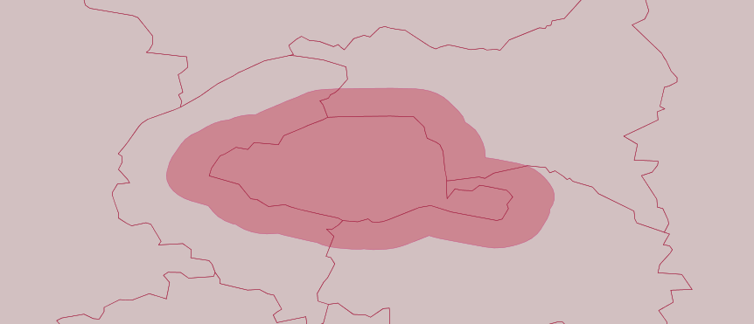
PostGIS functions : buffer
SELECT ST_Buffer(the_geom, 2500)
FROM dept
WHERE code_dept='75';

Slide 17
PostGIS functions : intersection
SELECT nom_dept
FROM dept
WHERE ST_Intersects(the_geom,
(SELECT ST_Buffer(the_geom, 2500)
FROM dept WHERE code_dept='75')
);
Results :
PARIS
HAUTS-DE-SEINE
SEINE-SAINT-DENIS
VAL-DE-MARNE

Slide 18
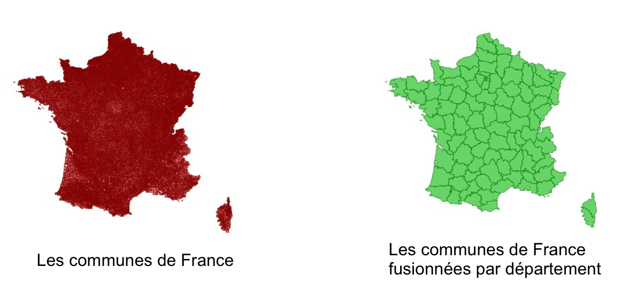
PostGIS functions : geometry aggregate
SELECT ST_Union(geom)
FROM commune
GROUP BY code_dept;
Geometries for departments
built from communes
Geometries
for communes

Slide 19
PostGIS functions : ST_Distance
SELECT code_dept, round(
ST_Distance(ST_Centroid(the_geom),
(SELECT ST_Centroid(the_geom)
FROM dept WHERE code_dept='75')) / 1000) AS distance
FROM dept ORDER BY distance LIMIT 4;
Results:
    75|0
    92|7
    93|12
    94|13

Slide 20
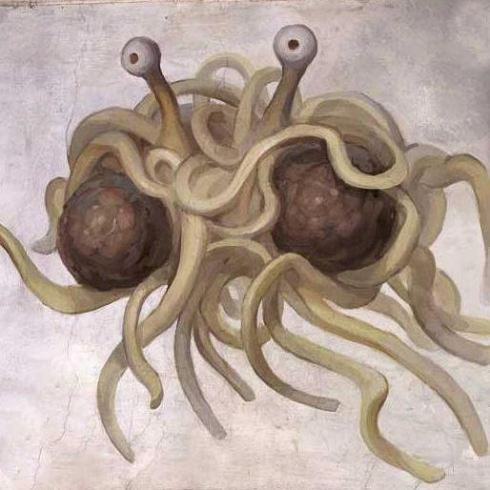
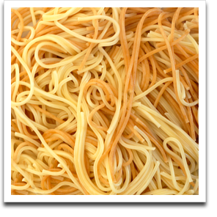
Topology
Beware of the spaghetti monster !

Slide 21
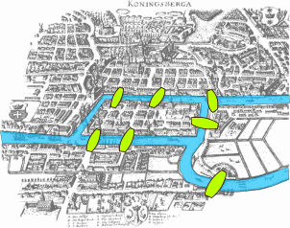
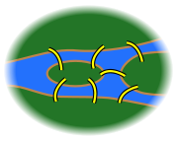
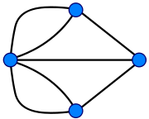
Topology - Graphs
Explicit relations between objects
Graph representation
Node / edge / face

Slide 22
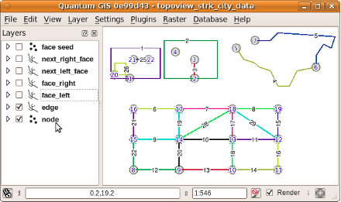
Topology
TopoGeometry Datatype
Uses schemas
  «topology» for functions and others
  Each topology in its own schema
Full SQL/MM topology support
Integrated in 2.0
  Sandro Santilli
  Toscane Region

Slide 23
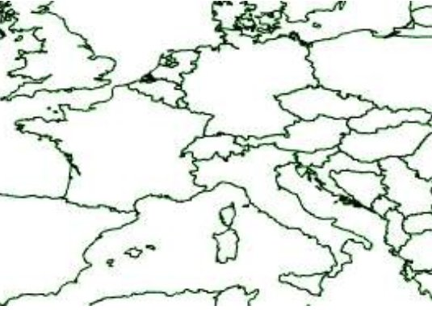
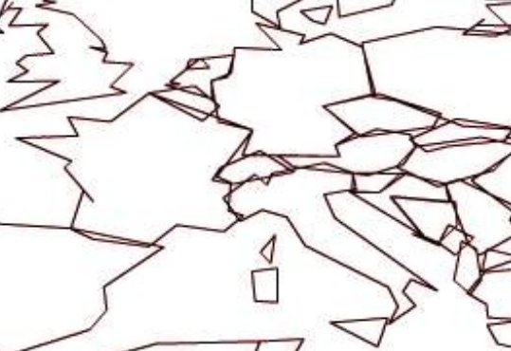
Topology
Reduced storage size
Explicit spatial relationships
Without topology !

Slide 24
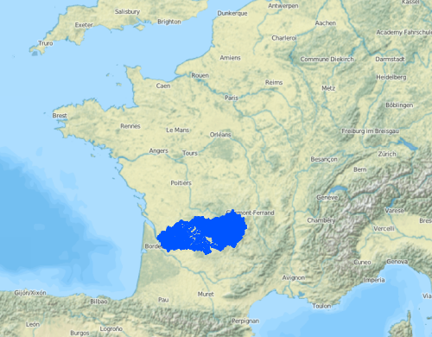
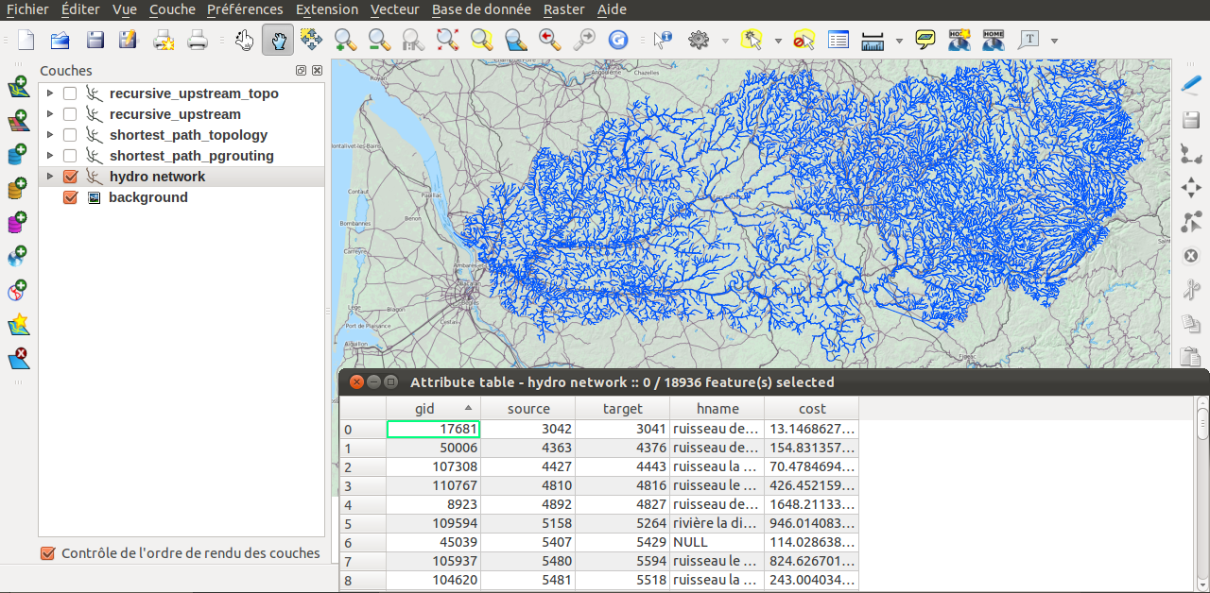
Topology use case
Table name : tr

Slide 25
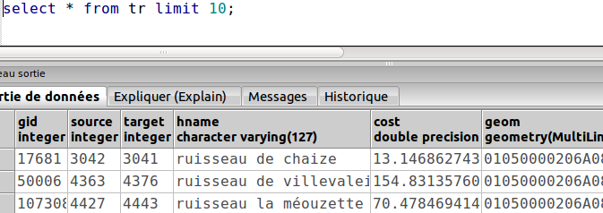
Topology
Geometry table = spaghetti
Custom attribute-based topology :
  source, target ( and cost )
Or build a PostGIS topology based on geom

Slide 26
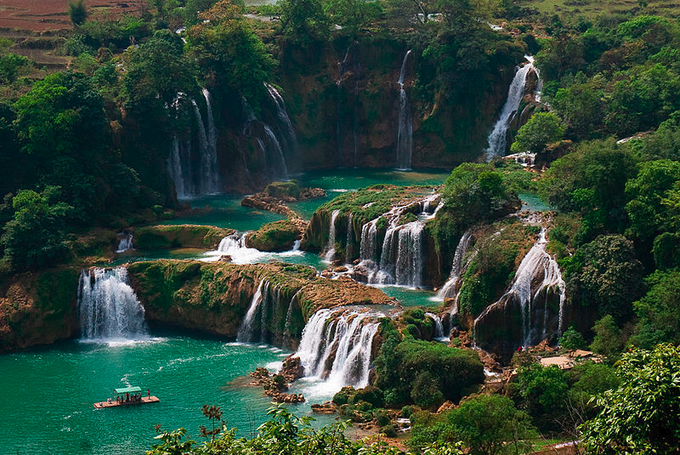
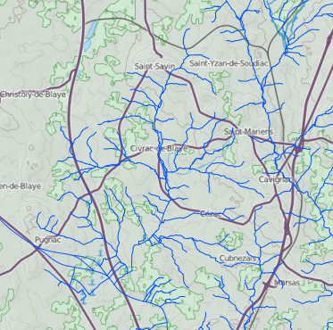
Find upstream
We want all connected
edges upstream
Starting edge

Slide 27
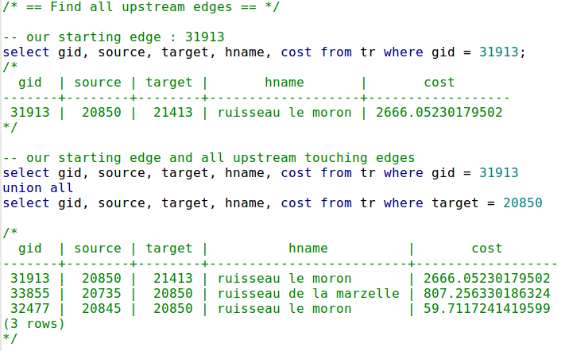
Touching upstream edges

Slide 28
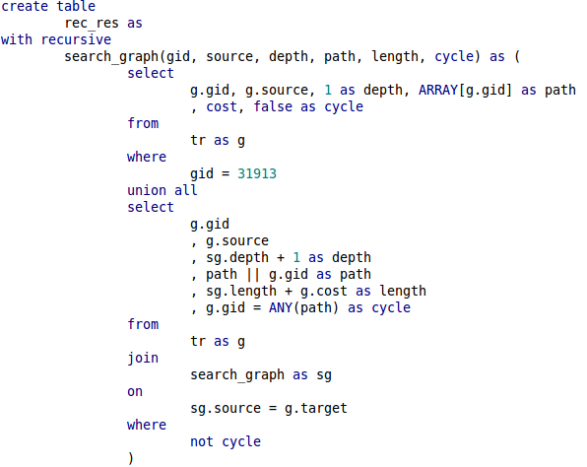
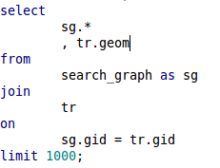
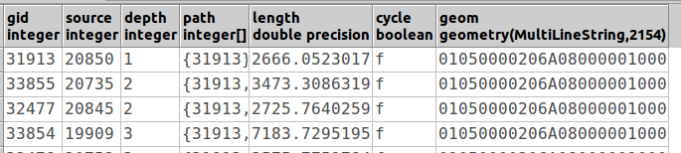
1
2
Recursive CTE
3

Slide 29
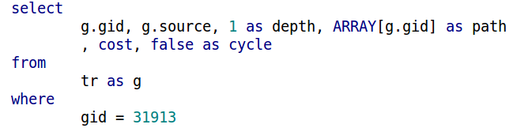
1 : init

Slide 30
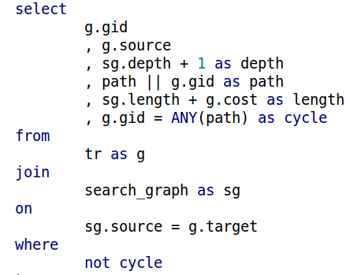
2 : recursive part
Stack the gid to the path
for this record
Sum up the cost
( it's the length here)
If the record gid is already
in the path, we have a cycle
Join result set from
previous iteration
to connected upstream
edges
Do not take elements
which make a cycle

Slide 31
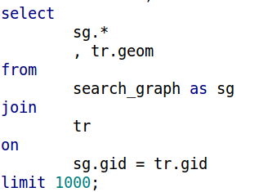
3 : Get results
Join CTE results to original
table to get geometries
Better limit recursive queries
to avoid unfinite loops

Slide 32
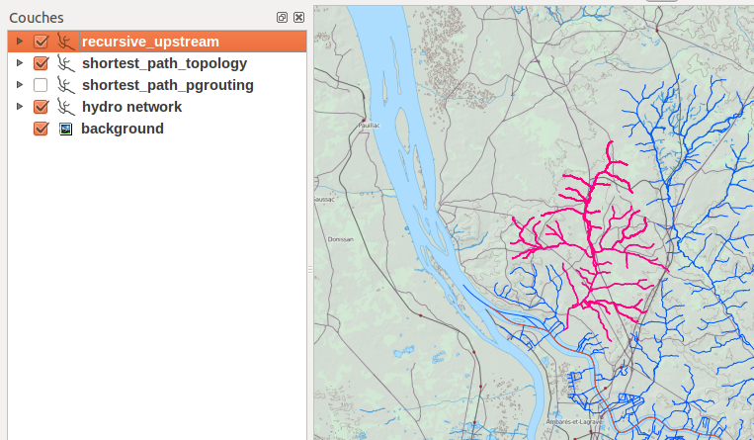

Slide 33
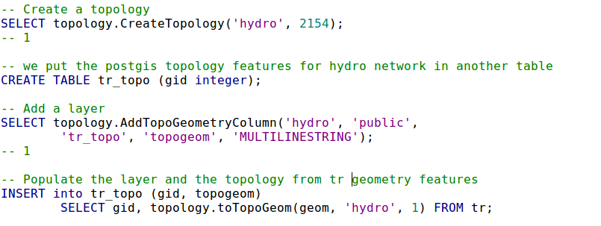
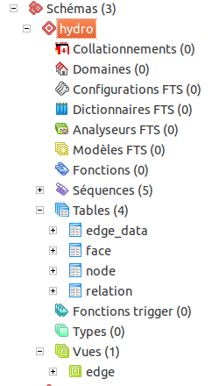
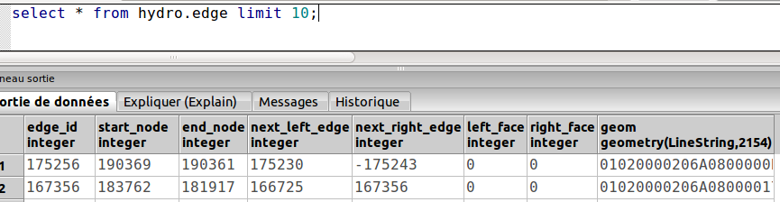
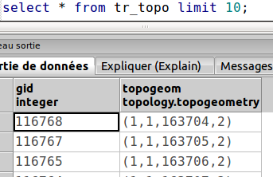

Slide 34
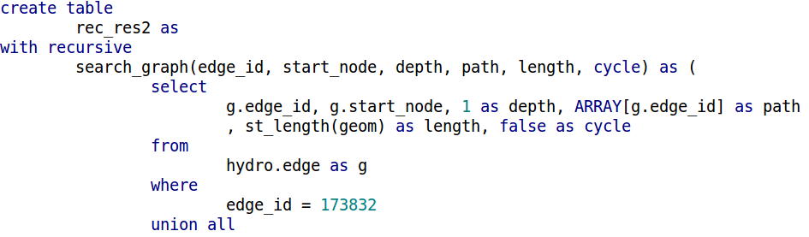
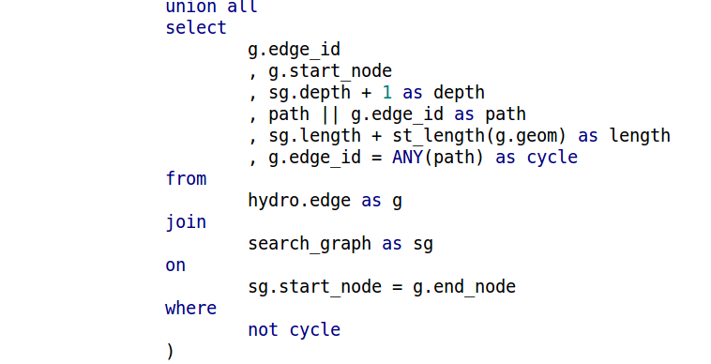
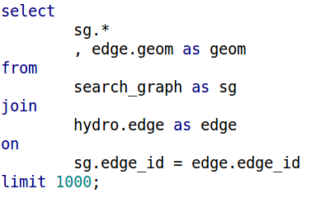
… and on PostGIS topology
1
2
3

Slide 35
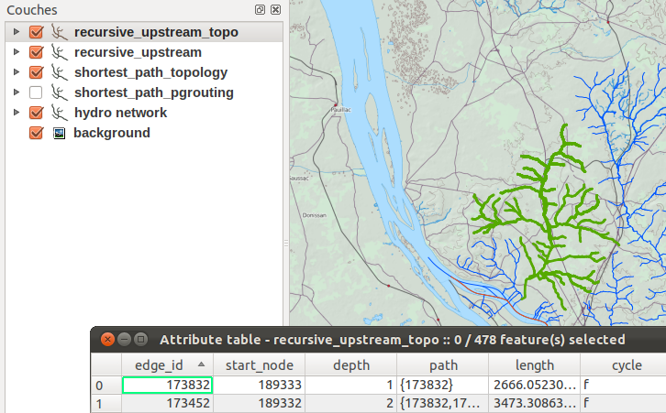

Slide 36

Rasters

Slide 37
PostGIS Rasters
Raster ~= bitmap picture
  With a georeference
Multiresolution, multiband, tile coverage
New datatype
Import/export (GDAL)
Functions
  Statistics, reprojection, edit, compute
  Vector/raster functions

Slide 38
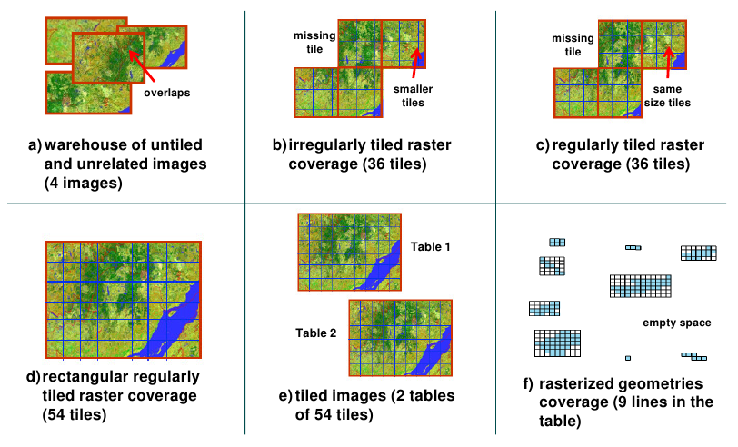
PostGIS Rasters

Slide 39
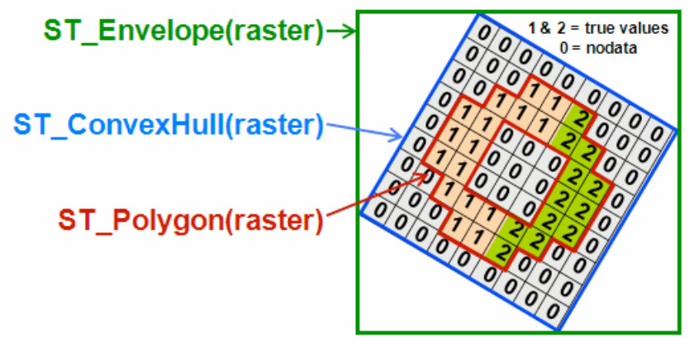
Rasters
Geometries ↔ rasters

Slide 40
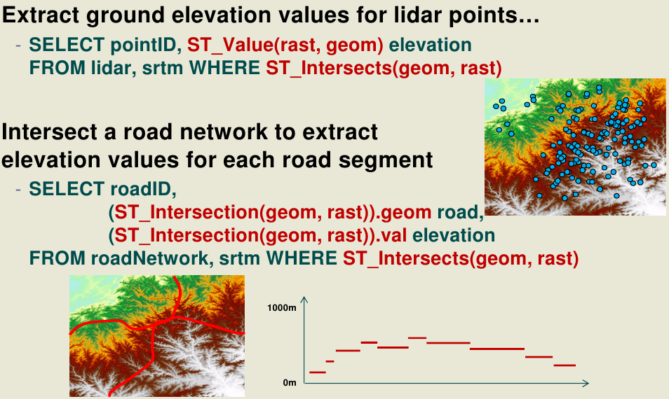
Queries with rasters

Slide 41
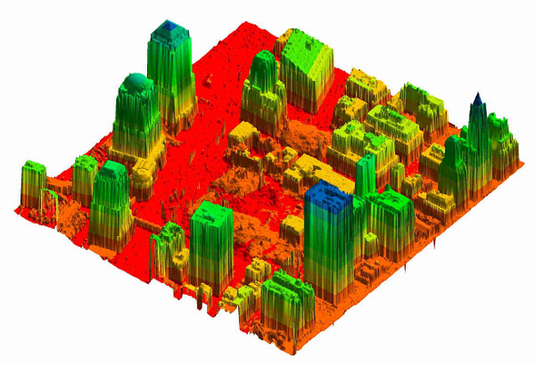
Point cloud (independant / 2.1)
LIDAR data
As a PG extension
  And a PostGIS extension
Points and patches of points
Arbitrary number of dimensions
  and representations
  (Use of point cloud « schema »)
Compression storage
Link with PDAL

Slide 42
Point cloud
Spatial filtering
SELECT PC_AsText(PC_Explode(PC_Intersection(
pa,
'SRID=4326;POLYGON((-126.451 45.552, -126.42 47.55, -126.40 45.552, -126.451 45.552))'::geometry
)))
FROM patches WHERE id = 7;
pc_astext
--------------------------------------
{"pcid":1,"pt":[-126.44,45.56,56,5]}
{"pcid":1,"pt":[-126.43,45.57,57,5]}
{"pcid":1,"pt":[-126.42,45.58,58,5]}
{"pcid":1,"pt":[-126.41,45.59,59,5]}

Slide 43
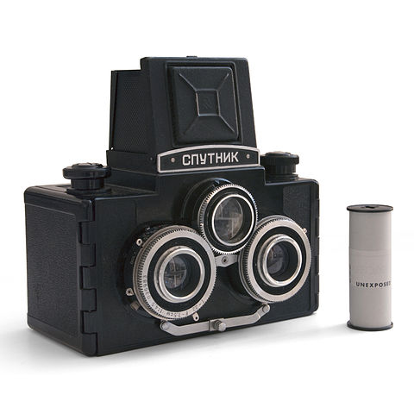
Let's go 3D !

Slide 44

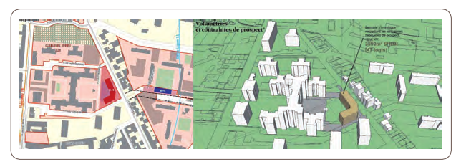
PostGIS 3D
Partial FEDER funding
Focus on urban planning

Slide 45

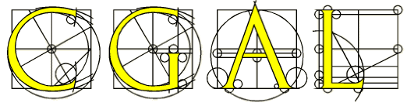
PostGIS 3D
NKOT(geo)B : CGAL
2D & 3D geometric computation
C++
Exact computation
Efficient, generic, extensible...

Slide 46
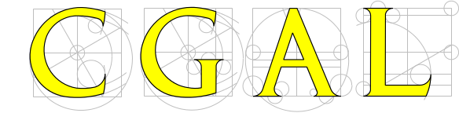

SFCGAL
SFCGAL
=
GIS Layer on top of CGAL
Some operators :
  3Dintersects
  3Dintersection
  3Dconvexhull
  Tesselation
  Straight skeletons
  Extrusion
1.0 release in July
www.sfcgal.org
+

Slide 47
PostGIS 3D
SFCGAL is integrated into PostGIS 2.1
3D storage is in
SFCGAL provides :
  ST_3Dintersects
  ST_3Dintersection
  ST_Extrude (2D -> 3D)
  ST_3Dconvexhull
  ST_StraightSkeleton
  ST_Tesselate...

Slide 48
PostGIS 3D + QGIS
Visualisation project based on an OpenSceneGraph (OpenGL) stack
Horao
Plugin for QGIS

Slide 49
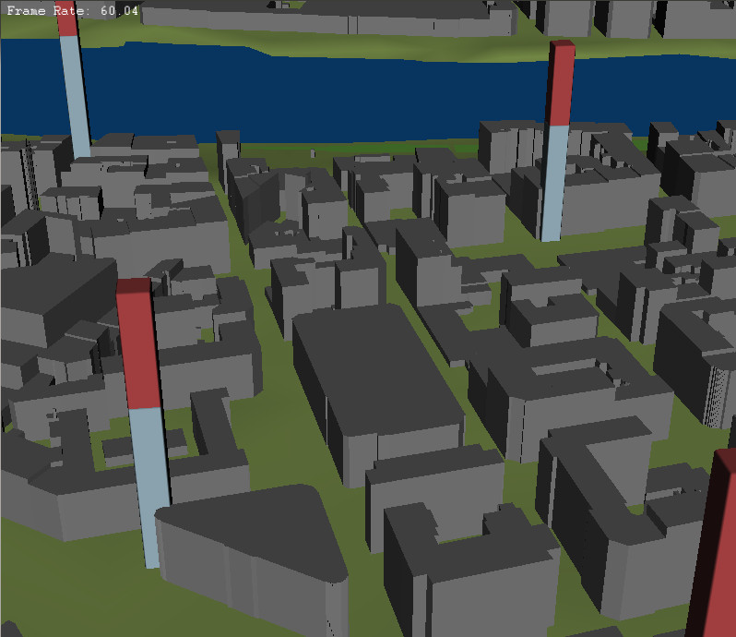

Slide 50
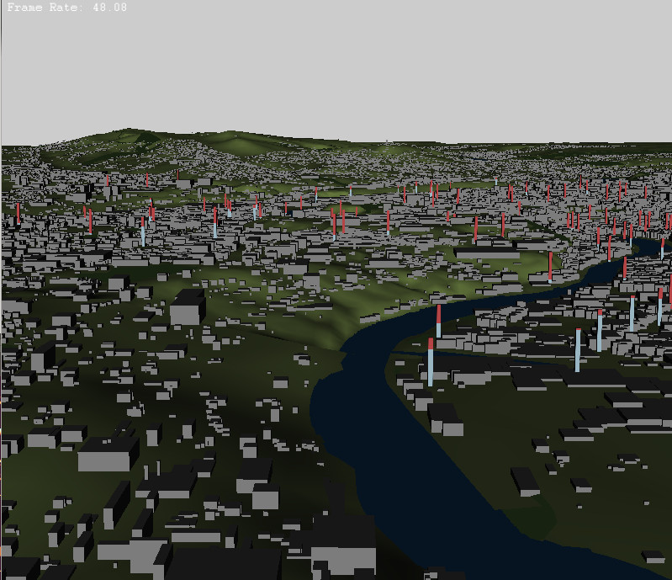

Slide 51
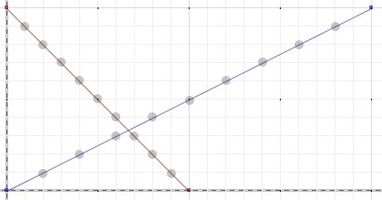
PostGIS 3D : next steps
CGAL : exact computations
New objects : exact geometries
  Try to avoid serialization
  (PostgreSQL patch)
SELECT
ST_Intersects(
ST_Intersection(
'LINESTRING(0 0,2 1)'::geometry,
'LINESTRING(1 0,0 1)'::geometry),
'LINESTRING(0 0,2 1)'::geometry);
st_intersects
---------------
f
(1 row)

Slide 52
3D Next steps
More features from CGAL
  Alpha shapes
  3D Minkowski sum
  ...
Better QGIS support (3D symbology)
Textures ?
Find €€€€€ to speed up development

Slide 53
Thanks !
hugo.mercier@oslandia.com
https://github.com/Oslandia

Slide 54
Also in PostGIS 2.1
Additional raster/raster spatial relationships (ST_Contains, ST_Covers, ST_Touches, etc.)
ST_Distance on curves
N rasters ST_MapAlgebra
Performance enhancements:
  ST_Union, ST_DumpPoints

Slide 55
Coming soon …
Raster test performances
TWKB
TopoJSON

