Slide 1

3D in QGIS
Hugo Mercier & Vincent Mora – Oslandia

Slide 2

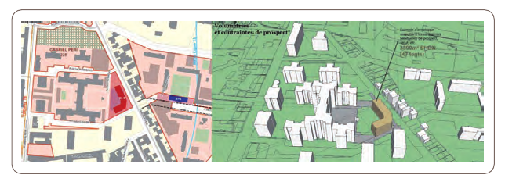
PostGIS 3D
Partial FEDER funding
Focus on urban planning

Slide 3
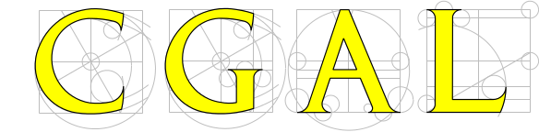

SFCGAL
SFCGAL
=
GIS Layer on top of CGAL
Some operators :
  3Dintersects
  3Dintersection
  3Dconvexhull
  Tesselation
  Straight skeletons
  Extrusion
1.0 release in July
www.sfcgal.org
+

Slide 4
PostGIS 3D
SFCGAL is integrated into PostGIS 2.1
3D storage is in
SFCGAL provides :
  ST_3Dintersects
  ST_3Dintersection
  ST_Extrude (2D -> 3D)
  ST_3Dconvexhull
  ST_StraightSkeleton
  ST_Tesselate...

Slide 5
Postgis 3D in QGIS
First attempt using Globe
Video
http://vimeo.com/54776907

Slide 6
PostGIS 3D in QGIS
OsgEarth :
  Slow for a whole 3D layer
  LOD strangely designed (additive rather than hierarchical)
QGIS
Globe
osgEarth
OpenSceneGraph
OpenGL
GPU

Slide 7
New architecture
QGIS
QGIS
Horao Plugin
Globe
pipe
osgEarth
OpenSceneGraph
LWGEOM(Postgis) + GDAL
OpenGL
OpenSceneGraph
GPU
OpenGL
GPU
Now 30 fps at a minimum for a whole city
On a basic Intel GPU board

Slide 8
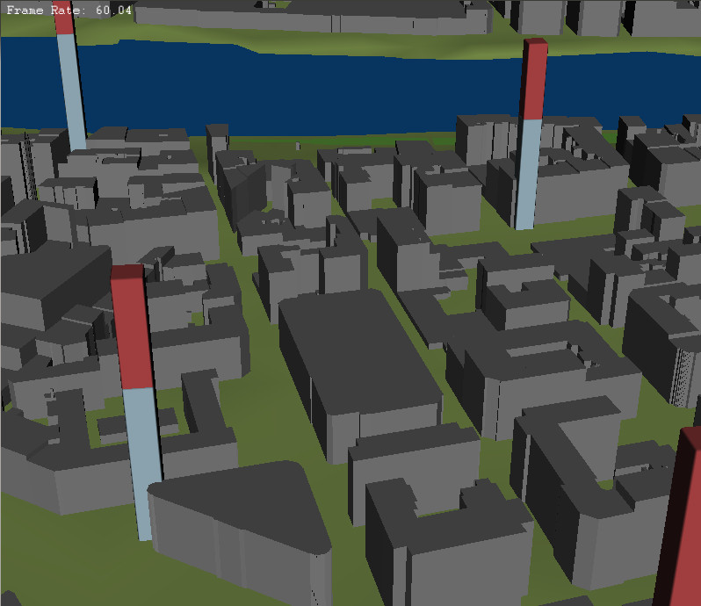

Slide 9
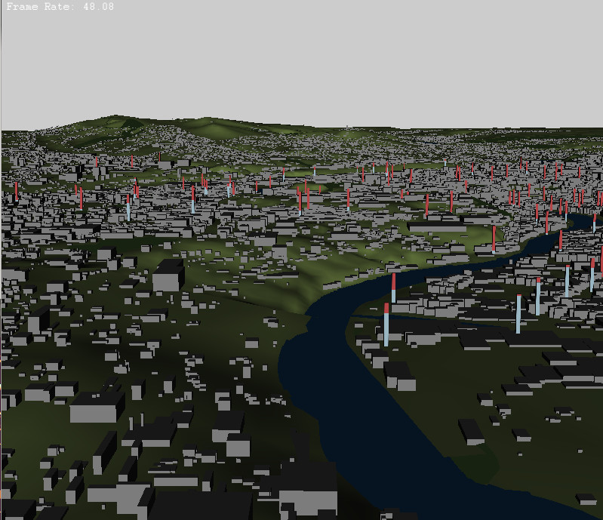

Slide 10
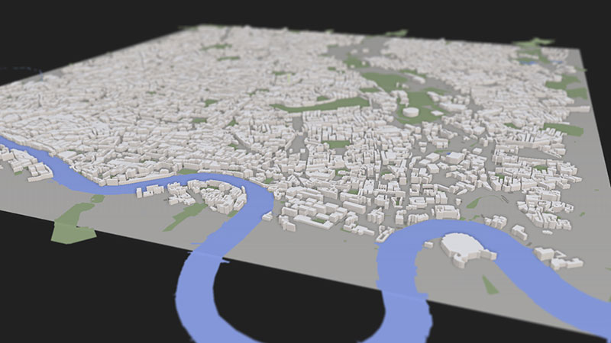
What we want : (ViziCities project)

Slide 11
Patches to QGIS
Add support for 3D types in the PostGIS provider (PR #826)
Emit a signal when properties of a layer change (PR #890)
https://github.com/Oslandia/horao

