Slide 1


QGIS 3 : plans, wishes and challenges
Hugo Mercier, FOSS4G 2016
Bonn, september 2016

Slide 2
Who am I ?
C++/Python developer
  QGIS core developer
  PostGIS developer
https://github.com/mhugo
We are hiring:-)

Slide 3
Outline
QGIS 3
  Why ?
  When ?
  API changes
  Migration « guides »
  New features / Feature proposals

Slide 4
QGIS 3 – why ?
QGIS is not just a desktop application
  It's a platform with an API
  Lots of Python plugins in the field
Major version : keep the API stable
Backward compatibility in 2.x branch

Slide 5
QGIS 3 – why ?
API stability is good
  … but enforced at a high price when new features keep coming
New features ~= new concepts
The original API does not always fit well
  « wrong » past choices
  Introduce hacks
  Hard to maintain and extend
  Increase « Technical debt »

Slide 6
QGIS 3 – why ?
Obsolescense
  Qt4 => Qt5
    Qt4 is to be discontinued
  Python 2 => 3
  PyQt4 => PyQt5
QGIS 3 :
  Qt5
  Python3 API

Slide 7
New possibilities
Python 3
  Better unicode support
Qt5
  Better OpenGL integration
  Better mobile support
  New Charts library
  New webengine
    Not really yet ...

Slide 8
QGIS 3 – when ?
2.16
  the « master » branch is forked to « master_2 »
  the « master » branch is the root of the future « 3.0 »
3.0 expected Q1 2017
  As a « beta »
  Date adjustment in January 2017
Current LTR (2.14) continued until 3.2
2.18 ?
  Maybe, maybe not

Slide 9
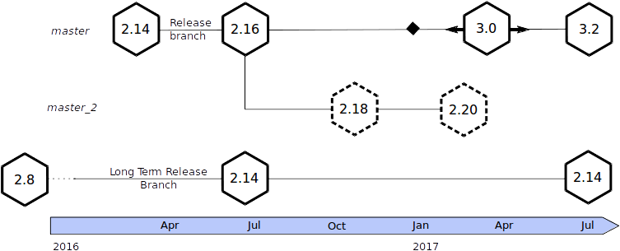
QGIS 3 – when ?

Slide 10
API breaks
Refactoring effort
  Cleanup
    More C++ good practices (const correctness)
    Get rid of old things (QgsLabel, ...)
  Overall consistency and readability
    Class / method names : no more « V2 » suffix, capitalization
    Helps newcomers (as well as experienced ones)
  Reduce complexity and « technical debt »

Slide 11
API breaks (2)
Refactoring effort
  Allow fixes that were not possible so far
    Because they would have broken the API
    9-year old bug #777 : QgsFeature geometry accessor
  Possible improvements
    C++11/14
    Multiple geometry columns
    Custom data providers in Python

Slide 12
Status
Status
  Good, compilation OK, already useable
  Each API change has big impacts, tests needed
  Things still missing (some unit tests – pyspatialite …)
Documentation
  Nice to have in QGIS 3
    https://github.com/qgis/qgis3.0_api/issues
  API breaks
    http://qgis.org/api/api_break.html
    https://github.com/qgis/QGIS/blob/master/doc/api_break.dox

Slide 13
Migration guide
Core :
  3.x (a.k.a master) branch first
  No more Qt4
  Backport to « master_2 » if you will
Plugins :
  No more Python 2

Slide 14
Migration guide : plugins
Don't use « from PyQt4.QtCore import * »
Use explicit lists of class imports
from PyQt4.QtCore import (
QDate,
QTime,
QDateTime,
QVariant
)

Slide 15
Migration guide : plugins
« 2to3 » script :
  Convert a python file
  From Python 2 to Python 3
  From PyQt4 to PyQt5
If you want to write a plugin for both Qt versions
  « Wrapping » packages
    Qgis.PyQt will choose the right version
Python is interpreted
  write more unit tests !
  test !

Slide 16
New features
QEP 20 – auxiliary storage
  Updateable joins
  New project file format (zip) that can embed layers
  Shortcuts to rapidly create « auxiliary fields » for a data-defined property
  Primary target : transparent manual label placement

Slide 17
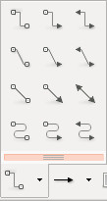
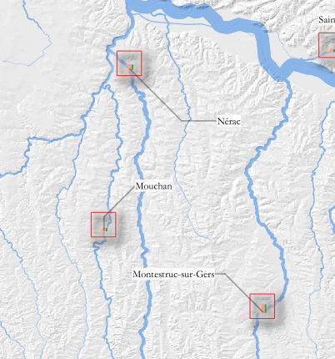
New features
QEP 28 – label connectors

Slide 18
New features
Form / edit widgets
  Custom widgets (registered by plugins) for some data types (C2C)
  Support for array and dictionary types
  Primary target : display and manipulation interlinked complex features (INSPIRE)

Slide 19
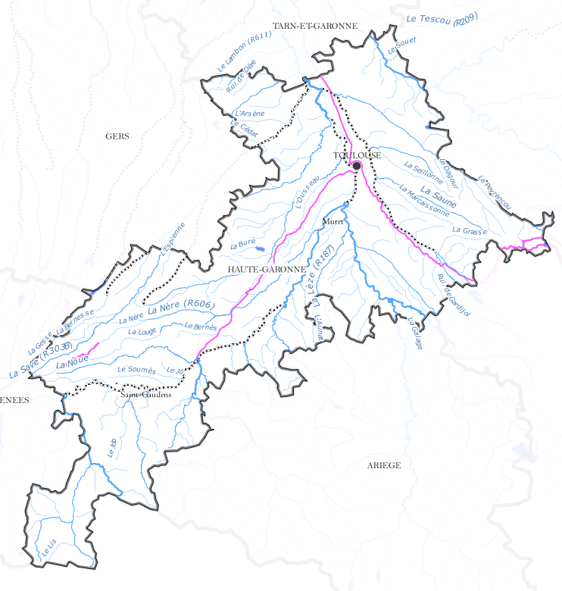
Feature proposals
QEP 27 – label path
  Curved labeling on a simplified / smooth version of the geometry
QEP 30 – label mask

Slide 20
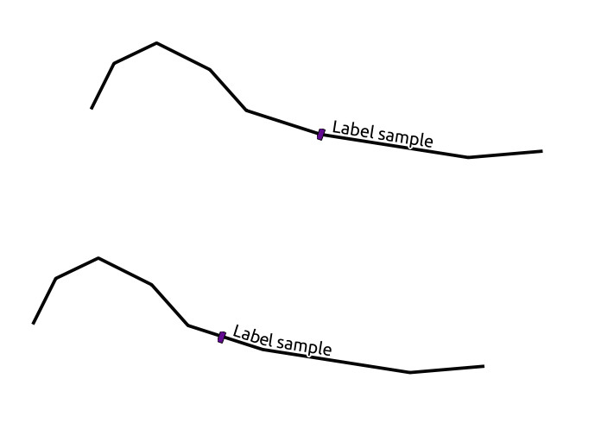
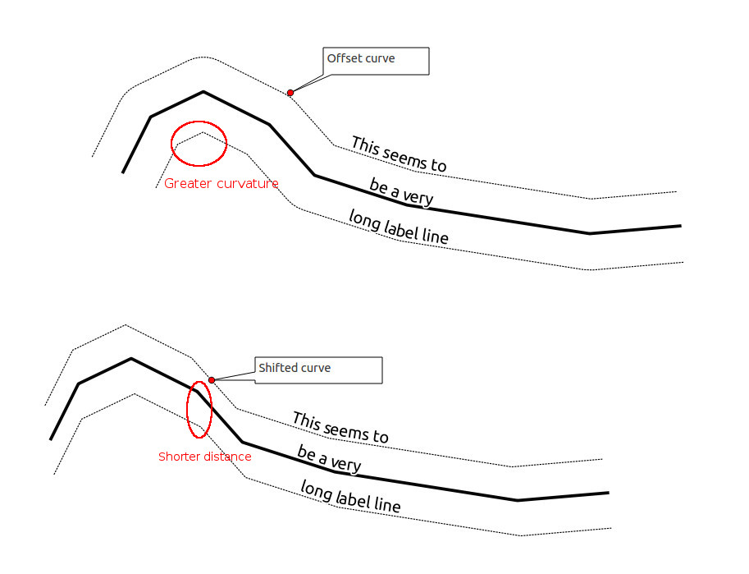
Feature proposals
QEP 41 – curved labels improvements

Slide 21


Feature proposals
Symbol clipping
  Buffer around labels / symbols that « removes » drawing from underlying layers.

Slide 22
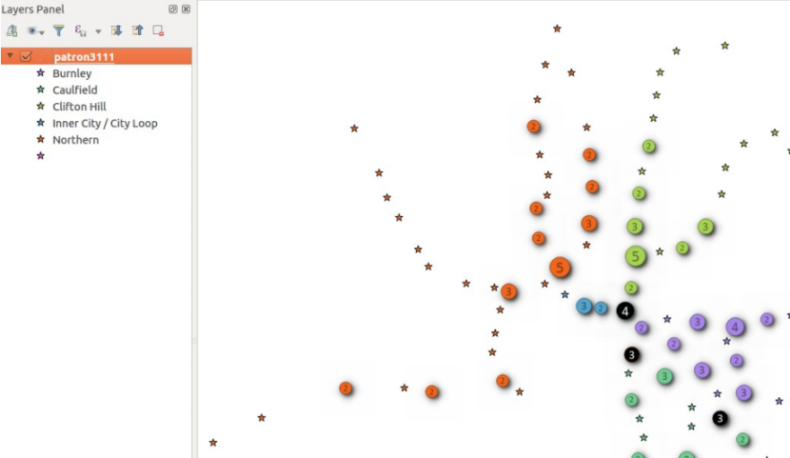
Feature proposals
Cluster renderer (Nyall Dawson)
  Crowdfunding campaign going on

Slide 23
  Thank you for your attention !

Slide 24
Sources
  Tim Sutton, Report back: 15th QGIS hackfest in Girona
  [FR] Médéric Ribreux, Sortie de QGIS 2.16 « Nødebo », LinuxFr.org
  Larry Shaffer, State of the QGIS Project, FOSS4GNA 2016
  Nyall Dawson, The road to QGIS 3.0
  Nyall Dawson, QGIS 3 is underway
  Matthias Kuhn, Prepare your plugins for QGIS 3

