Slide 1
All you need to know about the fmt package

Slide 2
F-M-T/fumpt/format
formatted I/O with functions analogous to C's printf and scanf. The format 'verbs' are derived from C's but are simpler.

Slide 3
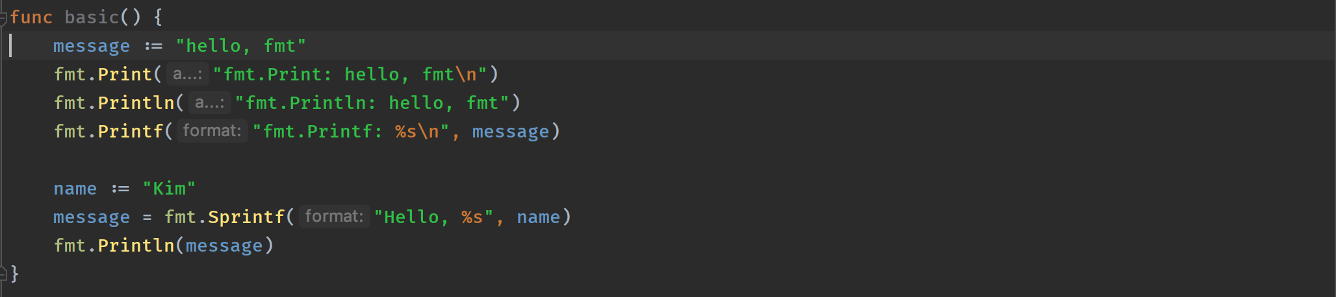
The basics

Slide 4
Follows common patterns
Print
Printf
Println
Sprint
Sprintf
Sprintln
Scan
Scanf
Scanln

Slide 5
Fprint, Fscan – uses io.Writer and io.Reader
Sprint, Sscan – uses strings

Slide 6
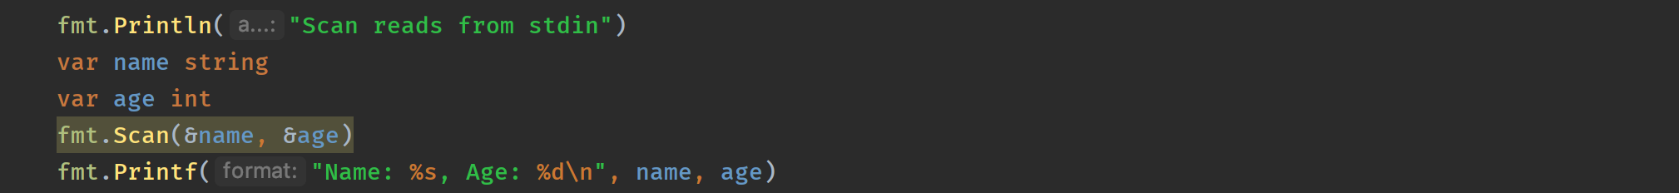
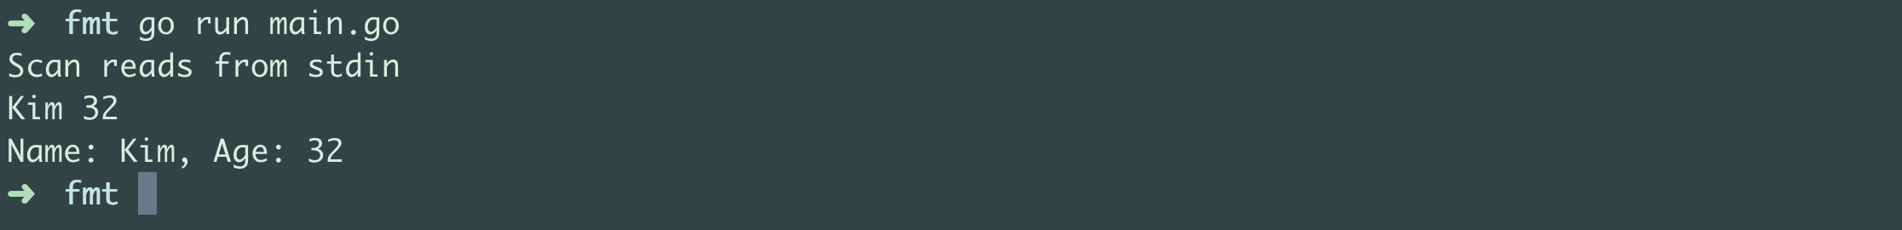
Scan – Reads from stdin

Slide 7
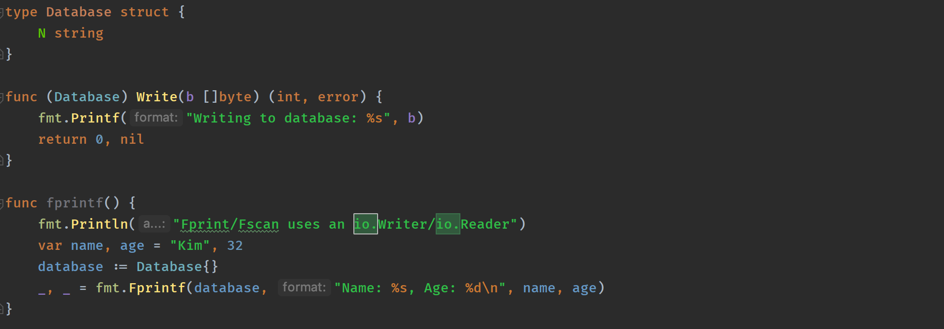
Fprintf

Slide 8
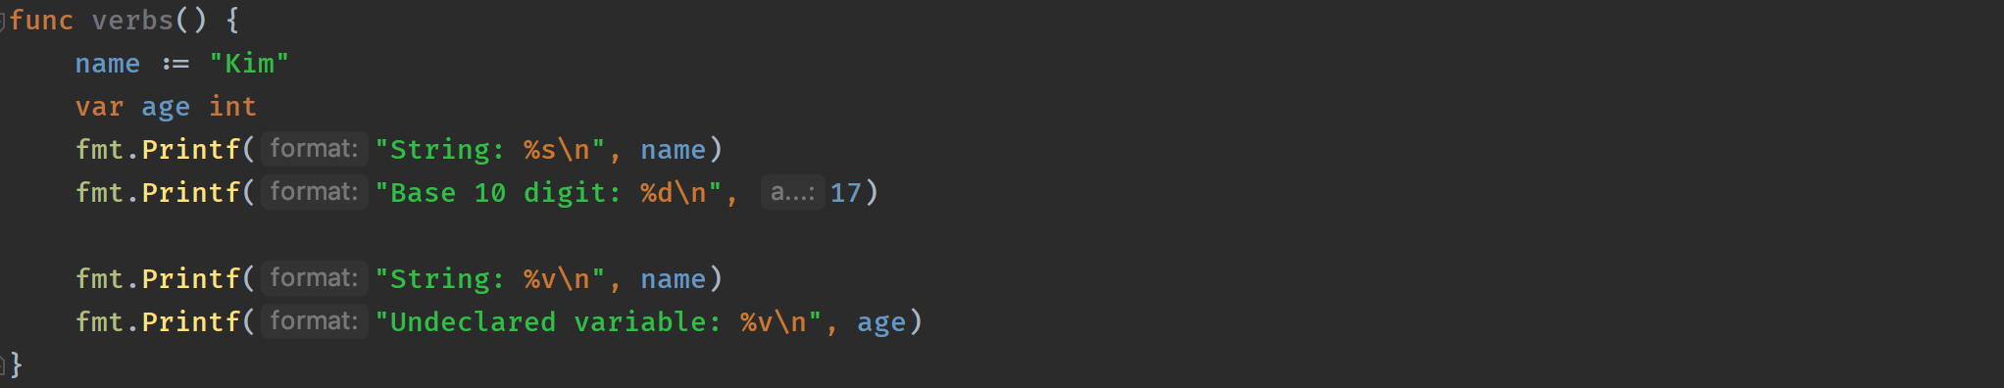
Verbs

Slide 9
Numbers

Slide 10
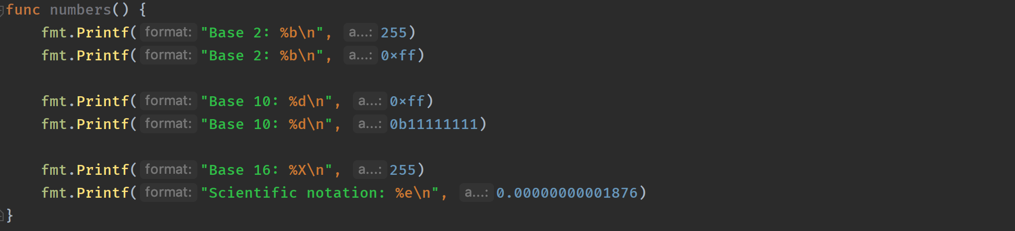
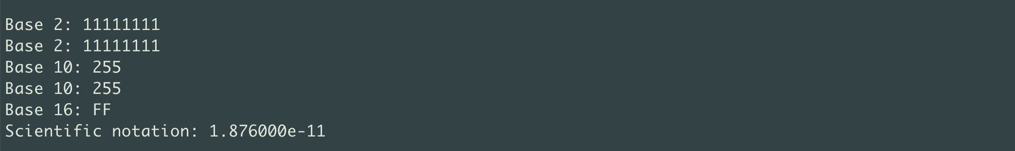

Slide 11
Unicode

Slide 12
Structs

Slide 13
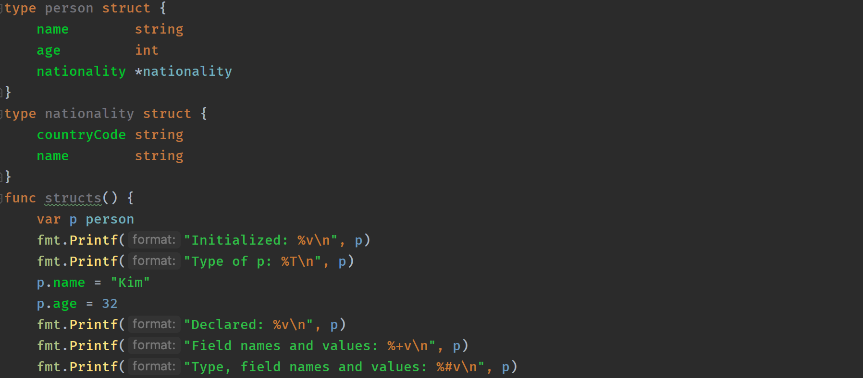
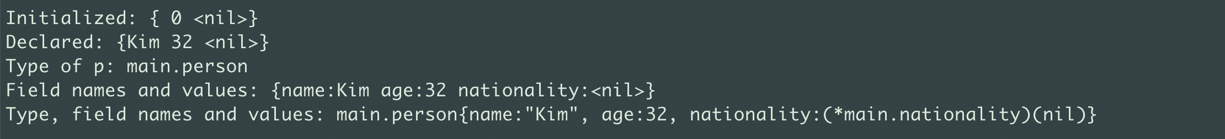

Slide 15
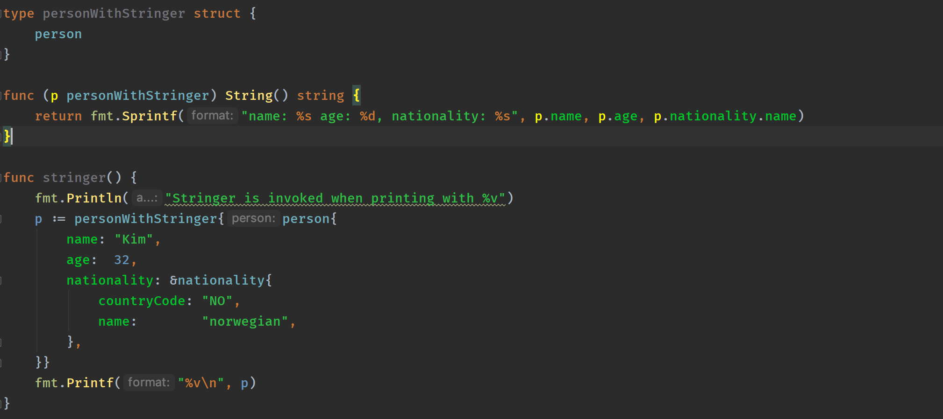

Slide 16
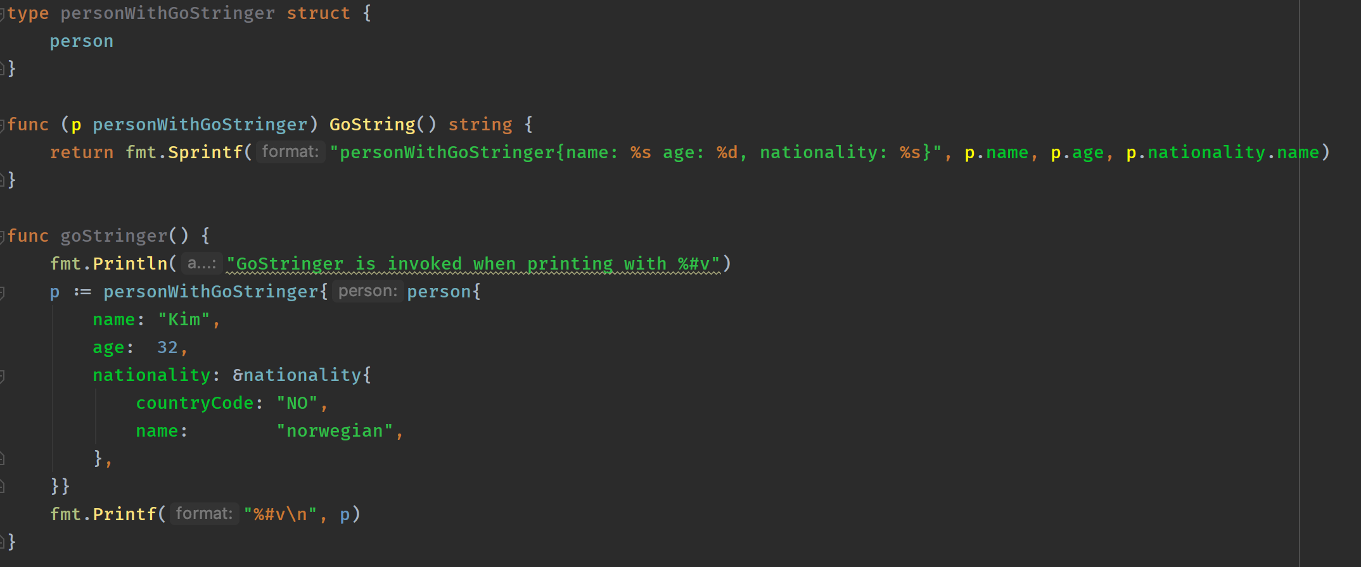

Slide 17
Casting a pointer to a string. aka »I hate my future self»

Slide 18
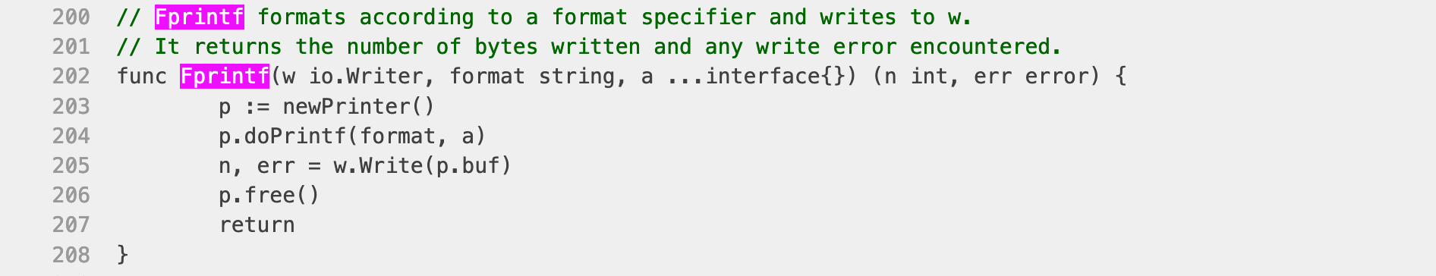
Implementation

