Slide 1
Telco
Churn predıctıon
Osman MUTLU
Beyza GÜR
- 2018510050
- 2018510035

Slide 2
OUTLINE
About of the project
Our Products & Services
ML Model Roadmap
Problem Defination & Analysis
Comparing Models
Best models
ROC Curves
Voting Classifier
MLOPS
API Design
API Swagger UI
FrontEnd Desing
Architecture
User Interface & Screen Shots

Slide 3
ABOUT OF THE PROJECT

Slide 4

About of the project
The purpose of the project is to predict customer churn in a telecom company. Our method is to develops survey application for identifying customers who will leave in the future with a machine learning model created by processing customers churn data set about a telecom company.

Slide 5
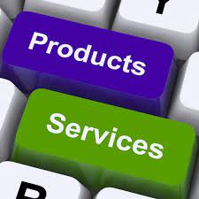
OUR PRODUCTS & SERVICES
Web survey application
Web Api for churn prediction.

Slide 6
ML MODEL Roadmap
Problem Defination & Analysis
Feature Engineering
Data Preprocessing
Model Building
Deployment
Filling missing values
Sampling
Outlier analysis
Scaling numarical features
One hot encoding
Creating extra features
Corelation analysis
Creating ml model
Hyper Parameter Optimization
Create Web API with FastAPI
Deploy container on Docker

Slide 7
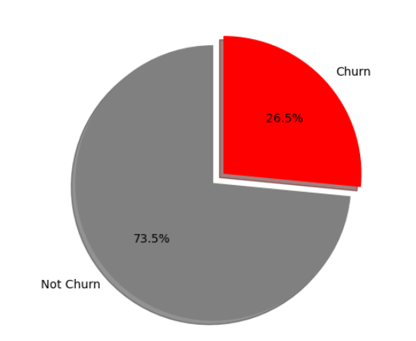
Problem DefInatIon & AnalysIs
Churn PredICTION
We want to minimize the possibility of churn in a telecom company. We should focus on the Churn class, which is a class minority. As can be seen in the pie chart, the data is unbiased. Since the cost of becoming a churn is high for us, the metrics we will take as a basis are f1 and recall.

Slide 8
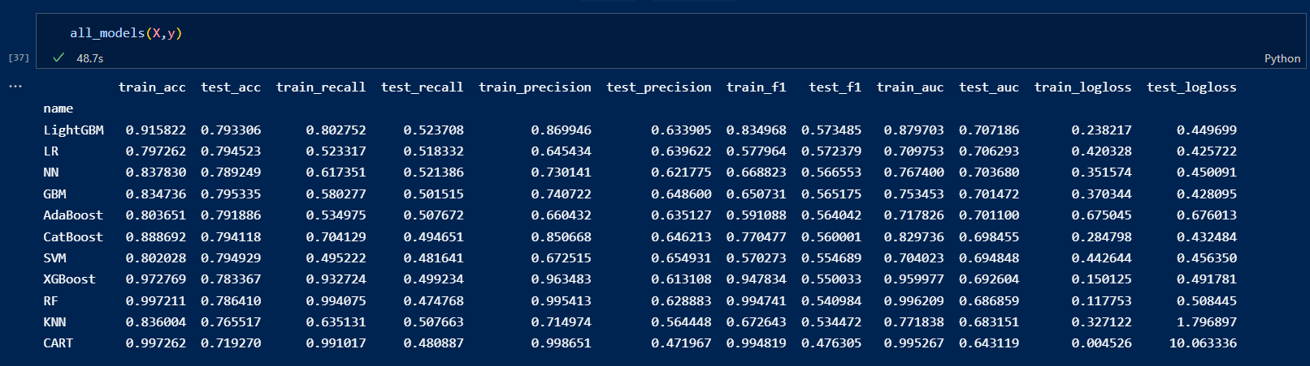
ComparIng Models - Best models

Slide 9
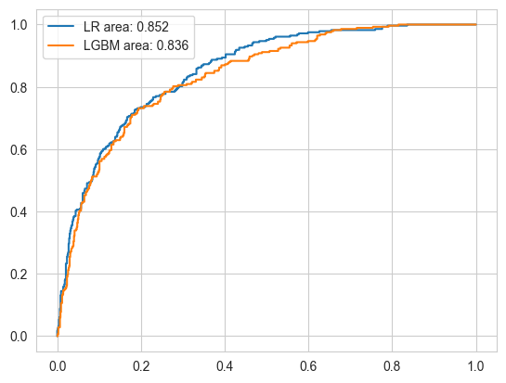
COMPARING MODELS – ROC CURVES
ROC Curve : The ROC curve is a graph that represents the classification success of a classifier. The more the area under the graph increases, the higher the success of the classifier is considered. The metric corresponding to this field is expressed as "AUC".
When we compare the LR and LGBM models, we see that they have almost the same classification success.

Slide 10
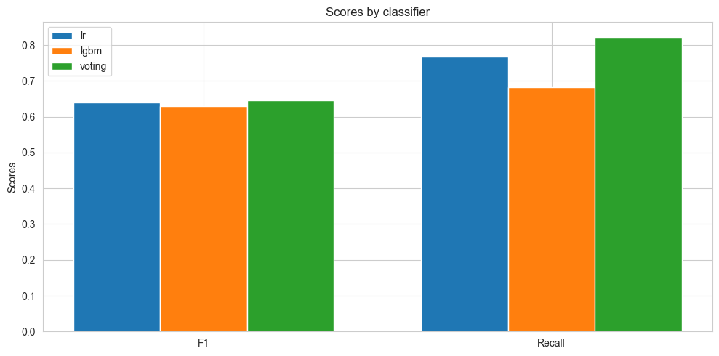
COMPARING MODELS – VOTING CLASSIFIER

Slide 11
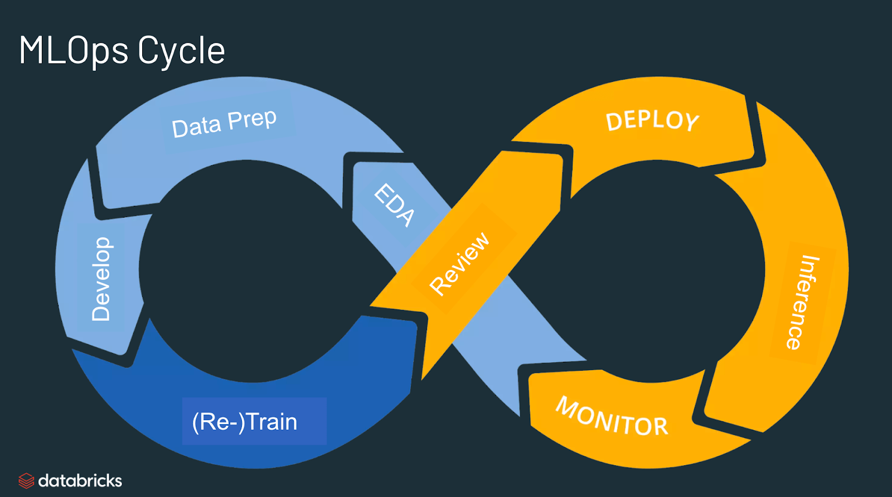

Slide 12
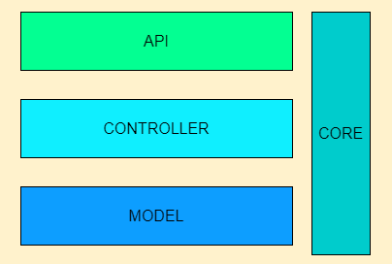
MLOPS – API DESIGN
The web api design was designed in a simple way using a structure similar to MVC.
There is a Model Deployment class in the Core layer.

Slide 13
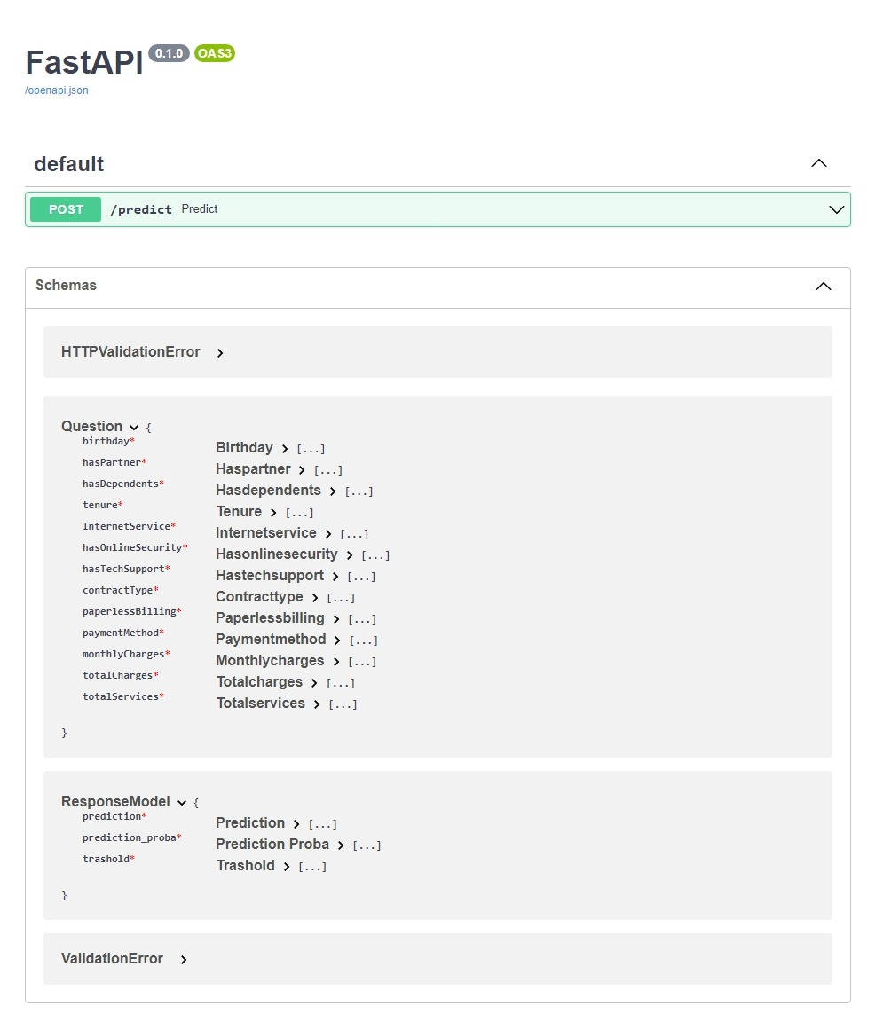
MLOPS – API Swagger UI
The predict method takes the question object, processes it and produces its output as an ResponseModel.
The question model is our input that represents the new instance. At the Controller layer, this data is adapted to the model and the model output is presented as a ResponseModel.

Slide 14
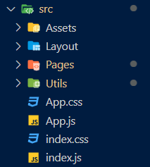
MLOPS – Frontend Desıgn
ReactJS was used for developing the front-end software.
We used ReactJS because it is quite easy to design a dynamic website thanks to its component-based architecture.

Slide 15
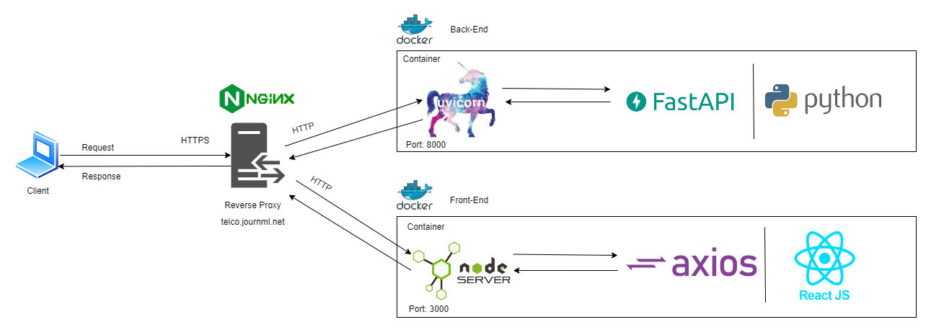
MLOPS – ARCHITECTURE

Slide 16
User ınterface & Screen Shots

Slide 17
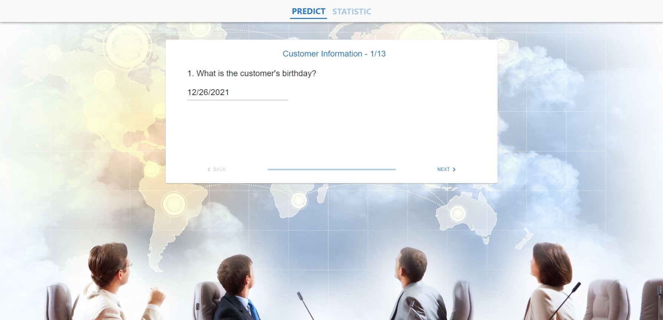

Slide 18
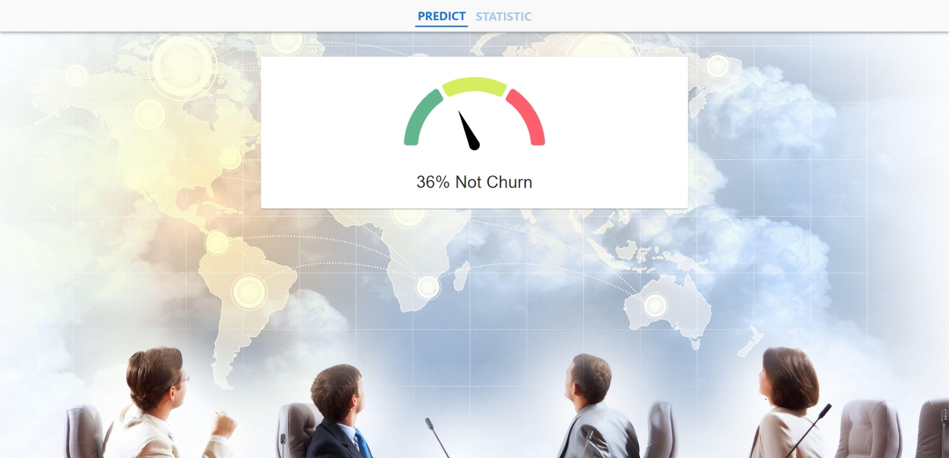

Slide 19
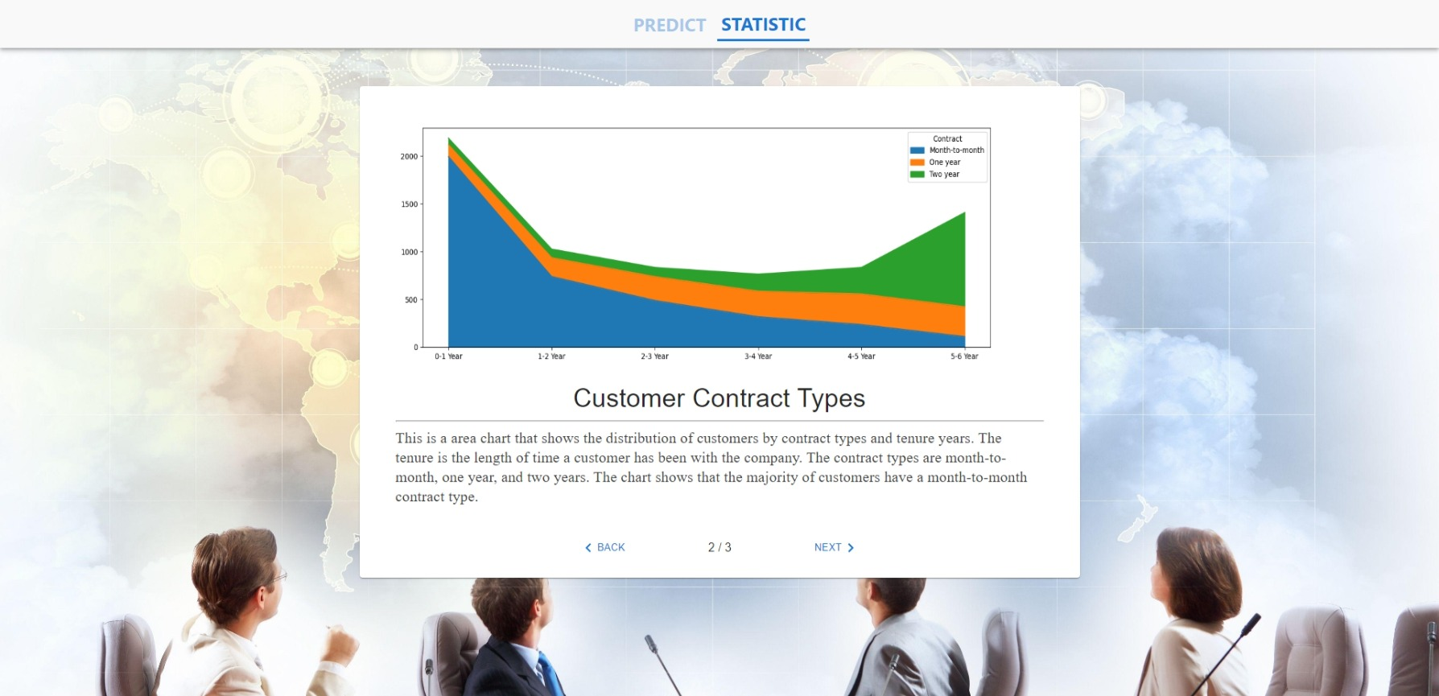

Slide 20
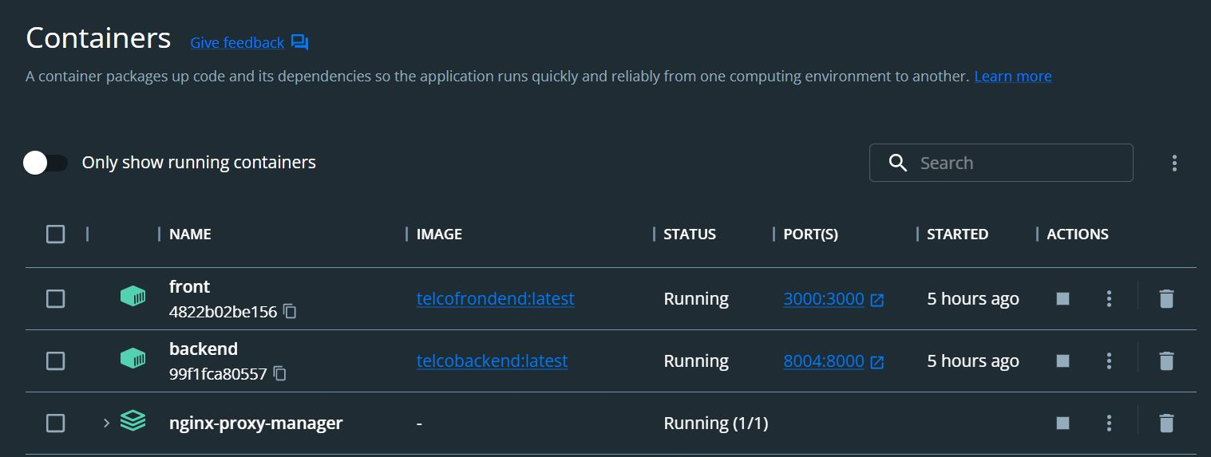

Slide 21
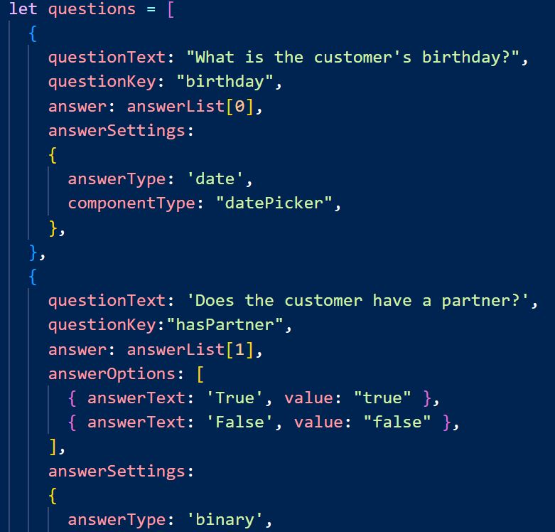
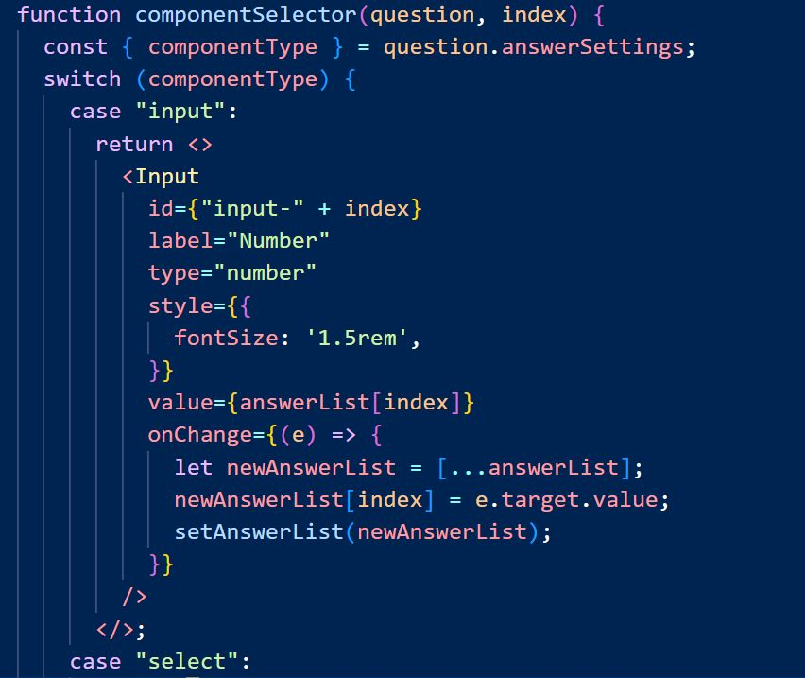

Slide 22
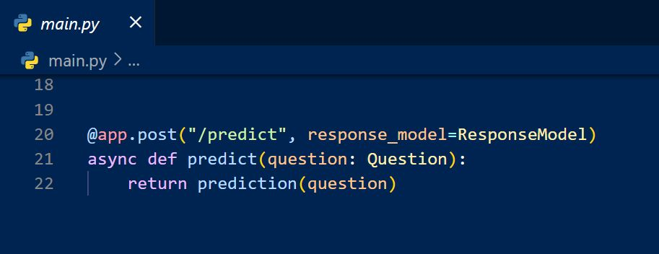
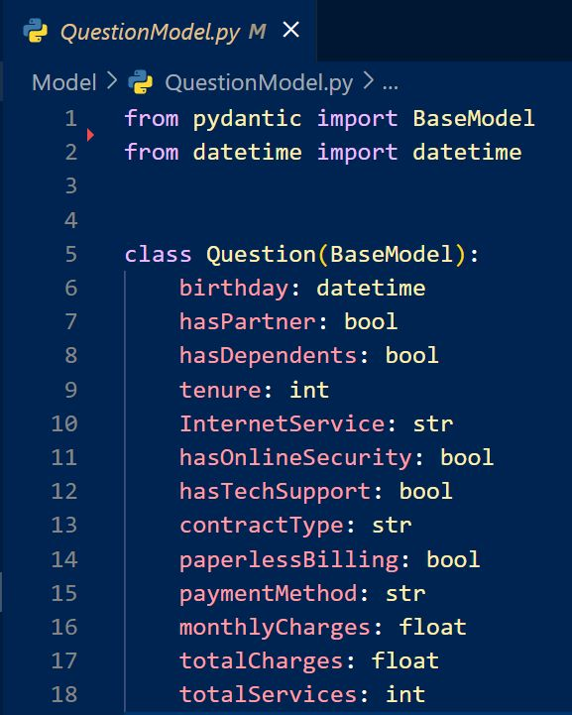
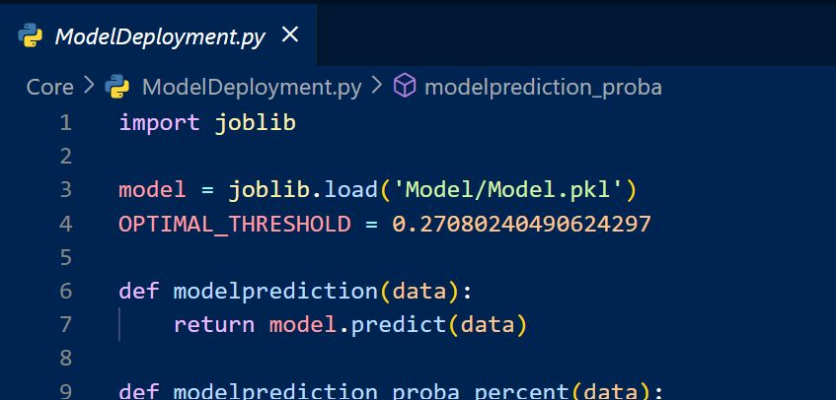

Slide 23

Questions?
Subtitle goes Here

