Slide 1

Project Title - Seasonal Agriculture Performance Analysis & Resource Optimization
Student Name: OSMAN AHMED KHAN
College Name: Malla Reddy University
AICTE STU ID: STU6973182c049f91769150508

Slide 2

Problem Statement
Agricultural activities are influenced by seasonal variations in environmental conditions, farming practices, resource availability, and market conditions.
Raw agricultural data does not clearly explain how performance changes across seasons or what patterns exist in different conditions.
The Goal: Analyze the dataset to investigate seasonal differences in agricultural performance by identifying meaningful patterns, trends, relationships, and variations.

Slide 3
Project Description & Methodology
Dataset Scope: 4,000 multi-regional farm records across 28 distinct agronomic, environmental, and financial features.
Data Engineering: Executed rigorous data hygiene, handling missing values in Yield and Rainfall via robust median imputation to preserve extreme weather outliers.
Analytical Approach: Conducted comprehensive Exploratory Data Analysis (EDA) using univariate distributions, bivariate comparisons, and multivariate correlation modeling.
Core Focus: Transitioned raw data into actionable intelligence regarding crop unit economics, irrigation efficiency, and climate-driven pest risks.

Slide 4

Who Are The End Users?
Agronomists & Farm Cooperatives: To optimize crop rotation schedules and prevent margin-trap farming during low-yield seasons.
Agricultural Policy Makers: To design targeted minimum support price (MSP) interventions and seasonal water rationing policies.
Agri-Tech Startups: To build predictive risk models for pest outbreaks based on historical humidity and temperature thresholds.
Irrigation Equipment Manufacturers: To quantify and market the ROI (Return on Investment) of micro-irrigation systems.

Slide 5

Technology Used
Programming Language: Python 3 (Core Analytics)
Data Manipulation: Pandas, NumPy (Aggregation, Imputation, Pivot Modeling)
Data Visualization: Matplotlib, Seaborn (Correlation Heatmaps, Boxplots, KDE Distributions)
Development Environment: Jupyter Notebook (.ipynb)
Reporting: Microsoft PowerPoint

Slide 6
RESULTS: Macro Seasonal Performance
Kharif (Monsoon): Highest average profitability (₹1.78L) and yield (5.64 t/ha), but carries severe pest risk (54.4%).
Rabi (Winter): The most stable season. Balanced profitability (₹87K) with the lowest baseline pest vulnerability (40.4%).
Zaid (Summer): Represents a severe margin trap. High water usage and intense heat result in an average net operational loss (-₹24.8K).

Slide 7
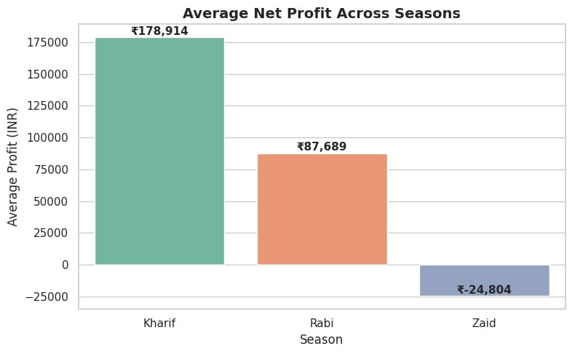
RESULTS: Financial Distribution Across Seasons
The bar plot demonstrates the stark contrast in net profitability.
Zaid season consistently dips below the break-even zero line.

Slide 8
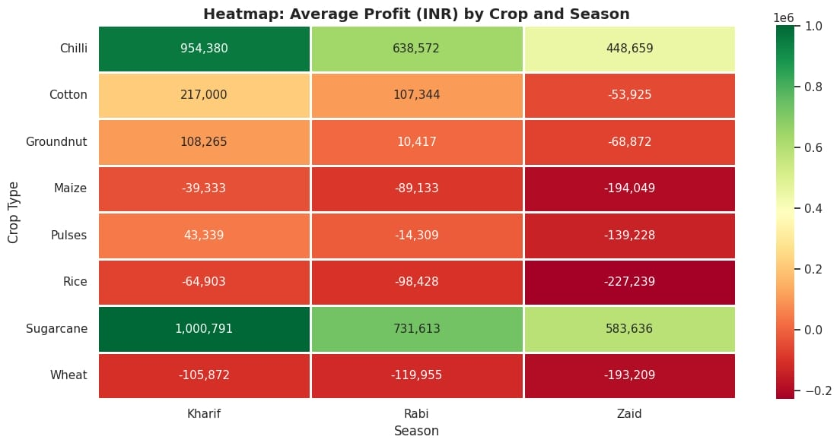
RESULTS: Crop Unit Economics (Cash Crops vs. Cereals)
Cash Crop Dominance: Sugarcane and Chilli maintain massive positive margins across all three seasons.
Cereal Deficits: Traditional grains (Rice, Wheat, Maize) consistently operate at net losses, heavily dragging down overall farm averages.

Slide 9
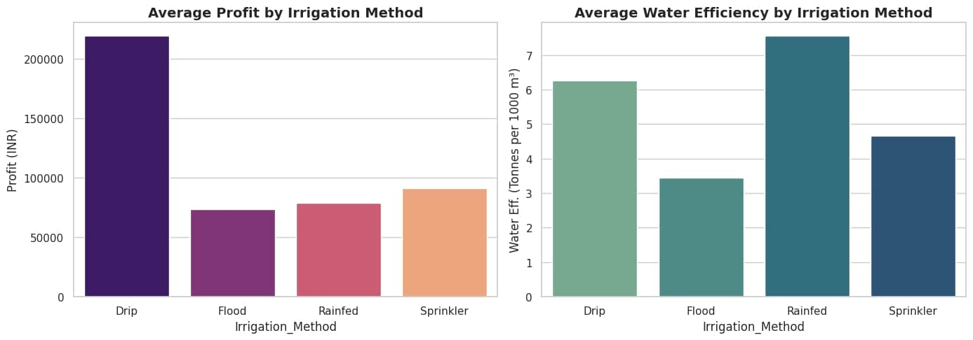
RESULTS: Irrigation Method Efficiency
RESULTS: Irrigation Method Efficiency
Drip Irrigation: Yields highest average profit (₹2.19L) and best water efficiency (6.26 t/1000m³).
Flood Irrigation: Most common but least efficient, consuming maximum water (8,026 m³) for minimal financial return.

Slide 10
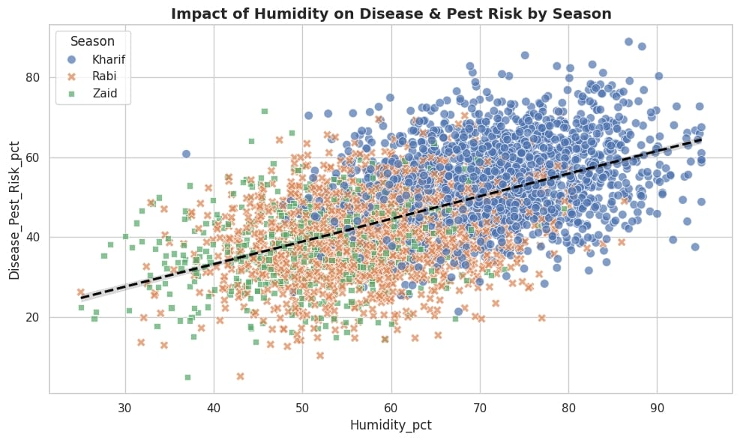
RESULTS: Irrigation Method Efficiency
RESULTS: Climate-Driven Disease & Pest Risk
Clear positive correlation between atmospheric humidity and pest risk.
Kharif's high humidity creates an optimal breeding ground for biological threats, requiring preemptive chemical mitigation.

Slide 11
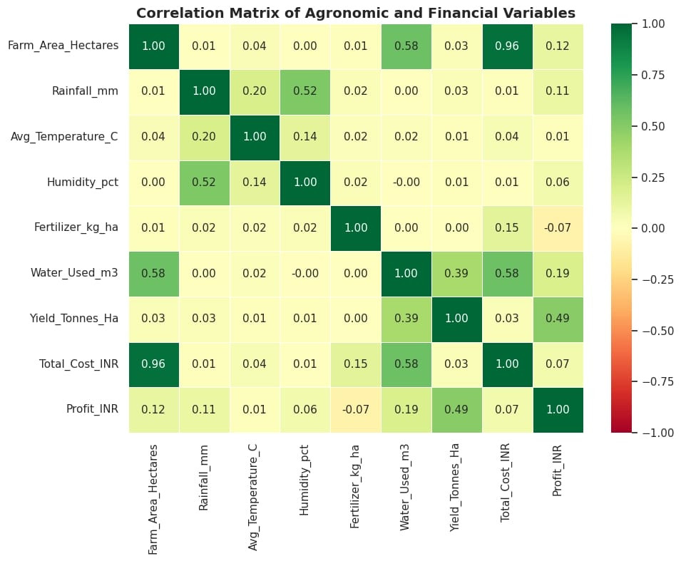
RESULTS: Irrigation Method Efficiency
RESULTS: Global Correlation Matrix
Identifies multi-variable relationships across agronomic and financial features.
Confirms a near-zero correlation between total water used and final profit, proving that simply adding more water (over-irrigation) does not scale revenue.

Slide 12
Data-Driven Recommendations
Irrigation Overhaul: Transition from Flood to Drip irrigation to drastically cut water volume while multiplying profit margins by 3x.
Zaid Season Crop Rotation: Advise farmers to halt cereal grain (Rice/Wheat) production during the summer (Zaid) to avoid guaranteed margin losses.
Preemptive Pest Control: Mandate prophylactic pesticide schedules prior to peak monsoon (Kharif) months, targeting the 70%+ humidity threshold.

Slide 13
Future Scope
Machine Learning Integration: Build predictive Random Forest models to forecast exact crop yields based on pre-season soil and climate inputs.
IoT Sensor Deployment: Integrate live soil-moisture IoT data to automate precision drip-irrigation schedules.
Geospatial Risk Mapping: Develop district-level heatmaps to visually track emerging pest outbreaks in real-time.

Slide 14
GitHub Link
Repository: https://github.com/OsmanKhanIO/seasonal-agriculture-performance-data-analytics
Contains full Jupyter Notebook, comprehensive Markdown EDA, and datasets.

Slide 15

VOIS Course Completion Certificate
Course Name: Data Visualization

Slide 16
Thank You
Thank you for your time and attention.
Open for questions and technical discussion.
Osman Ahmed Khan

