Slide 1
Ch.7
Structure,culture and change management in information systems
By: Mohammed Ahmed Mohammed Shaheen

Slide 2
INTRODUCTION
Organisational structure and culture are fundamental factors to be considered in information systems strategic management (ISSM).
An organizational structure is defined as a set of entities that collaborate and contribute towards a common goal.
Organizational culture is defined as the shared values, beliefs, or perceptions held by employees within an organization, which influences their attitudes and behaviors, thereby impacting teamwork and performance.

Slide 3
ORGANISATIONAL STRUCTURE AND
CULTURE
“Strategy cannot be formulated and implemented independently of the type of organisation concerned”.

Slide 4
ORGANISATIONAL STRUCTURE AND
CULTURE
Classification of organisations by Jackson (1987) :
1-Machines: rule-based systems can be used to control operations in a deterministic environment: that is, one in which, if the inputs to the process are known, the outputs can be predicted with a high degree of certainty.
2-Organisms: combination of sub-systems interacting together and attempting to maintain a ‘steady state’ within their environment.
3- Cultures: the primary consideration in any organisation is its functioning as a social structure.
4-Coercive systems: functioning according to power structures.
power structure: a group of persons having control of an organization.

Slide 5
ORGANISATIONAL STRUCTURE AND
CULTURE
However, whilst Jackson’s work lays a foundation for understanding the structure/culture conflict in organisations, it is Mintzberg who has provided the primary classificatory framework.

Slide 6
ORGANISATIONAL STRUCTURE
Organisations are subject to seven forces “Mintzberg (1991)”:
1-Direction: strategic direction or vision of the organisation.
2- Proficiency: knowledge and skill .
3-Innovation:the requirement to adapt and to learn about changing circumstances .
4- Concentration: requirement for certain parts of the organisation to concentrate their effort .
5- Efficiency: cost-benefit problem .
The forces for co-operation and competition which lie within the pentagon, Mintzberg sees as catalytic, and related to culture ...
6- Co-operation: The pulling together of ideology .
7-Competition: rests on conflict(clash) .

Slide 7
ORGANISATIONAL STRUCTURE
The argument to be drawn from this is not that any one organisation will match neatly any one of the forms and forces defined, but that by using a model ( mix of forces which are affecting a given organisation and the structural mix that it might need in order to deal with that).

Slide 8
ORGANISATIONAL STRUCTURE
Mintzberg counsels against becoming too attached to any given configuration within an organisation.
‘the dominance of a single force but also the constraining effects of other forces’

Slide 9
ORGANISATIONAL CULTURE
How culture affects the management of information?
Culture emerges from the social interaction of all organisational members – managers are as much a part and product of the culture as all other members; they are not a special group standing proud of the culture and managing it.

Slide 10
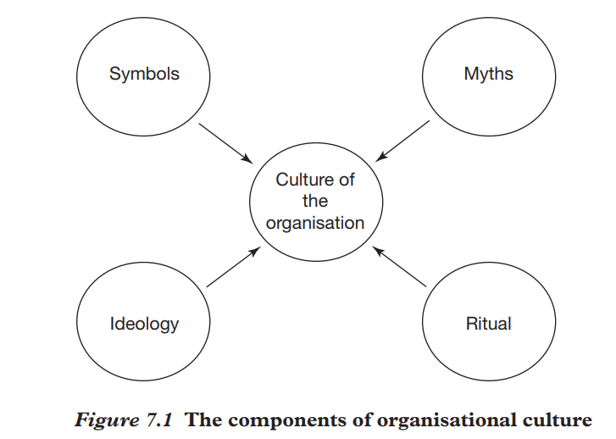
ORGANISATIONAL CULTURE
The essential view of organisational culture is embedded in :
1-Symbols are the shared codes of meaning within the organisation.
2-Myths are evident in all organisations.
3-Ideology is an organisation’s systems of knowledge or set of beliefs about the social world.
4-Rituals within organisations help to cement the underlying values.

Slide 11
ORGANISATIONAL CULTURE

Slide 12
ORGANISATIONAL CULTURE
Formulating and implementing strategies for improving the use of information in organisations inevitably(itself) implies some form of change.

Slide 13
MANAGING STRATEGIC CHANGE
Information systems strategic change management has been dominated by methods which aim to plan and control the change process :
1- Total quality management (TQM)
2- Business process re-engineering (BPR)
TQM and BPR aim to alter the structure of the organisation and the processes which make up its activities, whilst the people within the organisation have to adapt to these new conditions.

Slide 14
MANAGING STRATEGIC CHANGE
TQM: implement change successfully where people have different interests and values (Jackson, 1995), assuming, as it does, a common culture throughout the organisation.
BPR: offers a series of tools for identifying the necessary change and rebuilding the organisation in a new image.
BPR has little to say about problems beyond organisational processes:
‘If re-engineering fails, no matter what the proximate(nearest) cause, the underlying(following) reason can invariably be traced to senior managers’ inadequate(incomplete) understanding or leadership of the re-engineering effort’

Slide 15
MANAGING STRATEGIC CHANGE
Failure to change the organisational culture can lead to failure of the organisation.
If organizations rely in the short to medium term on emergent(old) strategies without undergoing any fundamental changes to structure, culture or people, the evidence suggests that eventually they will die.

Slide 16
STRATEGIC CHANGE AND INFORMATION
SYSTEMS
Orlikowski and Hofman (1997) see the traditional approach to change in organisations as one which starts with a plan and then manages the change according to that plan, with any alterations(modifications) being matched by changes to the plan.

Slide 17
STRATEGIC CHANGE AND INFORMATION
SYSTEMS
Since the technologies to be implemented and the organisational impact of those technologies is not predictable, a planned approach is not seen as feasible.
What is required is an approach to change which allows for emerging needs, unanticipated outcomes, continuous innovation and learning within the organisation

Slide 18
STRATEGIC CHANGE AND INFORMATION
SYSTEMS
Drawing on MIT’s ‘Management in the 1990s’ programme, Benjamin and Levinson (1993) see the bias towards technology, rather than ‘managing changes in process and organisational structure and culture’, as a fundamental cause of IT benefits not being realised.
A move is proposed away from what is seen as the traditional way of managing change through a management hierarchy, to an ‘informated organisation’ within which all have access to information and are empowered to use it.
Management hierarchy: next page

Slide 19
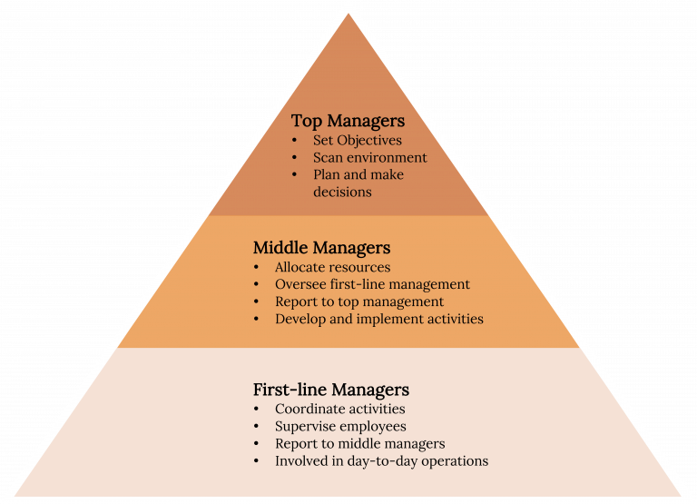
STRATEGIC CHANGE AND INFORMATION
SYSTEMS
Management hierarchy:

Slide 20
TOWARD A FRAMEWORK FOR
INFORMATION SYSTEMS CHANGE
MANAGEMENT

Slide 21
Positioning the organisation
Studies by Argyris and Schon (1974) suggest that organisations must determine their position on the grid (Figure 7.2), the aim being to move towards the bottom right.

Slide 22
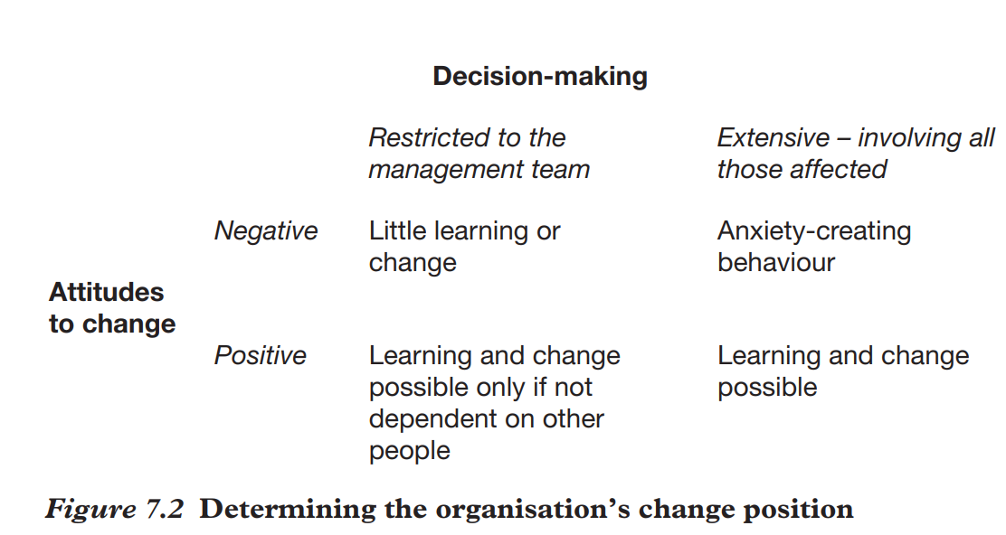
Positioning the organisation

Slide 23
Monitoring organisational effectiveness
A matrix for monitoring(control) organisational effectiveness in change situations is proposed by Carnall (1990).
The grid (Figure 7.3) maps efficiency and effectiveness on the horizontal axis, against quantitative and qualitative measures on the vertical axis.

Slide 24
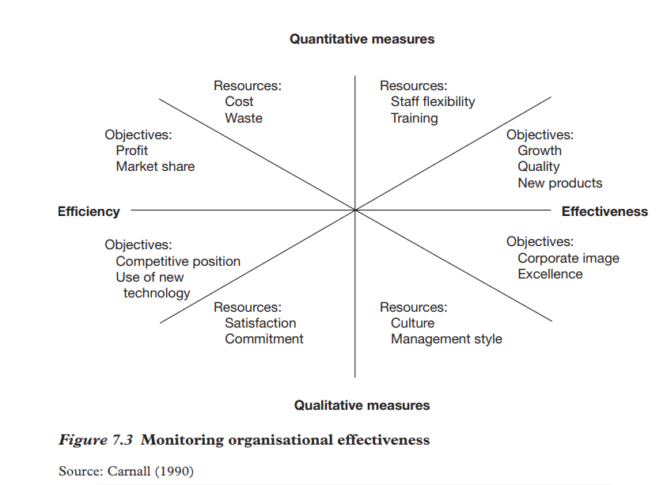
Monitoring organisational effectiveness

Slide 25
Blocks to change
Also important in this respect is the need to identify blocks to change (Adams, 1987).

Slide 26
Blocks to change
Such as an unwillingness to change the way things are done.
To unblock needs open management, free expression and a willingness to discuss negatives as well as positives.
Argyris (1985) stresses this as the need for ‘open confrontation(facing) of issues’.

Slide 27
Change styles
Three styles are seen to be important (Boddy and Buchanan, 1992): imposition; education and communication; and participation.

Slide 28
Change styles
Whilst imposition might be seen as possible through a manipulative approach to change, the other styles clearly need to be supported through a participative framework.
People need help in coping with change:
‘People need to understand the new system if they are to understand their own part in it’ (Carnall, 1990).
Many advantages are cited for involving people (improved decisions, better understanding and so on).
The keys to this are flexibility, team building, networking, communication skills (stimulating(exciting) motivation in others), and the ability to take a holistic(overall) view.

Slide 29
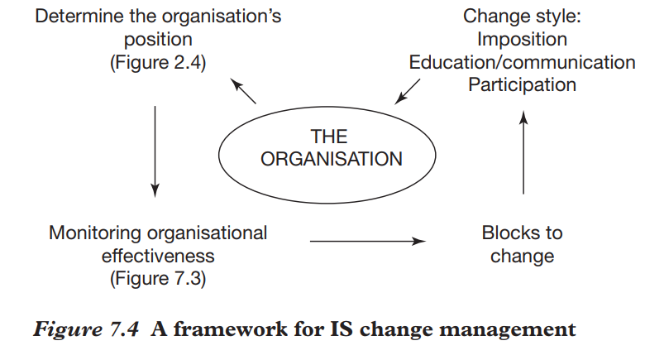
Change styles

Slide 30
Than you

