Slide 1
Ch.8
PLANNING AND FORMULATING INFORMATION SYSTEMS STRATEGY
By: Mohammed Ahmed Mohammed Shaheen

Slide 2
INTRODUCTION
IS is reconceptualised as a predominantly human-centred domain, but one which relies for support on the effective use of technology.
The outcome is a new framework for ISSM

Slide 3
INFORMATION SYSTEMS AS A DOMAIN
Information systems (IS) domain : the demand from business organisations has traditionally been for ‘systems’ which show an objective return in terms of cost, efficiency and/or effectiveness, with systems developers being driven to provide low-cost solutions to perceived business problems.
The management of IS under this model is governed by a need to design, develop and manage technological solutions to identified problems.

Slide 4
INFORMATION SYSTEMS AS A DOMAIN
The old way of building computer systems as just a tech problem ("hard" method) often failed.
The better way involves the people ("soft" method), getting them to agree and be creative.
The best approach is a mix of both.

Slide 5
CORPORATE STRATEGY: PLANS OR
PATTERNS
Strategy doesn't have to be a fixed, written "Plan." Often, the real strategy is a successful "Pattern" of actions that naturally develops over time.
Because technology changes so fast, a mix of planning and flexibility is needed to fit how your company actually works.

Slide 6
STRATEGIC ALIGNMENT
It's wrong to just make the IT (the technology) follow the main business plan.
The right way is to constantly make sure the business goals and the computer systems (IS) are aligned, based on what information the people in the company actually need.

Slide 7
Competitive Advantage
It is not an advantage just by having the newest technology.
It is an advantage by how well your people use the information and systems.
If two companies have the same computers, the one that manages its people and information better is the one that wins.

Slide 8
A New Approach to IS Strategy
The new way to plan computer strategy (ISSM) must put the people involved (participants) at the very center of the whole process (Figure 8.1).
The strategy must be driven by what people need, not by technology or fixed plans, because how people use information is what creates lasting success.

Slide 9
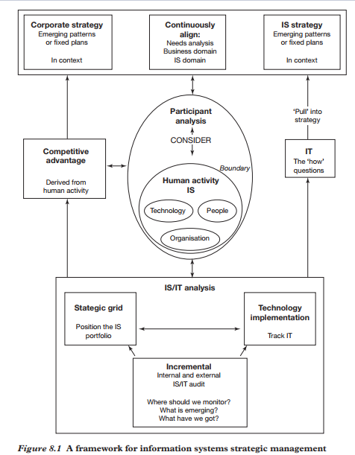
A New Approach to IS Strategy

Slide 10
Than you

