Slide 1
Intermediate results
11-04-25
Battery emulator, Julian Meeuwis

Slide 2
Progress
Testing
Gui
Simulations
Logs
POA
Software troubleshooting

Slide 3
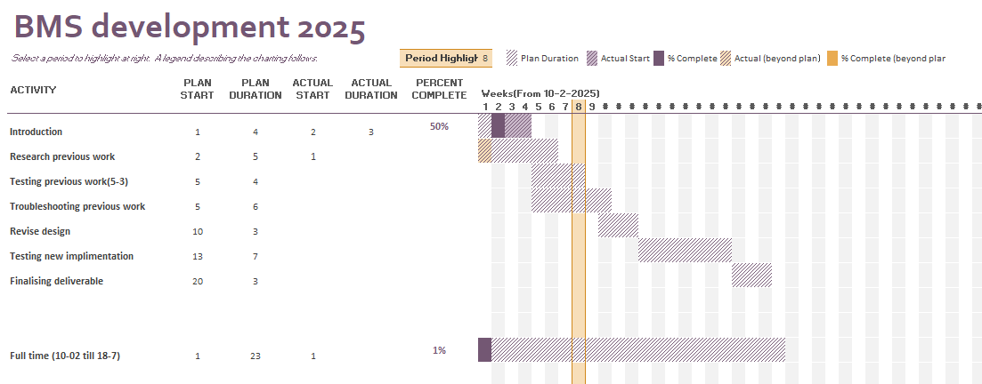
Gantt

Slide 4
What are we doing it for?
Commercial alternatives
Block diagram

Slide 5
What can be concluded?
System specification | Rational | Test description (Tests are compared example) | Expected result | Actual Result
Supply/Input voltage 12V - 5V | Lower power consumption | Set up normal environment Cycle down from 12V to 5V | System should function same as 12V input | Vout of cellboard start deviating from example under 6-7V supply. Iout of cellboard start deviating from example under 7.2V
1.5V offset | Solve oscillating problem | Remove offset by removing trace Test working | System should function as normal | System works OK without offset circuit
Volt sensor | Verify working | Measure output Compare to value in software | Measured output and value in software are the same | As expected.
Current sensor | Verify working | Measure output Compare to value in software | Measured output and value in software are the same | As expected.
Output voltage | Verify working | Measure output Compare to simulation | Measured output compared to simulations are identical | As expected,
Output current | Verify working | Measure output Compare to simulation | Measured output compared to simulations are identical | As expected till 1A, maximum current is 1.5A and 2 A is expected, reason not found yet. This wasn’t tested before

Slide 6
What are possible solutions for the problems?
Function | Problem | Rational | Impact | Solution
Thermal | Runaway |  | Critical | Series resistance (few hundred milli ohms) Mosfet instead of transistor.
Potentiometer | Rush current | Board and component damage. | Critical | Memory (how much rewriting?).
Potentiometer / I2C | No response after “full” reboot |  | Critical | -
Thermal | Heat generation | Heat decreases overall efficiency. | Medium | Lower supply voltage, less drop over LDO. Increase pad size and improve overall thermal surface (Vias)
Sensor | Wrong current scaling |  | Small | Adjust software scaling. OR Adjust hardware scaling.
Potentiometer | System does not reach designed maximum current |  | Small/Medium | -

Slide 7
Other possible “improvements”
Function | Idea | Rational | Impact
User-interface | Functional GUI | Easy use for customer | Large
Potentiometer | Change stepsize current controller | Accurate and suggesting from previous group | Small
Supply | Remove -12V | Simplify design | Medium
Multiplexer | Get rid of multiplexer | Simplify design | Large (lot of time)

Slide 8
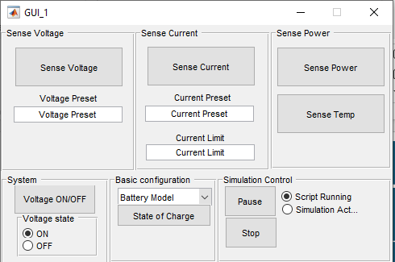
GUI
 | App designer (Matlab) | GUIDE (Matlab) | C# | C++
Compatibility (client & developer) | Good | OK | OK | OK
Implementation time (With my experience) | OK | OK | OK | Bad
Ease of use (Client) | GOOD (Assumption client has Matlab) | Bad? (Possible incompatible) | OK (windows security error?) | OK
Available documentation | Good | OK (Outdated) | GOOD | GOOD
Old GUI is made with matlab GUIDE. This is discontinued and will not longer be used.
 | Serial | UART | Bluetooth / WIFI | 1-wire
Ease of use (Client) | Good | Bad (Need for extra adapter) | OK | Bad
Compatibility (client & developer) | Good | Good | OK | Bad
Implementation time (With my experience) | Good | OK | Bad | Bad
Available documentation | Good | Good | Good | OK
Backwards compatible with Arduino IDE (console) | Good | - | - | -

Slide 9
Questions
Limited output current, how much does it matter for now?
I2C problem!
What are the upcoming events?
Capacitor close to LT3080 (see schematic, next page)

Slide 10
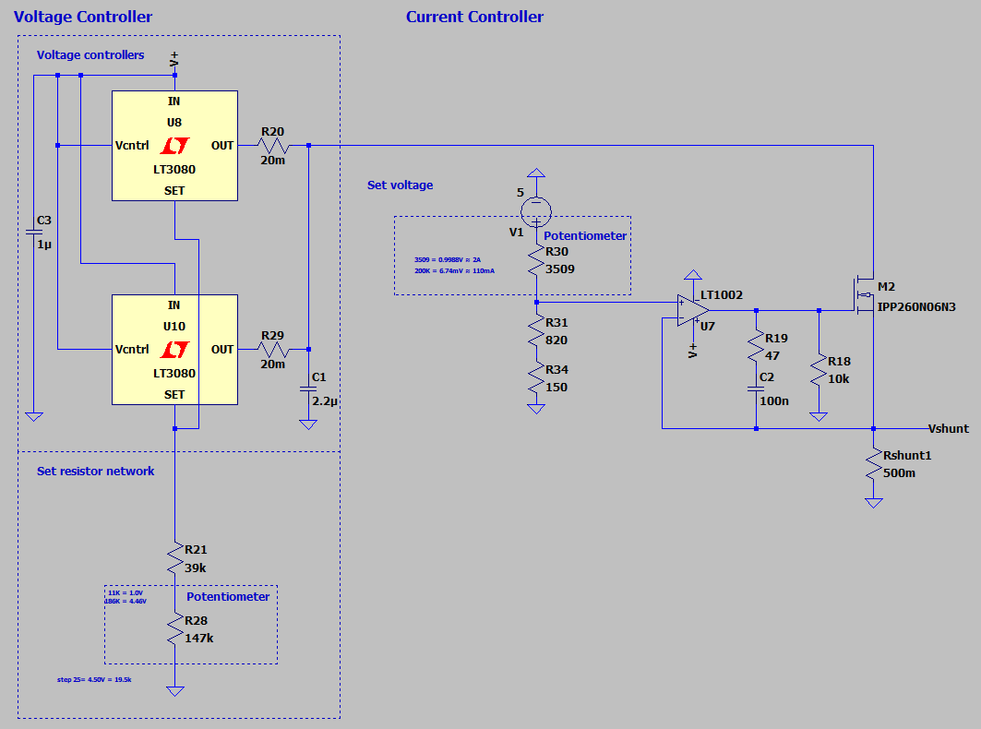
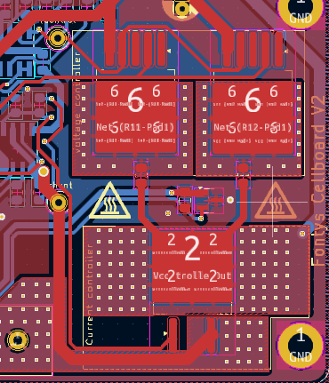
LTspice
A lot of improvement from the “smaller” things

Slide 11
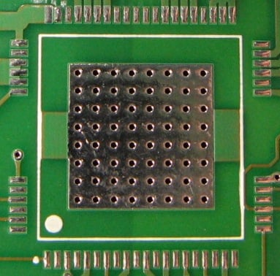
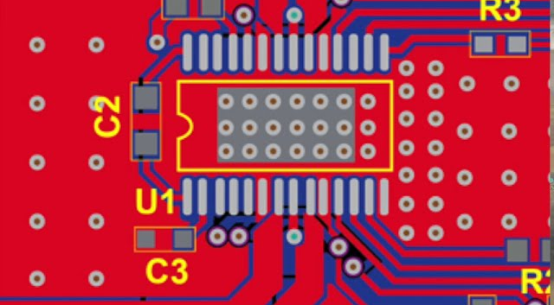
Passive

Slide 12
Active

