Slide 1

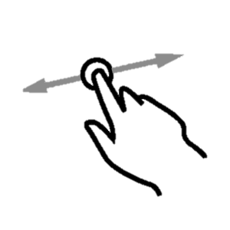
Welcome to…
The definitive source of motivation to perform projects and dreams.
Slide to continue.

Slide 2

Challenges
Fit Challenge
Lose 20 kg.
Remain:
$1350
101 days
Your bet:
Tastycakes
Open my pastry.
Remain:
204 days
Your bet:
$2300
Make a new challenge

Slide 3


Challenges
You vs yourself
Give a name to your challenge:
Tastycakes
Write a short description of it:
Open my own restaurant.
Define and end date:
July 10th, 2020
Bet a quantity of money:
$1350
If you achieve the objective, you will get the money back, otherwise, it will be fully donated to charity.
¡Let’s go!

Slide 4

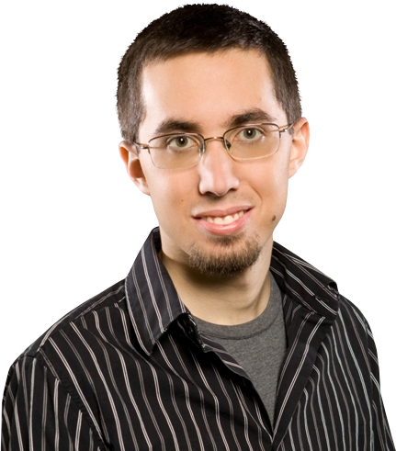
Challenges
You vs your friends
Give a name to your challenge:
Fit Challenge
Write a short description of it:
Lose 20 kg.
Define and end date:
July 10th, 2020
People challenged:
Rodolfo
Julián
+
Add more
Bet a quantity of money:
$120
The winners will share the money equally.
¡Let’s go!

