Slide 1

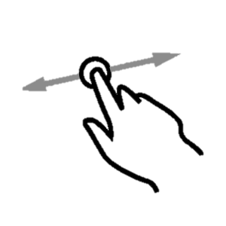
Welcome to…
The definitive source of motivation to perform projects and dreams.
Slide to continue.

Slide 2




Challenges
Search…
Go
You will see interesting tips if you touch the light bulb.
Fit Challenge
In the real version, here will be a nice background.
Lose 20 kg.
Deadline:
12/05/2018
Your bet:
$1350
Remain:
101 days
Got it!
Challenges
Fit Challenge
If you touch and keep pressing the background, you will see advance options
Lose 20 kg.
Fit Challenge
Search…
Go
If you touch this bulb when you see it, you will receive an interesting tip.
Once the bulb is gone, you can see the tips again in the “Tips” section.
Clic on edit will make the fields editable.
Lose 20 kg.
Fit Challenge
By touch and keep press over a challenge, you will see advanced options.
Lose 20 kg.
Start date:
07/12/2017
Cool pattern from black to white.
Search…
Go
12/05/2018
End date:
12/05/2018
Start date:
07/12/2017
Deadline:
$1350
Your bet:
$1350
End date:
12/05/2018
Current
Successes
Failures
Your bet:
Remain:
Edit will be available only in the adjust period of the challenge, and will let you edit right here.
Your bet:
$1350
Challenge name
ASC
101 days
Edit
Makes a little animation to make you notice that you can save.
Save
Remain:
Cancel
101 days
Remain:
If the quantity of challenges exceeds 10, you will have to scroll down to see the next challenges.
Delete
101 days
The touch icon has a little animation in the waves of the finger.
Got it!
In case of is a passed challenge, you will see it green or yellow, for success and failure respectively, also in case of failure, you will see what cause you supported with the money you lose.
Make a new challenge

Slide 3


Challenges
You vs yourself
Give a name to your challenge:
Tastycakes
Write a short description of it:
Open my own restaurant.
Define an start date:
July 10th, 2019
Define an end date:
July 10th, 2020
Bet a quantity of money:
$1350
When click on the button a challenging message appears.
SAY MY NAME!
If you achieve the objective, you will get the money back, otherwise, it will be fully donated to charity.
When click on the button a challenging message appears.
¡Let’s go!

Slide 4

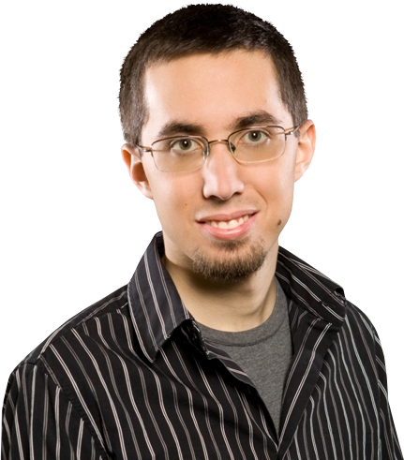
Challenges
You vs your friends
Give a name to your challenge:
Fit Challenge
Write a short description of it:
Lose 20 kg.
Define an start date:
July 10th, 2019
Define and end date:
July 10th, 2020
People challenged:
Rodolfo
Julián
+
Add more
Bet a quantity of money:
$120
The winners will share the money equally.
¡Let’s go!

Slide 5
Challenges
Challenges
You vs your friends
Give a name to your challenge:
Fit Challenge
Friends
Pay methods
Write a short description of it:
Lose 20 kg.
Configuration
Define and end date:
July 10th, 2020
People challenged:
Rodolfo
Julián
+
Add more
Bet a quantity of money:
$120
The winners will share the money equally.
¡Let’s go!

Slide 6
Friends
If you touch and keep pressing the background, you will see advance options
Search…
Go
When touch any friend, you will open profile view.
Your friend code: 1234
Search…
Go
Julián
Rodolfo
Friend name
ASC
Touch “Add more friends to open this modal window
Julián
Display name: Julián
Username: julian1234
Friend code: 12445
Friend since: 02/oct/2018
Challenges won: 23 ($ 12,000)
Challenges lose: 1 ($ 1300)
Add more friends
Insert here the username or the friend code of the user you want to add to your friends list.
Eduardo González
Delete
Your friends will be able to see all the challenges that you put in public mode, successes or failures, you can use this in order to encourage yourself to accomplish them.
Rodolfo
Add

Slide 7
Current
Challenge name
ASC
See profile
Delete

